Slide 1
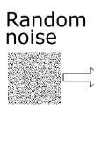
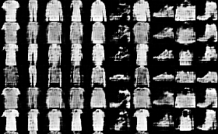
Assignment 5: CGAN
[Objective]
Your model should generate fashion MNIST images.
[Requirements]
1. Implement CGAN model with Pytorch or Tensorflow.
(Basic code is provided)
2. You should attach the generated images.
model

Slide 2
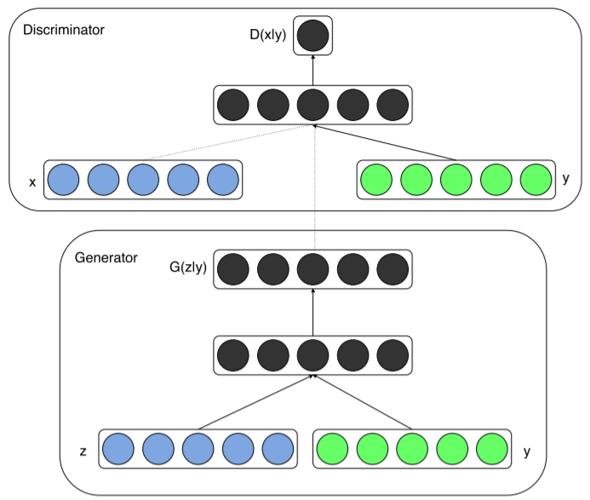
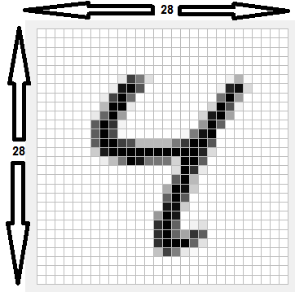
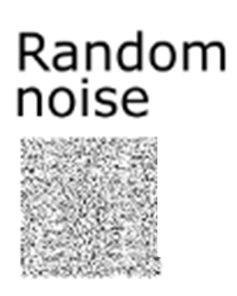
CGAN (Conditional GAN)
Vanilla (original) GAN에서는 어떤 이미지를 만들지 제어할 수 없음
Conditional GAN에서는 G와 D에 특정 condition을 나타내는 정보y 추가
“4”
( 0 0 0 0 1 0 0 0 0 0)
“4”
( 0 0 0 0 1 0 0 0 0 0)

Slide 3
CGAN (Conditional GAN)
Vanilla (original) GAN에서는 어떤 이미지를 만들지 제어할 수 없음
Conditional GAN에서는 G와 D에 특정 condition을 나타내는 정보y 추가

Slide 4
Code review
[Objective]
Your model should generate fashion MNIST images.
[Classes]
classes = ('T-shirt/top', 'Trouser', 'Pullover', 'Dress', 'Coat', 'Sandal', ‘Shirt', 'Sneaker', 'Bag', 'Ankle boot')
[PyTorch Code structure]
- CGAN_model.py
- CGAN_train.py
- GAN_model.py
- GAN_train.py
[TensorFLow Code structure]
- cgan.py
- cgan_train.py
- vanilla.py
- gan_train.py

Slide 5
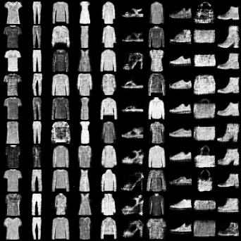
Assignment 5: CGAN
Evaluation Criteria
Simplicity | How concisely did you write the code? - 배점 7점
Performance | How well did the results of the code perform? - 배점 3점

Slide 6
Assignment 5: CGAN
- Due to : ~ 10.11(Sun)
- Submission : Online submission on blackboard
- Your submission should contain
1) The whole code of your implementation
2) The generated images
- You must implement the components yourself!
- File name : StudentID_Name.zip

