Slide 1
Optimizing Annotation Guideline Refinements
for LLM-Based Annotation
[Supervisor: Prof. Susumu Goto]
Hengyu Zhou

Slide 2
1 · INTRODUCTION
Why we need LLM for biomedical annotation?
Traditional ML annotation(i.e. BioBERT): supervised fine-tuning is needed to learn dataset conventions to adapt to the annotation objective.
NCBI Disease: 593 gold-annotated documents required
An LLM has another path: learn dataset conventions through dataset’s in-context guidelines.
This bypasses the need to produce large-scale gold data first
→ But is the guidelines alone enough to capture every convention?
→ The answer is no, many conventions live only in the gold-labeled data
2

Slide 3
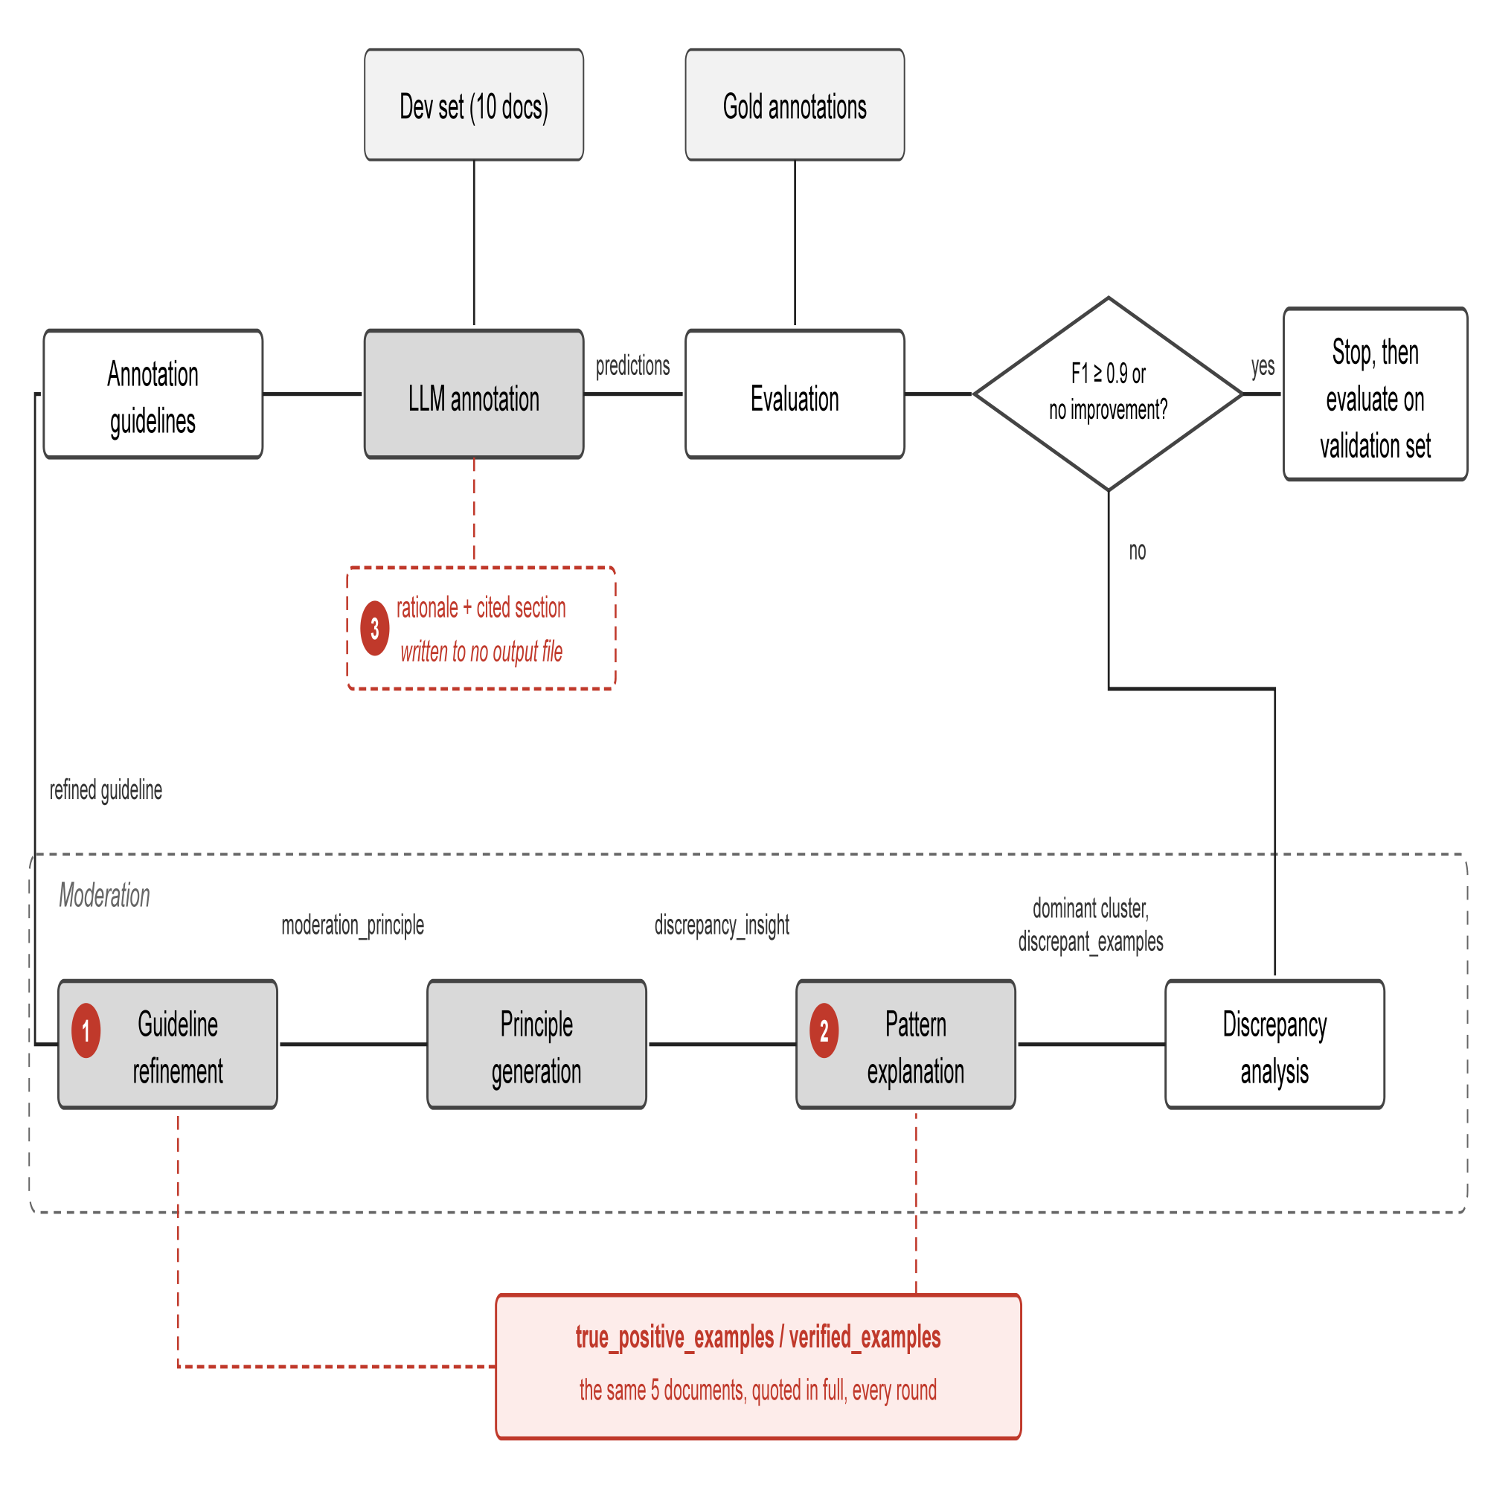
1 · INTRODUCTION
Prior work: iterative guideline refinement
iteratively extract conventions from gold data, then enrich the guidelines.
LLM annotates with guidelines
check discrepancies
with gold annotation.
discrepancy cause
inferred.
guideline refined

Slide 4
2 · OBSERVATIONS
Why does refinement contribute so little?
No guideline: 0.46 initial guideline: 0.73 refined guideline: 0.76
+0.27
+0.03
We examined the implementation stage by stage
Found 6 points limiting the gain
Grouped into three axes:
Extraction: Is the LLM making full use of the data in the dev set?
Generalization: Does the LLM performance gain on dev set generalize to validation?
Reliability: How stable is one annotation?
We selected 1 point from each axis to explore.

Slide 5
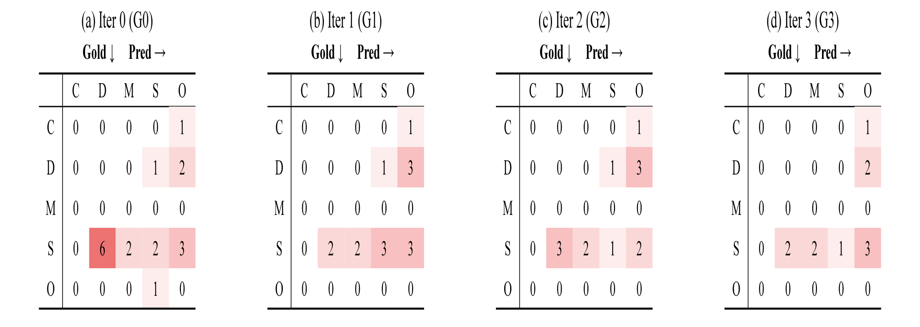
3.1 · METHODOLOGY & CURRENT RESULTS
Extraction: Is the LLM making full use of the data in the dev set?
Figure 2. Confusion matrices over moderation iterations. C = CompositeMention, D = DiseaseClass, M = Modifier, S = SpecificDisease, O = No Entity.
Problem: One group is moderated per round, so each repair causes errors elsewhere (Side Effects).
Example: Round 1 fixes 'gold SpecificDisease → DiseaseClass' (6 → 2), but adds new 'missed DiseaseClass' and 'SpecificDisease boundary' errors; Round 2 halves those, but pushes the original target back up to 3.
How to solve it: Target several groups within one round instead of one at a time, checking each round against more than one error cluster, then integrate them into guideline with conflict check.

Slide 6
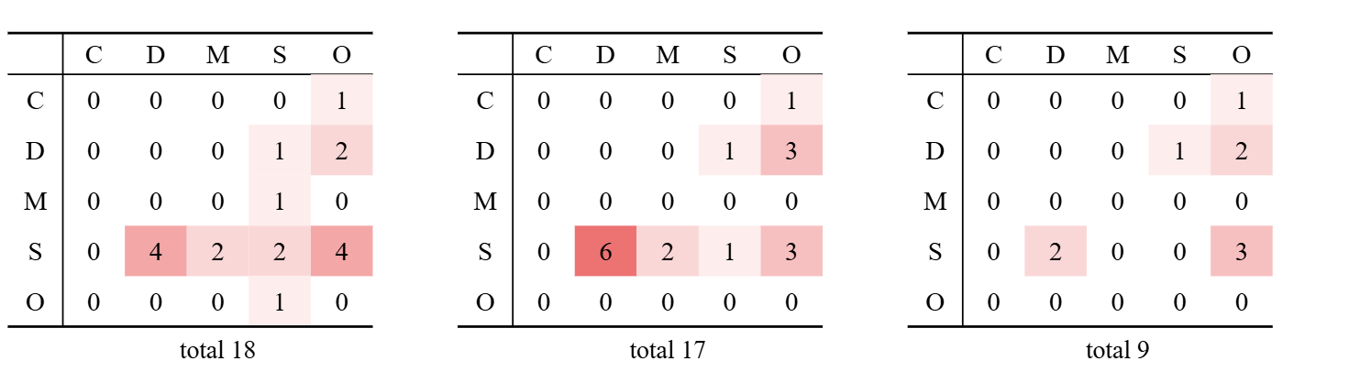
3.1 · METHODOLOGY & CURRENT RESULTS
Extraction: Is the LLM making full use of the data in the dev set?
Current improvements: Targeting 4 largest clusters within one round is tested (top-4), this didn’t prevent Side Effects else where (e.g. S→D confusion: 4→6) while the total fell; but reached the threshold faster: converged in 2 rounds vs. 4 for the baseline
Figure 3. Confusion matrices over top-4 moderation iterations. C = CompositeMention, D = DiseaseClass, M = Modifier, S = SpecificDisease, O = No Entity.
Need to explore another way to control Side Effects.

Slide 7
3.2 · METHODOLOGY & CURRENT RESULTS
Generalization: Does the LLM performance gain on dev set generalize to val set?
Problem: Verified examples, meant only to prevent regression, are copied verbatim into the guideline instead (hard coding)
Example: 38 of 52 (Copied Share) new lines in round 1 trace directly back to the five verified example documents
How to solve it: Tested two interventions: remove the verified examples; or keep them but require every rule to be stated in abstract terms
Condition | Development F1 | Threshold reached | Validation F1 | Copied Share
1. Verified examples supplied | 0.797 ± 0.015 → 0.909 ± 0.015 | Yes | 0.779→0.789 | 38/52 = 73%
2. Verified examples removed | 0.797 ± 0.015 → 0.837 ± 0.015 | No | 0.779→0.771 | 0/32 = 0%
3. Verified examples supplied, forbidding copying | 0.823 ± 0.015 → 0.833 ± 0.015 | No | 0.779→0.784 | 0/25 = 0%
Current improvements: Both 2 and 3 stop the hard coding, but neither reaches the F1 ≥ 0.9 threshold;
development gain (+0.112) does not transfer to validation (+0.010)

Slide 8
3.3 · METHODOLOGY & CURRENT RESULTS
Reliability: How stable is one annotation?
Problem: Annotating the same documents twice does not give the same result.
Example: 20 repeated annotations of the same 10 documents range from F1 0.739 to 0.859 — noise larger than the refinement gain itself (+ 0.01).
How to solve it: Average the noise down by enlarging the development set.
Current improvements: Annotation deviation falls from 0.0150 (10 docs) to 0.0092 (30 docs); running the loop on a larger, coverage-balanced set is under way.

Slide 9
4 · DISCUSSION & FUTURE WORK
Hard coding and reaching threshold share the same cause: the verified examples, if they’re removed, hard coding goes away, but so does the ability to reach threshold.
What's needed: a way to reach threshold reliably without hard coding.
Condition | Development F1 | Threshold reached | Validation F1 | Copied Share
1. Verified examples supplied | 0.797 ± 0.015 → 0.909 ± 0.015 | Yes | 0.779→0.789 | 38/52 = 73%
2. Verified examples removed | 0.797 ± 0.015 → 0.837 ± 0.015 | No | 0.779→0.771 | 0/32 = 0%
3. Verified examples supplied, forbidding copying | 0.823 ± 0.015 → 0.833 ± 0.015 | No | 0.779→0.784 | 0/25 = 0%
Next: finish scaling up the dev set (already under way), and look for that method.

