Slide 1
Optimizing Annotation Guideline Refinements
for LLM-Based Annotation
[Supervisor: Prof. Susumu Goto]
Hengyu Zhou

Slide 2
1 · INTRODUCTION
Why we need LLM for biomedical annotation?
Traditional ML annotation(i.e. BioBERT): supervised fine-tuning is needed to learn dataset conventions (i.e. a kind of instructions for annotation) to adapt to the annotation objective.
NCBI Disease: 593 gold-annotated documents required.
An LLM has another path: learn dataset conventions through dataset’s in-context guidelines.
This bypasses the need to produce large-scale gold data first
→ But is the guidelines alone enough to capture every convention?
→ The answer is no, many conventions live only in the gold-labeled data
2

Slide 3
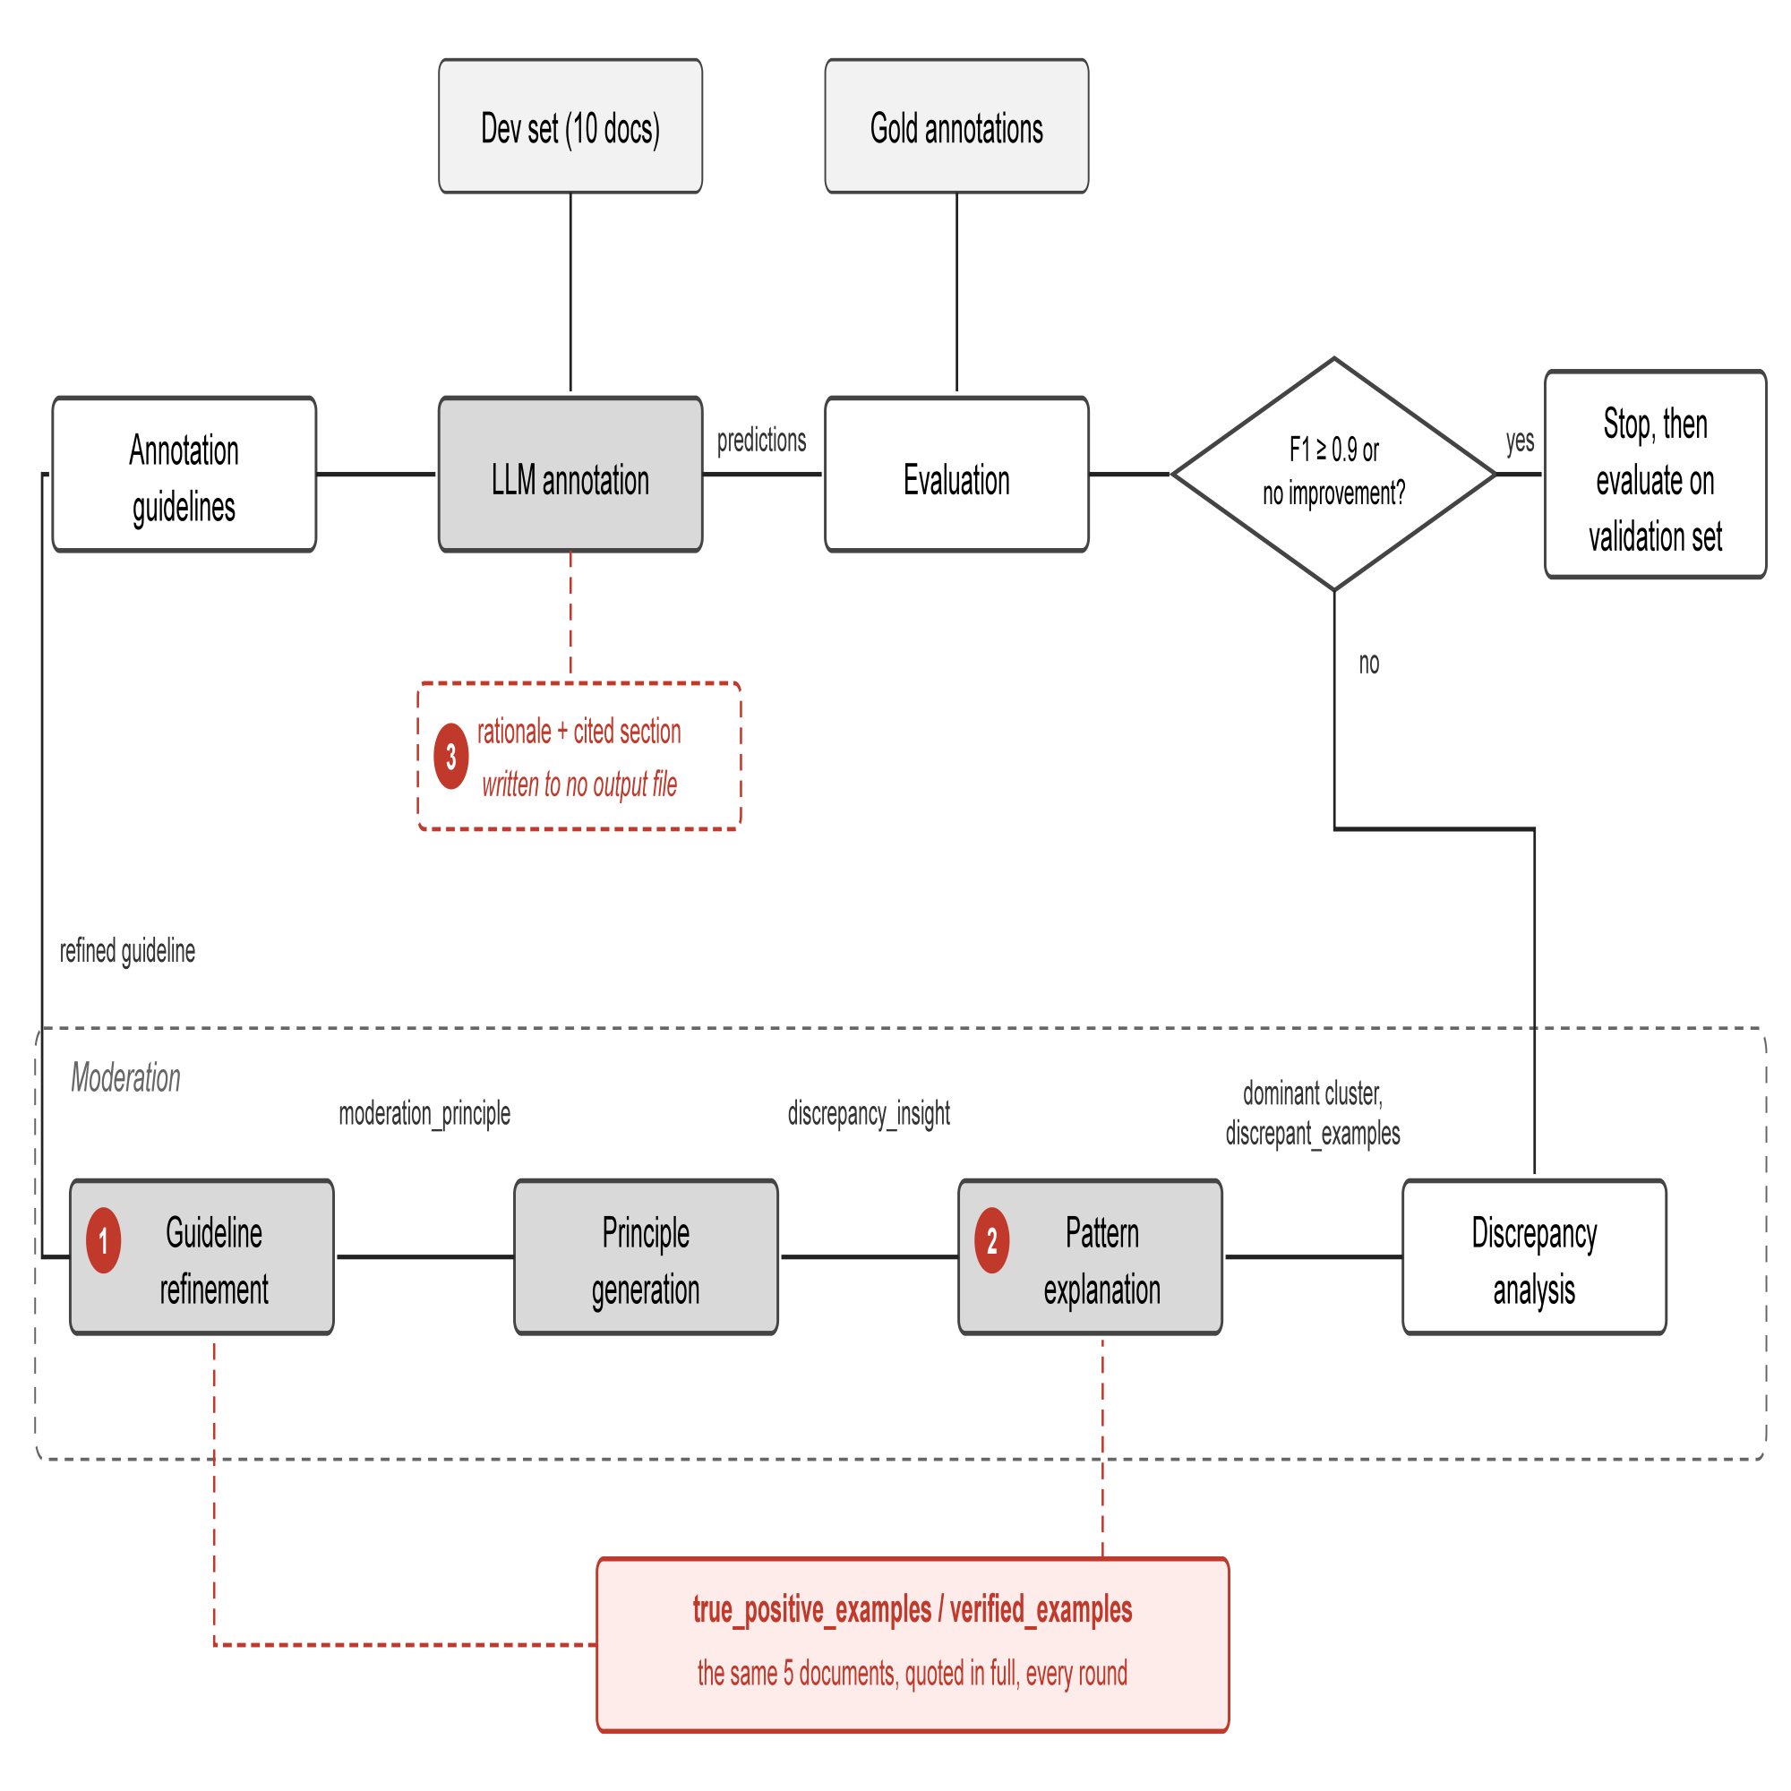
1 · INTRODUCTION
Prior work: iterative guideline refinement
iteratively extract conventions from gold data, then enrich the guidelines.
LLM annotates with guidelines
check discrepancies
with gold annotation.
discrepancy cause
inferred.
guideline refined
Kim, K. W., et al. (2026) Proceedings of the 64th Annual Meeting of the Association for Computational Linguistics, pp. 37951–37964.

Slide 4
2 · OBSERVATIONS
Why does refinement contribute so little?
F1 improvement of guideline refinement is not sufficient.
No guideline: 0.46 initial guideline: 0.73 refined guideline: 0.76
+0.27
+0.03
We examined the implementation stage by stage
Found 6 points limiting the gain
Grouped into three axes:
Extraction: Is the LLM making full use of the data in the dev set?
Generalization: Does the LLM performance gain on dev set generalize to validation?
Reliability: How stable is one annotation?
We selected 1 point from each axis to explore.

Slide 5
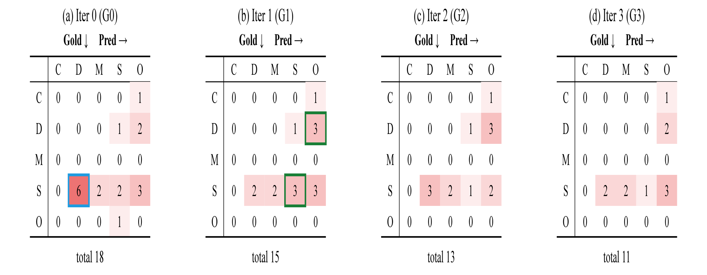
3.1 · METHODOLOGY & CURRENT RESULTS
Extraction: Is the LLM making full use of the data in the dev set?
Figure 2. Confusion matrices over top-1 refinement rounds. The diagonal represents boundary errors.
Terms Explanation:
  SpecificDisease (S): one named disease. "ovarian cancer"
  DiseaseClass (D): a whole family of diseases. "cancer"
  Modifier (M): disease name modifying another noun. "ovarian cancer cell lines"
  CompositeMention (C): one span, several diseases. "breast or ovarian cancer"
A real confusion (S → D): The text "we have observed mutations involving codon 50 in 11 of 37 pancreatic tumors." Here, pancreatic tumors is annotated as SpecificDisease in gold, but LLM annotates it as DiseaseClass. This is one case of the S → D discrepancies in round 0.

Slide 6
3.1 · METHODOLOGY & CURRENT RESULTS
Extraction: Is the LLM making full use of the data in the dev set?
Figure 2. Confusion matrices over top-1 refinement rounds. The diagonal represents boundary errors.
Problem: Only the largest discrepancy cluster is moderated per round, so each repair causes errors elsewhere (Side Effects).
Example: Round 1 fixes 'gold SpecificDisease → DiseaseClass' (6 → 2), but adds new 'missed DiseaseClass' and 'SpecificDisease boundary' errors; Round 2 halves those, but pushes the original target back up to 3.
How to solve it: Target several groups within one round instead of one at a time, checking each round against more than one error cluster, then integrate them into the guideline with conflict check.

Slide 7
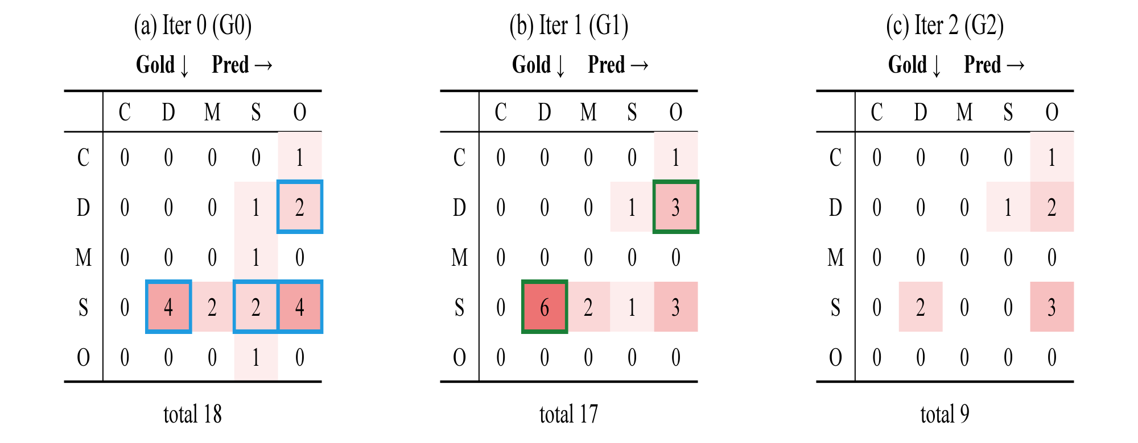
3.1 · METHODOLOGY & CURRENT RESULTS
Extraction: Is the LLM making full use of the data in the dev set?
Figure 3. Confusion matrices over top-4 refinement rounds. The diagonal represents boundary errors.
Current improvements:
  We test targeting the 4 largest discrepancy clusters per round (top-4), instead of just 1.
  The 4 clusters targeted are S→D, S→O, S→S, and D→O, highlighted in blue above.
  This doesn't prevent Side Effects: by round 1, S→D itself grows from 4 to 6, highlighted in green, even though it was one of the targeted clusters.
  But it converges in fewer rounds and solves more discrepancies: 2 rounds vs. 4 for the baseline; total discrepancies 18 → 9 vs. 18 → 11 for baseline.

Slide 8
3.2 · METHODOLOGY & CURRENT RESULTS
Generalization: Does the LLM performance gain on dev set generalize to val set?
Problem: Verified examples, meant only to prevent regression, are copied verbatim into the guideline instead (hard coding)
Example: 38 of 52 new lines in round 1 trace directly back to the five verified example documents
How to solve it: Tested two interventions: remove the verified examples; or keep them but require every rule to be stated in abstract terms
Condition | Development F1 | Threshold reached | Validation F1 | Copied Share
1. Verified examples supplied | 0.797 ± 0.015 → 0.909 ± 0.015 | Yes | 0.779→0.789 | 38/52 = 73%
2. Verified examples removed | 0.797 ± 0.015 → 0.837 ± 0.015 | No | 0.779→0.771 | 0/32 = 0%
3. Verified examples supplied, forbidding copying | 0.823 ± 0.015 → 0.833 ± 0.015 | No | 0.779→0.784 | 0/25 = 0%
Current improvements: Both 2 and 3 stop the hard coding, but neither reaches the F1 ≥ 0.9 threshold. Hard coding and reaching threshold share the same cause, the verified examples. Remove them, and hard coding goes away, but so does the ability to reach threshold. What's needed is a method that reaches threshold reliably without hard coding.

Slide 9
3.3 · METHODOLOGY & CURRENT RESULTS
Reliability: How stable is one annotation?
Problem: Annotating the same documents twice does not give the same result.
Example: 20 repeated annotations of the same 10 documents range from F1 0.739 to 0.859 — noise larger than the refinement gain itself (+0.01). And the Standard Deviation of these results is 0.0150.
How to solve it: Average the noise down by enlarging the development set.
Current improvements: Annotation Standard Deviation falls from 0.0150 (10 docs) to 0.0092 (30 docs); running the loop on a larger development set is under way.

Slide 10
4 · DISCUSSION & FUTURE WORK
Summary:
  Across the three axes: Extraction: Top-4 converges in fewer rounds and fixes more discrepancies. Generalization: Removing Verified Examples stops the hard coding, but also stops the loop from reaching threshold. Reliability: Enlarging the dev set reduces the annotation noise.
Next:
Optimize the methodology along the 3 axes above.
Goal:
  Close the gap between validation F1, currently around 0.79, and SOTA at 0.87, without giving up the low-supervision advantage (10 docs for refinement vs. 593 docs for fine-tuning).

