Slide 1
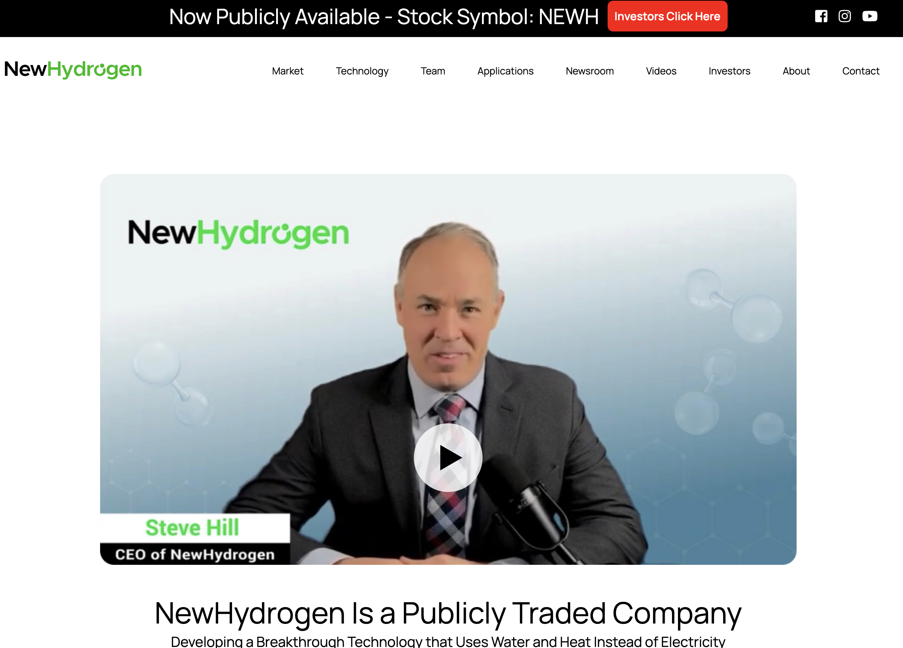
Revisions To: https://newhydrogen.com/investor
URL: https://finance.yahoo.com/quote/NEWH/
Stock Info
Investor
Presentation

