Slide 1
Test Plan
Game arousal Experiment
2024/04/02

Slide 2
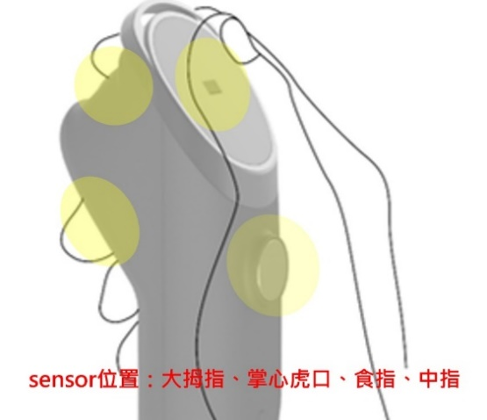
指導一名行人在綠燈期間過馬路，並記錄他們的緊張程度和心理狀態。
指導同一行人在紅燈期間過馬路，並記錄他們的緊張程度和心理狀態。
當測試人員完成上述兩個步驟後，比較綠燈和紅燈的數據，判斷個體打算亂穿馬路時的心理狀態。
結果可用於預測行人亂穿馬路的傾向，並相應地向附近的司機發出警告。
Gaming emotion prediction Experiment
Purpose:
Gaming experience using GSR sensors
expect:
Can predict whether the game experience will be positive or negative
Challenge:
It is difficult to objectively know the status of the tester at this time
.
Use signal
HR、GSR、SKT
SKT、GSR、PPG(HR)
Measure

Slide 3

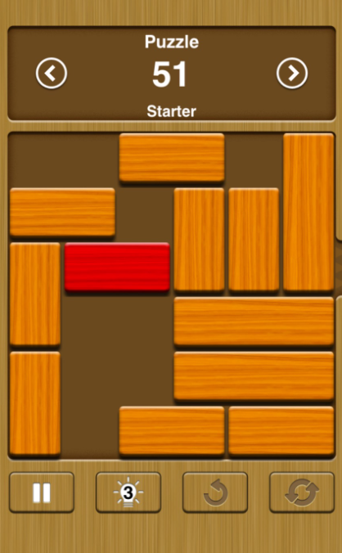

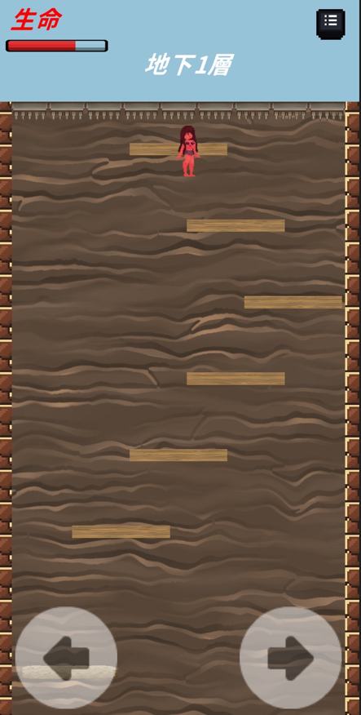
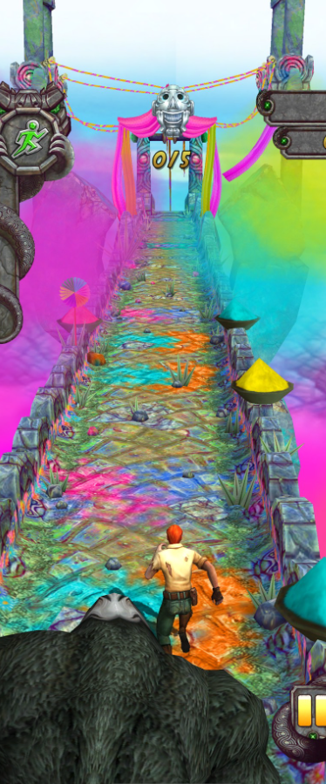
Gaming emotion prediction for training and testing
Data collection process
Wearable device measurement signal Relax for 3 minutes
Subjects were asked to play the games in order game1 game2 game3, with each game lasting 6 minutes. Then rest for 2 minutes before playing the next game
Fill out the post-test questionnaire
Reset(3m)
Game1
Reset(2m)
Game2(6m)
Reset(2m)
Game3(6m)
Game4(6m)
Reset(2m)
Game2
Game1
Game3
Game4

Slide 4
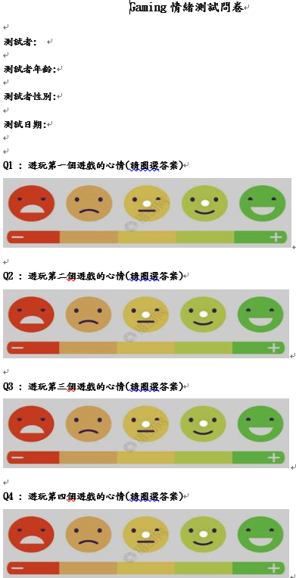
Questionnaire
We will ask the subjects to fill in one questionnaire.

Slide 5
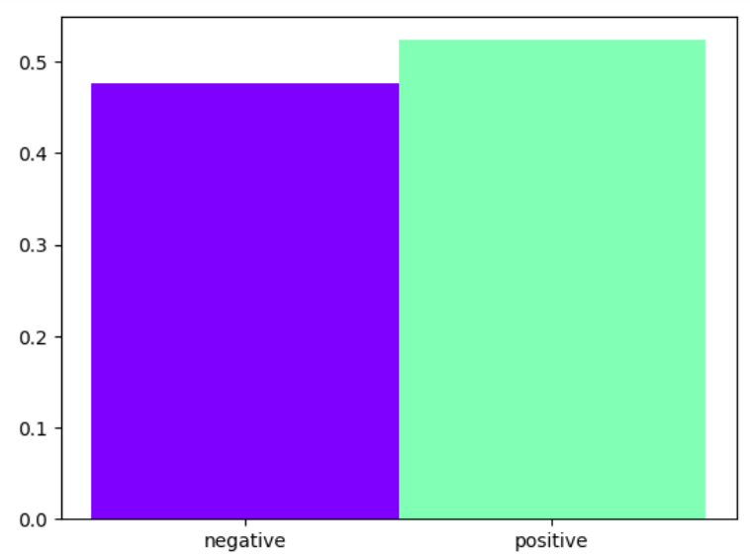
Training and Test Results-Data Set
Everyone will have a total of 180 sec normal environment + 60sec*4(watching)
4: 4type of games
Subject | dataLength | Number of data records
Tony | 463sec | 457
Dylan | 441sec | 435
Zheyu | 436sec | 430
Ken | 418sec | 412
Fred | 429sec | 423
EmotionType | negatvie | positive
record | 622 | 683

Slide 6
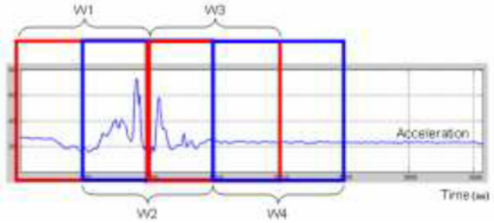
Algorithm flow-Preprocess&feature extraction
Preprocess
notch filter
Heartbeats and muscle movements can cause noise, which can be removed with a notch filter.
SlidingWindow(Bio vital sign to change)
windowsize: 5sec
It is 1.2 times the window size of the feature, so take about 2 times conservatively(reference-Appendix-4-2)
windowStep: 1sec
Predict one result per second
featrue extraction
time domain: 9features
freqeuece domain: 7features
1. Original
Heartrate Data
2. Preprocess
3. SlidingWindow
4. feature extraction
5. model
6. Classification

Slide 7
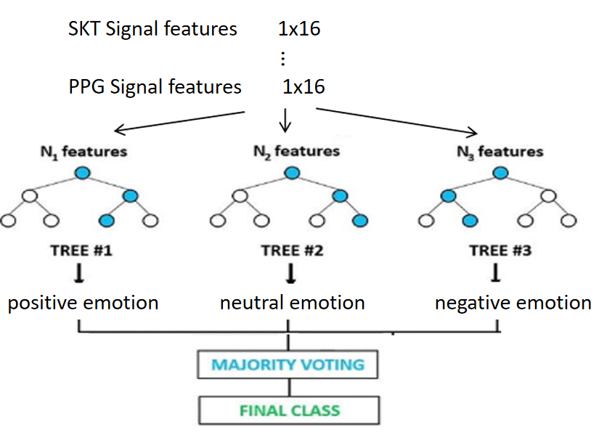
Training and Test Results-Method
Method: raindom forest
Input:
one signal has 3*16 features
After feature selection, we use a total of 19 features
Ouput:
2 Type of emotions
Negative、positive

Slide 8
Training and Test Results-K fold
K-fold(cross validation)
sometimes called rotation estimation.Testing set and training set are doing swaps, and average test results.Validation for a small amount of data.
At present, the data of 10 people are collected, the data of 4 people is used for training, and the data of 1 person is used for testing, and through Cross Validation(5-fold) for testing
turn1
data1
data2
data3
test set
turn2
data1
data2
data3
train set
turn3
data1
data2
data3

Slide 9
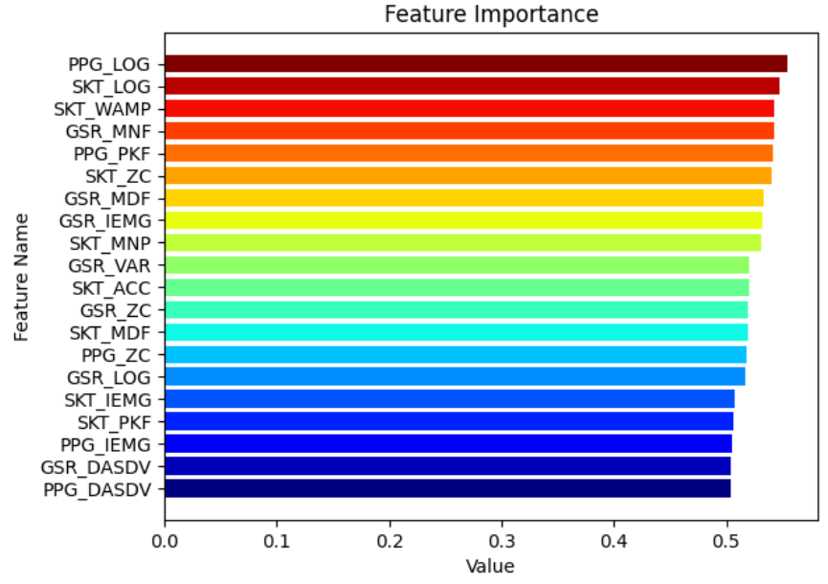
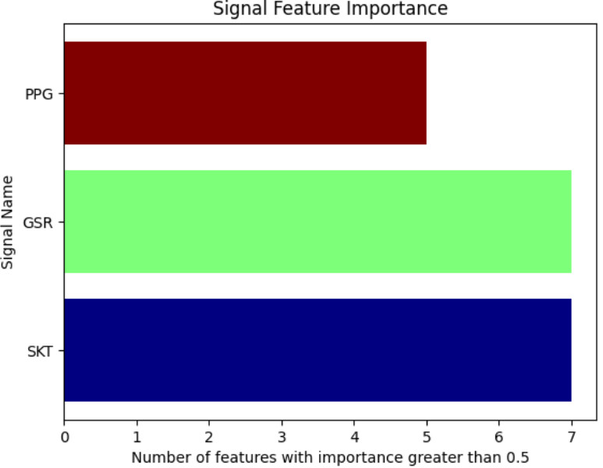
Feature analyze-Feature Importance and Result1
Result
From the signal characteristics of feature selection, it can be found that the importance is as follows: SKT = GSR> PPG
There are a total of 19 features with a contribution of 0.50 or more, of which SKT accounts for 7 and gsr 7.
For Best for wearing sensor selection and improvement accuracy to 77.2%
Grid Search | 2 classes | 2-class predict w/ vote(5sec) th | CNN | CNN w/5 th
HR + GSR | 65.7 | 66.6 | 71.3 | 73.4
HR + SKT + GSR | 74.2 | 75.7 | 77.2 | 76.5

Slide 10
Feature analyze-Result2
Result
Use three other games for training and one game for testing
For Predict Image Test
Subject: Zheyu、Chengiu、fred、tony、aaron
Grid Search | Test | 2 classes | 2-class predict w/ vote(5sec) th | CNN | CNN w/5 th
HR + SKT + GSR | Game1 | 50.6 | 53.4 | 52.1 | 52.1
HR + SKT + GSR | Game2 | 52.6 | 53.7 | 56.8 | 57.5
HR + SKT + GSR | Game3 | 77.5 | 74.3 | 79.2 | 80.8
HR + SKT + GSR | Gmae4 | 82.6 | 82.6 | 84.2 | 82.6
Grid Search | 2 classes | 2-class predict w/ vote(5sec) th | CNN | CNN w/5 th
HR + SKT | 51.7 | 56.6 | 55.1 | 57.4
HR + SKT + GSR | 37.9 | 41.2 | 43.2 | 40.6

Slide 11
Feature analyze-Result3
Result
Lists each person's accuracy for various games
Divide the game into static and dynamic group for training and testing later.
Grid Search | Subject | Game1 | Game2 | Game3 | Game4
HR + SKT + GSR | Tony | 80.6 | 85.3 | 92.3 | 90.6
HR + SKT + GSR | Fred | 56.6 | 72.5 | 67.3 | 71.5
HR + SKT + GSR | Ken | 83.5 | 71.6 | 91.1 | 92.3
HR + SKT + GSR | Dylan | 56.6 | 63.7 | 73.2 | 77.1
HR + SKT + GSR | Zheyu | 63.7 | 61.6 | 72.1 | 73.9
Grid Search | Test | 2 classes | 2-class predict w/ vote(5sec) th | CNN | CNN w/5 th
HR + SKT + GSR | Static Game | 63.1 | 69.6 | 73.1 | 75.2
HR + SKT + GSR | Dynamic Game | 85.6 | 85.6 | 89.5 | 89.5

Slide 12
Feature analyze-Result4
Result
The individual uses two of his own games to train, and then predicts the two self-generated games.
Signal | Method | Tony | Zheyu | Dylan | Ken | Fred | Total
HR + SKT + GSR | CNN | 47.4 | 36.0 | 40.6 | 58.7 | 76.5 | 46.3
Tony
Predict\actual | Negative | Positive
Negative | 28 | 31
Positive | 38 | 35
Zheyu
Predict\actual | Negative | Positive
Negative | 30 | 50
Positive | 30 | 15
Dylan
Predict\actual | Negative | Positive
Negative | 21 | 33
Positive | 43 | 31
Ken
Predict\actual | Negative | Positive
Negative | 57 | 45
Positive | 12 | 24
Fred
Predict\actual | Negative | Positive
Negative | 23 | 24
Positive | 45 | 44

Slide 13
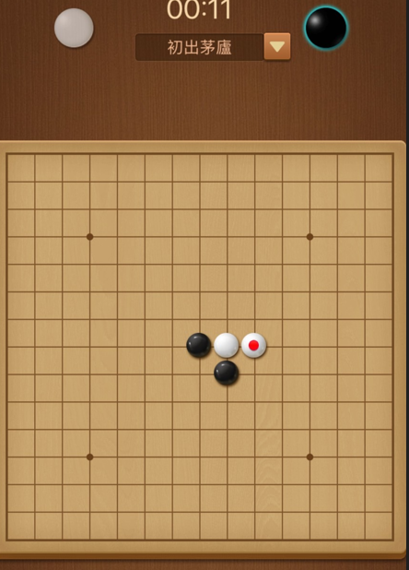

Gaming emotion prediction Experiment2
指導一名行人在綠燈期間過馬路，並記錄他們的緊張程度和心理狀態。
指導同一行人在紅燈期間過馬路，並記錄他們的緊張程度和心理狀態。
當測試人員完成上述兩個步驟後，比較綠燈和紅燈的數據，判斷個體打算亂穿馬路時的心理狀態。
結果可用於預測行人亂穿馬路的傾向，並相應地向附近的司機發出警告。
Purpose:
收集測試更多信號，增加系統之泛性
新增一種靜態遊戲(五子棋)以及一種動態遊戲(fluppy bird)
.
Use signal
HR、GSR、SKT

Slide 14
Music arousal Experiment
指導一名行人在綠燈期間過馬路，並記錄他們的緊張程度和心理狀態。
指導同一行人在紅燈期間過馬路，並記錄他們的緊張程度和心理狀態。
當測試人員完成上述兩個步驟後，比較綠燈和紅燈的數據，判斷個體打算亂穿馬路時的心理狀態。
結果可用於預測行人亂穿馬路的傾向，並相應地向附近的司機發出警告。
Purpose:
Music experience using GSR、SKT、HR sensors
expect:
Can predict whether the Music experience will be Happy、Sad、relax、Anger
Challenge:
It is difficult to objectively know the status of the tester at this time

Slide 15
Previous VR experience
PaperSurvey
Zainab, Rida, and Muhammad Majid. "Emotion recognition based on EEG signals in response to bilingual music tracks." Int. Arab J. Inf. Technol. 18.3 (2021): 286-296.

Slide 16
Analysis information-1 Experiment setup conditions
Item\Paper | Paper1 | Ours
use signal | α波（8-13 Hz） β波（14-30 Hz） δ波（1-3 Hz） γ波（31-50 Hz） θ波（4-7 Hz) | GSR、PPG、SKT
use questionnaire | Y | Y-refer to paper1
Test item | Happy Sad Relax Anger | Happy Sad Relax Anger -refer to paper1
Number of experimenters | 27 | 5
Experimental results | 可以有8成的正確率 | TBD
Experimental Environments | 確保在一個黑暗安靜的環境中進行數據收集，排除外部環境的干擾。 | 確保在一個黑暗安靜的環境中進行數據收集，排除外部環境的干擾。

Slide 17
Analysis information-1 Experiment setup conditions
Item\Paper | Paper1 | Ours
Experiment process | 參與者選取：確保參與者符合特定標準，如年齡、性別、健康狀況和音樂相關經驗。 1. 實驗準備：確保參與者在實驗前有足夠的休息時間，並在一個黑暗安靜的環境中進行數據收集。 2. EEG數據收集：使用EEG設備對參與者的腦電活動進行記錄和收集。 3. 音樂刺激呈現：播放不同類型的音樂刺激，如無歌詞的音樂（旋律）和有歌詞的音樂（歌曲）。(共播三首，每首6分鐘) 4. 填寫問卷 | 1. 實驗準備：在一個黑暗安靜的環境中進行數據收集，收集常態訊號。 2. 播放音樂刺激收集訊號(共播三首，每首6分鐘) 3. 填寫問卷
3+6+2+6+2+6 = 25min/person

Slide 18
Appendix

