Slide 2
Topics
The if Statement
The if-else Statement
Comparing Strings
Nested Decision Structures and the if-elif-else Statement
Logical Operators
Boolean Variables and Expressions
[Turtle Graphics: Determining the State of the Turtle]
Note: slides with the fuchsia-colored pointed symbol in the lower right corner were added by your course instructor; slides in general have been modified and added to by your instructor

Slide 3
The if Statement
Control structure: logical design that controls order in which set of statements execute
Sequence structure: set of statements that execute in the order they appear
Decision structure: specific action(s) performed only if a condition exists
Also known as selection or branch structure

Slide 4
The if Statement (cont’d.)
In flowchart, diamond represents true/false condition that must be tested
Actions can be conditionally executed
Performed only when a condition is true
Single alternative decision structure: provides only one alternative path of execution
If condition is not true, exit the structure

Slide 5
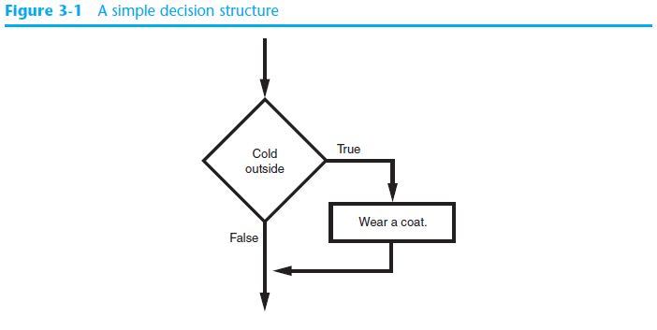
The if Statement (cont’d.)
test_average.py

Slide 6
The if Statement (cont’d.)
Python syntax:
if condition:
Statement
Statement
First line known as the if clause
Includes the keyword if followed by condition
The condition can be true or false
When the if statement executes, the condition is tested, and if it is true the block statements are executed. otherwise, block statements are skipped

Slide 7
Boolean Expressions and Relational Operators
Boolean expression: expression tested by if statement to determine if it is true or false
Example: a > b
true if a is greater than b; false otherwise
Relational operator: determines whether a specific relationship exists between two values
Example: greater than (>)

Slide 8
Boolean Expressions and Relational Operators (cont’d.)
>= and <= operators test more than one relationship
It is enough for one of the relationships to exist for the expression to be true
== operator determines whether the two operands are equal to one another
Do not confuse with assignment operator (=)
!= operator determines whether the two operands are not equal

Slide 9
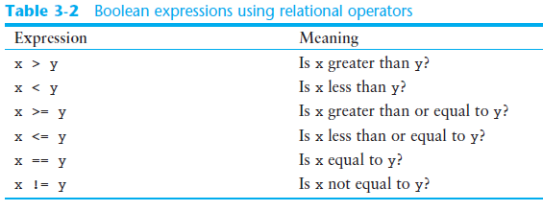
Boolean Expressions and Relational Operators (cont’d.)

Slide 10
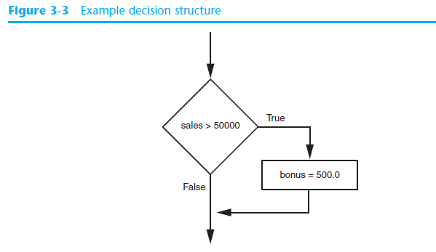
Boolean Expressions and Relational Operators (cont’d.)
Using a Boolean expression with the > relational operator

Slide 11
Boolean Expressions and Relational Operators (cont’d.)
Any relational operator can be used in a decision block
Example: if balance == 0
Example: if payment != balance
It is possible to have a block inside another block
Example: if statement inside a function
Statements in inner block must be indented with respect to the outer block

Slide 12
The if-else Statement
Dual alternative decision structure: two possible paths of execution
One is taken if the condition is true, and the other if the condition is false
Syntax: if condition:
statements
else:
other statements
if clause and else clause must be aligned
Statements must be consistently indented

Slide 13
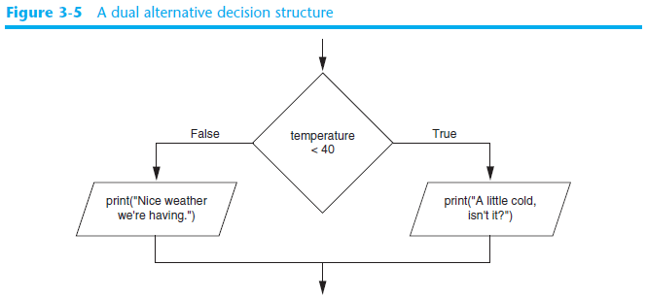
The if-else Statement (cont’d.)

Slide 14
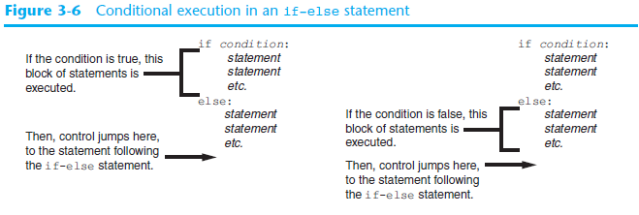
The if-else Statement (cont’d.)
password.py

Slide 15
Comparing Strings
Strings can be compared using the == and != operators
String comparisons are case sensitive
Strings can be compared using >, <, >=, and <=
Compared character by character based on the ASCII values for each character
If shorter word is substring of longer word, longer word is greater than shorter word

Slide 16
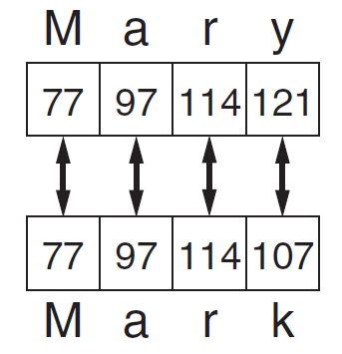
Comparing Strings (cont’d.)
sort_names.py

Slide 17
Nested Decision Structures and the if-elif-else Statement
A decision structure can be nested inside another decision structure
Commonly needed in programs
Example:
Determine if someone qualifies for a loan, they must meet two conditions:
Must earn at least $30,000/year
Must have been employed for at least two years
Check first condition, and if it is true, check second condition

Slide 18
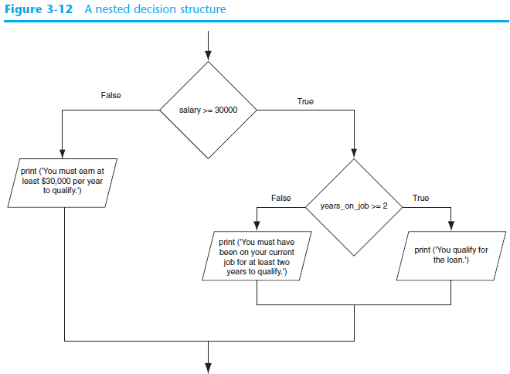

Slide 19
Nested Decision Structures and the if-elif-else Statement (cont’d.)
Important to use proper indentation in a nested decision structure
Important for Python interpreter
Makes code more readable for programmer
Rules for writing nested if statements:
else clause should align with matching if clause
Statements in each block must be consistently indented

Slide 20
The if-elif-else Statement
if-elif-else statement: special version of a decision structure
Makes logic of nested decision structures simpler to write
Can include multiple elif statements
Syntax:
if condition_1:
statement(s)
elif condition_2:
statement(s)
elif condition_3:
statement(s)
else
statement(s)
Insert as many elif clauses
as necessary.

Slide 21
The if-elif-else Statement (cont’d.)
Alignment used with if-elif-else statement:
if, elif, and else clauses are all aligned
Conditionally executed blocks are consistently indented
if-elif-else statement is never required, but logic easier to follow
Can be accomplished by nested if-else
Code can become complex, and indentation can cause problematic long lines

Slide 22
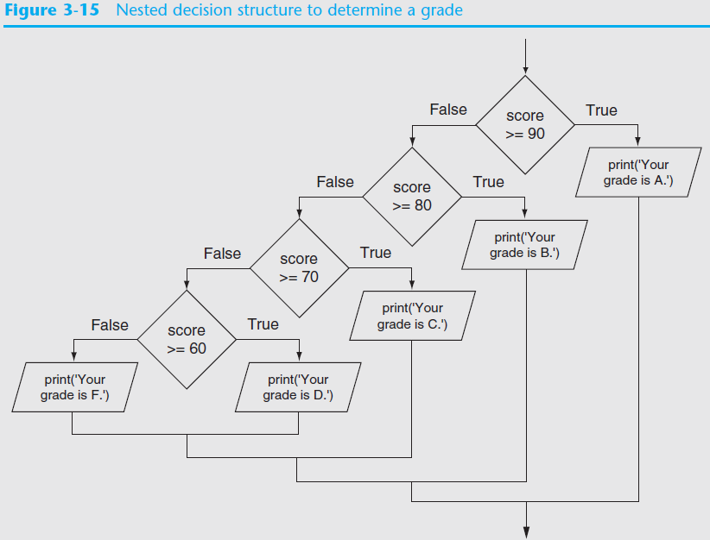
grader.py
grader2.py

Slide 23
Logical Operators
Logical operators: operators that can be used to create complex Boolean expressions
and operator and or operator: binary operators, connect two Boolean expressions into a compound Boolean expression
not operator: unary operator, reverses the truth of its Boolean operand

Slide 24
The and Operator
loan_qualifier2.py
Takes two Boolean expressions as operands
Creates compound Boolean expression that is true only when both sub expressions are true
Can be used to simplify nested decision structures
Truth table for
the and operator
Value of the Expression | Expression
false | false and false
false | false and true
false | true and false
true | true and true

Slide 25
The or Operator
loan_qualifier3.py
Takes two Boolean expressions as operands
Creates compound Boolean expression that is true when either of the sub expressions is true
Can be used to simplify nested decision structures
Truth table for
the or operator
Value of the Expression | Expression
false | false and false
true | false and true
true | true and false
true | true and true

Slide 26
Short-Circuit Evaluation
Short circuit evaluation: deciding the value of a compound Boolean expression after evaluating only one sub expression
Performed by the or and and operators
For or operator: If left operand is true, compound expression is true. Otherwise, evaluate right operand
For and operator: If left operand is false, compound expression is false. Otherwise, evaluate right operand

Slide 27
The not Operator
Takes one Boolean expressions as operand and reverses its logical value
Sometimes it may be necessary to place parentheses around an expression to clarify to what you are applying the not operator
Truth table for the not operator
Value of the Expression | Expression
false | true
true | false

Slide 28

Checking Numeric Ranges with Logical Operators
To determine whether a numeric value is within a specific range of values, use and
Example: x >= 10 and x <= 20
To determine whether a numeric value is outside of a specific range of values, use or
Example: x < 10 or x > 20

Slide 29
if Efficiency Notes
avoid unnecessary comparisons (relational and logical operator expressions); strive to use minimum number of comparisons required
work from most general cases to most specific
in a nested if, work from most likely cases to least likely (when known)

Slide 30
Exercise: Word Problem ---> if
Your veterinarian poses a problem. She needs to dose animals with a particular medication at differing levels. If the patient is a dog, she must give .15 mg per pound for dogs less than 30 pounds, .2 mg per pound for dogs who weigh 30 through 50 pounds, and .38 mg per pound for dogs more than 50 pounds. If the patient is a cat, she must give .05 mg per pound for cats less than 12 pounds, and .075 mg per pounds for cats at 12 pounds or more.
How many "cases" are there? Outline a nested if using pseudocode to solve this problem.
Notes:
DISCUSS: what needs to be input before the if? which is more likely, dog or cat? how would we find out (research it, ask the user, the vet) what would we start with as a test expr? would we start with "if the animal weighs >= 30 pounds" for example?
what if later on there were more animals? more categories? large (cow, horse), bird, rodent (mouse, guinea pig, hamster), etc.

Slide 31
Boolean Variables
Boolean variable: references one of two values, True or False
Represented by bool data type
Commonly used as flags
Flag: variable that signals when some condition exists in a program
Flag set to False → condition does not exist
Flag set to True → condition exists

Slide 32
Program Example: nestedif.py
This program illustrates several of the if statement topics we have covered so far, and adds in the usage of a flag

Slide 33
Nested if : consider this code
# consider: read a char code and 2 floats # x and y, then do calculation of result
# how many comparisons ?
if code == '+' :
result = x + y
elif code == '-' :
result = x - y
elif code == '*' :
result = x * y
elif code == '/' :
result = x / y
else: print ("Operator invalid!")
Notes:
mention the processing of menus, such as
if menuChoice = FILE then
if menuChoice = Open then
---
else if menuChoice = New then
etc.

Slide 34
Turtle Graphics: Determining the State of the Turtle
The turtle.xcor() and turtle.ycor() functions return the turtle's X and Y coordinates
Examples of calling these functions in an if statement:
if turtle.ycor() < 0:
turtle.goto(0, 0)
if turtle.xcor() > 100 and turtle.xcor() < 200:
turtle.goto(0, 0)
These turtle graphic slides are provided for your reference; will not be covered in lectures

Slide 35
Turtle Graphics: Determining the State of the Turtle
The turtle.heading() function returns the turtle's heading. (By default, the heading is returned in degrees.)
Example of calling the function in an if statement:
if turtle.heading() >= 90 and turtle.heading() <= 270:
turtle.setheading(180)

Slide 36
Turtle Graphics: Determining the State of the Turtle
The turtle.isdown() function returns True if the pen is down, or False otherwise.
Example of calling the function in an if statement:
if turtle.isdown():
turtle.penup()
if not(turtle.isdown()):
turtle.pendown()

Slide 37
Turtle Graphics: Determining the State of the Turtle
The turtle.isvisible() function returns True if the turtle is visible, or False otherwise.
Example of calling the function in an if statement:
if turtle.isvisible():
turtle.hideturtle()

Slide 38
Turtle Graphics: Determining the State of the Turtle
When you call turtle.pencolor() without passing an argument, the function returns the pen's current color as a string. Example of calling the function in an if statement:
When you call turtle.fillcolor() without passing an argument, the function returns the current fill color as a string. Example of calling the function in an if statement:
if turtle.pencolor() == 'red':
turtle.pencolor('blue')
if turtle.fillcolor() == 'blue':
turtle.fillcolor('white')

Slide 39
Turtle Graphics: Determining the State of the Turtle
When you call turtle.bgcolor() without passing an argument, the function returns the current background color as a string. Example of calling the function in an if statement:
if turtle.bgcolor() == 'white':
turtle.bgcolor('gray')

Slide 40
Turtle Graphics: Determining the State of the Turtle
When you call turtle.pensize() without passing an argument, the function returns the pen's current size as a string. Example of calling the function in an if statement:
if turtle.pensize() < 3:
turtle.pensize(3)

Slide 41
Turtle Graphics: Determining the State of the Turtle
When you call turtle.speed() without passing an argument, the function returns the current animation speed. Example of calling the function in an if statement:
if turtle.speed() > 0:
turtle.speed(0)

Slide 42
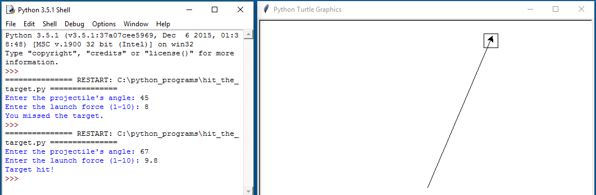
Turtle Graphics: Determining the State of the Turtle
See In the Spotlight: The Hit the Target Game in your textbook for numerous examples of determining the state of the turtle.

Slide 43
Summary
This chapter covered:
Decision structures, including:
Single alternative decision structures
Dual alternative decision structures
Nested decision structures
Relational operators and logical operators as used in creating Boolean expressions
String comparison as used in creating Boolean expressions
Boolean variables
Determining the state of the turtle in Turtle Graphics

Slide 44
Next…
Top-Down Design
Basics of Incremental Testing and Debugging


