Slide 1
COP 3035 Intro to Python IDLE Interactive Debugger
Slide Author: Course Instructor Ann Ford Tyson

Slide 2
Recap: Overview of Basic Debugging Tools
Use extra print (tracing) statements
Print out the values of critical variables at critical points in the program
Often use flags to control whether debugging information prints or not
Use an interactive debugger
Check critical variables at critical points
Examine the flow of control
Set breakpoints and use step and other commands to examine code and behavior
Use stubs and drivers
Notes:
---

Slide 3
Interactive Debugger Tools
Look at values of critical variables at critical points
Utilize debugger’s variable display window and may use stepping and/or breakpoints
Breakpoint: a line in your program at which you choose to suspend execution so you can look at the current state of the program’s variables
Look at flow of control
Use interactive debugger to observe execution flow
IDLE Commands Go, Step, Over, Out, Quit

Slide 4
IDLE Run Menu (Editor window only) p. 1 These command descriptions from IDLE docs
Python Shell
Open or wake up the Python Shell window.
Check Module
Check the syntax of the module currently open in the Editor window. If the module has not been saved IDLE will either prompt the user to save or autosave, as selected in the General tab of the Idle Settings dialog. If there is a syntax error, the approximate location is indicated in the Editor window.

Slide 5
IDLE Run Menu (Editor window only) p. 2 These command descriptions from IDLE docs
Run Module
Do Check Module. If no error, restart the shell to clean the environment, then execute the module. Output is displayed in the Shell window. Note that output requires use of print or write. When execution is complete, the Shell retains focus and displays a prompt. At this point, one may interactively explore the result of execution. This is similar to executing a file with python -i file at a command line.
Run… Customized (for your reference)
Same as Run Module, but run the module with customized settings. Command Line Arguments extend sys.argv as if passed on a command line. The module can be run in the Shell without restarting.

Slide 6
IDLE Debug Menu (Shell window only) p. 1 These command descriptions from IDLE docs
Go to File/Line
Look on the current line. with the cursor, and the line above for a filename and line number. If found, open the file if not already open, and show the line. Use this to view source lines referenced in an exception traceback and lines found by Find in Files. Also available in the context menu of the Shell window and Output windows.
Debugger (toggle)
When activated, code entered in the Shell or run from an Editor will run under the debugger. In the Editor, breakpoints can be set with the context menu. This feature is still incomplete and somewhat experimental.

Slide 7
IDLE Debug Menu (Shell window only) p. 2 These command descriptions from IDLE docs
Stack Viewer
Show the stack traceback of the last exception in a tree widget, with access to locals and globals.
Auto-open Stack Viewer
Toggle automatically opening the stack viewer on an unhandled exception.
Recap: the runtime stack
basically the chain of current function calls, showing the order in which they were called, and which function is currently active
Each function may be represented as a block (as we have drawn it on the board in class before) which contains the values of its local variables (includes parameters)

Slide 8
Getting Started
Start the Python Shell, and then using the menus:
Select Debug/Debugger
Select File/Open and open the .py file you want to debug
Select Run/Run Module
We will demo this live in class using the functions2.py program from our functions lecture, time permitting

Slide 9
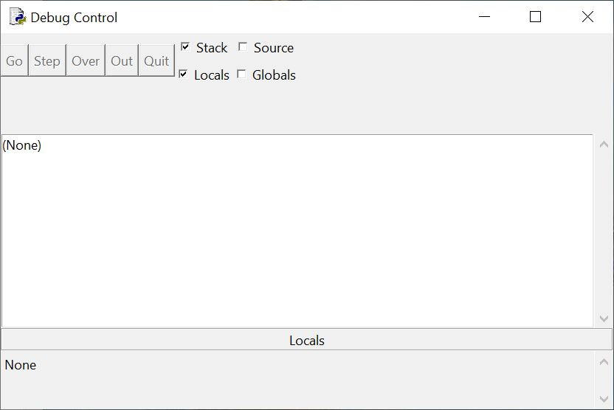
First Debug Window Display

Slide 10
Basic Run Control Commands
Go: run the program starting at current line until either program is finished, an exception is thrown, or a breakpoint is encountered
Step: execute one line, and if the line is a function call, enter it (note that interpreter and system level functions may be entered at times)
Over: execute one line, but if the line is a function call, do not enter the function
Out: when in a function, finish executing it, but step out and return to caller
Quit: quit running the program

Slide 11
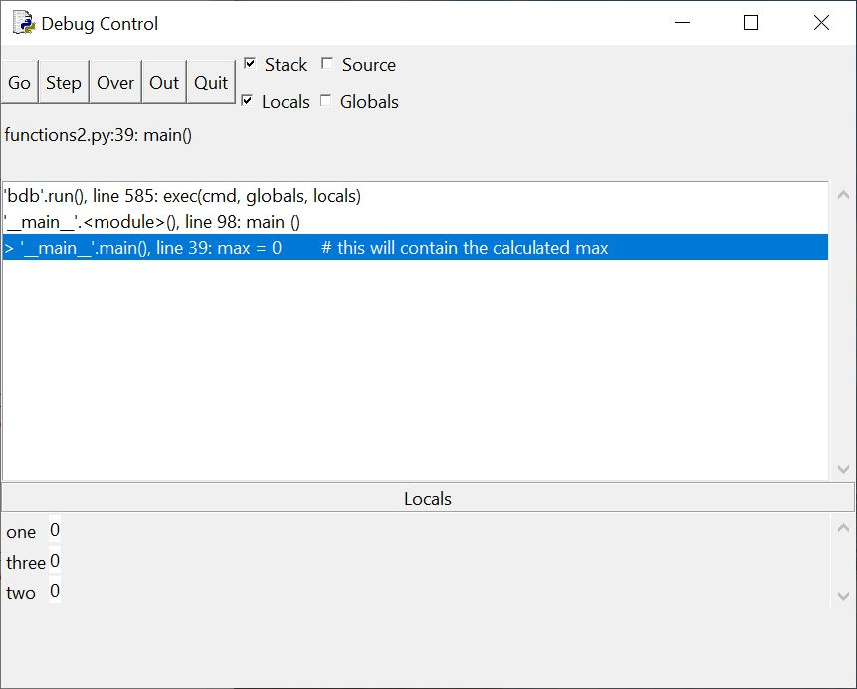
Window after a few steps in main() function (just after one, two, three created)

Slide 12
Next…
Step into printIntro()
Use both step and over to see what displays
Can use out to leave an active function
Can check both program source window and output window in addition to debugger display window
Try all commands as time permits

Slide 13
Setting and Clearing Breakpoints
Go to the program source code window
Right click on the line on which you want to set a breakpoint
Then select set breakpoint to set
Can choose clear breakpoint to remove it later as needed
Then try: re-run the program under the debugger. Set a breakpoint at a place of your choosing. Try the Go command to run to that point, and then examine variable values etc.
Try other commands that we have mentioned in this lecture, as you explore options!


