Slide 2
Topics
Introduction to File Input and Output
Using Loops to Process Files
Processing Records
Exceptions
Note: slides with the fuchsia-colored pointed symbol in the lower right corner were added by your course instructor; slides in general have been modified and added to by your instructor

Slide 3
Examples of Programs that use files
office/productivity programs e.g. word processors, spreadsheets
image editors, photo, video
games, e.g. save scores and game status between plays
businesses: inventories and payrolls
web browsers e.g. cookies
programming: save source code files and executables
Etc.

Slide 4
Introduction to File Input and Output
For program to retain data between the times it is run, you must save the data
Data is saved to a file, typically on computer disk
Saved data can be retrieved and used at a later time
“Writing data to”: saving data on a file
Output file: a file that data is written to

Slide 5
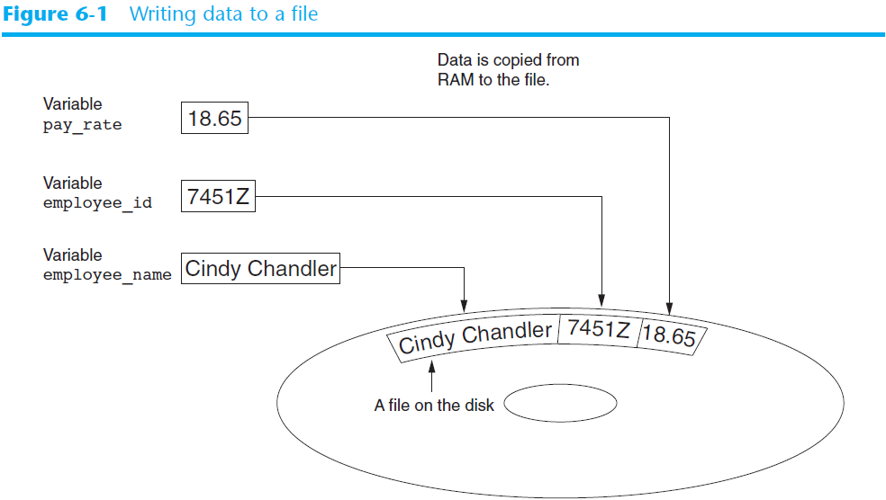

Slide 6
Introduction to File Input and Output (cont’d.)
“Reading data from”: process of retrieving data from a file
Input file: a file from which data is read
Three steps when a program uses a file
Open the file
Process the file
Close the file
ALWAYS close a file when done using it

Slide 7
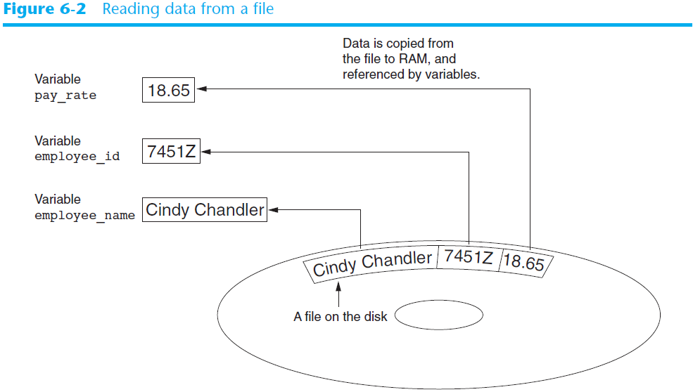

Slide 8
Introduction to File Input and Output
Types of Files
Two types of files:
Text file - contains data that has been saved as text (ASCII, Unicode); these files can be typed in by a user, or written/read by a program
Binary file - contains data that has not been saved as text; these files must be written by a program, and can only be read by a program
Notes:
we will only use text files in this course

Slide 9
External Files and Internal File Objects
On your disk, flash drive etc. you have external files
.mp3, .txt, .jpg, .py which are text? binary?
in your program you must create an internal file object to correspond to the external file on your drive
The term object refers to class object

Slide 10
What's a class?
A data structure available in many programming languages, including Python
Contains both data (information) and operations which operate on that data (functions a.k.a. methods)
A class object is typically a variable which is set up using a class data structure type

Slide 11
Basic File Access Methods
Two ways to access data stored in file
Sequential access: file read sequentially from beginning to end, can’t skip ahead
Direct access: can jump directly to any piece of data in the file

Slide 12
Filenames and File Objects
Filename extensions: short sequences of characters that appear at the end of a filename preceded by a period
Extension indicates type of data stored in the file
File object: object associated with a specific file within a program
Provides a way for a program to work with the file: file object referenced by a variable

Slide 13
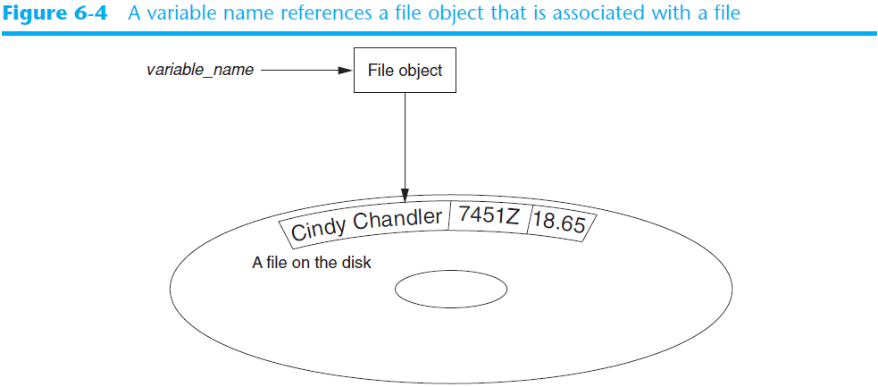
Filenames and File Objects (cont’d.)

Slide 14
Opening a File
open function: used to open a file
Creates a file object and associates it with a file on the disk
General format:
file_object = open(filename, mode)
Mode: string specifying how the file will be opened
Example: reading only ('r'), writing ('w'), and appending ('a')

Slide 15
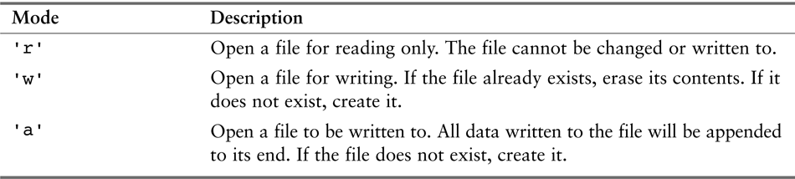
Introduction to File Input and Output
Some of the Python file modes
customer_file = open('customers.txt', 'r')
sales_file = open('sales.txt', 'w')

Slide 16

Specifying the Location of a File
If open function receives a filename that does not contain a path, assumes that file is in same directory as program
If program is running and file is created, it is created in the same directory as the program
Can specify alternative path and file name in the open function argument (see book for examples)
Prefix the path string literal with the letter r

Slide 17
Writing Data to a File
Method: a function that belongs to an object
Performs operations using that object
File object’s write method used to write data to the file
Format: file_variable.write(string)
File is closed using file object close method
Format: file_variable.close()

Slide 18
Example Program
file_write.py

Slide 19
Basic Text File Structure
John Locke<eoln> David Hume<eoln> Edmund Burke<eoln> <eof>
Fundamental file markers:
eoln is end of line or newline ('\n')
eof is end of file marker
Can look at file with MS Word to see EOLNs

Slide 20
Reading Data From a File
read method: file object method that reads entire file contents into memory
Only works if file has been opened for reading
Contents returned as a string
readline method: file object method that reads a line from the file
Line returned as a string, including any '\n'
Read position: marks the location of the next item to be read from a file

Slide 21
Example Program
file_read.py
reads entire file into a single string

Slide 22
Example Program
line_read.py
reads one line at a time from the file
a line is a string of chars terminated by newline char

Slide 23
Concatenating a Newline to and Stripping it From a String
In most cases, data items written to a file are values referenced by variables
Often necessary to concatenate a '\n' to data before writing it
Carried out using the + operator in the argument of the write method
In many cases need to remove '\n' from a string after it is read from a file
rstrip method: string method that strips specific characters from end of the string

Slide 24
Introduction to File Input and Output
Concatenating a Newline to a String
myfile.write(name1 + '\n')
Reading a String and Stripping the Newline From It
line1 = infile.readline()
# Strip the \n from the string
line1 = line1.rstrip('\n')
look at write_names.py
look at strip_newline.py
Notes:
many string variables do not have a newline
readline method may provide an unwanted newline in a string read from a file

Slide 25
Appending Data to an Existing File
When open file with 'w' mode, if the file already exists it is overwritten
To append data to a file use the 'a' mode
If file exists, it is not erased, and if it does not exist it is created
Data is written to the file at the end of the current contents
outfile = open('philosophers.txt', 'a')
outfile.write('Rene Descartes\n')

Slide 26
Writing and Reading Numeric Data
Numbers must be converted to strings before they are written to a file
str function: converts value to string
Numbers are read from a text file as strings
Must be converted to numeric type in order to perform mathematical operations
Use int and float functions to convert string to numeric value

Slide 27
Introduction to File Input and Output
Writing and Reading Numeric Data
Numbers must be converted to strings before they can be written
The write function only writes strings
Built-in function, str, converts a value to a string
outfile.write(str(num1) + '\n')
look at write_numbers.py

Slide 28
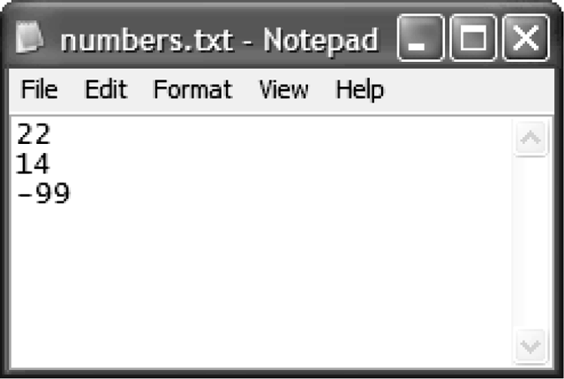
Introduction to File Input and Output
Writing and Reading Numeric Data
infile = open(‘number.txt’, ‘r’)
# readline method reads strings
string_input = infile.readline()
# built-in function int converts string to an integer
value = int(string_input)
Figure 7-15 The numbers.txt file viewed in Notepad
look at read_numbers.py
Notes:
note the int and float functions both ignore any newline at the end of a string argument passed in

Slide 29
Using Loops to Process Files
Concept:
Files usually hold large amounts of data, and programs often use a while or a for loop to process the data in a file.
MAJOR LOOP TYPE: END OF FILE or EOF loop
read and process until encounter EOF
first, look at write_sales.py

Slide 30
Using EOF Loops to Process Files
Often the number of items stored in a file is unknown
Often we want a program to handle any size file
The readline method uses an empty string as a sentinel when end of file is reached
When a while loop is used, must have a priming read
Can write a while loop with the condition
while line != ''

Slide 31
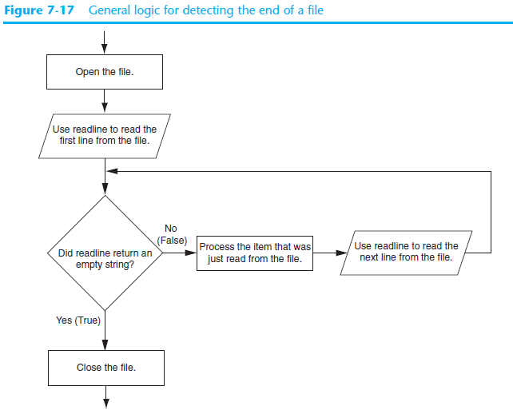
Next, look at read_sales.py

Slide 32
Using Python’s for Loop to Read Lines
Python allows the programmer to write a for loop that automatically reads lines in a file and stops when end of file is reached
Format: for line in file_object:
statements
The loop iterates once over each line in the file

Slide 33
Next, look at read_sales.py

Slide 34
Using Python’s for Loop to Read Lines IN EOF loop
Python allows programmer to write a for loop that automatically reads lines in a file and stops when end of file is reached:
Format: for line in file_object:
statements
The loop iterates once for each line in the file

Slide 35
Using for Loop to Process File until EOF
Using Python’s for Loop to Read Lines until EOF
for loop automatically reads a line of text from the input file
No special condition or testing is needed; this is automatic as well
No priming read is needed
Automatically stops when the end of file is reached
for variable in file_object:
statement
statement
etc.
Now, look at read_sales2.py

Slide 36
Example Task
Video producer wants 2 programs:
A program that allows him/her to enter the running time in seconds of each short video in a project and save these times to a file.
A program that reads this file, displays the running times, and then displays the total running time of all the videos.
look at save_running_times.py
look at read_running_times.py

Slide 37
Processing Records
Record: set of data that describes one item
Field: single piece of data within a record
Write record to sequential access file by writing the fields one after the other
Read record from sequential access file by reading each field until record complete

Slide 38

Processing Records
Figure Records in a file
Employee has: name, ID number, department

Slide 39
Processing Records (cont’d.)
When working with records, it is also important to be able to:
Add records (create)
Display records (read, print)
Search for a specific record
Modify records (must search first)
Delete records (must search first)

Slide 40
Processing Records
Creating an employee records file … employees.txt
Get the total number of employees
Open the file for writing
For each employee
Get the data for an employee
Pad each field with newline character
Write the employee record to the file
Close the file
save_emp_records.py

Slide 41
Processing Records
Reading an employee records file … employees.txt
Open the file for reading
Read the first line from file (which is the first field, the name)
While NOT end-of-file
Read rest of the employee record
Strip the newlines from each field
Display employee record
Close the file
read_emp_records.py

Slide 42
Next several examples…
A coffee roasting company needs inventory management software. We will look at:
adding coffee product records to the end of an existing data file (append operation)
displaying the contents of the file
searching for a particular record in the file
modifying a record in the file
deleting a record in the file

Slide 43
Processing Records
Add records to a file … coffee.txt
Set user response to Yes (meaning wants to add a record)
Open the file for appending
While user response is Yes
Get a coffee record
Append the coffee record
Determine whether the user wants to add another record
Close the file
look at data file before and after running this program
add_coffee_record.py

Slide 44
Display the coffee records in the file
example program
Next… what if we want to search the coffee file for a specific coffee?
show_coffee_records.py

Slide 45
Basic Linear Search
Linear Search algorithm to search a list of values
look at 1st value and test for match to target value
if match, stop, otherwise
look at 2nd value and test for match
if match, stop, otherwise
look at 3rd value
etc...
also stop if hit end of list
Note: if want to find all matches, do not stop until end of list

Slide 46
Processing Records
Searching for a record in a file … coffee.txt
Set a flag to False to represent not found yet
Get the search value (the target)
Open the file for reading
Read the first line from file
While NOT end-of-file
Read coffee record
Strip the newline from description field
Determine whether the record is a match to search value
If match - Set flag to True
Read the next line from the file
Close the file
If flag is False – Display message “Not Found”
LINEAR SEARCH ALGORITHM
Notes:
this code will find ALL instances of the same description in the file and prints the description and the quantity

Slide 47
Recap: How are strings compared?
Left to right, one character at a time
ASCII codes are used to do comparisons
To be equal, two strings must be exactly the same length and contain exactly the same characters in every position. Characters can only be equal if they are the same case.
If one string is longer than another, the longer string is greater if they are equal up to the length of the shorter string.
search_coffee_records.py

Slide 48
Processing Records
Modify a record in a file … coffee.txt
Requires a temporary file
Copy all records from existing file to temporary file
BUT do not copy the contents of the modified record
Write the new data for the modified record
Delete the original file …
Import Python’s os module
Use the remove function
os.remove(original_file_name)
Rename the temporary file to the original file name …
Import Python’s os module
Use the rename function
os.rename(temporary_file_name, original_file_name)

Slide 49
Processing Records
Modify a record in a file … coffee.txt
Import os module
Set a search flag to False
Get the search value
Open the original file for reading
Open a temporary file for writing
Read the first line from file
While NOT end-of-file
Read coffee record
Strip newlines as needed
Determine whether the record is a match to search value
If match – Write modified record to temporary file; Set flag to True
If NOT match – Write current record to temporary file
Read the next line from the file
Close the original file
Close the temporary file
Delete original file using os module
Rename temporary to the original file name using os module
If flag is True – Display message “File updated”
If flag is False – Display message “Not Found”
modify_coffee_record.py

Slide 50
Processing Records
Deleting a record in a file … coffee.txt
Import os module
Set a search flag to False
Get the search value
Open the original file for reading
Open a temporary file for writing
Read the first line from file
While NOT end-of-file
Read coffee record
Strip newlines as needed
Determine whether the record is a match to search value
If match – Set flag to True
If NOT match – Write current record to temporary file
Read the next line from the file
Close the original file
Close the temporary file
Delete original file
Rename temporary to the original file name
If flag is True – Display message “File updated”
If flag is False – Display message “Not Found”
delete_coffee_record.py

Slide 51
In-class exercise
Next we will do an in-class programming exercise using file IO (exercise 1)

Slide 52
Exceptions
Concept:
An exception is an error that occurs while a program is running, causing the program to abruptly halt. You can use the try/exception statement to handle some exceptions.

Slide 53
Traceback
Traceback: error message that gives information regarding line number(s) that caused the exception
Indicates the type of exception and gives a brief description of the error that caused exception to be raised
division.py
division2.py

Slide 54
Notes on exceptions
Some exceptions are thrown automatically by the Python interpreter
You as a programmer can also throw and catch exceptions
In general, exception handling is only used in VERY LARGE programs, not in short ones such as written in an introductory course; hence we will cover only the basics for this topic area (you may want or need to use it later on, for example)
Many local style guidelines prohibit the use of exceptions by programmers
an exception is an unconditional jump and can cause confusion
so follow local style guidelines, as always!

Slide 55
Exceptions (cont’d.)
Many exceptions can be prevented by careful coding
Example: input validation
Usually involves a simple decision construct
Some exceptions cannot be avoided by careful coding
Examples
Trying to convert non-numeric string to a number
Trying to open for reading a file that doesn’t exist
gross_pay1.py

Slide 56
Exceptions
An exception handler can prevent a program from abruptly crashing
Use the try/except statement (note: some languages use try/catch terminology instead)
try:
statement
statement
etc.
except ExceptionName:
statement
statement
etc.
try block
except clause
handler
Notes:
except clause is the line with the word except on it

Slide 57
Exceptions: summary of flow of control
When try/except statement executes, the statements in the try block begin to execute:
If a statement in the try block raises an exception that is specified by an ExceptionName in an except clause, then the handler that immediately follows that except clause executes. Then, the program resumes execution with the statement immediately following the try/except statement.
If a statement in the try block raises an exception that is not specified by the ExceptionName in an except clause, then the program will halt with a traceback error message.
If the statements in the try block execute without raising an exception, then any except clauses and handlers in the statements are skipped and the program resumes execution with the statements immediately following the try/except statement.

Slide 58
Exceptions (cont’d.)
If statement in try suite raises exception:
Exception specified in except clause:
Handler immediately following except clause executes
Continue program after try/except statement
Other exceptions:
Program halts with traceback error message
If no exception is raised, handlers are skipped
gross_pay2.py

Slide 59
Examples: File opening errors
display_file.py
display_file2.py

Slide 60
Handling Multiple Exceptions
Often code in try suite can throw more than one type of exception
Need to write except clause for each type of exception that needs to be handled
An except clause that does not list a specific exception will handle any exception that is raised in the try suite
Should always be last in a series of except clauses
sales_report1.py

Slide 61
Displaying an Exception’s Default Error Message
Exception object: object created in memory when an exception is thrown
Usually contains default error message pertaining to the exception
Can assign the exception object to a variable in an except clause
Example: except ValueError as err:
Can pass exception object variable to print function to display the default error message
gross_pay3.py

Slide 62
The else Clause
try/except statement may include an optional else clause, which appears after all the except clauses
Aligned with try and except clauses
Syntax similar to else clause in decision structure
Else suite: block of statements executed after statements in try suite, only if no exceptions were raised
If exception was raised, the else suite is skipped
sales_report4.py

Slide 63
The finally Clause
try/except statement may include an optional finally clause, which appears after all the except clauses
Aligned with try and except clauses
General format: finally:
statements
Finally suite: block of statements after the finally clause
Executes whether an exception occurs or not
Purpose is to perform cleanup before exiting
Notes:
There is no example of this one in textbook

Slide 64
What If an Exception Is Not Handled?
Two ways for exception to go unhandled:
No except clause specifying exception of the right type
Exception raised outside a try suite
In both cases, exception will cause the program to halt
Python documentation provides information about exceptions that can be raised by different functions

Slide 65
In-class exercise
Next we will do an in-class exercise using exceptions (exercise 2)

Slide 66
Summary
This chapter covered:
Types of files and file access methods
Filenames and file objects
Writing data to a file
Reading data from a file and determining when the end of the file is reached
Processing records
Exceptions, including:
Traceback messages
Handling exceptions

Slide 67
Next…
Data Structures: Lists and Tuples


