Slide 2
Topics
Sequences
Introduction to Lists
List Slicing
Finding Items in Lists with the in Operator
List Methods and Useful Built-in Functions
Note: slides with the fuchsia-colored pointed symbol in the lower right corner were added by your course instructor; slides in general have been modified and added to by your instructor

Slide 3
Topics (cont’d.)
Copying Lists
Processing Lists
Two-Dimensional Lists
Tuples
Plotting List Data with the matplotlib Package (will discuss if time permits)

Slide 4
ADT Concept
ADT stands for Abstract Data Type
Basic idea: how do people conceptualize collections of data
Examples
List (one-dimensional)
Table, chart (two-dimensional)
Record (collection of information about an entity, often has mixed data types)
Etc.

Slide 5
Sequences
Sequence: an object that contains multiple items of data
Another term used for data structures is often "container"
The items are stored in sequence one after another
Python provides different types of sequences, including lists and tuples
The difference between these is that a list is mutable and a tuple is immutable

Slide 6
Concepts
Mutable: contents can be changed during program execution
Immutable: once created, the contents cannot be changed
Note: the foundation data types int, float, bool and str are all immutable

Slide 7
Huh?
But can't we change the value of an int? What is happening in Python? What is happening in memory?
myVar = 5
myVar = 7
and then even this…
myVar = "sue"
myVar
?

Slide 8
Introduction to Lists
List: an object that contains multiple data items
Element: An item in a list
Format: list = [item1, item2, etc.]
Can hold items of different types
print function can be used to display an entire list
list() function can convert certain types of objects to lists

Slide 9
Example
numbers = list(range(5))
range function returns an "iterable" object, of type range, with values 0, 1, 2, 3, 4
The list function converts this to a list [0, 1, 2, 3, 4]

Slide 10
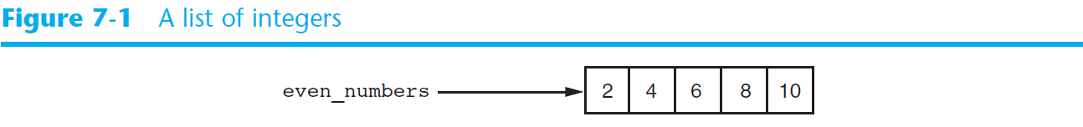
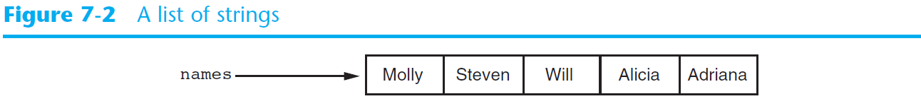
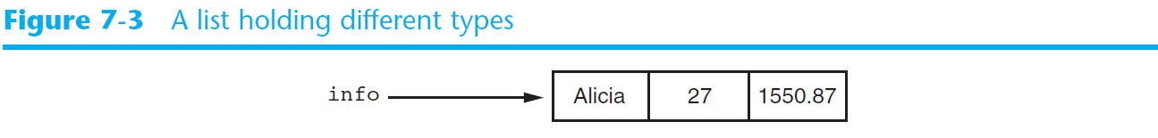
Introduction to Lists (cont’d.)

Slide 11
The Repetition Operator and Iterating over a List
Repetition operator: makes multiple copies of a list and joins them together
The * symbol is a repetition operator when applied to a sequence and an integer
Sequence is left operand, number is right
General format: list * n
You can iterate over a list using a for loop
Format: for x in list:

Slide 12
Example
numbers = [1, 2, 3] * 2 sets numbers to [1, 2, 3, 1, 2, 3] print (numbers) then gives [1, 2, 3, 1, 2, 3]

Slide 13
The Repetition Operator and Iterating over a List
You can iterate over a list using a for loop
General Format: for x in list: example: for s in ["Ada", "BCPL", "Cobol"] print (s) prints each string

Slide 14
Indexing
Index: a number specifying the position of an element in a list
Enables access to individual element in list
Index of first element in the list is 0, second element is 1, and nth element is n-1
Negative indexes identify positions relative to the end of the list
The index -1 identifies the last element, -2 identifies the next to last element, etc.

Slide 15
The len function
An IndexError exception is raised if an invalid index is used
len function: returns the length of a sequence such as a list
Example: size = len(my_list)
Returns the number of elements in the list, so the index of last element is len(list)-1
Can be used to prevent an IndexError exception when iterating over a list with a loop

Slide 16
Lists
Indexing
my_list = [10, 20, 30, 40]
index = 0 # this loop prints the list
while index < 4:
print (my_list[index])
index += 1
my_list
10 | 20 | 30 | 40
0 | 1 | 2 | 3
-4 | -3 | -2 | -1

Slide 17
List Factoids
Attempt to use an invalid index raises the IndexError exception
example: on prior slide, off by one error while index <= 4:
Use len function to help prevent errors and maximize readability
example: on prior slide, use this instead listLength = len(my_list) while index < listLength:

Slide 18
Lists Are Mutable
Mutable sequence: the items in the sequence can be changed
Lists are mutable, and so their elements can be changed
An expression such as
list[1] = new_value can be used to assign a new value to a list element
Must use a valid index to prevent raising of an IndexError exception

Slide 19
Notes
myList = [3, 5, 7, 9]
myList[1] = 4 # changes the 2nd element to 4 myList[4] = 15 # IndexError exception !!!
sales_list.py

Slide 20
Concatenating Lists
Concatenate: join two things together
The + operator can be used to concatenate two lists
Cannot concatenate a list with another data type, such as a number
The += augmented assignment operator can also be used to concatenate lists

Slide 21
Example
numbers1 = [1, 2, 3]
numbers2 = [10, 20, 30]
numbers3 = numbers1 + numbers2 sets numbers3 to [1, 2, 3, 10, 20, 30]

Slide 22
List Slicing
Slice: a span of items that are taken from a sequence
List slicing format: list[start : end]
Span is a list containing copies of elements from start up to, but not including, end
If start not specified, 0 is used for start index
If end not specified, len(list) is used for end index
Slicing expressions can include a step value and negative indexes relative to end of list

Slide 23
Lists
Slicing
days = [‘Sunday’, ‘Monday’, ‘Tuesday’, ‘Wednesday’,
‘Thursday’, ‘Friday’, ‘Saturday’]
mid_days = days[2:5] # from indexes 2 up to but not including 5
# [‘Tuesday’, ‘Wednesday’,‘Thursday’]
Sunday | Monday | Tuesday | Wednesday | Thursday | Friday | Saturday
0 | 1 | 2 | 3 | 4 | 5 | 6
-7 | -6 | -5 | -4 | -3 | -2 | -1
days

Slide 24
Finding Items in Lists with the in Operator
You can use the in operator to determine whether an item is contained in a list
General format: item in list
Returns True if the item is in the list, or False if it is not in the list
Similarly you can use the not in operator to determine whether an item is not in a list
in_list.py

Slide 25
List Methods and Useful Built-in Functions
append(item): used to add items to a list – item is appended to the end of the existing list
index(item): used to determine where an item is located in a list
Returns the index of the first element in the list containing item
Raises ValueError exception if item not in the list

Slide 26
List Methods and Useful Built-in Functions (cont’d.)
insert(index, item): used to insert item at position index in the list
sort(): used to sort the elements of the list in ascending order
remove(item): removes the first occurrence of item in the list
reverse(): reverses the order of the elements in the list

Slide 27
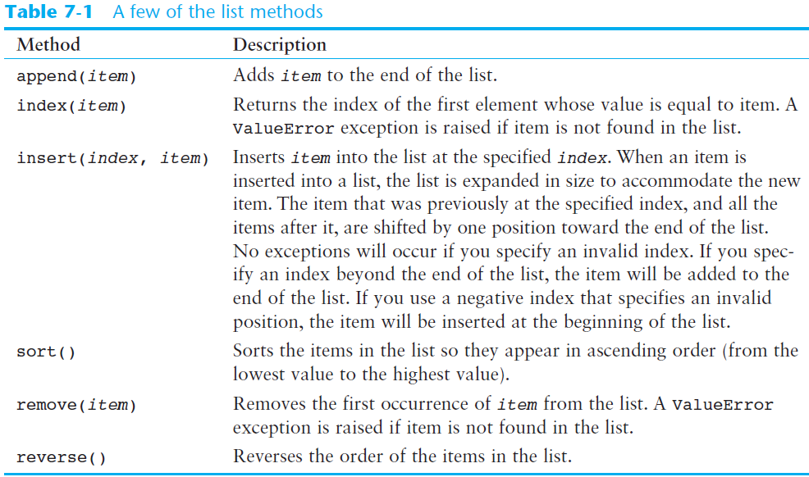

Slide 28
List Methods and Useful Built-in Functions (cont’d.)
del statement: removes an element from a specific index in a list
General format: del list[i]
min and max functions: built-in functions that return the item that has the lowest or highest value in a sequence
The sequence is passed as an argument

Slide 29
Some Example Programs Demonstrating Methods
list_append.py
index_list.py
insert_list.py
remove_item.py
sortAndReverse.py

Slide 30
Lists
The del Statement : example
Removes an element from a specific index
For example:
my_list = [1, 2, 3, 4, 5]
print ('Before deletion:', my_list)
del my_list[2] # delete the 3rd element
print ('After deletion:', my_list)
IndexError exception if index not valid

Slide 31
Lists
The min and max functions (lists and strings)
min function accepts a sequence and returns the item that has the lowest value
max function accepts a sequence and returns the item that has the highest value
myList = [45, -2, 117]
print ("The maximum is: ", max(myList))

Slide 32
Copying Lists
To make a copy of a list you must copy each element of the list
Two methods to do this:
Creating a new empty list and using a for loop to add a copy of each element from the original list to the new list
Creating a new empty list and concatenating the old list to the new empty list

Slide 33
Lists
Copying Lists
For example:
list1 = [1, 2, 3, 4] # Creates a list with values
list2 = list1 # does not copy the list! # makes both identifiers reference # the same list object in memory!
list2 = [ ] + list1 # Creates a copy of list1

Slide 34
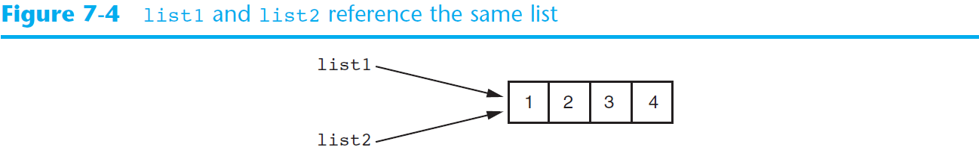
Copying Lists (cont’d.)

Slide 35
Processing Lists
List elements can be used in calculations
To calculate total of numeric values in a list use loop with accumulator variable
To average numeric values in a list:
Calculate total of the values
Divide total of the values by len(list)
List can be passed as an argument to a function

Slide 36
Processing Lists (cont’d.)
A function can return a reference to a list
To save the contents of a list to a file:
Use the file object’s writelines method
Does not automatically write \n at then end of each item
Use a for loop to write each element and \n
To read data from a file use the file object’s readlines method
We will see an example of this later

Slide 37
Example Programs
barista_pay.py (basic list usage)
total_list.py (total list values)
average_list.py (average list values)
total_function.py (pass list to a function; by value)
return_list.py (return reference to a list)

Slide 38
Example Program: working with a list and multiple functions
Create a list of test scores
Drop the lowest score
Calculate the average
drop_lowest_score.py

Slide 39
Example: reading and writing a list of strings using files
There are multiple options, see book for more functions and examples
write_list.py
read_list.py
Notes:
Add an extra print to the authors read function, so can see strings before \n is stripped off

Slide 40
Two-Dimensional Lists
Two-dimensional list: a list that contains other lists as its elements
Also known as nested list
Common to think of two-dimensional lists as having rows and columns (tables, charts)
Useful for working with multiple sets of data
To process data in a two-dimensional list need to use two indexes
Typically use nested loops to process

Slide 41
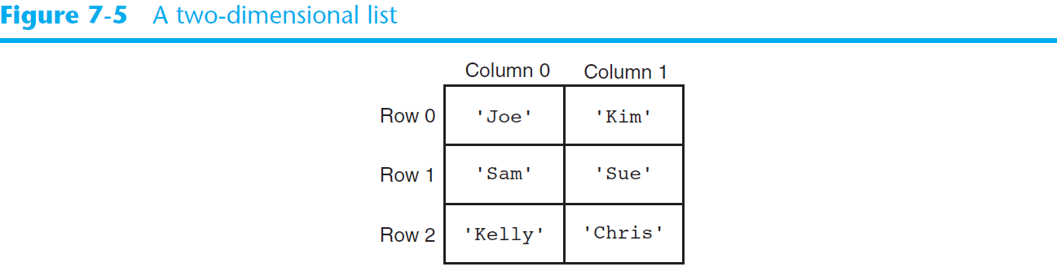
Two-Dimensional Lists (cont’d.)

Slide 42
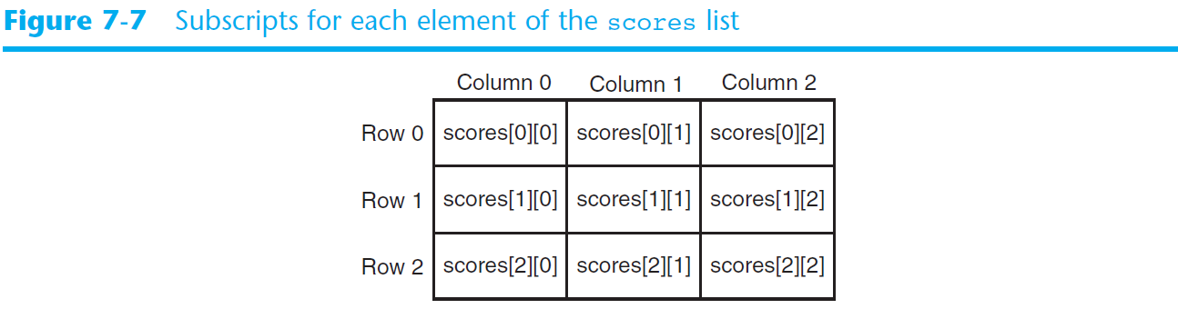
Two-Dimensional Lists (cont’d.)

Slide 43
Example Program
Creates a 3 by 4 "table" or 2D list
you can call it a "list of lists" also
Fills it with random numbers
random_numbers.py

Slide 44
Tuples
Tuple: an immutable sequence
Very similar to a list
Once it is created it cannot be modified
Format: tuple_name = (item1, item2)
Tuples generally support operations as lists
Subscript indexing for retrieving elements
Methods such as index
Built in functions such as len, min, max
Slicing expressions
The in, +, and * operators

Slide 45
Tuples (cont’d.)
Tuples do not support the methods:
append
remove
insert
reverse
sort
myTuple.py

Slide 46
Tuples (cont’d.)
Advantages for using tuples over lists:
Processing tuples is faster than processing lists
Tuples are safe
Some operations in Python require use of tuples
list() function: converts tuple to list
tuple() function: converts list to tuple

Slide 47
Plotting Data with matplotlib
Time permitting, we may cover this topic in lectures; or, we may leave it for reading and reference
The matplotlib package is a library for creating two-dimensional charts and graphs.
It is not part of the standard Python library, so you will have to install it separately, after you have installed Python on your system.

Slide 48
Plotting Data with matplotlib
To install matplotlib on a Windows system, open a Command Prompt window and enter this command:
To install matplotlib on a Mac or Linux system, open a Terminal window and enter this command:
See Appendix F in your textbook for more information about packages and the pip utility.
pip install matplotlib
sudo pip3 install matplotlib

Slide 49
Plotting Data with matplotlib
To verify the package was installed, start IDLE and enter this command:
If you don't see any error messages, you can assume the package was properly installed.
>>> import matplotlib

Slide 50
Plotting Data with matplotlib
The matplotlib package contains a module named pyplot that you will need to import.
Use the following import statement to import the module and create an alias named plt:
import matplotlib.pyplot as plt
For more information about the import statement, see Appendix E in your textbook.

Slide 51
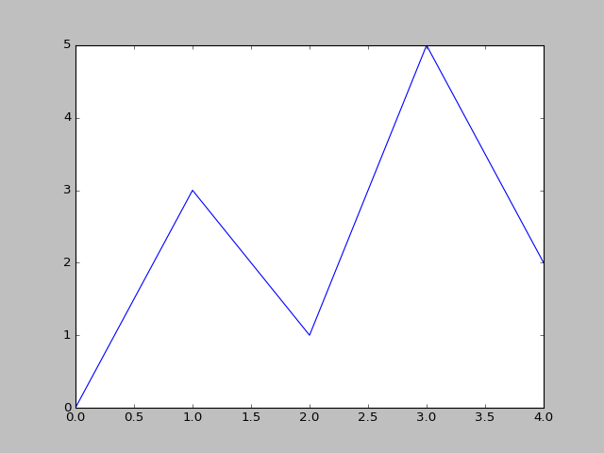
Plotting a Line Graph with the plot Function
Use the plot function to create a line graph that connects a series of points with straight lines.
The line graph has a horizontal X axis, and a vertical Y axis.
Each point in the graph is located at a (X,Y) coordinate.

Slide 52
Plotting a Line Graph with the plot Function
Program 7-19 (line_graph1.py)
1 # This program displays a simple line graph.
2 import matplotlib.pyplot as plt
3
4 def main():
5 # Create lists with the X and Y coordinates of each data point.
6 x_coords = [0, 1, 2, 3, 4]
7 y_coords = [0, 3, 1, 5, 2]
8
9 # Build the line graph.
10 plt.plot(x_coords, y_coords)
11
12 # Display the line graph.
13 plt.show()
14
15 # Call the main function.
16 main()

Slide 53
Plotting a Line Graph with the plot Function
You can change the lower and upper limits of the X and Y axes by calling the xlim and ylim functions. Example:
This code does the following:
Causes the X axis to begin at 1 and end at 100
Causes the Y axis to begin at 10 and end at 50
plt.xlim(xmin=1, xmax=100)
plt.ylim(ymin=10, ymax=50)

Slide 54
Plotting a Line Graph with the plot Function
You can customize each tick mark's label with the xticks and yticks functions.
These functions each take two lists as arguments.
The first argument is a list of tick mark locations
The second argument is a list of labels to display at the specified locations.
plt.xticks([0, 1, 2, 3, 4],
['2016', '2017', '2018', '2019', '2020'])
plt.yticks([0, 1, 2, 3, 4, 5],
['$0m', '$1m', '$2m', '$3m', '$4m', '$5m'])

Slide 55
Program 7-24
1 # This program displays a simple line graph. 2 import matplotlib.pyplot as plt 3 4 def main(): 5 # Create lists with the X,Y coordinates of each data point. 6 x_coords = [0, 1, 2, 3, 4] 7 y_coords = [0, 3, 1, 5, 2] 8 9 # Build the line graph. 10 plt.plot(x_coords, y_coords, marker='o') 11 12 # Add a title. 13 plt.title('Sales by Year') 14 15 # Add labels to the axes. 16 plt.xlabel('Year') 17 plt.ylabel('Sales') 18
Continued…

Slide 56
Program 7-24 (continued)
19 # Customize the tick marks. 20 plt.xticks([0, 1, 2, 3, 4], 21 ['2016', '2017', '2018', '2019', '2020']) 22 plt.yticks([0, 1, 2, 3, 4, 5], 23 ['$0m', '$1m', '$2m', '$3m', '$4m', '$5m']) 24 25 # Add a grid. 26 plt.grid(True) 27 28 # Display the line graph. 29 plt.show() 30 31 # Call the main function. 32 main()

Slide 57
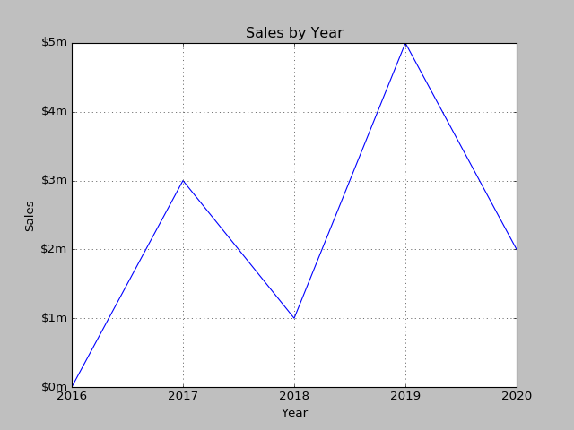
Output of Program 7-24
Displayed by the yticks() function.
Displayed by the title() function.
Displayed by the ylabel() function.
Displayed by the xticks() function.
Displayed by the xlabel() function.

Slide 58
Plotting a Bar Chart
Use the bar function in the matplotlib.pyplot module to create a bar chart.
The function needs two lists: one with the X coordinates of each bar's left edge, and another with the heights of each bar, along the Y axis.

Slide 59
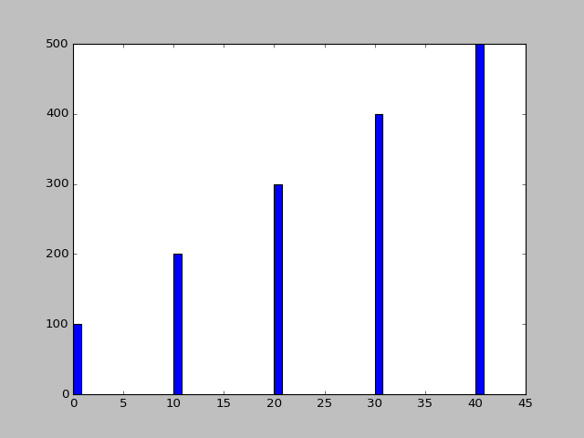
Plotting a Bar Chart
left_edges = [0, 10, 20, 30, 40]
heights = [100, 200, 300, 400, 500]
plt.bar(left_edges, heights)
plt.show()

Slide 60
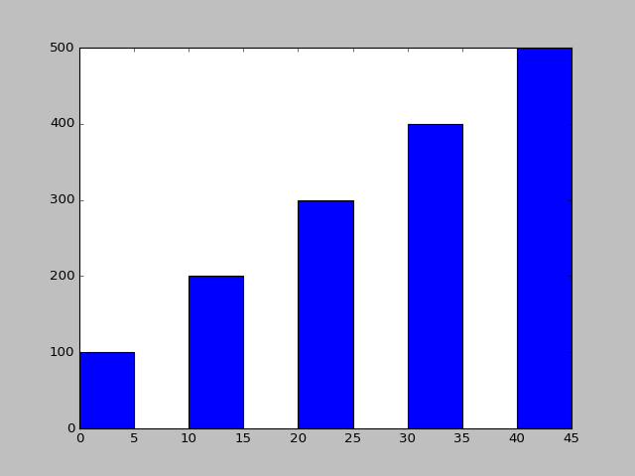
Plotting a Bar Chart
The default width of each bar in a bar graph is 0.8 along the X axis.
You can change the bar width by passing a third argument to the bar function.
left_edges = [0, 10, 20, 30, 40]
heights = [100, 200, 300, 400, 500]
bar_width = 5
plt.bar(left_edges, heights, bar_width)
plt.show()

Slide 61
Plotting a Bar Chart
The bar function has a color parameter that you can use to change the colors of the bars.
The argument that you pass into this parameter is a tuple containing a series of color codes.
Color Code | Corresponding Color
'b' | Blue
'g' | Green
'r' | Red
'c' | Cyan
'm' | Magenta
'y' | Yellow
'k' | Black
'w' | White

Slide 62
Plotting a Bar Chart
Example of how to pass a tuple of color codes as a keyword argument:
The colors of the bars in the resulting bar chart will be as follows:
The first bar will be red.
The second bar will be green.
The third bar will be blue.
The fourth bar will be white.
The fifth bar will be black.
plt.bar(left_edges, heights, color=('r', 'g', 'b', 'w', 'k'))

Slide 63
Plotting a Bar Chart
Use the xlabel and ylabel functions to add labels to the X and Y axes.
Use the xticks function to display custom tick mark labels along the X axis
Use the yticks function to display custom tick mark labels along the Y axis.

Slide 64
Plotting a Pie Chart
You use the pie function in the matplotlib.pyplot module to create a pie chart.
When you call the pie function, you pass a list of values as an argument.
The sum of the values will be used as the value of the whole.
Each element in the list will become a slice in the pie chart.
The size of a slice represents that element's value as a percentage of the whole.

Slide 65
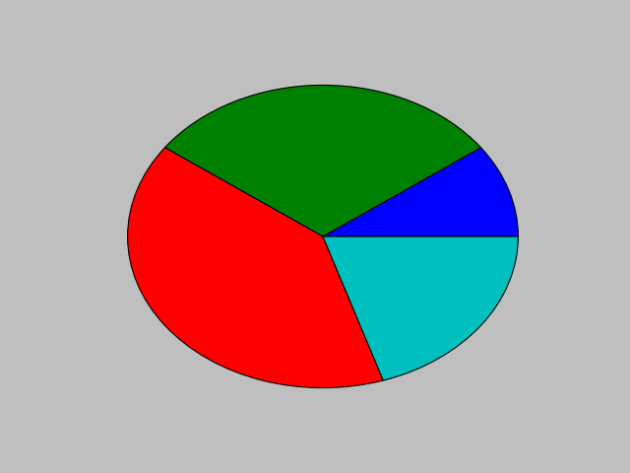
Plotting a Pie Chart
Example
values = [20, 60, 80, 40]
plt.pie(values)
plt.show()

Slide 66
Plotting a Pie Chart
The pie function has a labels parameter that you can use to display labels for the slices in the pie chart.
The argument that you pass into this parameter is a list containing the desired labels, as strings.

Slide 67
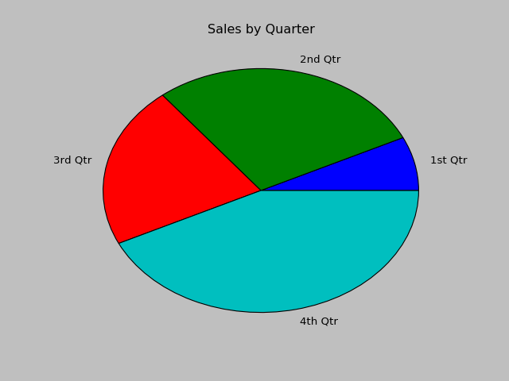
Plotting a Pie Chart
Example
sales = [100, 400, 300, 600]
slice_labels = ['1st Qtr', '2nd Qtr', '3rd Qtr', '4th Qtr']
plt.pie(sales, labels=slice_labels)
plt.title('Sales by Quarter')
plt.show()

Slide 68
Plotting a Pie Chart
The pie function automatically changes the color of the slices, in the following order:
blue, green, red, cyan, magenta, yellow, black, and white.
You can specify a different set of colors, however, by passing a tuple of color codes as an argument to the pie function's colors parameter:
When this statement executes, the colors of the slices in the resulting pie chart will be red, green, blue, white, and black.
plt.pie(values, colors=('r', 'g', 'b', 'w', 'k'))

Slide 69
Summary
This chapter covered:
Lists, including:
Repetition and concatenation operators
Indexing
Techniques for processing lists
Slicing and copying lists
List methods and built-in functions for lists
Two-dimensional lists
Tuples, including:
Immutability
Difference from and advantages over lists
Plotting charts and graphs with the matplotlib Package (optional topic)

Slide 70
Next…
More About Strings in Python


