Slide 2
Topics
Basic String Operations
String Slicing
Testing, Searching, and Manipulating Strings
Note: slides with the fuchsia-colored pointed symbol in the lower right corner were added by your course instructor; slides in general have been modified and added to by your instructor

Slide 3
Recap: Sequences
A sequence is an object that holds multiple items of data, stored one after another
Python string: sequence of characters
Python list or tuple: may have various data types

Slide 4
Why use strings?
Fundamental data type that people use frequently
Text processing
Word processing
Email
Text and comment boxes
Generally, all written communications
Etc.

Slide 5
Basic String Operations
Many types of programs perform operations on strings
In Python, there are many tools for examining and manipulating strings
Strings are sequences, so many of the tools that work with sequences work with strings

Slide 6
Accessing the Individual Characters in a String
To access an individual character in a string:
Use a for loop
Format: for character in string:
Useful when need to iterate over the whole string, such as to count the occurrences of a specific character
Use indexing
Each character has an index specifying its position in the string, starting at 0
Format: character = my_string[i]

Slide 7
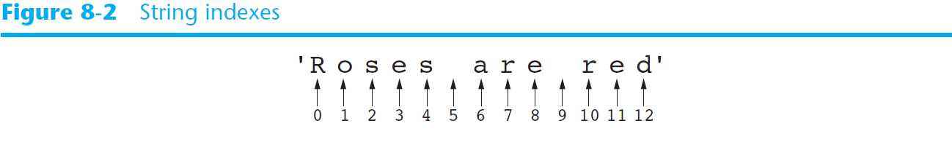
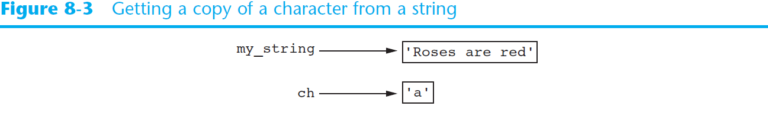
Accessing the Individual Characters in a String (cont’d.)

Slide 8
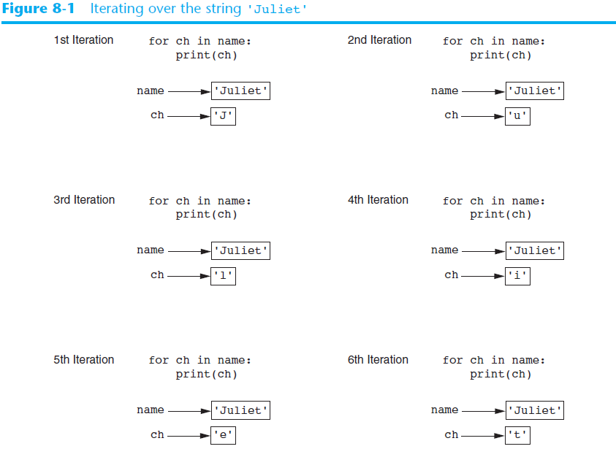

Slide 9
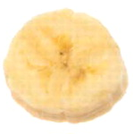
Accessing the Individual Characters in a String (cont’d.)
IndexError exception will occur if:
You try to use an index that is out of range for the string
Likely to happen when loop iterates beyond the end of the string
len(string) function can be used to obtain the length of a string
Useful to prevent loops from iterating beyond the end of a string

Slide 10
Example Program
count_Ts.py

Slide 11
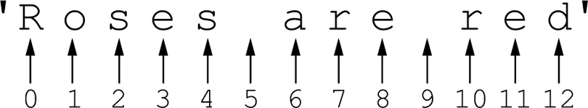
Working with Strings
Accessing the Individual Characters in a String: Indexing
my_string = ‘Roses are red’
print (my_string[0], my_string[6], my_string[10])
print (my_string[-1], my_string[-2], my_string[-3])
length is 13
Figure 8-2 String indexes
what is printed?
Notes:
indices go 0 through length – 1 in positive direction
indices go -1 through –length in negative direction

Slide 12
Working with Strings
Accessing the Individual Characters in a String: Indexing
my_string = ‘Roses are red’
print (my_string[0], my_string[6], my_string[10])
print (my_string[-1], my_string[-2], my_string[-3])
Figure 8-2 String indexes
what is printed?
R a r and d e r
Notes:
given a negative index, python subtracts the negative number from the string length, to find the index to use

Slide 13
Working with Strings
Accessing the Individual Characters in a String
IndexError Exceptions
IndexError exception will occur if an out of range index is accessed
For example:
city = ‘Boston’
index = 0
while index < 7:
print (city[index])
index += 1
B o s t o n
↑ ↑ ↑ ↑ ↑ ↑
0 1 2 3 4 5
question: what are the length and valid positive and negative indices into this string?

Slide 14
Working with Strings
Accessing the Individual Characters in a String
The len Function
len returns the length of a sequence
For example:
city = ‘Boston’
index = 0
while index < len(city):
print (city[index])
index += 1
B o s t o n
↑ ↑ ↑ ↑ ↑ ↑
0 1 2 3 4 5
This could be done better… how???

Slide 15
Working with Strings
Accessing the Individual Characters in a String
The len Function
len returns the length of a sequence
For example:
city = ‘Boston’
index = 0 slen = len(city)
while index < slen:
print (city[index])
index += 1
B o s t o n
↑ ↑ ↑ ↑ ↑ ↑
0 1 2 3 4 5
Better: don't call the len function repeatedly!

Slide 16
String Concatenation
Concatenation: appending one string to the end of another string
Use the + operator to produce a string that is a combination of its operands
The augmented assignment operator += can also be used to concatenate strings
The operand on the left side of the += operator must be an existing variable; otherwise, an exception is raised
concatenate.py

Slide 17
Strings Are Immutable
Strings are immutable
Once they are created, they cannot be changed
Concatenation doesn’t actually change the existing string, but rather creates a new string and assigns the new string to the previously used variable name
Cannot use an expression of the form
string[index] = new_character
Statement of this type will raise an exception

Slide 18
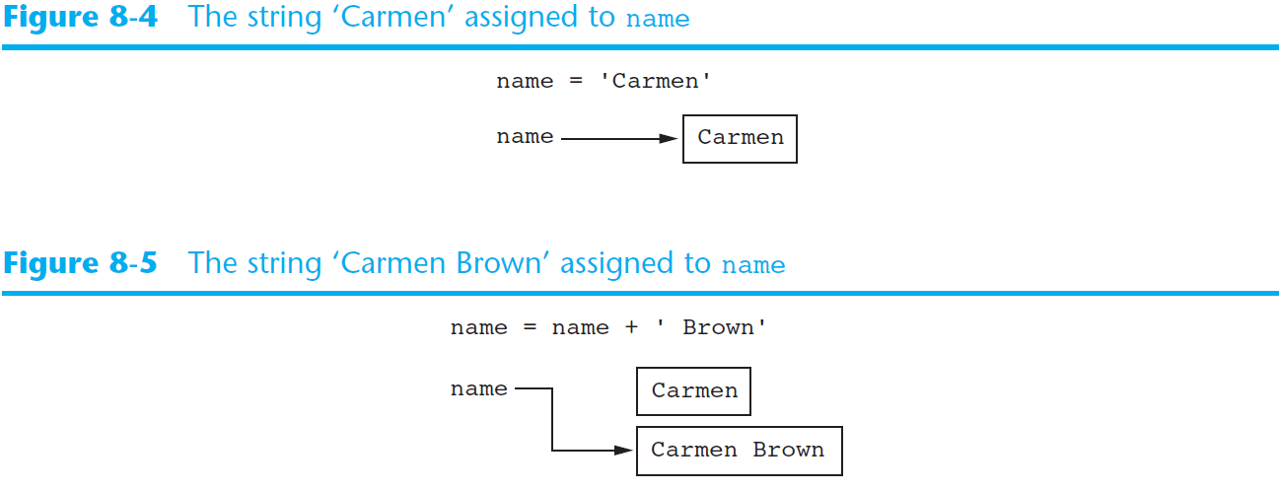
Strings Are Immutable (cont’d.)

Slide 19
Working with Strings
Strings Are Immutable
Immutable means that once they are created they cannot be changed.
For example:
friend = ‘Bill’
friend[0] = ‘J’ # No, this will cause exception
syntax error: str object does not support item assignment
B i l l
↑ ↑ ↑ ↑
0 1 2 3

Slide 20
Exercise: Ideas?
If we have an existing string variable, how might we change it? E.g. change 'Bill' in the previous, to 'Byll' ???
One Idea: string = “Bill”
Convert it to list which are mutable:
ch = list (string)
ch[ch.index (“i”) = “y”
new_string = ‘’.join(ch)
Notes:
Create an empty target string. Using the source string, take one char at a time using indexing, and concatenate it on to the target string.

Slide 21
String Slicing
Slice: span of items taken from a sequence, known as substring
Slicing format: string[start : end]
Expression will return a string containing a copy of the characters from start up to, but not including, end
If start not specified, 0 is used for start index
If end not specified, len(string) is used for end index
Slicing expressions can include a step value and negative indexes relative to end of string

Slide 22
Factoids
start is the index to start at; end is the index to stop at + 1 (a limit)
if start is omitted, Python uses 0
if end is omitted, Python uses the string length
you can specify a step value to skip chars
you can use negative numbers for indices
invalid indices do NOT raise an exception
if end is invalid, Python uses length
if start is invalid, Python uses 0
if start > length, empty string is returned

Slide 23
Working with Strings
String Slicing
P a t t y L y n n S m i t h
0 1 2 3 4 5 6 7 8 9 10 11 12 13 14 15
-16 - 15 -14 -13 -12 -11 -10 -9 -8 -7 -6 -5 -4 -3 - 2 -1
full_name = 'Patty Lynn Smith'
middle_name = full_name[6:10] # middle_name = 'Lynn'
first_name = full_name[:5] # first_name = 'Patty'
last_name = full_name[11:] # last_name = 'Smith'
my_string = full_name[:] # my_string = 'Patty Lynn Smith'
my_string = full_name[0:len(full_name)] # my_string = 'Patty Lynn Smith'
last_name = full_name[-5:] # last_name = 'Smith'

Slide 24
Working with Strings
String Slicing and step
ABCDEFGHIJKLMNOPQRSTUVWXYZ
0 1 2 3 4 5 6 7 8 9 10 11 12 13 14 15 16 17 18 19 20 21 22 23 24 25
string[start : end : step]
letters = 'ABCDEFGHIJKLMNOPQRSTUVWXYZ'
print (letters[0:26:2]) # 'ACEGIKMOQSUWY'

Slide 25
Program Example: Generate User Login ID
Read first name, last name, ID number
Get 1st 3 chars of first name (if less than 3 chars, use entire first name)
Get 1st 3 chars of last name (same)
Get last 3 chars of ID number (same)
Concatenate all 3 to create a user login ID

Slide 26
Example
Given
first name is William
last name is Gates
ID number is COP3035
Login name is WilGat035
we will discuss: generate_login.py (app) login.py

Slide 27
Testing, Searching, and Manipulating Strings
You can use the in operator to determine whether one string is contained in another string
General format: string1 in string2
string1 and string2 can be string literals or variables referencing strings
Similarly you can use the not in operator to determine whether one string is not contained in another string

Slide 28
Example
text = "Four score and seven years ago"
if "seven" in text: # cp: if "seven" not in text: print ("found") else: print ("not found")

Slide 29
String Methods
Strings in Python have many types of methods, divided into different types of operations
General format: mystring.method(arguments)
Some methods test a string for specific characteristics
Generally Boolean methods, that return True if a condition exists, and False otherwise

Slide 30
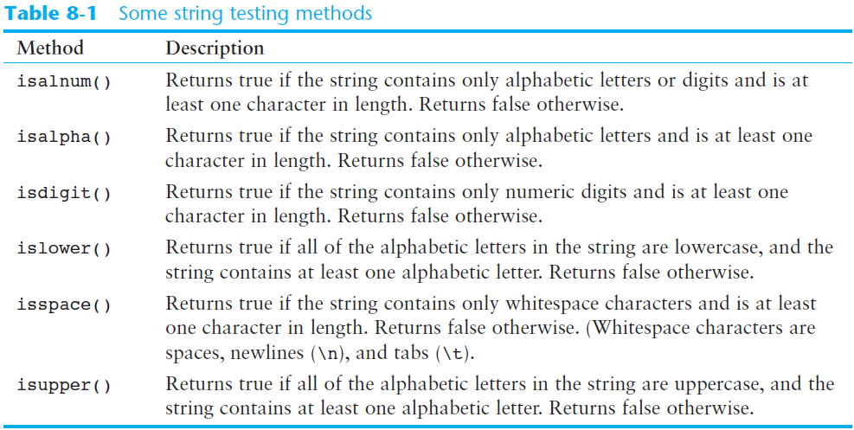
String Methods (cont’d.)

Slide 31
String Methods (cont’d.)
Some methods return a copy of the string, to which modifications have been made
Simulate strings as mutable objects
String comparisons are case-sensitive
Uppercase characters are distinguished from lowercase characters
lower and upper methods can be used for making case-insensitive string comparisons

Slide 32
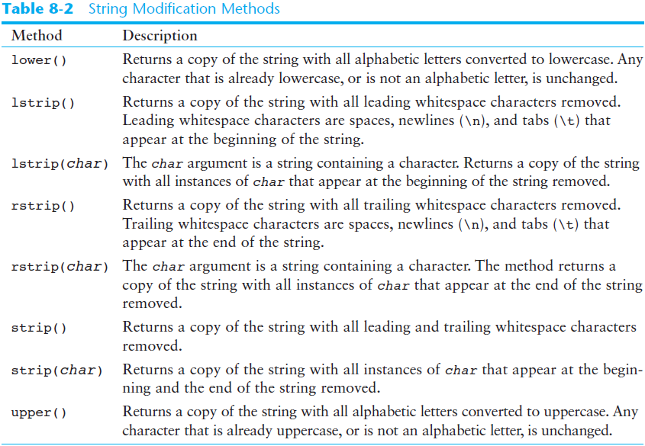
String Methods (cont’d.)

Slide 33
Example
response = 'y' while response.lower( ) == 'y': print ("Doing a loop task again") print ("Do you want to repeat again?") response = input("Enter Y or y to repeat: ") # allows user to enter either upper or lower case

Slide 34
String Methods (cont’d.)
Programs commonly need to search for substrings
Several methods to accomplish this:
endswith(substring): checks if the string ends with substring
Returns True or False
startswith(substring): checks if the string starts with substring
Returns True or False

Slide 35
String Methods (cont’d.)
Several methods to accomplish this (cont’d):
find(substring): searches for substring within the string
Returns lowest index of the substring, or if the substring is not contained in the string, returns -1
replace(substring, new_string):
Returns a copy of the string where every occurrence of substring is replaced with new_string

Slide 36
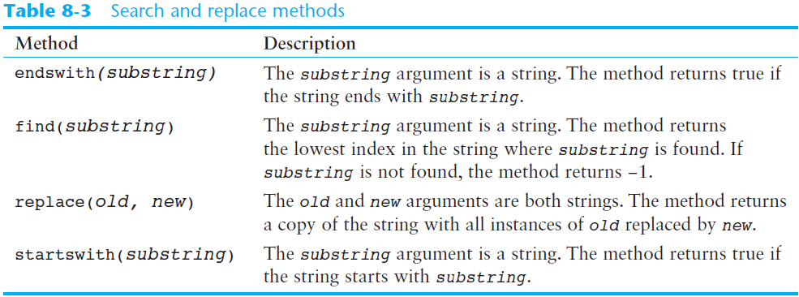
String Methods (cont’d.)

Slide 37
Example 1
filename = input("Enter filename: ") if filename.endswith(".txt"): print ("text file") elif filename.endswith(".jpg"): print ("image file") elif filename.endswith(".docx"): print ("MS Word file")

Slide 38
Example 2
myString = "Monty Python is a TV show" foundAt = myString.find("Python") if foundAt != -1: print ("Found at index ", foundAt) else: print ("Word not found in string")
What is printed?
Notes:
index foundAt is 6; ask class, what does this print, to review

Slide 39
The Repetition Operator
Repetition operator: makes multiple copies of a string and joins them together
The * symbol is a repetition operator when applied to a string and an integer
String is left operand; number is right
General format: string_to_copy * n
Variable references a new string which contains multiple copies of the original string

Slide 40
Example Program
repetition_operator.py

Slide 41
Splitting a String
split method: returns a list containing the words in the string
By default, uses space as separator
Can specify a different separator by passing it as an argument to the split method

Slide 42
Example Programs
string_split.py
split_date.py

Slide 43
Program Example : password check
A password must
be at least 7 characters long
contain at least 1 uppercase letter
contain at least 1 lowercase letter
contain at least 1 numeric digit
we will discuss: validate_password.py (app) login.py

Slide 44
Strings, Lists and Eliza
Famous program: Eliza eliza.py
Turing Test
Alan Turing, 1950
can a machine think?
to pass the Turing Test: a computer must interact with a human and a human observer must not be able to determine which participant is the human being or the computer
text is the only "conversation" via keyboards and separated screens, allowed

Slide 45
Summary
This chapter covered:
String operations, including:
Methods for iterating over strings
Repetition and concatenation operators
Strings as immutable objects
Slicing strings and testing strings
String methods
Splitting a string

Slide 46
Next…
Dictionaries and Sets in Python


