Slide 2
Topics
Procedural and Object-Oriented Programming
Classes
Working with Instances
Techniques for Designing Classes
Note: slides with the fuchsia-colored pointed symbol in the lower right corner were added by your course instructor; slides in general have been modified and added to by your instructor

Slide 3
Procedural Programming
Procedural programming: writing programs made of functions that perform specific tasks
Procedures typically operate on data items that are separate from the procedures
Data items commonly passed from one procedure to another
Focus: to create procedures that operate on the program’s data

Slide 4
Object-Oriented Programming
Object-oriented programming: focused on creating objects
Object: entity that contains data and procedures
Data is known as data attributes and procedures are known as methods
Methods perform operations on the data attributes
Encapsulation: combining data and code into a single object
e.g. string and file objects

Slide 5
Procedural and Object-Oriented Programming
Two major methods, or paradigms, of programming:
Procedural
Object-Oriented
Note: there are many other programming paradigms; these are currently two of the most popular

Slide 6
Some Styles of Programming
OBJECT-BASED
use objects that already exist in a language
e.g. using the Python string and file objects, as we have already
OBJECT-ORIENTED
creating new objects and going through the object-oriented design process; this is a major field of study
typically most useful for VERY LARGE programs

Slide 7
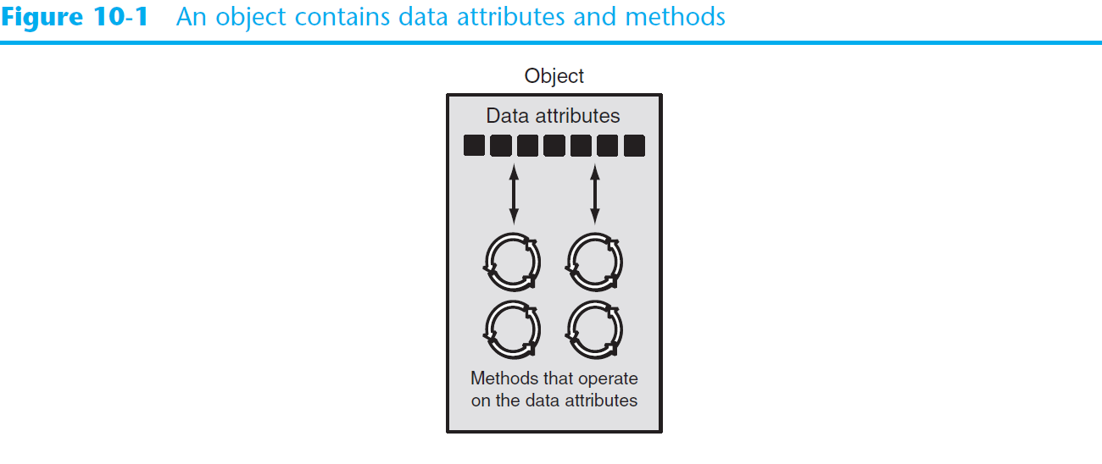
Object-Oriented Programming (cont’d.)

Slide 8
Object-Oriented Programming (cont’d.)
Data hiding: object’s data attributes are hidden from code outside the object
Access restricted to the object’s methods
Protects from accidental corruption
Outside code does not need to know internal structure of the object
Object reusability: the same object can be used in different programs
Example: 3D image object can be used for architecture and game programming

Slide 9
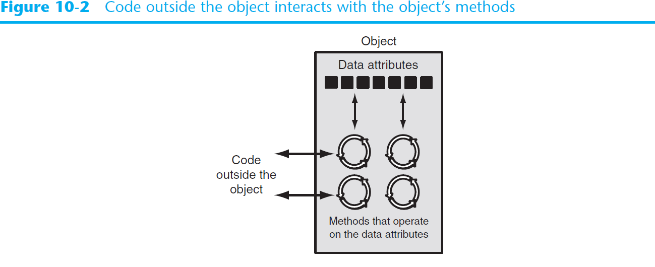
Object-Oriented Programming (cont’d.)

Slide 10
An Everyday Example of an Object
Data attributes: define the state of an object
Example: clock object would have second, minute, and hour data attributes
Public methods: allow external code to manipulate the object
Example: set_time, set_alarm_time
Private methods: used for object’s inner workings
public vs private members

Slide 11
E.g. Alarm Clock Object
private data
current_second, current_minute, current_hour
alarm_time, alarm_is_set
public methods
set_time, set_alarm_time, set_alarm_on, set_alarm_off
private methods
increment_current_second, increment_current_minute, increment_current_hour, sound_alarm

Slide 12
Major Concept
Class: A class is a data structure that specifies data attributes and methods for a particular type of information

Slide 13
Classes
Class: code that specifies the data attributes and methods of a particular type of object
Similar to a blueprint of a house or a cookie cutter
Instance: an object created from a class
Similar to a specific house built according to the blueprint or a specific cookie
There can be many instances of one class

Slide 14
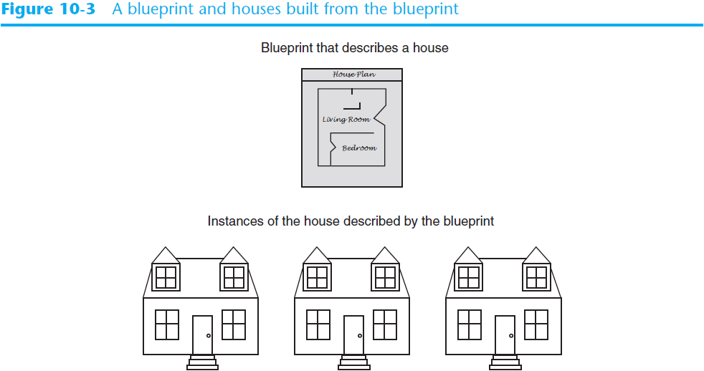
Classes (cont’d.)

Slide 15
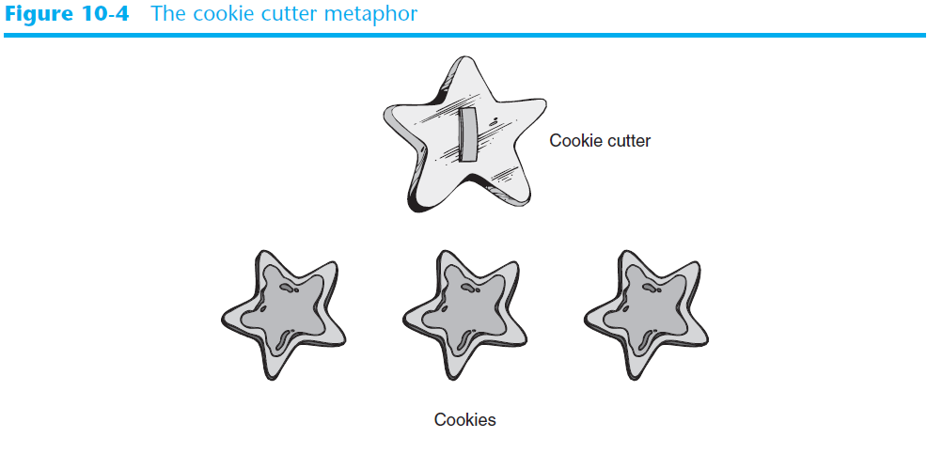
Classes (cont’d.)

Slide 16
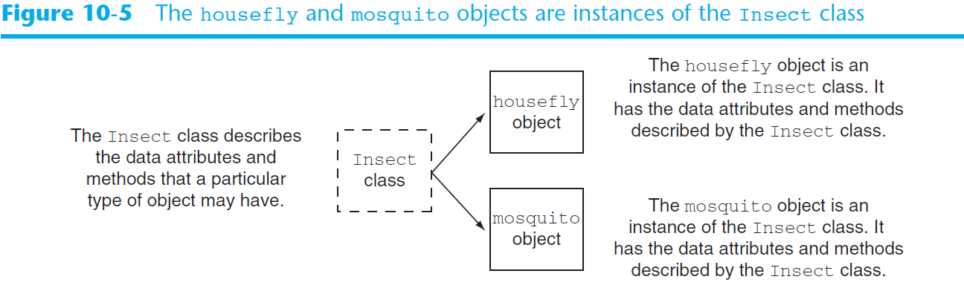
Classes (cont’d.)

Slide 17
Class Definitions
Class definition: set of statements that define a class’s methods and data attributes
Format: begin with class Class_name:
Class names often start with uppercase letter
Method definition like any other python function definition
self parameter: required in every method in the class – references the specific object that the method is working on

Slide 18
Class Definitions (cont’d.)
Initializer method: automatically executed when an instance of the class is created
Initializes object’s data attributes and assigns self parameter to the object that was just created
Format: def __init__ (self):
Usually the first method in a class definition

Slide 19
Accessor and Mutator Methods
Often called gets and sets
A set method sets some data member of a class object to a particular value
A get method retrieves some data member value of a class object

Slide 20
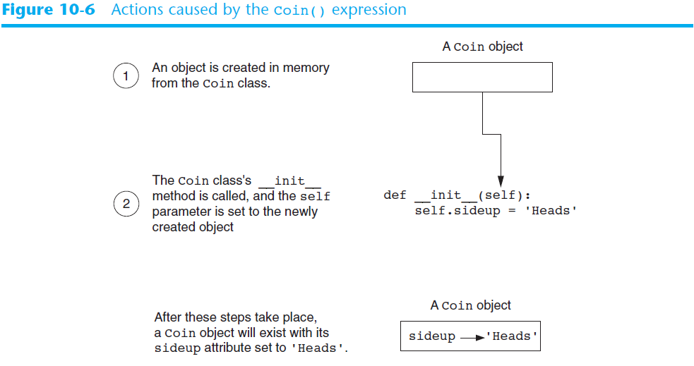
Class Definitions (cont’d.)

Slide 21
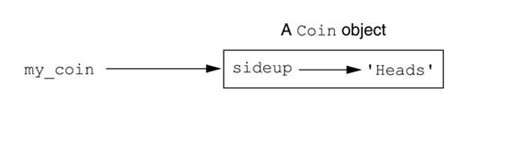
Example
The my_coin variable references a Coin object

Slide 22
Data Hiding and Encapsulation
Typically, we want to prevent application code (here, main) from directly accessing class member data directly
in our program example so far, sideup is PUBLIC
we want to make it PRIVATE
General Principle: class data members are generally made private to hide them from direct access from outside the class. Only class methods can access private data.

Slide 23
Example
coin_demo2.py
illustrates the public status of sideup

Slide 24
Class Definitions (cont’d.)
To create a new instance of a class call the initializer method
Format: My_instance = Class_Name()
To call any of the class methods using the created instance, use dot notation
Format: My_instance.method()
Because the self parameter references the specific instance of the object, the method will affect this instance
Reference to self is passed automatically

Slide 25
Hiding Attributes and Storing Classes in Modules
An object’s data attributes should be private
To make sure of this, place two underscores (__) in front of attribute name
Example: __current_minute
Classes can be stored in modules
Filename for module must end in .py
Module can be imported to programs that use the class

Slide 26
Example
coin_demo3.py
illustrates the now private status of sideup

Slide 27
Storing Classes in Modules
Create a module with the class definitions; save the file using .py extension
Import the module into any program that needs to use the class
we will look at coin_demo4.py
coin.py
important when writing LARGE programs with MULTIPLE CLASSES

Slide 28
The BankAccount Class – More About Classes
Class methods can have multiple parameters in addition to self
For __init__, parameters needed to create an instance of the class
Example: a BankAccount object is created with a balance
When called, the initializer method receives a value to be assigned to a __balance attribute
For other methods, parameters needed to perform required task
Example: deposit method amount to be deposited

Slide 29
The __str__ method
Object’s state: the values of the object’s attribute at a given moment
__str__ method: displays the object’s state
Automatically called when the object is passed as an argument to the print function
Automatically called when the object is passed as an argument to the str function
printing an object's state is a very common operation

Slide 30
Example
we will look at these in class:
bankaccount2.py
account_test2.py

Slide 31
Major Concept
Each instance of a class has its own set of data attributes, or instance variables

Slide 32
Working With Instances
Instance attribute: belongs to a specific instance of a class
Created when a method uses the self parameter to create an attribute
If many instances of a class are created, each would have its own set of attributes

Slide 33
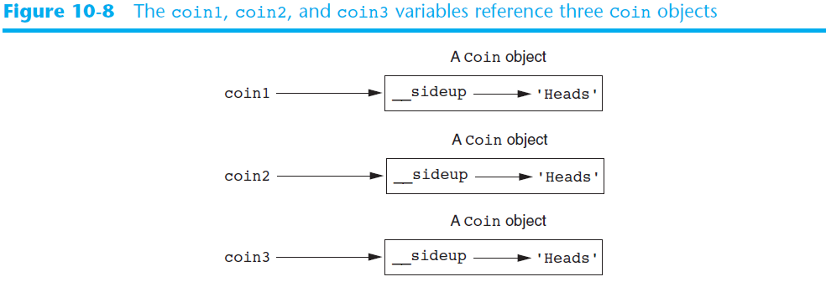
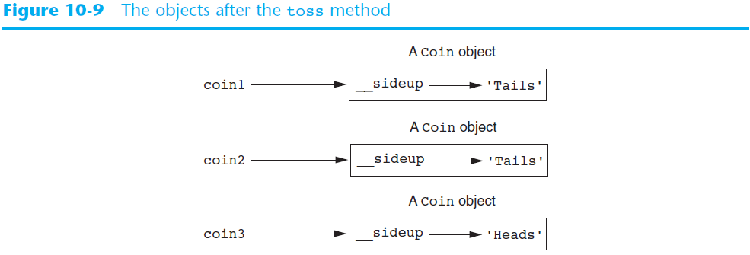
we will discuss coin_demo5.py

Slide 34
Accessor and Mutator Methods
Typically, all of a class’s data attributes are private and provide methods to access and change them
Accessor methods: return a value from a class’s attribute without changing it
Safe way for code outside the class to retrieve the value of attributes
Mutator methods: store or change the value of a data attribute

Slide 35
Example Program: Cell Phone Class
In lecture we will discuss
cell_phone.py
cell_phone_test.py
Notes:
note: there appears to be no "const" like mechanism, as in C++, to protect the calling object

Slide 36
What about a list of class objects?
Yes, definitely!
We will now discuss
cell_phone.py
cell_phone_list.py

Slide 37
Passing Objects as Arguments
coin_argument.py
Methods and functions often need to accept objects as arguments
When you pass an object as an argument, you are actually passing a reference to the object
The receiving method or function has access to the actual object
Methods of the object can be called within the receiving function or method, and data attributes may be changed using mutator methods

Slide 38
Designing Classes
The Unified Modeling Language (UML)
Provides a set of standard diagrams for graphically depicting object-oriented systems
NOTE: A full discussion of object-oriented design is beyond the scope of an introductory programming course. This is a topic you may wish to study in more detail later on.

Slide 39
Techniques for Designing Classes
UML diagram: standard diagrams for graphically depicting object-oriented systems
Stands for Unified Modeling Language
General layout: box divided into three sections:
Top section: name of the class
Middle section: list of data attributes
Bottom section: list of class methods

Slide 40
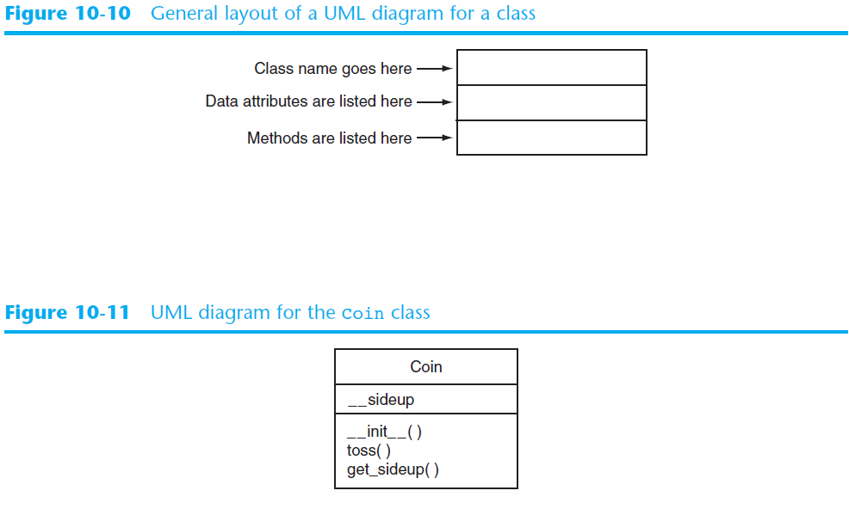

Slide 41
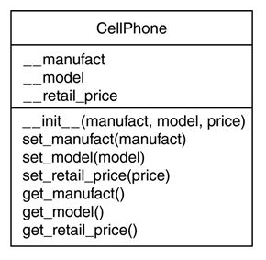
UML Diagram for a Cell Phone Class

Slide 42
Finding the Classes in a Problem
When developing object oriented program, first goal is to identify classes
Typically involves identifying the real-world objects that are in the problem
Technique for identifying classes:
Get written description of the problem domain
Identify all nouns in the description, each of which is a potential class
Refine the list to include only classes that are relevant to the problem

Slide 43
Finding the Classes in a Problem (cont’d.)
Get written description of the problem domain
May be written by you or by an expert
Should include any or all of the following:
Physical objects simulated by the program
The role played by a person
The result of a business event
Recordkeeping items

Slide 44
Finding the Classes in a Problem (cont’d.)
Identify all nouns in the description, each of which is a potential class
Should include noun phrases and pronouns
Some nouns may appear twice

Slide 45
Finding the Classes in a Problem (cont’d.)
Refine the list to include only classes that are relevant to the problem
Remove nouns that mean the same thing
Remove nouns that represent items that the program does not need to be concerned with
Remove nouns that represent objects, not classes
Remove nouns that represent simple values that can be assigned to a variable

Slide 46
Identifying a Class’s Responsibilities
A classes responsibilities are:
The things the class is responsible for knowing
Identifying these helps identify the class’s data attributes
The actions the class is responsible for doing
Identifying these helps identify the class’s methods
To find out a class’s responsibilities look at the problem domain
Deduce required information and actions

Slide 47
Some Additional Considerations
In a program with multiple classes,
do the classes interact?
does one class "contain" or "own" another class, e.g. a student object HAS A transcript object
does one class need access to the data in another class? e.g. a user object may need access to a document object, in a word processing program
does a class inherit properties from another? e.g. a scrolling window, or a fixed window, IS A window (GUI interfaces, graphical user interface objects)

Slide 48
Summary
This chapter covered:
Procedural vs. object-oriented programming
Classes and instances
Class definitions, including:
The self parameter
Data attributes and methods
__init__ and __str__ functions
Hiding attributes from code outside a class
Storing classes in modules
Designing classes

Slide 49
Next…
Inheritance


