Slide 2
Topics
Introduction to Inheritance
Polymorphism
Note: slides with the fuchsia-colored pointed symbol in the lower right corner were added by your course instructor; slides in general have been modified and added to by your instructor

Slide 3
Food for Thought… where is all that internet information stored ???
"Data centers" power usage has doubled in the last 5 years (source: Google research talk)
Data centers (e.g. major web sites) use about 2% of national power supply
Efficiency == work/energy used
what is "work?"
analyzing data to further cancer research?
watching youtube videos of dogs on skateboards?
Software and hardware issues
past: major focus on performance
future: perhaps major focus on efficiency (power required)
Notes:
used this and next slide: FA 10
is this GREEN ???

Slide 4
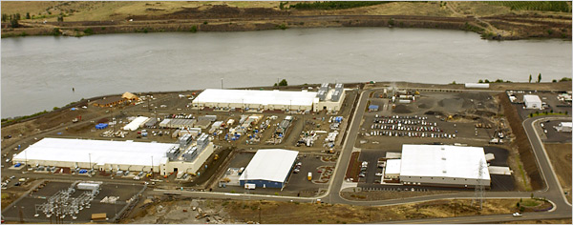
Data centers…
Google data center in Oregon
Google, btw, is investing major research dollars into reducing power usage… and hiring for this research area (from T. Heath, FSU alumni and Google "imagineer")
Notes:
in "The Dalles" Oregon on Columbia River; Tolliver Heath is the FSU alumni specifically who originally showed this photo in his talk at FSU in 2009

Slide 5
Data Centers and Heat
http://www.scientificamerican.com/article.cfm?id=greening-the-internet

Slide 6
The Three Major Attributes of Object-Oriented Programming
Encapsulation
Inheritance
Polymorphism
this chapter will introduce the last 2

Slide 7
Major Concept
Inheritance allows a new class to extend an existing class. The new class inherits the members of the class it extends.

Slide 8
Introduction to Inheritance
In the real world, many objects are a specialized version of more general objects
Example: grasshoppers and bees are specialized types of insect
In addition to the general insect characteristics, they have unique characteristics:
Grasshoppers can jump
Bees can sting, make honey, and build hives

Slide 9
People, by nature, categorize the world in this way
Animals
Mammals
Reptiles
Birds
etc.
etc.
Canines
Rodents
Felines
what about web sites, e.g. amazon.com ?
etc.

Slide 10
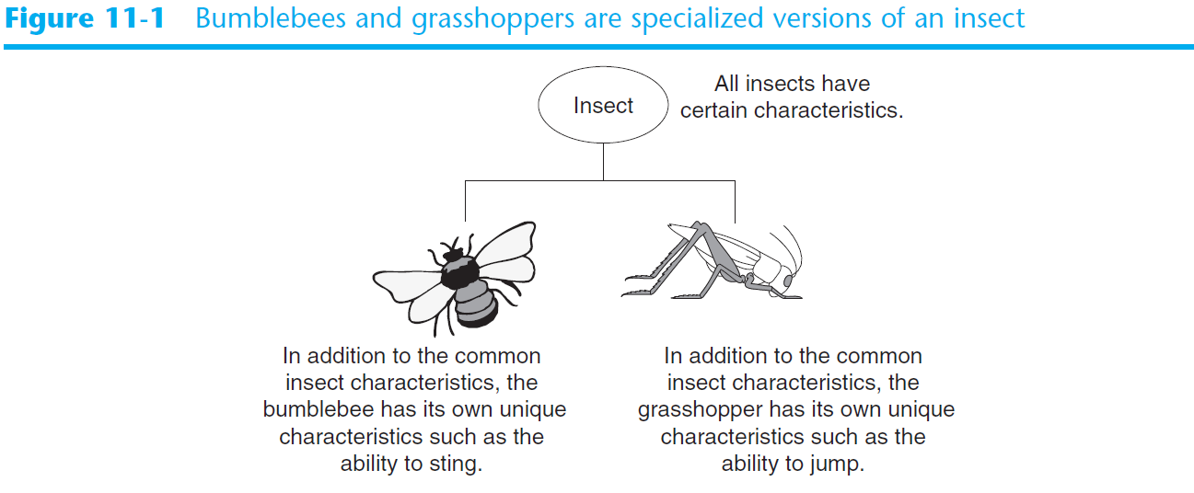
Introduction to Inheritance (cont’d.)

Slide 11
Inheritance and the “Is a” Relationship
“Is a” relationship: exists when one object is a specialized version of another object
Specialized object has all the characteristics of the general object plus unique characteristics
Example: Rectangle is a shape
Daisy is a flower

Slide 12
Inheritance and the “Is a” Relationship (cont’d.)
Inheritance: used to create an “is a” relationship between classes
Superclass (base class): a general class
Subclass (derived class): a specialized class
An extended version of the superclass
Inherits attributes and methods of the superclass
New attributes and methods can be added

Slide 13
Inheritance and the “Is a” Relationship (cont’d.)
For example, need to create classes for cars, pickup trucks, and SUVs
All are automobiles
Have a make, year model, mileage, and price
This can be the attributes for the base class
In addition:
Car has a number of doors
Pickup truck has a drive type
SUV has a passenger capacity

Slide 14
Example: Auto Dealership
Three kinds of vehicles: cars, pickup trucks, SUVs
All have: make, year model, mileage, price
Cars have: number of doors (2 or 4)
Pickup Trucks have: drive type (2-wheel or 4-wheel drive)
SUVs have: passenger capacity
Should we declare 3 separate classes?

Slide 15
Example
Automobile
Car
Truck
SUV

Slide 16
Inheritance and the “Is a” Relationship (cont’d.)
In a class definition for a subclass:
To indicate inheritance, the superclass name is placed in parentheses after subclass name
Example: class Car(Automobile):
The initializer method of a subclass calls the initializer method of the superclass and then initializes the unique data attributes
Add method definitions for unique methods

Slide 17
Example
vehicles.py
car_demo.py (app)

Slide 18
Now look at…
Truck Class (both in vehicles.py)
SUV Class
car_truck_suv_demo.py (app)

Slide 19
Inheritance in UML Diagrams
In UML diagram, show inheritance by drawing a line with an open arrowhead from subclass to superclass

Slide 20
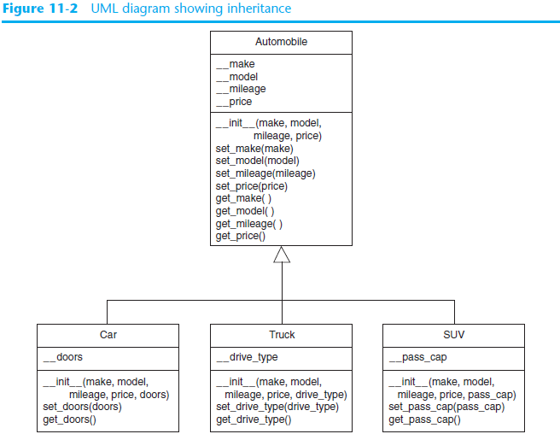

Slide 21
Program Example
You get a job with a bank. The bank needs a program to process savings accounts and CD accounts.
Savings Account has: account number, interest rate, account balance
CD account has: all of that plus maturity date
How should we set up these classes? What are the options to consider?

Slide 22
Program Example continued
We will look at
accounts.py
account_demo.py (app)

Slide 23
Major Concept
Polymorphism allows subclasses to have methods with the same names as methods in their superclasses. It provides the ability for a program to call the correct method depending on the type of object that is used to call the method.

Slide 24
Polymorphism
we have already seen this with init methods !
Polymorphism: an object’s ability to take different forms
Essential ingredients of polymorphic behavior:
Ability to define a method in a superclass and override it in a subclass
Subclass defines method with the same name
Ability to call the correct version of overridden method depending on the type of object that called for it

Slide 25
Example
they all need to make a sound,
BUT the sounds are different
Mammal
Dog
Cat

Slide 26
Polymorphism (cont’d.)
In previous inheritance examples showed how to override the __init__ method
Called superclass __init__ method and then added onto that
The same can be done for any other method
The method can call the superclass equivalent and add to it, or do something completely different

Slide 27
The isinstance Function
Polymorphism provides great flexibility when designing programs
AttributeError exception: raised when a method is receives an object which is not an instance of the right class
isinstance function: determines whether object is an instance of a class
Format: isinstance(object, class)

Slide 28
Examples
We will look at
wrong_type.py
polymorphism_demo2.py

Slide 29
Summary
This chapter covered:
Inheritance, including:
“Is a” relationships
Subclasses and superclasses
Defining subclasses and initializer methods
Depicting inheritance in UML diagrams
Polymorphism
The isinstance function

Slide 30
Next…
Recursion


