Slide 1
COP 3035 Lecture File 19: Recursion
Topics
What is recursion?
Recursion examples
Copyright Ann Ford Tyson

Slide 2
What is recursion ?
A method of defining a concept which refers to the concept itself
A method of solving a problem by decomposing it into sub-problems of the same type as the original problem
A powerful, elegant, efficient way to solve certain classes of programming problems
A recursive function calls itself

Slide 3
Recursive Definitions
Definition of a concept refers to the concept itself
Definition of a procedure (task) invokes the procedure itself

Slide 4
Words to ponder…
To understand recursion, you must first understand recursion. -- unknown source

Slide 5
Concept: Relative
x is a relative of y iff (if and only if)
x is y’s parent
x is y’s child
x is y’s spouse
x is a relative of a relative of y

Slide 6
Procedure: Divide and Conquer
A common algorithmic approach
Three steps:
Divide: Split problem into subproblems
Conquer: Solve subproblems
Combine: Merge subproblem solutions into overall solution

Slide 7
Example: N-Factorial N(N-1)(N-2)…(2)(1)
base case
1 if n ≤ 1
n (n – 1)! otherwise
n! =
recursive case

Slide 8
Example: 5 !
PROBLEM SIMPLIFIED PROBLEM
5 ! 5 * 4 !
4 ! 4 * 3 !
3 ! 3 * 2 !
2 ! 2 * 1 !
1 ! none (value is 1)

Slide 9
Example Use: Combinatorics
You are at Subway, looking over the 8 choices of vegetables to put on your sub. In how many ways can you choose 3 items? 56
n = number of items in set
r = number of items selected
C(n, r) = n! / (r! * (n-r)!)
Notes:
8!/(3! * 5!)
40320/(6 * 120)
56 possible ways

Slide 10
Recursive Factorial p.1
recursiveFact.py
def main():
N = 0 # we need an integer variable
print ("Compute N factorial")
N = int(input("Enter an integer: "))
print ("N is: ", N)
print ("N factorial is: ", Nfact(N))
Notes:
---

Slide 11
Recursive Factorial p. 2
def Nfact(N) :
if ( N <= 1 ): # base case
return 1
else: # recursive case
return ( N * Nfact(N - 1) )
main() # call to get things started
Notes:
---

Slide 12
Tracing Nfact(4) runtime stack
?
4 * NFact (3)
NFact (4)
4
?
3 * NFact (2)
NFact (3)
3
?
2 * NFact (1)
NFact (2)
2
?
NFact (1)
NFact (1)
1

Slide 13
Tracing Nfact(4) p.2
depth of recursion:
number of times func calls itself
24
4 * 6
NFact (4)
4
6
3 * 2
NFact (3)
3
2
2 * 1
NFact (2)
2
1
NFact (1)
NFact (1)
1

Slide 14
Serious Error: no base case
def Nfact ( N ) :
return ( N * Nfact(N - 1) )
Result: infinite recursion runtime stack overflow
Notes:
---

Slide 15
Recursion and Iteration
A recursive solution can always be written instead using iteration
An iterative solution can always be written instead using recursion
Recursive solution: involves lots of function call overhead
Many programming languages will evaluate certain types of recursive code and generate the executable using iteration instead, to optimize

Slide 16
Iterative Factorial
iterativeFact.py
def Nfact2 (N) : result = 1 for countdown in range (N, 1, -1) : result = result * countdown; return result

Slide 17
Direct and Indirect Recursion
Direct recursion example: a function A which calls itself
Indirect recursion example: function A calls function B, and function B calls function A
Always check for possibility of infinite recursion: won't terminate! Runtime stack overflow!

Slide 18
When do we choose recursion?
When it gives the algorithm and resulting code more clarity
E.g. major well-studied examples which utilize recursion appropriately
Hoare's quicksort
Towers of Hanoi game
Certain processing of data structures, e.g. lists and trees (chess or checkers game)
This is discussed thoroughly in more advanced courses

Slide 19
The Geometric Dreams of Benoit Mendelbrot, father of fractal geometry (Jeffrey Goldsmith, Wired Magazine)
Fractals: a branch of mathematics that reveals patterns in a coastline, swings of commodities prices, properties of new materials such as aerogels, and is used to generate images in computer-animation in movies and games
brainchild of maverick mathematician Benoit Mandelbrot, who coined the term in the 1970s and popularized it in the 1980s, fractals (for fractional dimensions) allowed him to eschew traditional geometric analysis in favor of his own flair for visualizing phenomena

Slide 20
Mandelbrot Set
The Mandelbrot Set, displayed by digital computers, the result of an iterative feedback loop, with different colors representing this recursive equation's acceleration toward infinity.
Graph of
f(x) = f(x-1) ^ 2 + c where c is any complex number (x + iy)
color of each point displayed is determined by an algorithm
Notes:
Zn = Zn-1 * Zn-1 + c
Z0 = 0, hence Z1 = c, Z2 = c * c + c; etc.
If |Zn| converges for c (I.e. less than 2) then c is in the set and color it black, else color is chosen based on the value of n for which it diverges (exceeds 2)
A point on graph is x + iy
Y-axis is imaginary axis

Slide 21
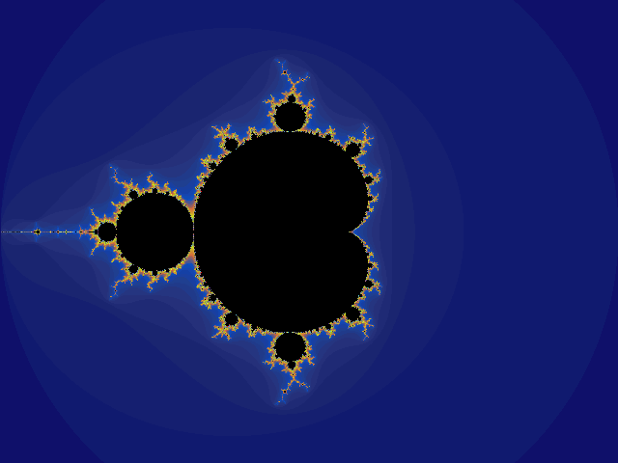
Mandelbrot plot

Slide 22
Mandelbrot on Nature
Wired:
Your book is called The Fractal Geometry of Nature. What is the fractal geometry of nature?
Mandelbrot:
The geometry of nature is fractal to the extent that if you look at many shapes in nature -- clouds, trees, et cetera -- small parts are the same as big parts; that's the definition of fractal.

Slide 23
Another thought…
Alan Beck in What Is a Fractal? And who is this guy Mandelbrot? writes:
"Basically, a fractal is any pattern that reveals greater complexity as it is enlarged. Thus, fractals graphically portray the notion of "worlds within worlds" which has obsessed Western culture from its tenth-century beginnings."
Consider: artwork by Jackson Pollack
American Abstract Expressionist Painter, 1912-1956

Slide 24
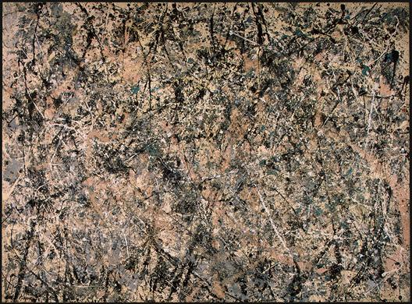
Art of Jackson Pollack
"Lavender Mist" 1950
Technique - ?
"There are no accidents." J.P.
Notes:
Pollack appeared to throw paint at the canvas, but he said his technique was very deliberate. Mathematicians analyzed it later on and found many of his works to be fractal in form.

Slide 25
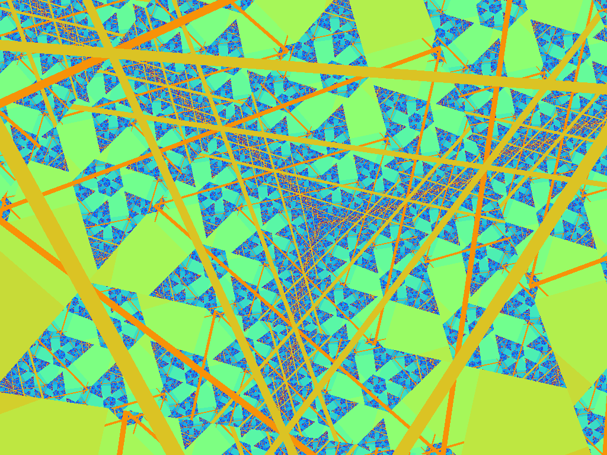
Example Fractal Image 1
Notes:
---

Slide 26
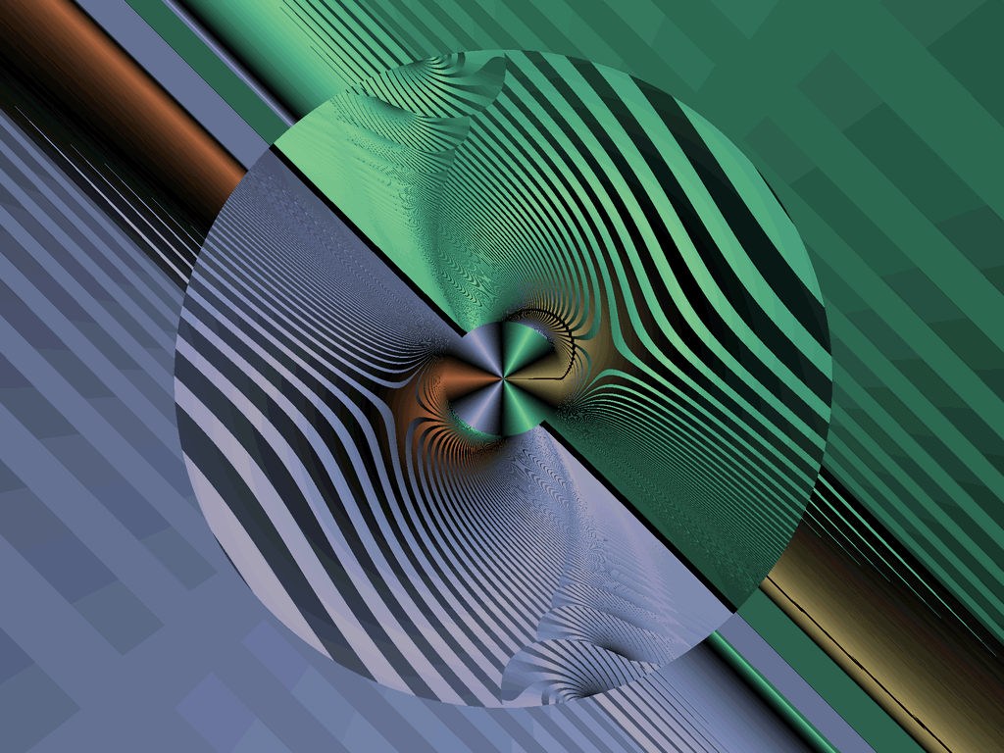
Example Fractal Image 2

Slide 27
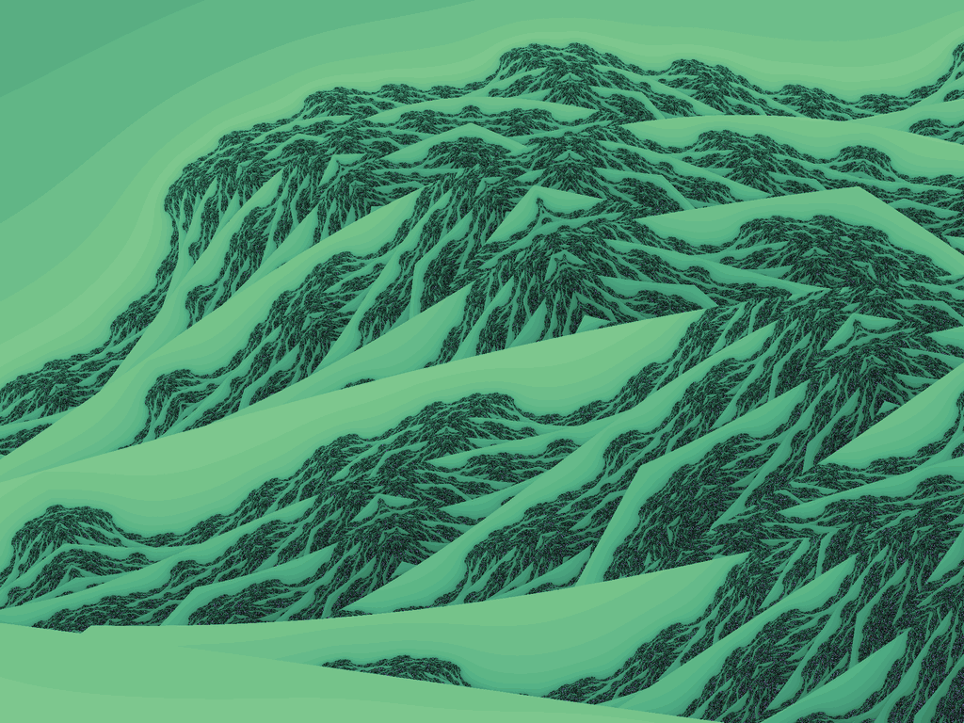
Fractal Images are used in movie and game image creation

Slide 28
What about vegetables???
Do a google image search for romanesco broccoli
Notes:
do live google image search in class for romanesco broccoli
really amazing stuff, living broccoli in fractal patterns!

Slide 29
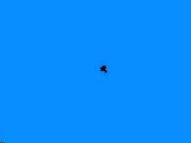
A Mandelbrot movie…

Slide 30
Another Recursion Example (try this as an exercise)
QUIT = 'q'
def main( ) :
Mystery( )
print ()
mystery.py

Slide 31
Mystery Subroutine
If the user types the word “cat” as input, what is printed ?
def Mystery ( ):
ch = input("Enter a char (q to quit): ")
if (ch != QUIT):
Mystery ( )
print (ch)
main ()
Notes:
tac is printed; the reverse of whatever the user types prior to the quit code
May trace this on the board during lecture, or ask students to do it as exercise

Slide 32
Expression Evaluation
General form:
Expr → Number
Expr → [Expr Operator Expr]
Evaluate (expr)
If expr is a number, return the number
Otherwise (form is [expr1 op expr2]):
val1 = Evaluate (expr1)
val2 = Evaluate (expr2)
Return op (val1,val2)

Slide 33
Example: expressions (tree)
[ 5 × [ [3 + 7 ] × [ 11 – 4 ] ] ]
×
5
×
+
—
3
7
11
4

Slide 34
Example Program: List Process
We will look at a function that takes a numeric list as input, as well as a starting index and an ending index, and calculates the sum of the values in that range
Example: numbers = [1,2,3,4,5,6,7,8,9] sum = range_sum(numbers, 3, 7) # sets sum to 30
range_sum.py (from Gaddis book)
Notes:
range_sum uses indices 3 through 7 inclusive here, so adds 4,5,6,7,8

Slide 35
Example: Towers of Hanoi
Invented by the French mathematician, Edouard Lucas, in 1883
A short elegant solution is possible with recursion, whereas the iterative solution is much more difficult

Slide 36
Legend of an ancient Hindu temple
The legend says that at the beginning of time Hindu priests in a temple were given a stack of 64 gold disks, each one a little smaller than the one beneath it. Their assignment was to transfer the 64 disks from one of three poles to another, with several important provisos: only the top disk could be moved, a larger disk could never be placed on top of a smaller one, only one disk could be moved at a time, and a disk could only be placed on a tower. The priests worked very efficiently, day and night. When they finished their work, the myth said, the temple would crumble into dust and the world would vanish.

Slide 37
In mathematical terms…
The number of separate transfers of single disks the priests would have to make to transfer the tower is 2 to the 64th minus 1, or 18,446,744,073,709,551,615 moves! If the priests worked day and night, making one move every second it would take slightly more than 580 billion years to accomplish the job!
Notes:
number of moves required is 2**(number of disks – 1)

Slide 38
Consider three disks
In the case of three disks, seven movements are necessary to move all disks from one tower to another. An example moving three disks from tower1 to tower3 is shown next.

Slide 39
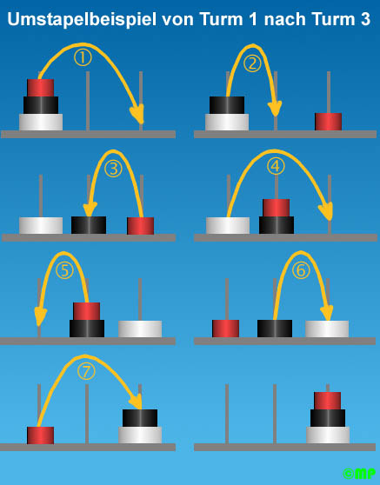
Three Disk Example http://www.fh-konstanz.de/studium/ze/cim/projekte/webcam/e_turm.html

Slide 40
Animated Display (7 disks)
Can find animations on youtube
Notes:
2**7 is 128, hence there will be 127 moves

Slide 41

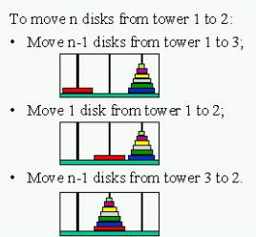
General Case

Slide 42
Example Program p.1
towersOfHanoi.py
def main():
number = 0 # we need an int variable print("TOWERS of Hanoi") print("Enter a number of disks to play.") print(" I'll give the necessary moves.") A = 'A' B = 'B' C = 'C' number = int(input("Enter a number: ")) towers(number, A, B, C)

Slide 43
Example Program p.3
def towers(count, src, dest, spare):
if (count == 1): print ("Move a disk from post " + \ src + " to post " + \ dest) else: towers(count - 1, src, spare, dest) towers(1, src, dest, spare) towers(count - 1, spare, dest, src) main ()

Slide 44
Example Program Output
TOWERS of Hanoi
Enter a number of disks to play. I'll give necessary moves. 3 Move a disk from post A to post B Move a disk from post A to post C Move a disk from post B to post C Move a disk from post A to post B Move a disk from post C to post A Move a disk from post C to post B Move a disk from post A to post B

Slide 45
Final thoughts: thinking and designing algorithms recursively p.1
Ignore details
Forget about the runtime stack
Forget about the suspended computations
Use abstraction
Focus on big picture
What is the overall task
How to express the task in terms of subtasks which are same as original task

Slide 46
Final thoughts: thinking and designing algorithms recursively p.2
Check for these three properties
1- No infinite recursion (base case(s) will cause termination)
2- Base case(s) return correct value(s)
3- Recursive case(s) return correct value(s)

Slide 47
And…
Don't use recursion when a simpler, more efficient solution using loops would suffice

Slide 48
Some major uses of recursion
Fast sort algorithms
mergesort
quicksort (Hoare)
Processing dynamic data structures
lists (used in tasks like maintaining class lists in course registration programs)
trees (chess, board games, many other games)

Slide 49
Exercises
We will now do 2 exercises in class, time permitting


