Slide 1
Modern Sequencing Technologies
Alan R. Lemmon

Slide 2
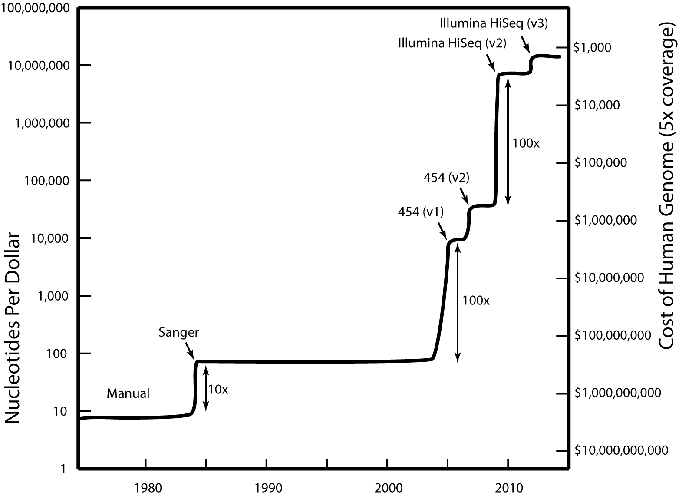
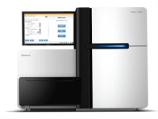
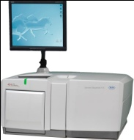
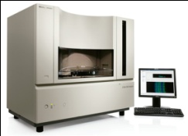
Advances in DNA Sequencing

Slide 3
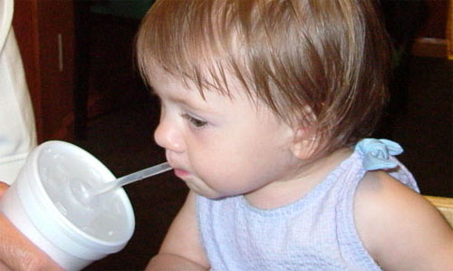
1995

Slide 4

2005

Slide 5

2018

Slide 6
Components of High-Throughput Sequencing
DNA Isolation
Fragmentation
Adapter Ligation
Indexing
Quantification
Isolation
Bead
Flow cell
Well
Amplification
Emulsion PCR
Bridge Amplification
None
Sequencing / Signal Detection
Light
pH
Current
Base Calling
Output File

Slide 7
Emulsion-PCR based Sequencing
454 Sequencing
https://www.youtube.com/watch?v=KzdWZ5ryBlA
Ion Torrent Sequencing
https://www.youtube.com/watch?v=DyijNS0LWBY
Homopolymer error

Slide 8
Illumina
https://www.youtube.com/watch?v=fCd6B5HRaZ8
Search “Illumina Sequencing by Synthesis” in youtube
Sonication/Nebulization
Adapter Ligation
Isolation - Lawn of adapter oligos in flow cell
Bridge Amplification (generate Clusters), Cluster density
Sequencing by synthesis, with competitive nucleotide incorporation (low indel error)
Color used to call base (laser)
Note two sided flow cell
Output depends on platform , up to PE 250bp paired**
Cost per GB: ~$10
Onboard vs. c-bot clustring
2 vs 8 lane flow cells
Cost of machine = $600k+
MiSeq, HiSeq2500, HiSeq3000/4000, HiSeqX, NovaSeq
Patterned Flow Cells

Slide 9
Pacific Biosciences
VIDEO http://www.youtube.com/watch?v=v8p4ph2MAvI
Sonication / Nebulization
Isolation
Sequencing by Synthesis, real-time, single molecule
light detection (colored)
25k reads, each ~1000+ bp
Cost of 1 run = $99
Cost of machine = $800k
PacBio Sequel System now available
7x increase data per run

Slide 10
Oxford Nanopore
VIDEO:
https://www.youtube.com/watch?v=hs0FdiTHMbc
https://www.youtube.com/watch?v=GUb1TZvMWsw
MinION –
USB-key sized sequencer
$1000 for machine
100 pores
2-5kb avg length (max 100kb)
Error rate = 40%
PromethION –
High througput sequencer
144,000 pores

Slide 11
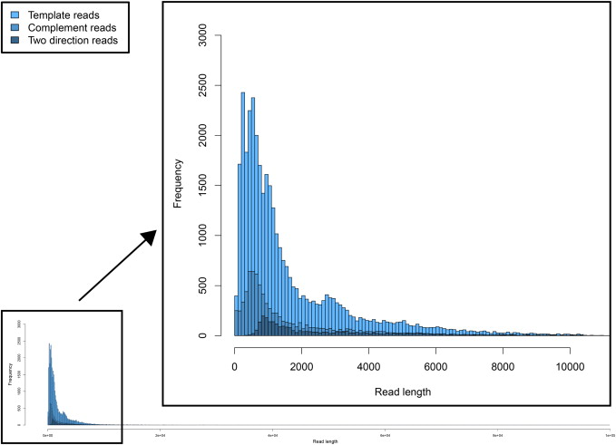
Oxford Nanopore

Slide 12
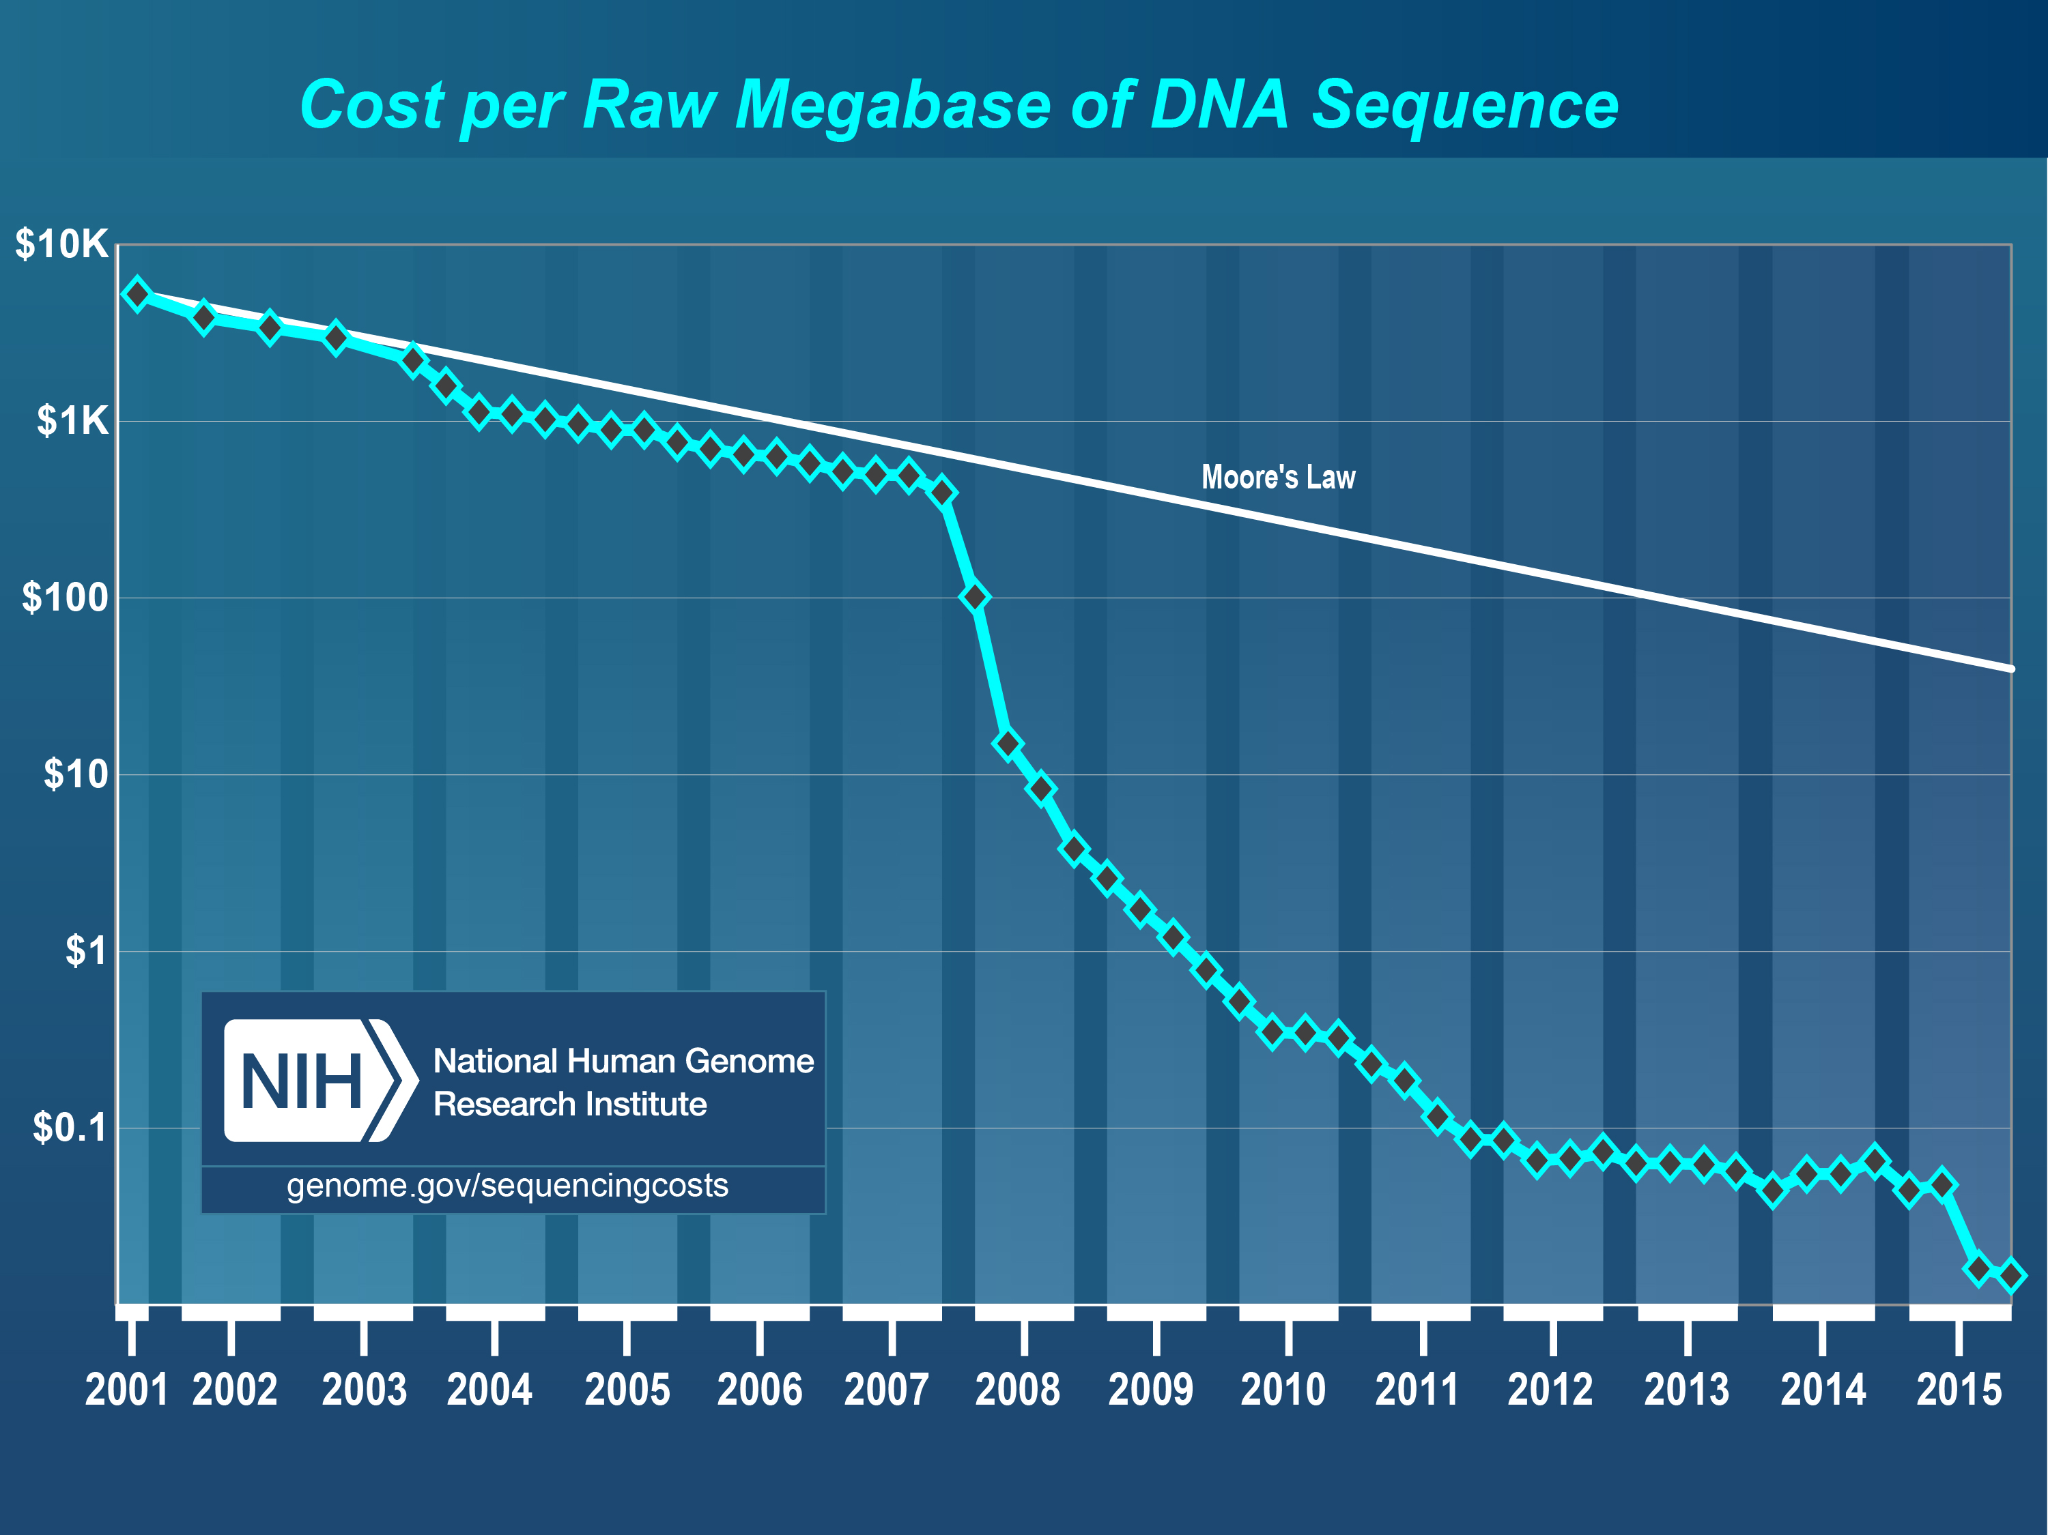
MinION
1000x the price
20x the error
New PacBio
100x the price

Slide 13
Trade-offs
Quantity vs. Read Length vs. Quality
Sources of Constraints
Asynchrony (all multi-molecule sequencers)
Strand confusion
*454 / Ion => multiple library fragments per bead
Illumina => cluster mixing
Low Signal
Pacific Biosciences
Oxford Nanopore
NOTE: Cost constraints shifting from collecting sequence data to library preparation and downstream analysis

Slide 14
Get updates on Sequencing
http://omicsomics.blogspot.com

