Slide 1
File Formats
2020.09.02

Slide 2
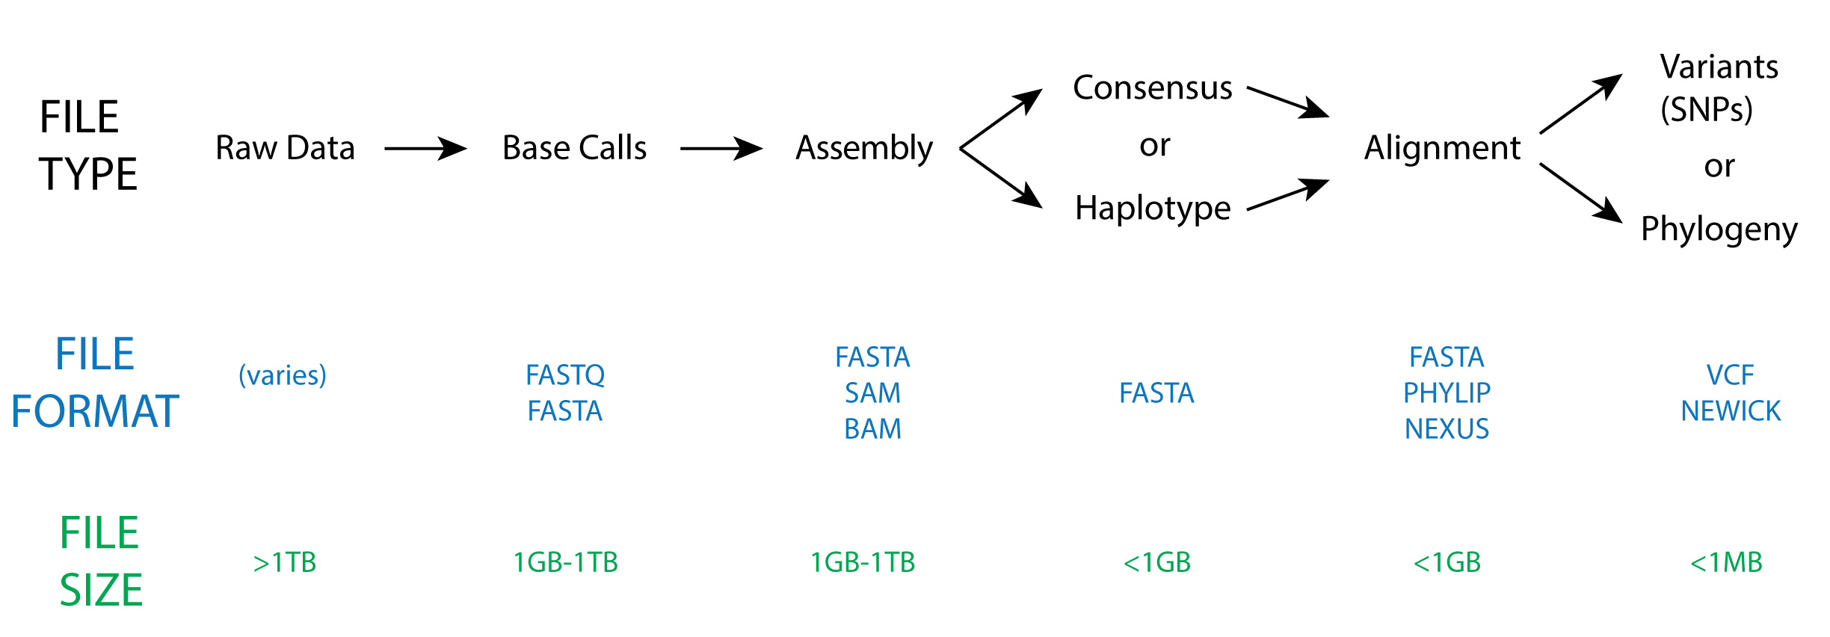
Common File Types and Formats

