Slide 1
End-to-End Machine Learning Pipeline for Real Estate Valuation
Nawaraj Paudel, PhD
Data Scientist and ML Engineer

Slide 2
Real estate tech: Where massive markets meet innovation
Real Estate Market by the Numbers
146 million residential (SFR/MFR) units valued at 43 Trillion USD
Commercial real estate valued at 21 Trillion USD
2 - 8 % of these properties sold every year
Marketcap Comparison
S &P 500 : 45 Trillion USD
NASDAQ 100 : 20 Trillion USD
Tech Transformation: Key Real Estate Domains
PropTech: Real estate markets
ConTech: Construction startups
SmartRealEstate: Intelligent cities and buildings
RealEstateFinTech: Mortage marketplace, Blockchain and smart contracts, Crowdfunding platforms
Collaborative economy

Slide 3
Learning from Zillow: A Multi-Model Approach to Real Estate Forecasting
Zillow: AI Model Concept Drift and Market Dynamics
Zillow's algorithms failed to adapt to changing market conditions, continuing to assume a hot market even as it cooled. The models didn't account for COVID-19 related factors like contractor shortages and shifting suburban preferences
Maintain human oversight for high-stakes decisions and implement gradual scaling rather than aggressive expansion. Create multiple models with different assumptions and use ensemble approaches. Set clear risk thresholds and transaction limits based on prediction confidence levels
A Multi-Layered Strategy for Predictive Modeling
Agile Time Series Analysis for Market Dynamics
Meta Prophet : Quick market trend analysis, Seasonality patterns, Adaptable to market events (COVID-19), Univariate/multivariate modeling in SFR/MFR price prediction
(S)ARIMA(X)(p, d, q, P, D, Q, S): Zip code level seasonality, One-step ahead forecasting, Correlation analysis, Granular market patterns
Advanced Modeling Approach
High accuracy tree-based methods, SVMs, MLPs for
capturing non-linear relationships and complex feature interactions
Deep learning models RNN/LSTM for temporal dependencies

Slide 4
The housing data contains 80 features including 43 categorical features
Dwelling Characteristics
OverallQual: Rates the overall material and finish of the house
YearBuilt: Original construction date
Year Remod/Add: Remodel date
Bedrooms and Bathrooms
Bsmt Full Bath: Basement full bathrooms
Bsmt Half Bath: Basement half bathrooms
Full Bath: Full bathrooms above grade
Half Bath: Half baths above grade
Bedroom: Bedrooms above grade
Property Recommendation
Living Area
1st Flr SF: First Floor square feet
2nd Flr SF: Second floor square feet
Low Qual Fin SF: Low quality finished square feet (all floors)
Gr Liv Area: Above grade (ground) living area square feet
Other Features
Fireplaces: Number of fireplaces
FireplaceQu: Fireplace quality
Garage Cars: Size of garage in car capacity
Garage Area: Size of garage in square feet
64 other features
Sale Price Prediction

Slide 5
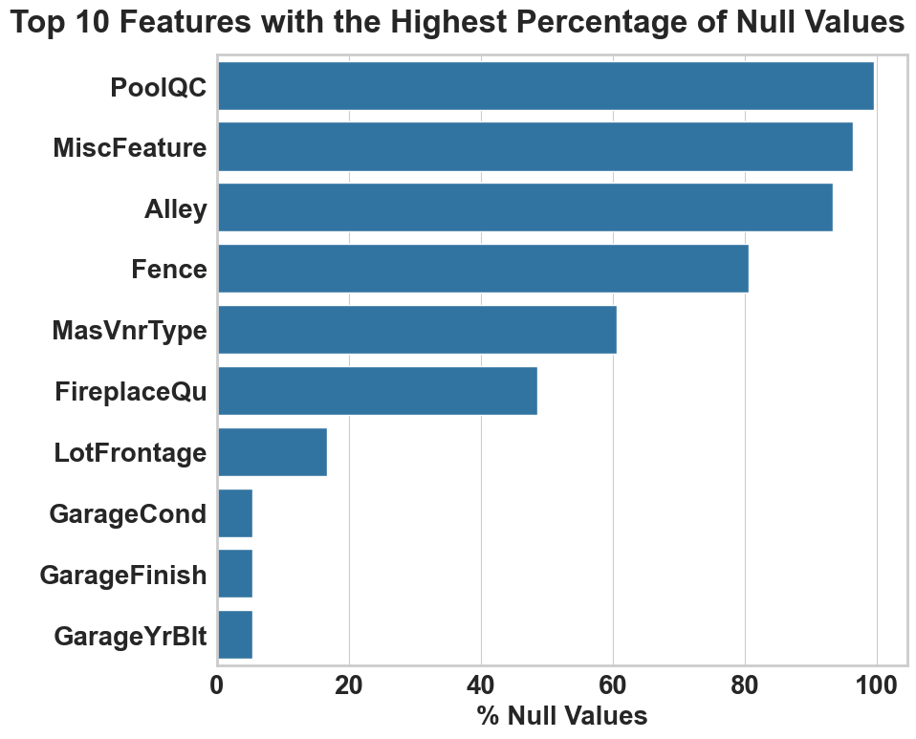
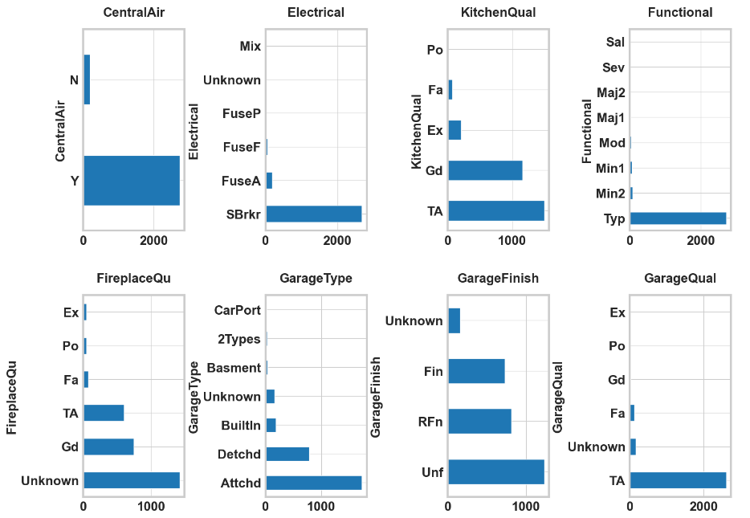
Missing data were labeled ‘unknown’ for categorical features
If a categorical predictor had more than 10% missing values, a new category called 'Unknown' was created. For predictors with less than 10% missing values, they were imputed with the most frequent category.

Slide 6
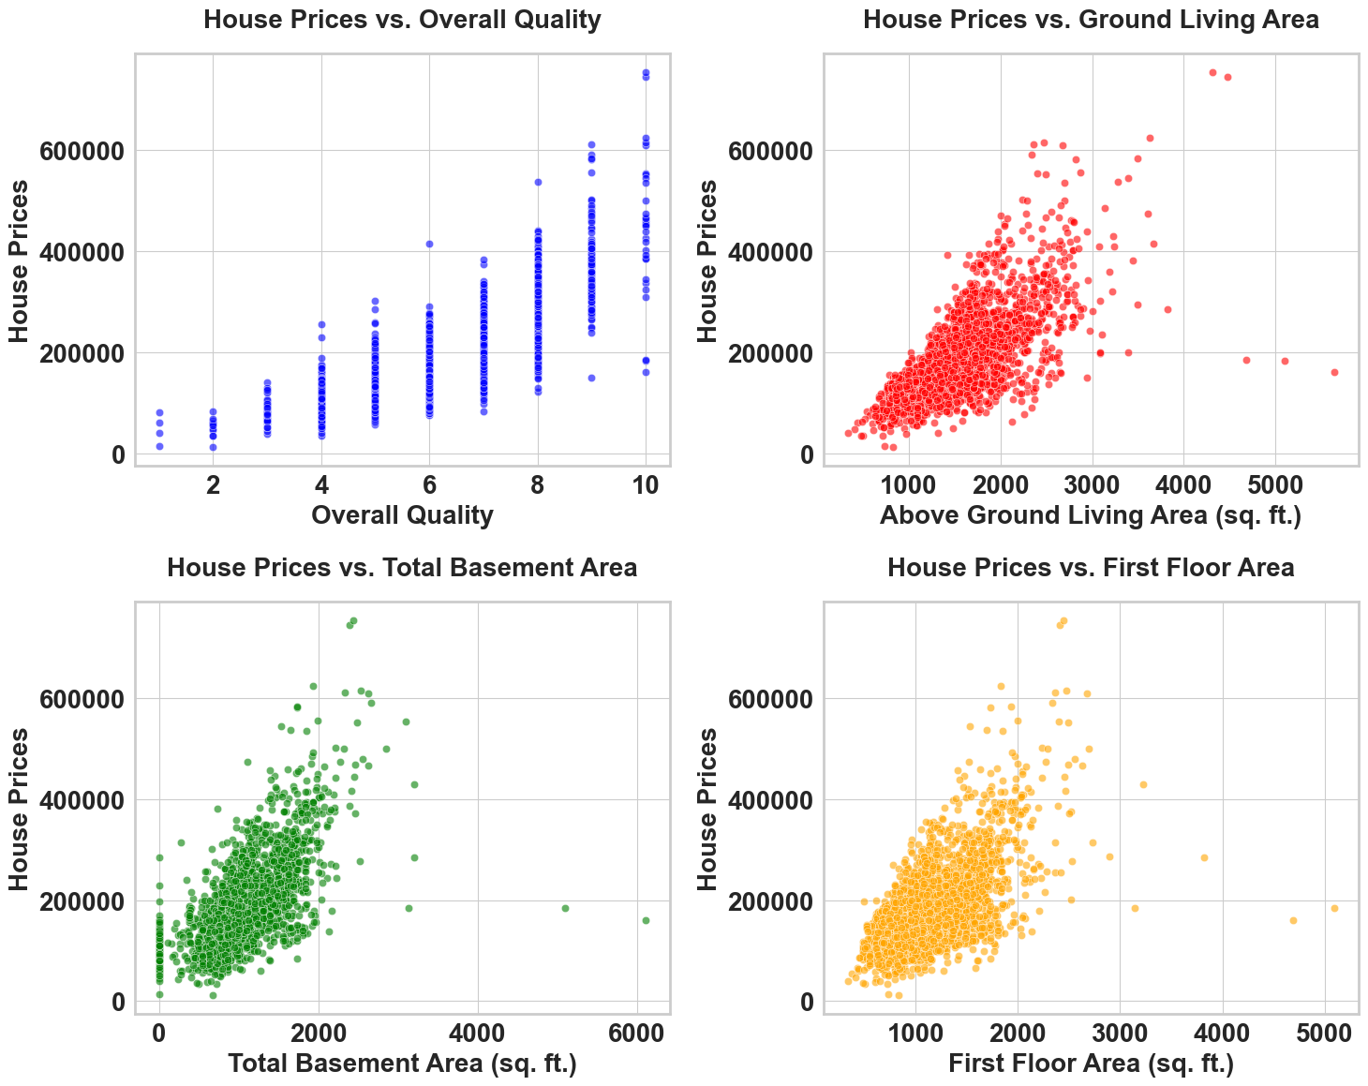
House prices have linear relationship with area and quality
The house price increases with quality and area of the house
The rate of change of house price is steeper for total basement area
There are price ranges for same quality and area stemming a fan like structure more pronounced in ‘AboveGround Living Area’ and ‘First Floor Area’
There are some outliers in area features

Slide 7
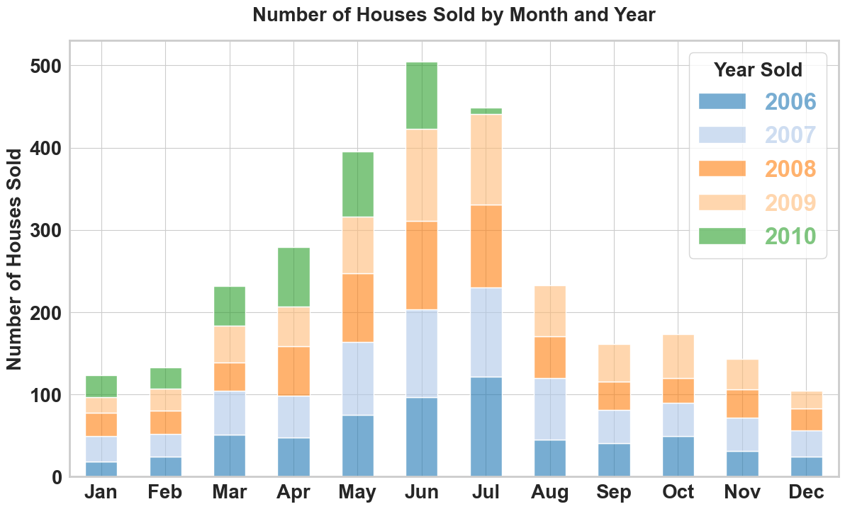
Q2/Q3: Peak season for home sales
House Sales Seasonal Trend
Sales start increasing in May and peaks in June
Lowest transactions occur at the end of the year and extend into the first two months of the following year

Slide 8
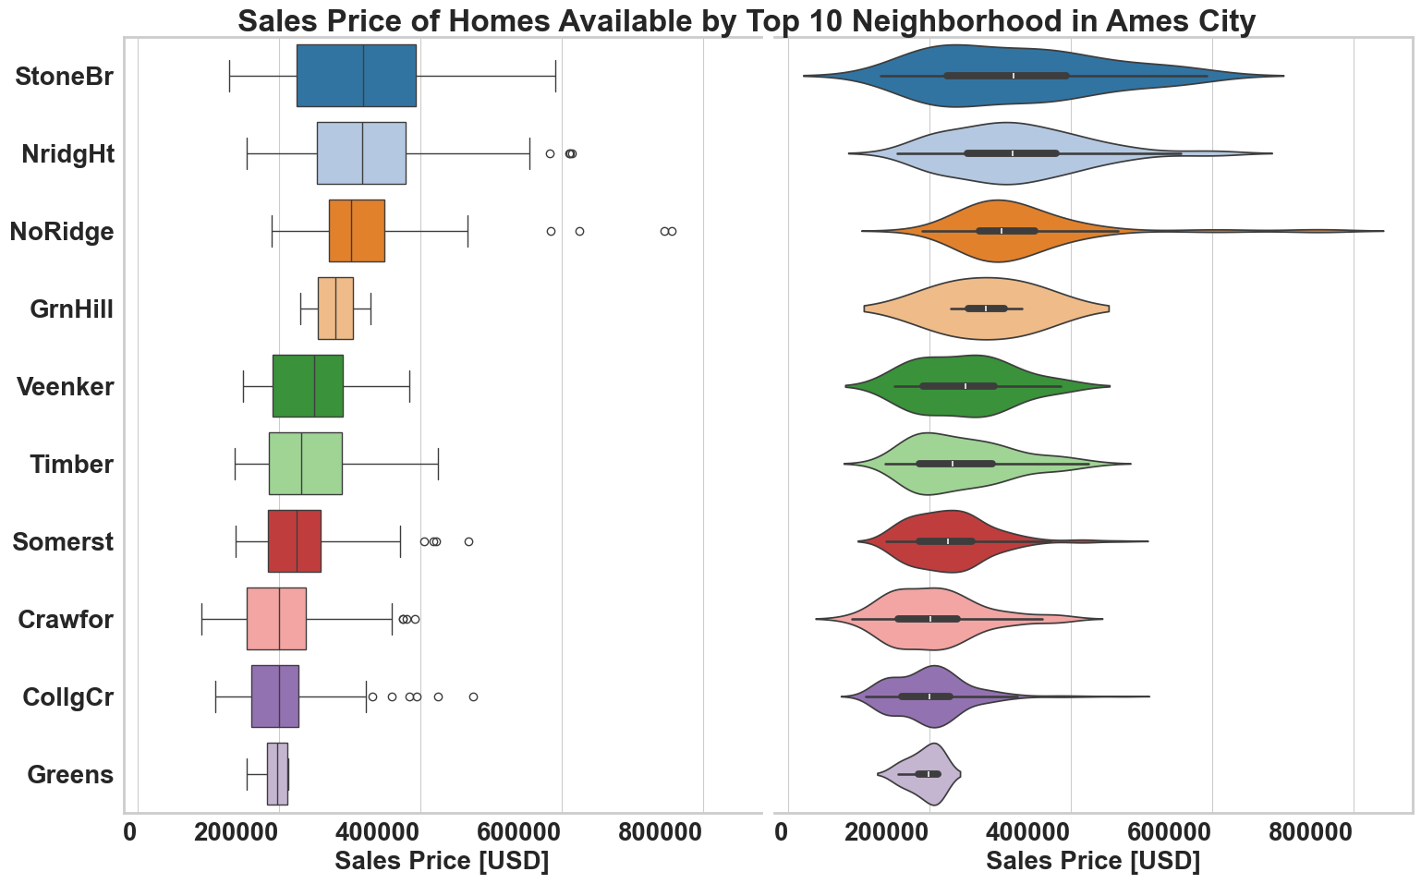
Neighborhood-based median house prices
House prices in some neighborhoods start from as low as $200K, while the highest-priced neighborhoods can reach up to $600K
Median house prices vary depending on the neighborhood
Certain neighborhoods exhibit outlier house prices, with some properties significantly deviating from the median range

Slide 9
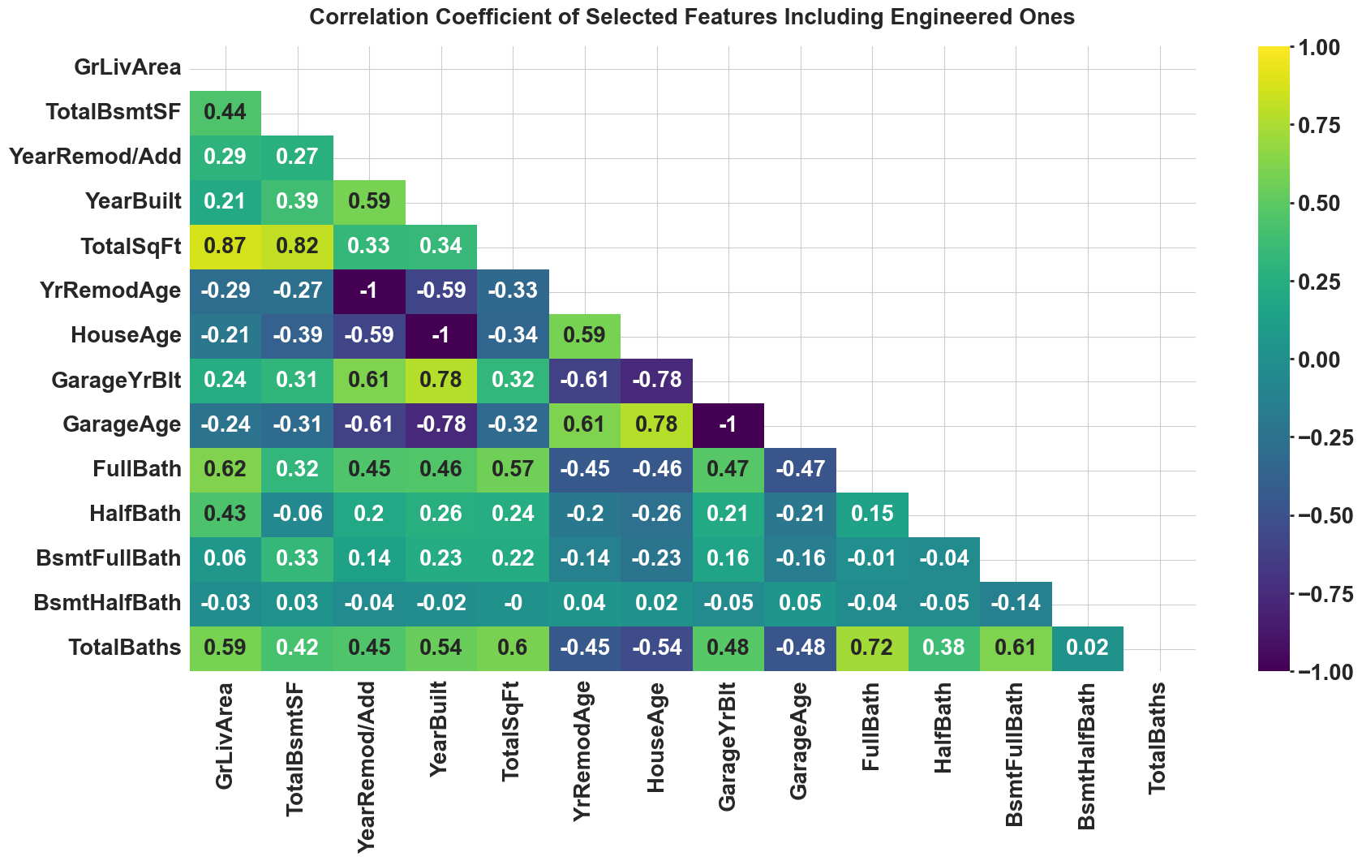
Engineered features are highly correlated with original features
Engineered Features
TotalBaths
HouseAge
YearRemodAge
TotalSqFt
Features | VIF
TotalSqFt | 3201.15
BsmtFinSF1 | 1021.55
BsmtUnfSF | 954.11
2ndFlrSF | 915.30
1stFlrSF | 755.71
BsmtFinSF2 | 145.64
LowQualFinSF | 11.83
GarageCars | 5.60
GarageArea | 5.44
TotRmsAbvGrd | 4.50
HouseAge | 4.49
GarageAge | 3.20
TotalBaths | 3.04
YrRemodAge | 2.37

Slide 10
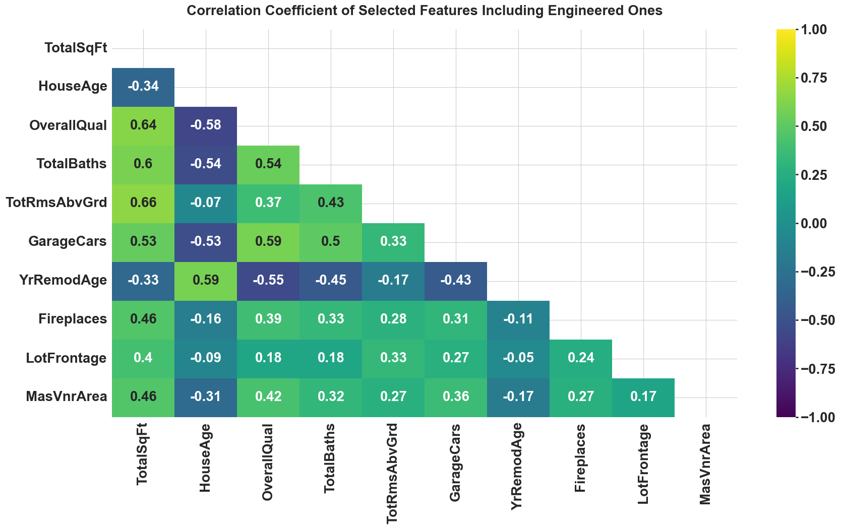
The top 10 numerical features were selected for modeling, ensuring the most impactful variables are used for accurate predictions
Feature | F-Score | P-Value
OverallQual | 4342.9792 | 0.000000
TotalSqFt | 3873.3856 | 0.000000
GarageCars | 1752.9074 | 0.000000
TotalBaths | 1709.5729 | 0.000000
GarageArea | 1665.5998 | 0.000000
1stFlrSF | 1519.5015 | 0.000000
HouseAge | 1053.7745 | 0.000000
YrRemodAge | 939.3147 | 0.000000
GarageAge | 817.7759 | 0.000000
MasVnrArea | 806.9772 | 0.000000
TotRmsAbvGrd | 736.0766 | 0.000000
Fireplaces | 718.7684 | 0.000000
BsmtFinSF1 | 543.6743 | 0.000000
WoodDeckSF | 317.1991 | 0.000000
LotFrontage | 280.3683 | 0.000000
Variable | VIF
TotalSqFt | 3.55
HouseAge | 3.42
OverallQual | 2.77
TotalBaths | 2.10
YrRemodAge | 1.94
TotRmsAbvGrd | 1.93
GarageCars | 1.90
Fireplaces | 1.41
MasVnrArea | 1.36
LotFrontage | 1.36

Slide 11
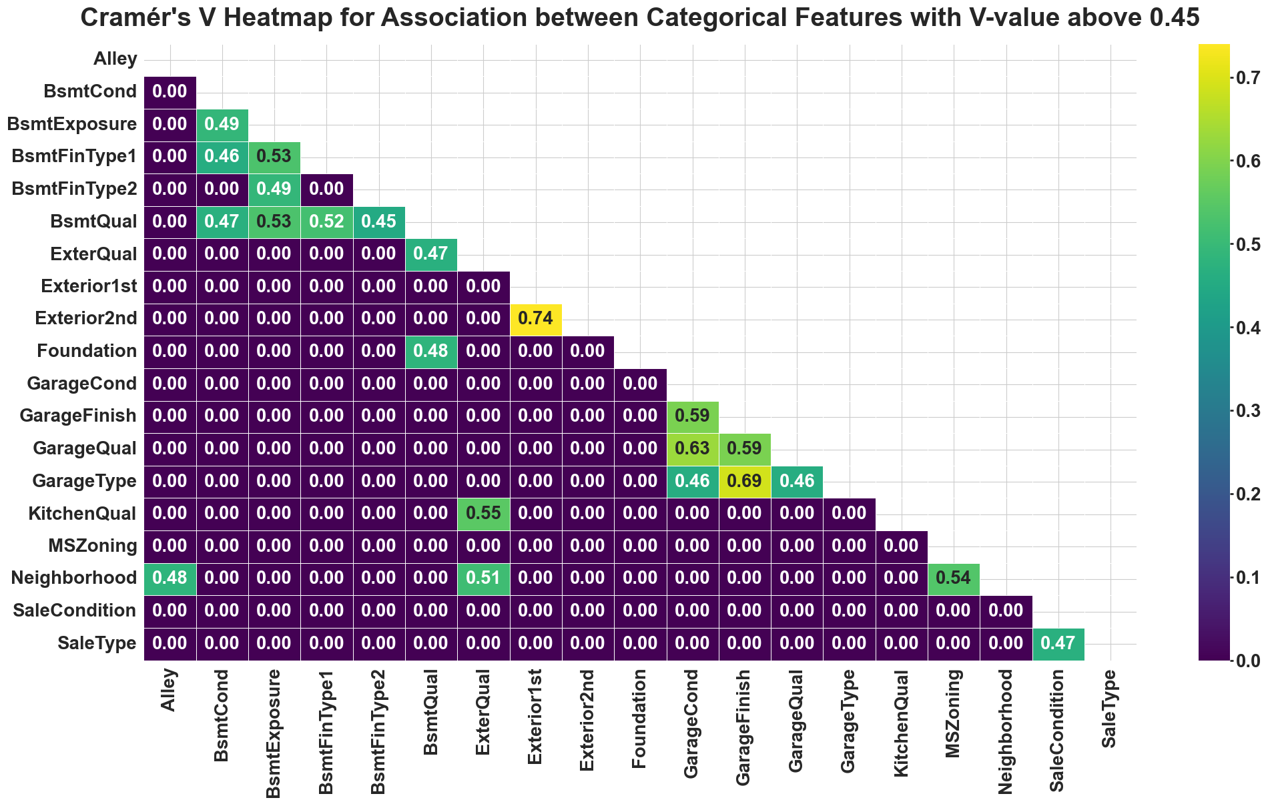
The top 4 categorical features were selected using ANOVA and Cramer's V
ANOVA Test
Categorical Column | F-value | P-value
ExterQual | 808.16 | 0
KitchenQual | 555.20 | 0
BsmtQual | 489.49 | 0
GarageFinish | 341.35 | 1.30E-185
FireplaceQu | 220.99 | 1.81E-195
CentralAir | 194.12 | 1.52E-42
Foundation | 186.77 | 3.43E-169
HeatingQC | 161.99 | 2.40E-123
MasVnrType | 133.61 | 1.70E-103
GarageType | 130.70 | 4.59E-144
BsmtExposure | 130.08 | 5.58E-101
BsmtFinType1 | 117.58 | 5.55E-131
Neighborhood | 117.23 | 0

Slide 12
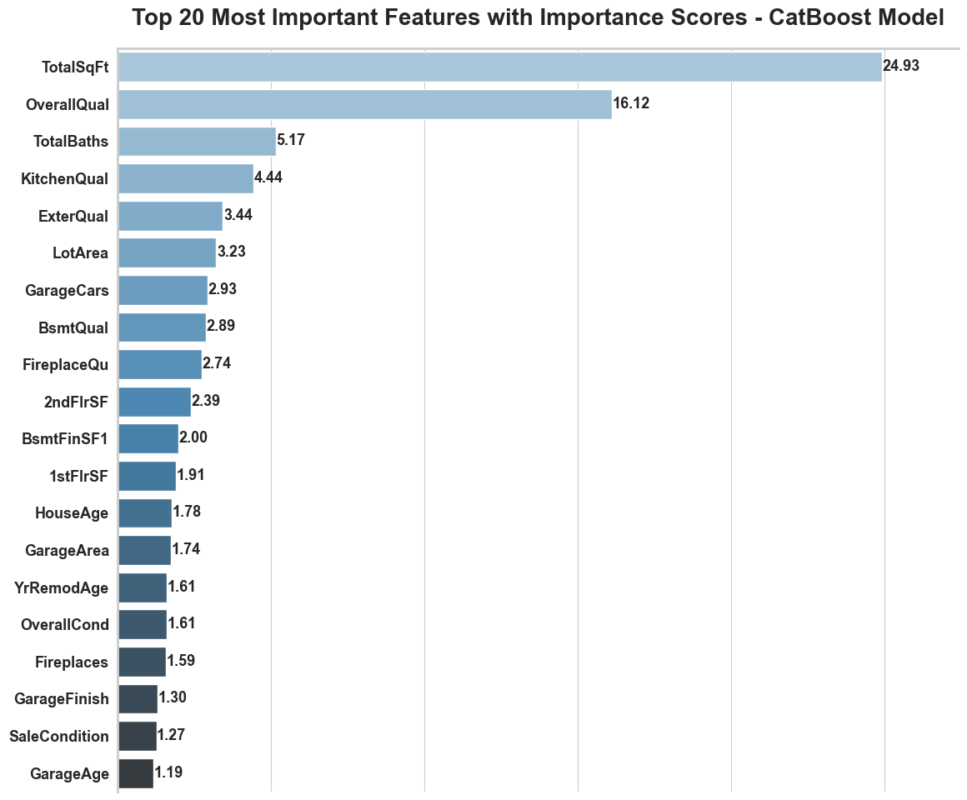
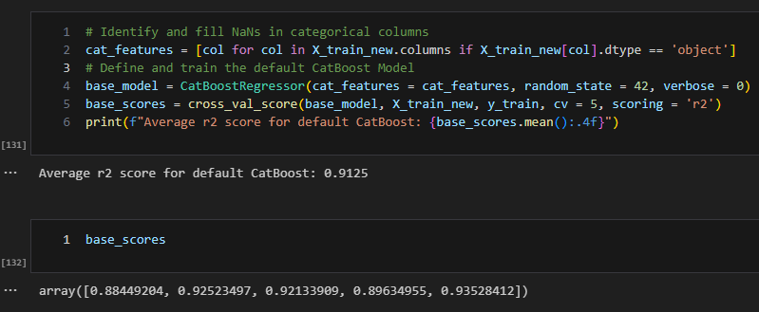
Minimum viable product (MVP): CatBoost trained with all features
TotalSqFt and OverallQual emerged as the most significant features, contributing over 40% to the model's predictive power
Over 10 features individually contribute 1 - 2% to the model's predictions
The CatBoost model, trained with default parameters and using all input features, achieved an average out-of-fold (OOF) R2 score of 91.25%

Slide 13
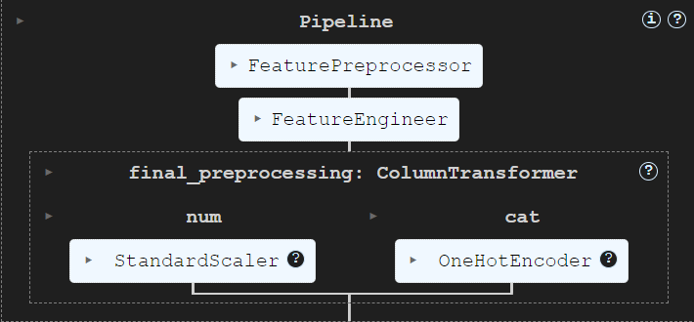
Automated preprocessing pipeline
Feature Preprocessor
Data loading, column names normalization and data validation
Handles missing values using median imputation for numeric features and 'Unknown' for categorical features
Consolidates rare categories based on threshold (merges categories < 8% into 'Other')
Feature Engineer
Creates engineered features: TotalSqFt, HouseAge , TotalBaths, and YrRemodAge
Automatically drops original features after engineering new ones
Final Column Transformers
Numeric Pipeline: Applies StandardScaler to normalize all numeric features
Categorical Pipeline: Uses OneHotEncoder with drop = 'first' and handle_unknown = 'ignore' for categorical variables
Pipeline(steps=[('initial_preprocessing', FeaturePreprocessor(categorical_features=['Neighborhood', 'FireplaceQu', 'KitchenQual', 'BsmtExposure'], numeric_features=['YearRemodAdd', 'YrSold', 'Fireplaces', 'LotFrontage', 'GarageCars', 'MasVnrArea', 'BsmtFullBath', 'GrLivArea', 'BsmtHalfBath', 'YearBuilt', 'OverallQual', 'TotalBsmtSF', 'HalfBath', 'FullBath', 'TotRmsAb... Pipeline(steps=[('scaler', StandardScaler())]), ['OverallQual', 'TotRmsAbvGrd', 'GarageCars', 'Fireplaces', 'LotFrontage', 'MasVnrArea', 'TotalSqFt', 'HouseAge', 'TotalBaths', 'YrRemodAge']), ('cat', Pipeline(steps=[('onehot', OneHotEncoder(drop='first', handle_unknown='ignore', sparse_output=False))]), ['Neighborhood', 'FireplaceQu', 'KitchenQual', 'BsmtExposure'])]))])

Slide 14
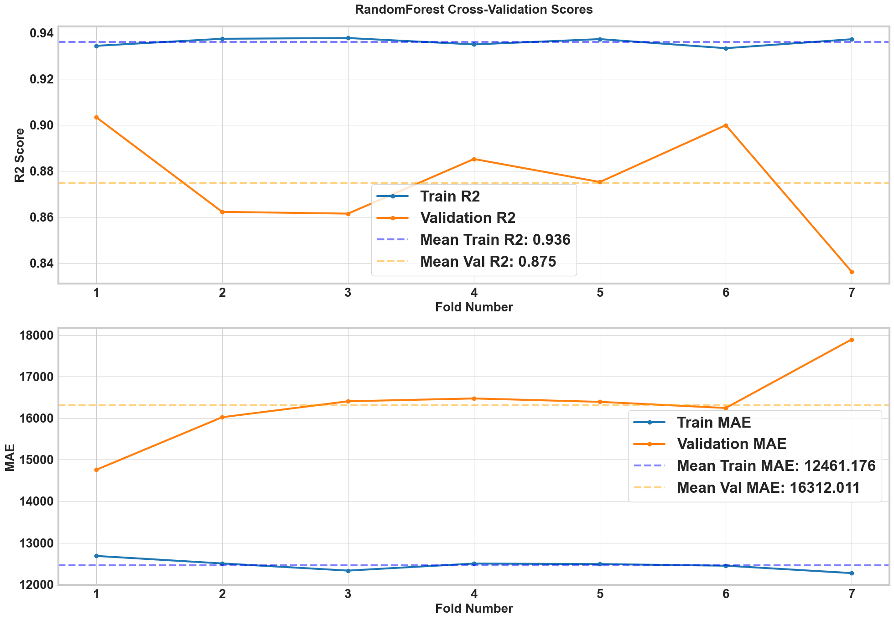
Cross validation shows slight variation in OOF prediction

Slide 15
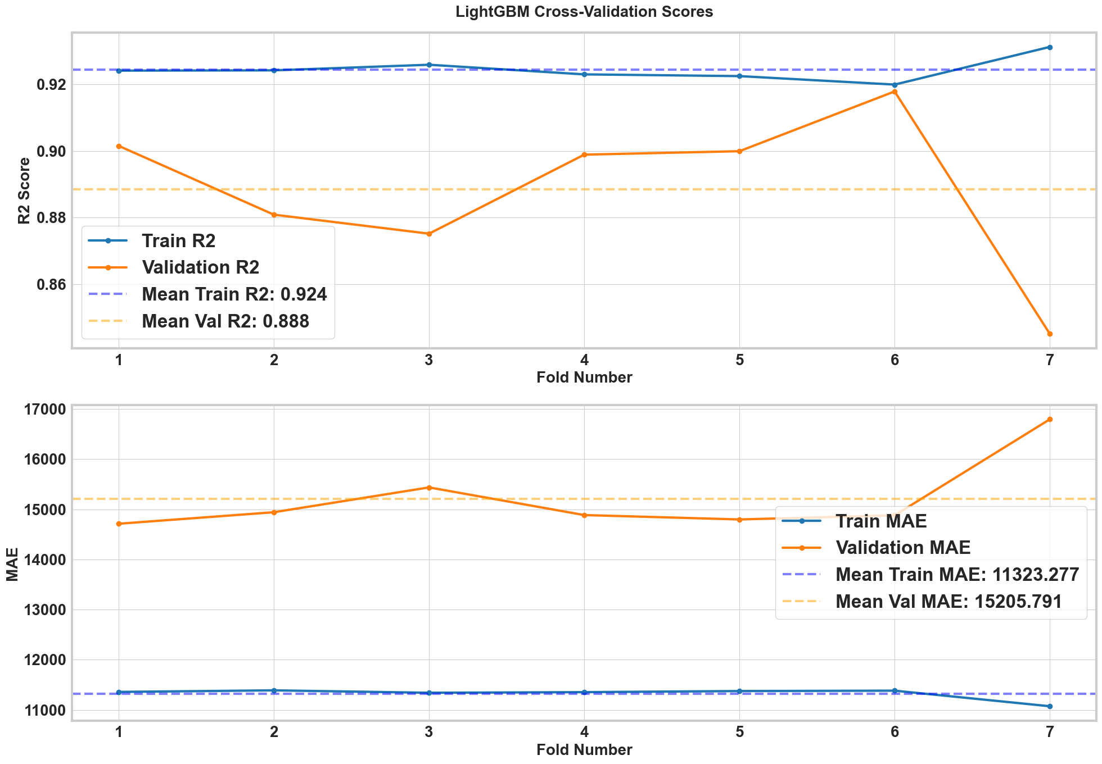
Cross validation shows slight variation in OOF prediction

Slide 16
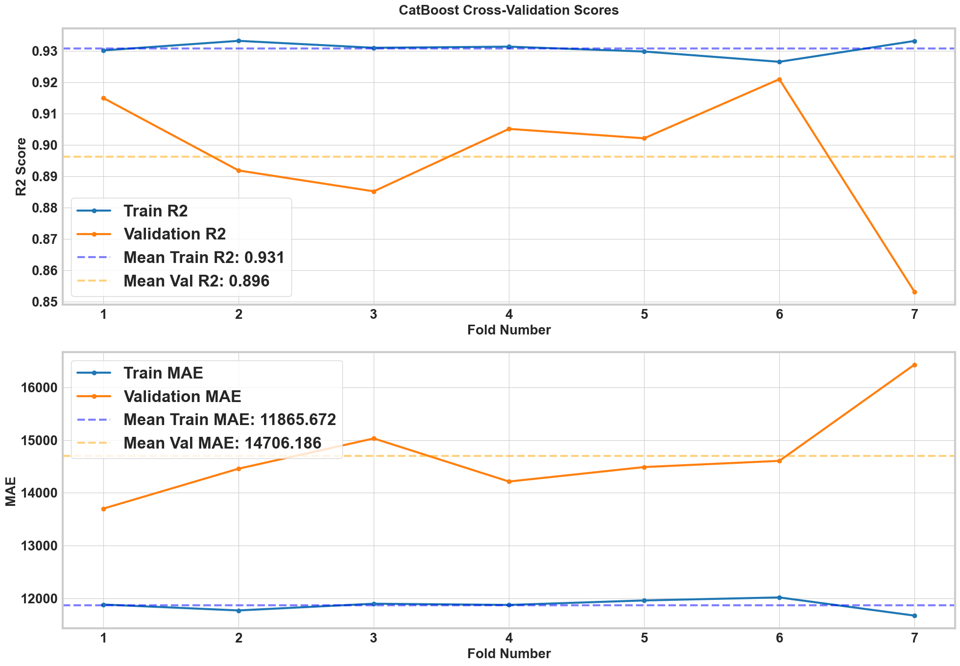
Cross validation shows slight variation in OOF prediction

Slide 17
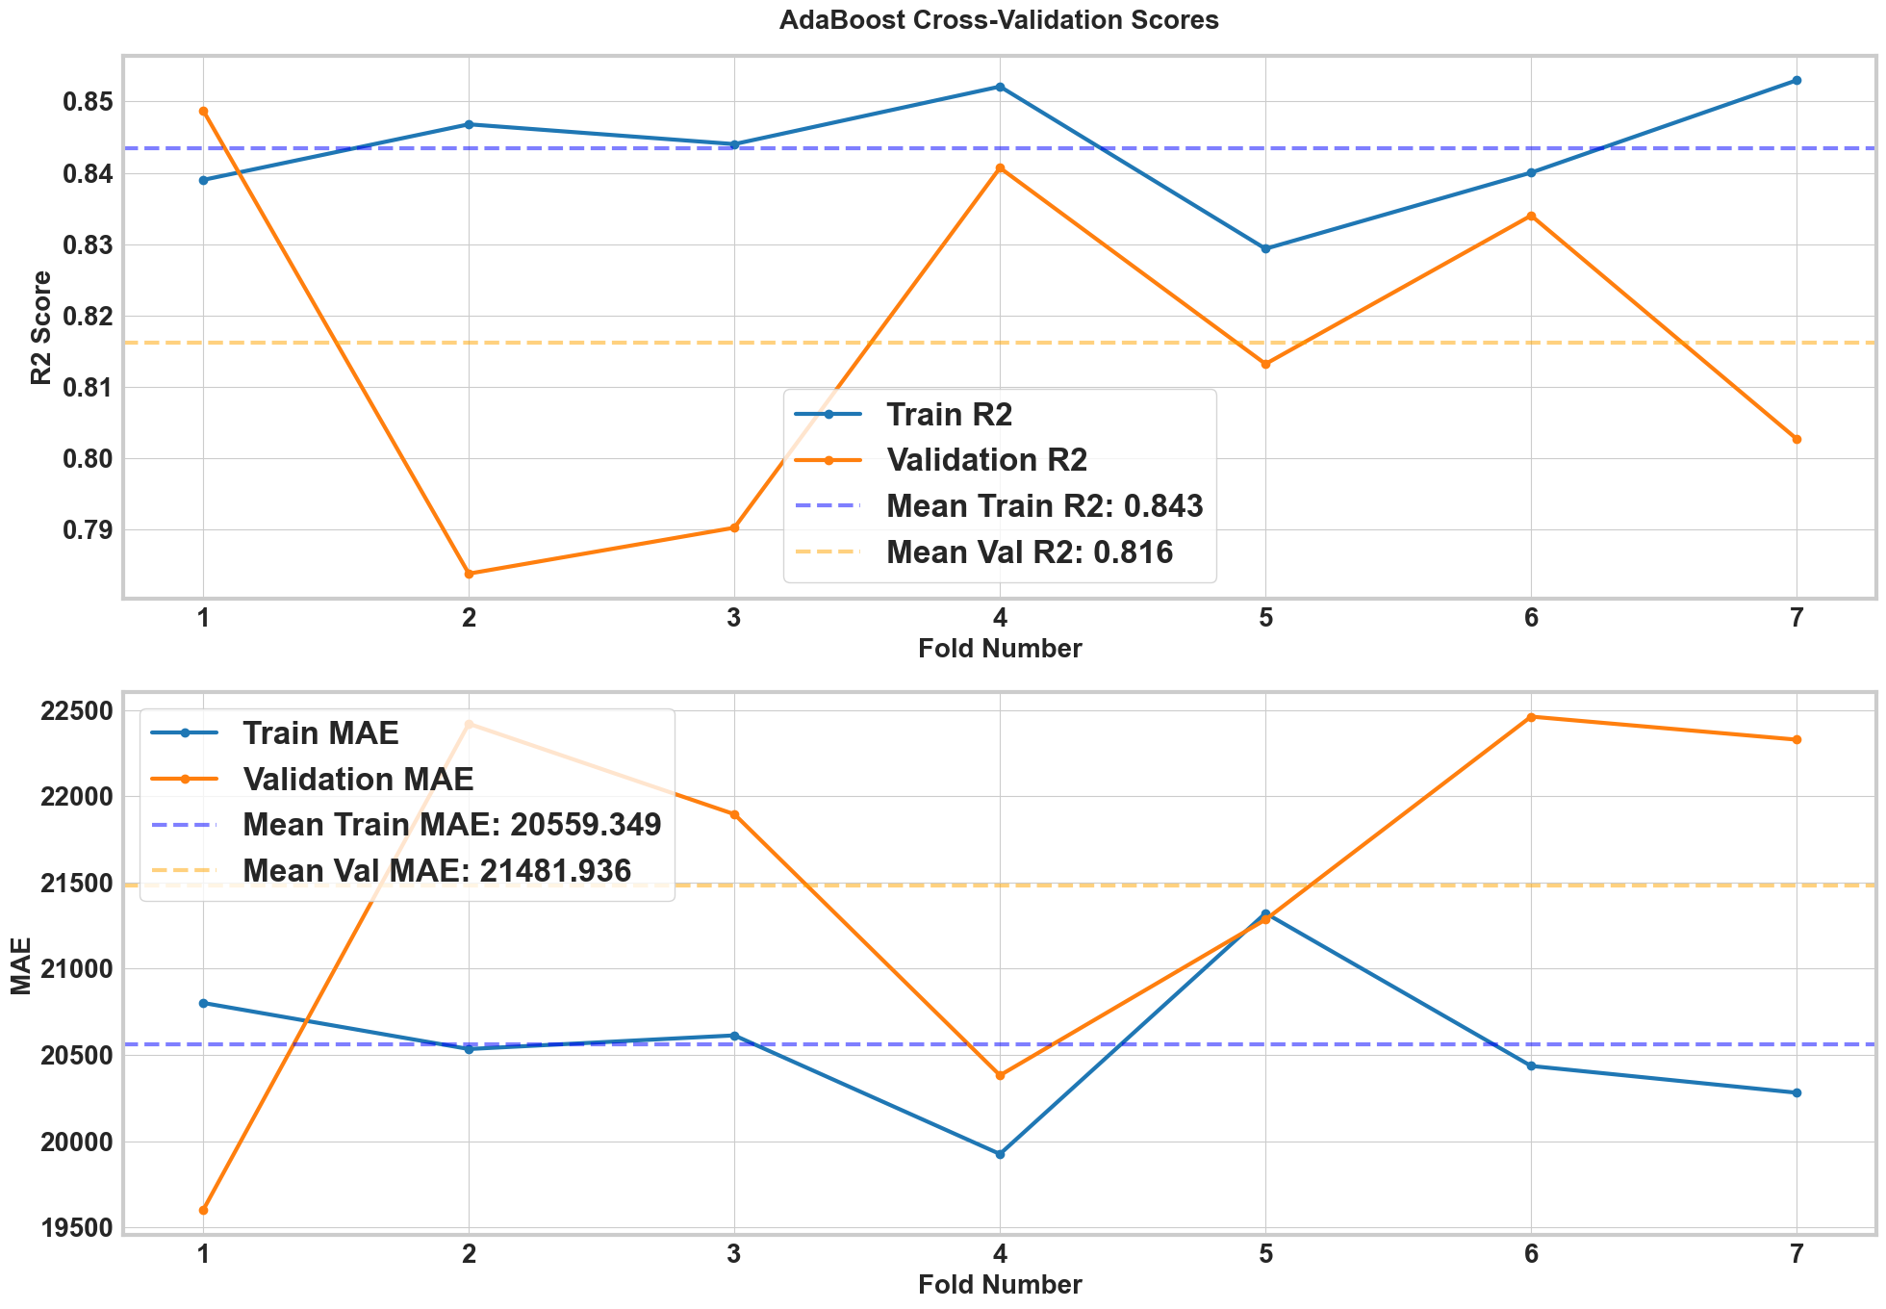
Cross validation shows slight variation in OOF prediction

Slide 18
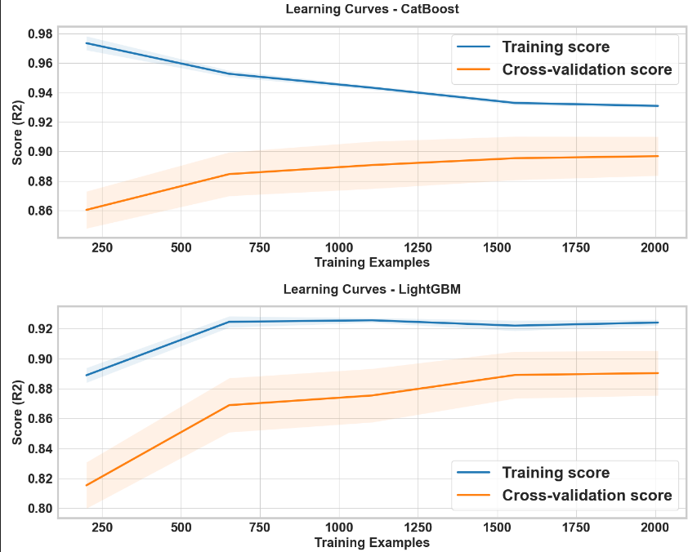
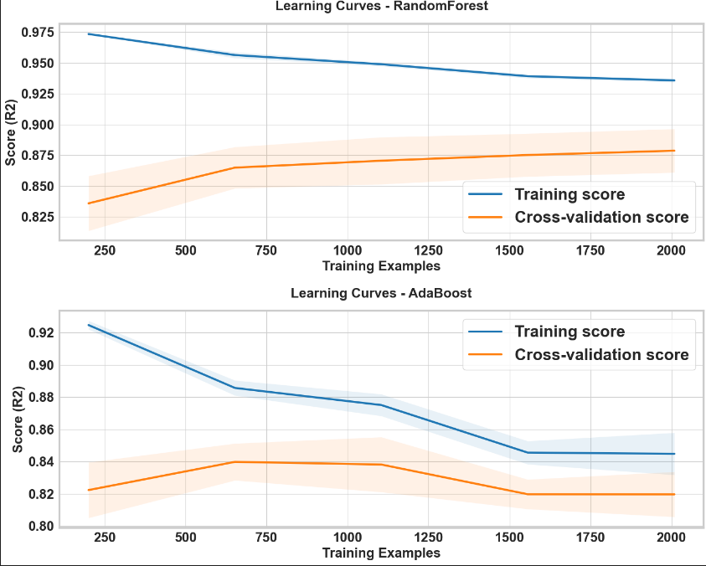
All models stabilize for sample sizes above 1500, but they consistently overfit

Slide 19
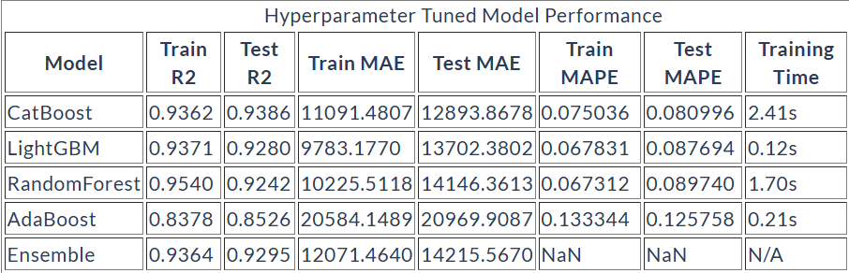
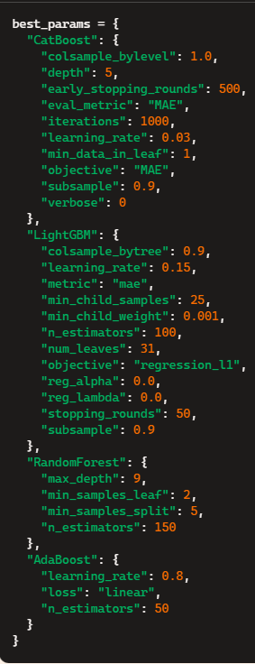
LightGBM excels in both predictive power and training compute; CatBoost offers slightly enhanced predictive capabilities
Training Compute vs Performance Trade-off
LightGBM emerges as the most efficient model with just 0.12s training time while maintaining strong performance (R² 0.928, MAE 13702)
CatBoost achieves the best test accuracy (R² 0.939) but requires 20x longer training time (2.41s) than LightGBM
RandomForest's higher training R² (0.954) comes at the cost of longer training time (1.70s), suggesting potential overfitting
The choice between CatBoost and LightGBM would depend on whether the 1% improvement in test R² justifies the 20x increase in training time

Slide 20
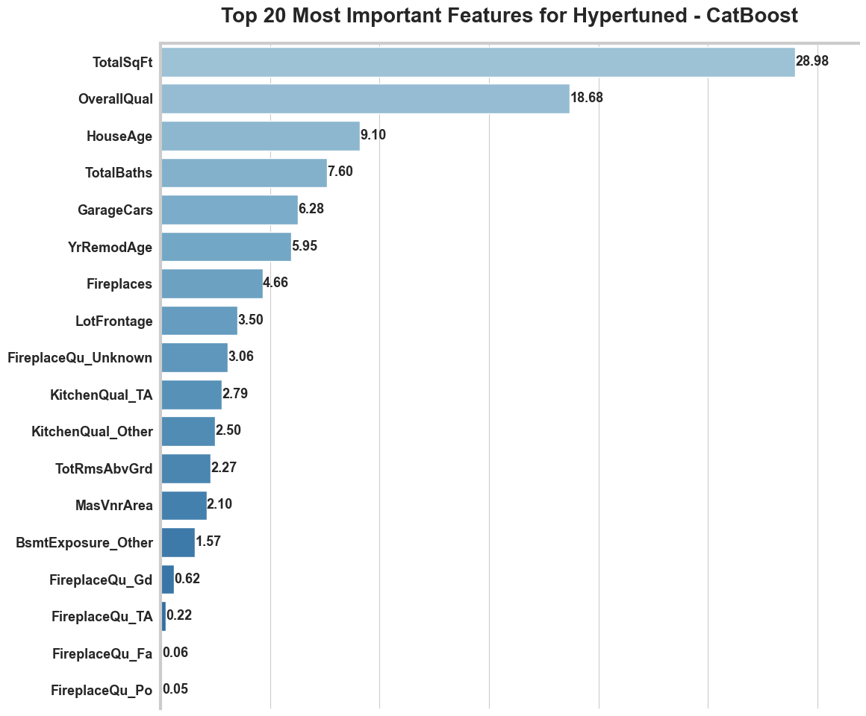
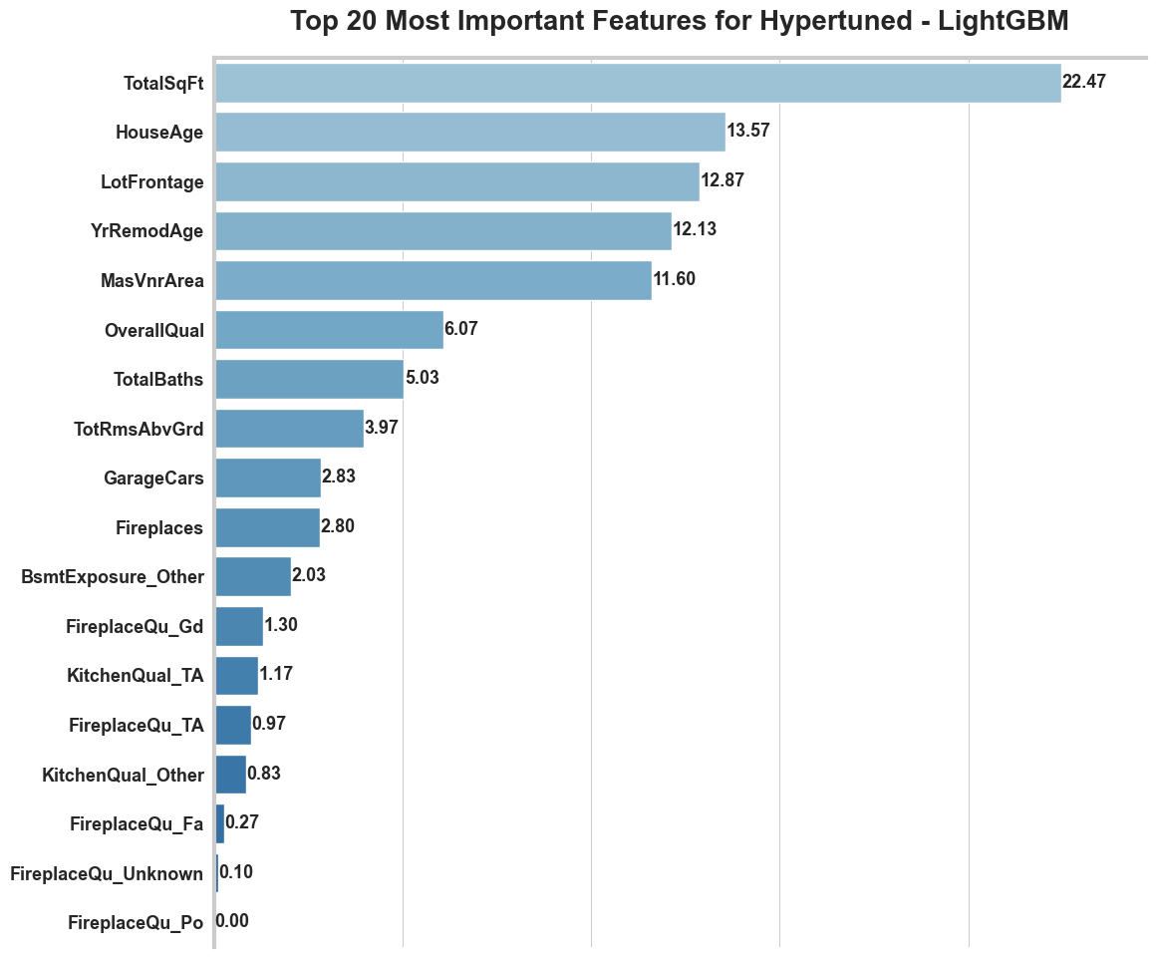
Feature importance: How different models tell different stories
CatBoost emphasizes quality metrics: OverallQual, TotalBaths, and KitchenQual rank higher. LightGBM gives more weight to physical attributes: LotFrontage and MasVnrArea show much higher importance
Notes:
Top Feature Agreement & Disagreement: While TotalSqFt ranks #1 in both models, its relative importance varies significantly (29% in CatBoost vs 22% in LightGBM) OverallQual shows dramatic difference: 2nd most important in CatBoost (19%) but drops to 6th in LightGBM (6%) HouseAge importance nearly inverts: 3rd in LightGBM (14%) vs 9% in CatBoost Model-Specific Emphases: CatBoost emphasizes quality metrics: OverallQual, TotalBaths, and KitchenQual rank higher LightGBM gives more weight to physical attributes: LotFrontage and MasVnrArea show much higher importance YrRemodAge shows stronger influence in LightGBM (12%) compared to CatBoost (6%) Practical Implications: Model choice significantly affects feature interpretation Core features (TotalSqFt) remain important regardless of model Secondary features show high variability between models, suggesting careful model selection is crucial for specific use cases

Slide 21
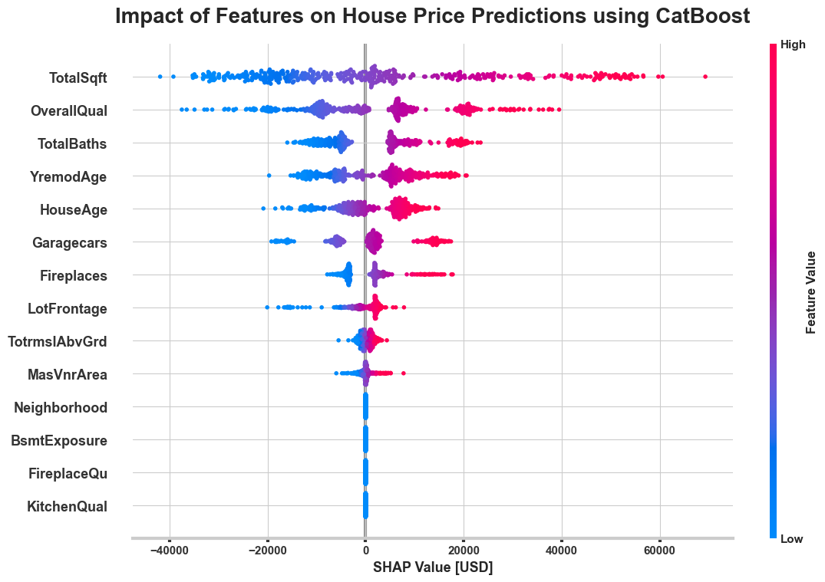
$$ value impact: What each home feature adds ?
Total Square Footage (TotalSqft) has the largest impact range (~60K USD) and shows consistently positive influence for larger values
Overall Quality (OverallQual) is the second most influential feature, with higher quality scores strongly driving up prices
Neighborhood and quality-related categorical features (KitchenQual, FireplaceQu, BsmtExposure) show clustered impacts

Slide 22
Potential Directions
LLMs in Proptech: Utilizing LLMs to scan and extract valuable information from property and legal documents, enhancing property transaction efficiency.
Foreclosure Predictions: Implementing AI models to forecast foreclosure risks and assess buyer preparedness after listing a property for sale.
Image Analysis for Property Assessment: Using AI – computer vision – for image analysis to detect property damages, aiding in accurate property valuation.
Proactive Real Estate Services: Collaborating with banks and mortgage lenders to create databases tracking mortgage defaults, offering proactive property management.
AI/ML as SaaS: Providing AI and ML technologies as a service to the real estate sector, enabling unprecedented insights and operational efficiency.

Slide 23
Discussion & Questions
I appreciate your time and welcome any questions !!!

