Slide 1

Title of Slideshow

Slide 2
Title of Slideshow
With a long winded tag line below the title to explain the show or anything else you need.
Your name and degrees

Slide 3
A non-profit think tank working to increase understanding of how people build knowledge and motivate engagement in social justice, so all people can live life to the fullest in harmony with a thriving biosphere.
Facing Society’s Grand Challenges Head On

Slide 4

Facing Society’s Grand Challenges Head On

Slide 5
One or two words

Slide 6
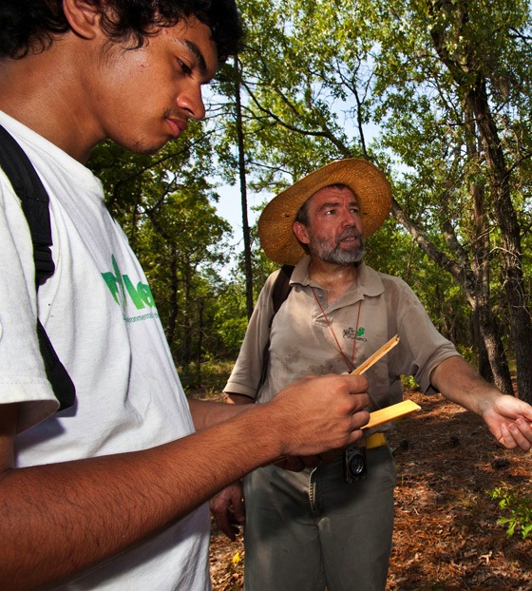
Vertical picture with title

Slide 7
This is a page including a quote from someone we interviewed that we think captures all of their ideas, or emotions or anything that takes them a long time to say sumthin’ utility-like.
“
“
”

Slide 8
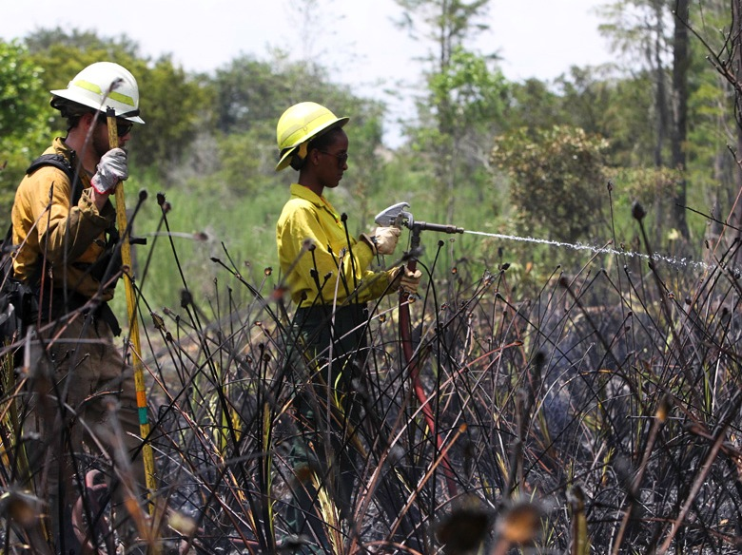
Title on Picture
Photo credit

Slide 10

Credit: Dave Herholz / Flickr Creative Commons

Slide 11
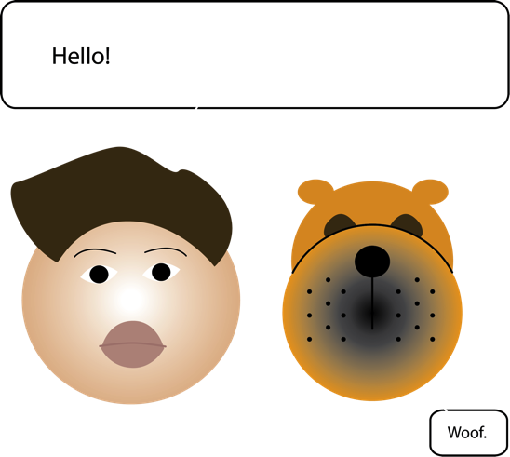

Slide 12
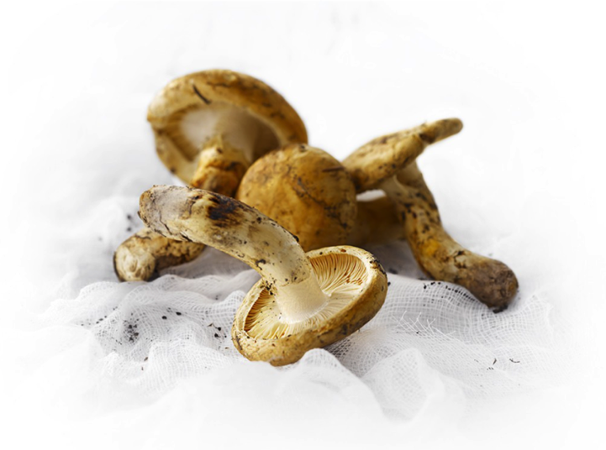
Notes:
When we consider how we actually study how people come to develop their environmental identity and choose to act in ways that protect nature, we recognize that there are multiple interrelated factors that all contribute to an outcome. In this case, we used a Structural Equation Model to consider the variables that emerge over time that leads volunteers at conservation organizations to change their behaviors over time.
If we really want

Slide 13
Bullet list
This is the big set of words
Second level
Third level
Fourth level
Fifth level

Slide 14
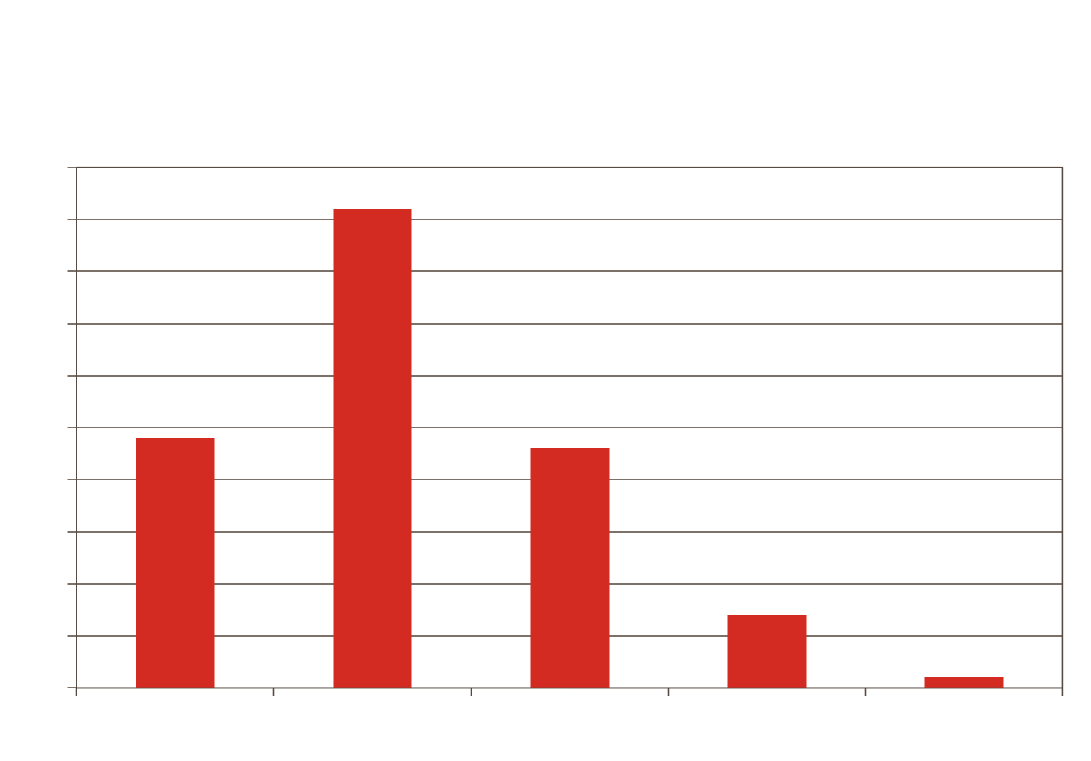
Swim & Fraser (2014)

Slide 15

Graphic with Sur-Title

Slide 16


Lots of words that need to explain something that isn’t self evident
Concerned about
Looking stupid
Concerned about
audience disinterest

Slide 17
Frequency and types of public discussion

Slide 18
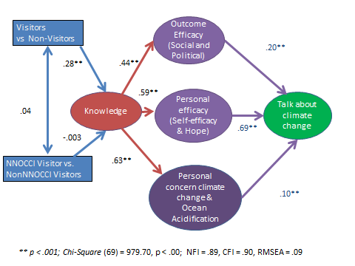
Proposed model

Slide 19
Illustration of an idea
Work Dyad 1
Conservation Colleagues
Work Dyad 2
Friends
Trainees
Community of Practice
Work Dyad 3
Visitors/Guests
Work Dyad 4

Slide 20
More bullet examples
1) More discussions
2) More effective discussions using framing
3) Personal understanding of CC improved
4) Readiness & likelihood of actions increased
Notes:
Spring 2014 cohort: Greater changes for coworkers than friends and family
Fall 2014 cohort: Sometimes no difference (1 and 2), sometimes friends and family greater (2, 3, 5), sometimes coworkers greater (4)

Slide 21
Thanks |
JFraser@NewKnowledge.org

