Slide 1



Slide 2
VIDEO v/s SMARTPHONES. IT IS ON!

Slide 3
TRUST IS WHERE IT STARTS, AND ENDS.
Video has many applications. What kills more than half of them is trust deficit. That’s where the tech with the cape chips in.
Picture this: a university is raided by goons, scores are injured and terrorised. Even years later, perpetrators are at large. Could there be video proof of the otherwise well-documented incident that could help? Perhaps yes. Would it stand ground on tech scrutiny for authenticity? Perhaps not.
If only some folks had the Ravi Reporter on their phones! Use state of the art technology for safe, secure and authenticated videos.
Every smartphone has a camera to record a video. We can offer trustable GPS Tagging and Bluetooth witnesses with ACR. Kill doubts, not trust. Start?

Slide 4
THE SAFEST PLACE. WELL, ALMOST.
Privacy matters, and why won’t it? When was the last time you wondered after syncing your content on the cloud – ‘is it safe?’ Well, each time to a certain degree with a certain degree of uncertainty.
Now picture this: encryption keeps all your videos as safe as safe can be on cloud, with only the key being on your device. Already getting ideas on what to shoot next? Go on, rest assured, that’s where the tech with the cape chips in. With anonymity built in as a standard feature riding the encryption. And time and place markers for verifications when needed.
Safe to say, it doesn’t get safer than this. Did we just convert you? Well, almost!

Slide 5
SMART IS AS SMART DOES.
Smartphones have triggered a tsunami of content creators. And video is in. However, they are only as smart as the people using them. While sharing triggers endorphins, privacy breaches sometimes can ruin lives and how! Couldn’t agree more?
Consider this: while you’ve chosen the smartest device around and the choice wasn’t that difficult to make, why is the choice of tech that protects what you create not so obvious a choice to make?
Default is definitely not a smart choice. Smart choices are fuelled by knowledge that influences decision making. That’s where the tech with the cape chips in. Its intuitive user interface and robust security architecture ensure ‘dumb and dumber’ is only a movie. Not the choices you make. Now it’s your turn!

Slide 6
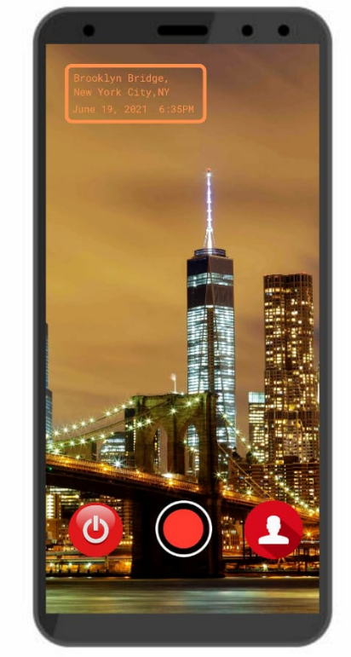


PRODUCT OVERVIEW
Shoot videos with usable Anonymity and Privacy - each video has authenticated GPS place and time tagging
Private mode: The default recording mode
Anonymous mode: Phone pretends to be out of battery (while recording anonymously)
Standby mode: Keep buffering recent video locally in order to start recording with a few seconds of history
Notes:
App will give you option to visually hide the orange GPS place and time watermark shown in the phone image above

Slide 7
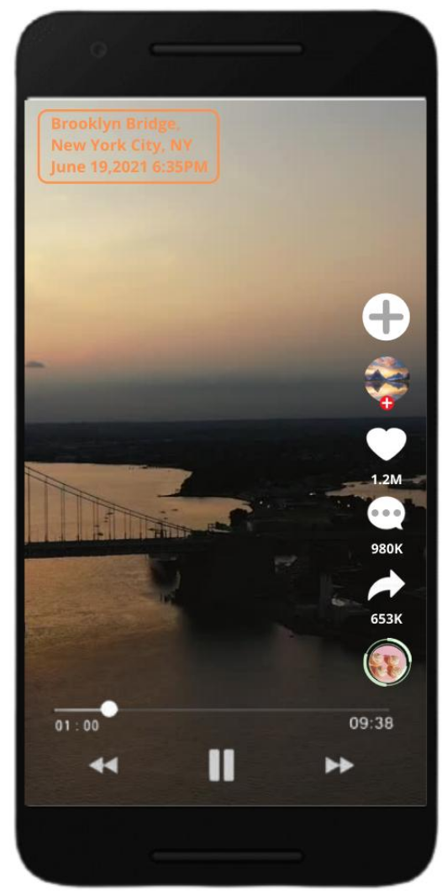
PRODUCT OVERVIEW
Play them, share them, enhance them ... without ever losing track of where the video came from!
Open source approach, developers can & will add functionality that entertains - without requiring them to compromise on their privacy.
The player tools closely resembling TikTok are for suggestion only. Initial version will not have many of them. Moreover, the open source community can write better more fun tools.
Notes:
App will give you option to visually hide the orange GPS place and time watermark shown in the phone image above

Slide 8
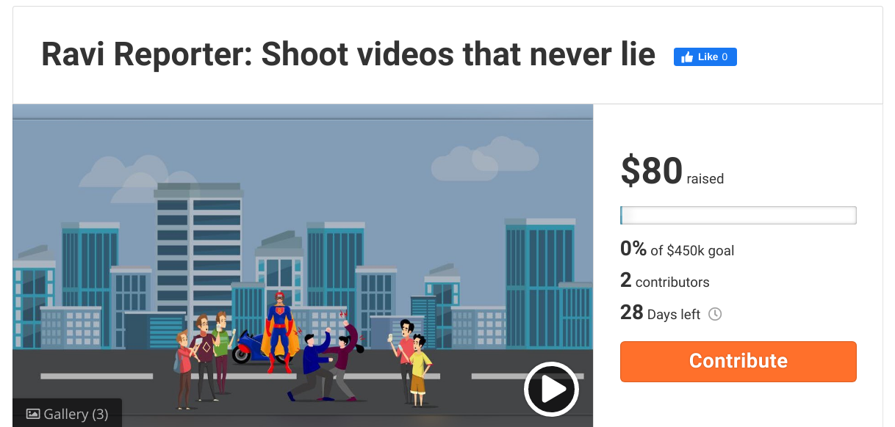
FUNDRAISER
https://fundrazr.com/RaviReporter

Slide 9
WITH GREAT POWER COMES …

