Slide 1
PMICostCalculator Brief Introduction
2015-6

Slide 2
Basic Pricinpals
Order1
Cost Calculation Sheet1
Order2
Cost Calculation Sheet2

Slide 3
Basic Calculation Unit
CostCalculationSheet
CostItem1
CostItem2
CostItem3
CostItem4
CostItem5

Slide 4
Basic CostItem Unit
CostItem
CostItem
ItemName
ItemCategory
ItemType
ItemCost
ItemRemark

Slide 5
MaterialsCost
PowderProcessingCost
VHPCost
ItemCategory
MachiningCost
PackcageCost
BondingCost
DeliveryCost

Slide 6
Product
ItemType
Experiment

Slide 7
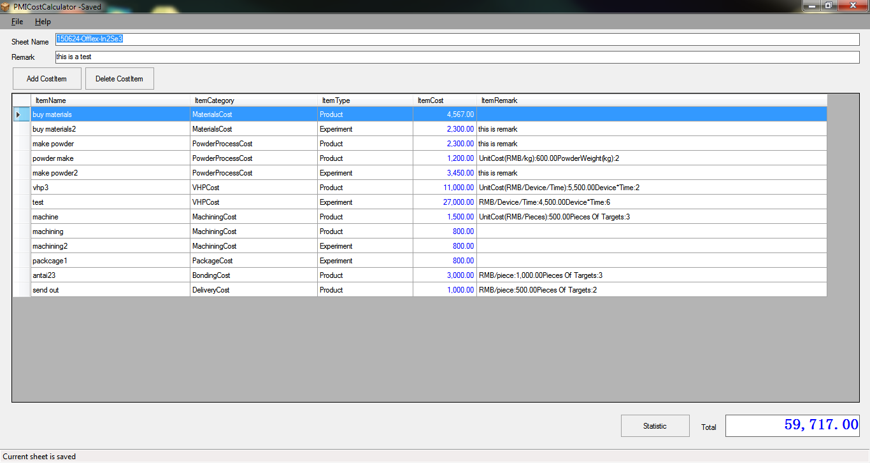
Calculation Software Usage

Slide 8
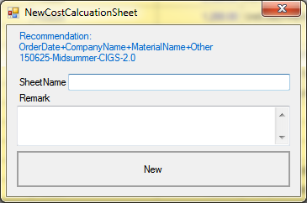
Create New CostCalculationSheet

Slide 9
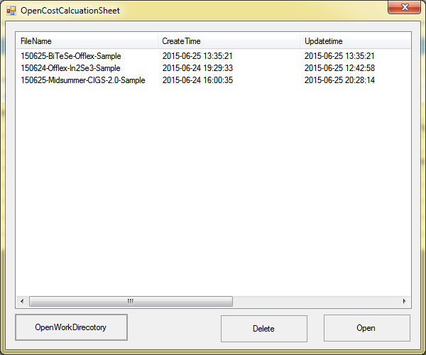
Open CostCalculationSheet

Slide 10
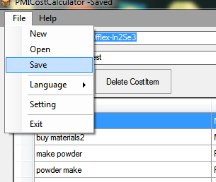
Save CostCalculationSheet

Slide 11
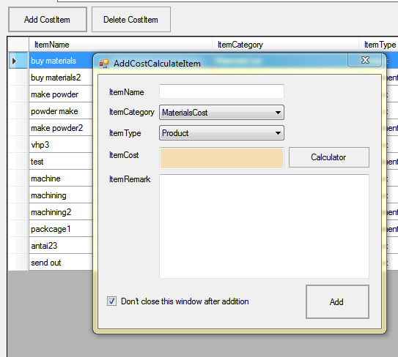
Add And Delete CostItem

Slide 12
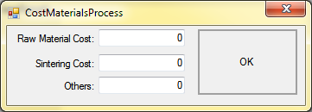
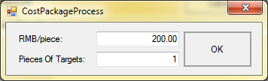
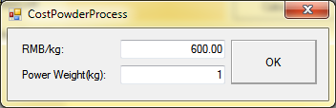
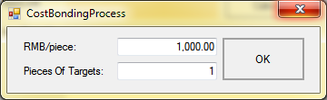
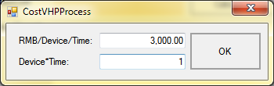
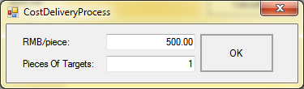
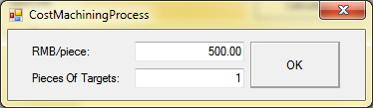
Small Assistant Tools

Slide 13
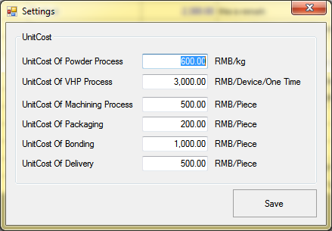
Settings

Slide 14
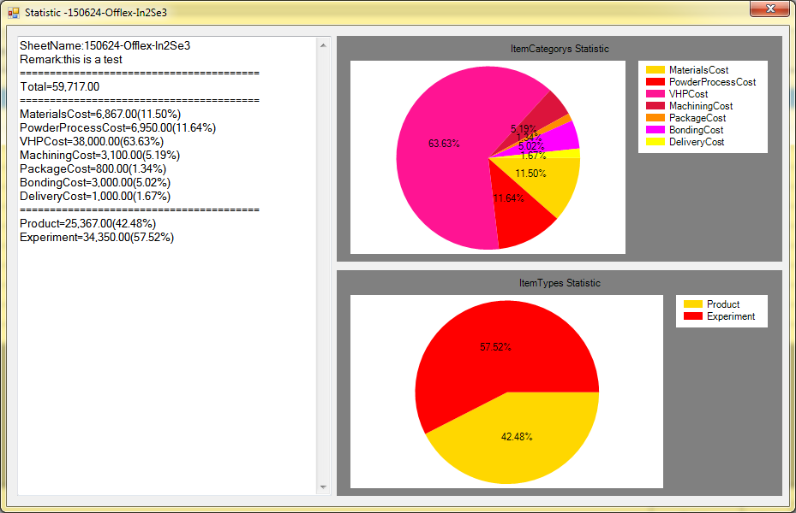
Statistic Data And Graph

