Slide 1
Fitting Of
“Poisson” Distribution

Slide 2

R.D.Clarke
Source : AN APPLICATION OF THE POISSON DISTRIBUTION BY R. D. CLARKE, F.I.A. of the Prudential Assurance Company, Ltd
British actuary & Secret Agent of British Military

Slide 3

World War II (1939-45)
THE BLITZ -1940

Slide 4
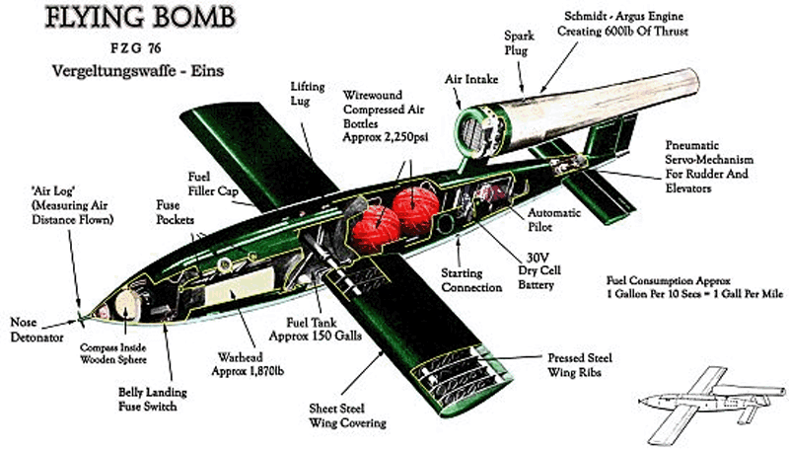
Vergeltungswaffe 1
(Vengeance Weapon 1, V-1)
H1MIN: V1 FLYING BOMB - YouTube

Slide 5
V-1 LANDING MISSION : LONDON
52°0′ N 0°0′ W
Geographic situation
1,572 km²
It’s the area of London
Killed : 43,500 civilians
Expected Kill : 55,000
Population of London : 8 million(1940)

Slide 6
WHAT IS THEIR STRATEGY ?
RANDOM CHANCE
vs
Precision Guidance(Targetted)

Slide 7
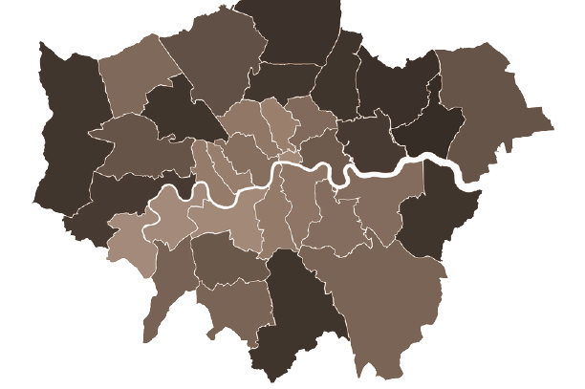

1,44 km²
It’s the area of South London
576 Squares
144 km² divided ¼ km²
144/(¼) = 576
South London
537 Squares
Blasted Squares

Slide 8
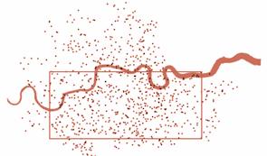
BLASTED SPOTS

Slide 9
“POISSON PROCESS” Criteria
-01-
Events are Independent of each other.
-02-
The average rate (events per time period) is constant.
-03-
Events should be random and not simultaneous.

Slide 10
THE ALGORITHM
Finding Parameter λ - mean
-01-
Probability Mass Function
-02-
Calculating Expected Frequency
-03-

Slide 11
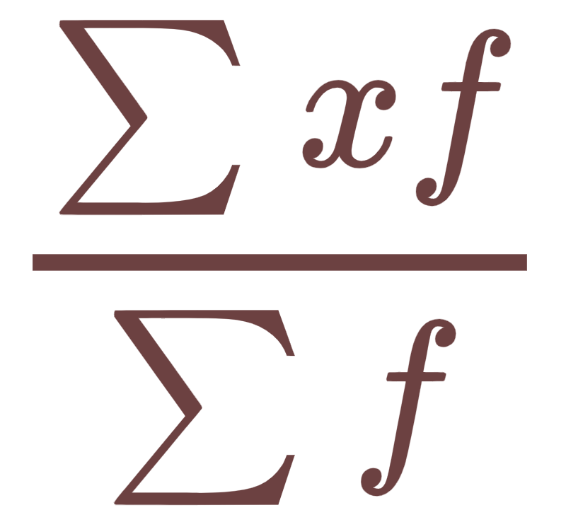
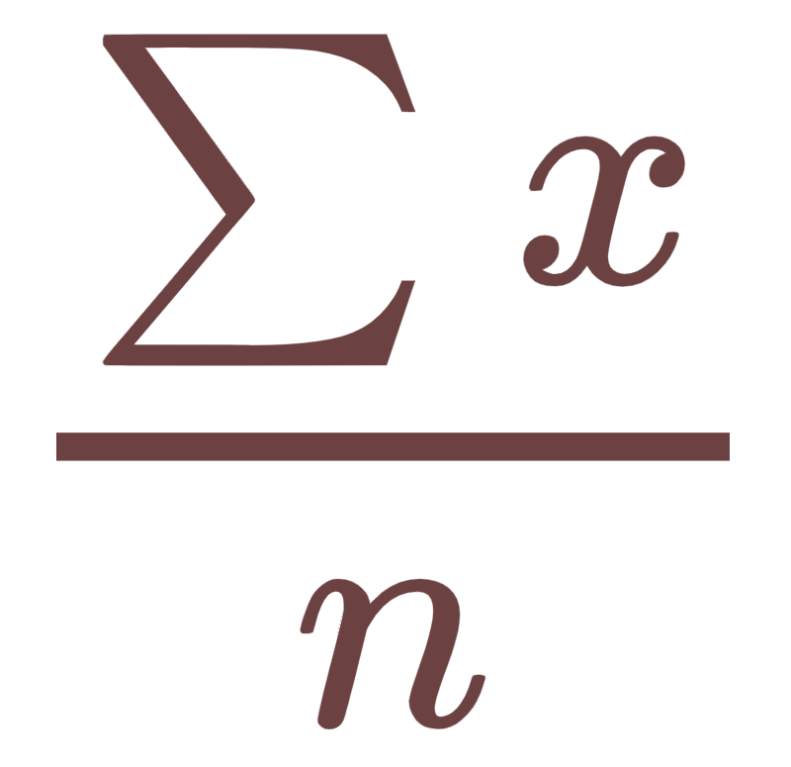
-01-
Finding Parameter λ - mean
Clarke assumed V-1 landings as “RANDOM’’
λ = Area Density (Quantity/Area)
= 537 / 576
= 0.932291

Slide 12
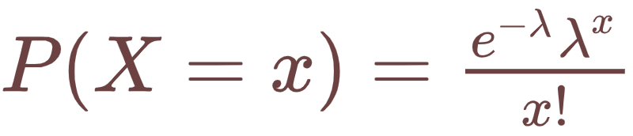
-02-
Probability Mass Function

Slide 13
Let’s Tabulate
Number of V-1s in square | P( X = x )
0 | 0.39365
1 | 0.367
2 | 0.17107
3 | 0.05316
4 | 0.01239
5 and above | 0.00273
Total | 1

Slide 14
Calculating Expected Frequency
-03-
N = Total Frequency
f_{expected} = N P(X = x)

Slide 15
Let’s Tabulate
Number of V-1s in square | Expected number of squares (Poisson) | Observed number of squares
0 | 226.74 | 229
1 | 211.39 | 211
2 | 98.54 | 93
3 | 30.62 | 35
4 | 7.14 | 7
5 and over | 1.57 | 1
 | 576 | 576

Slide 17
THANKS!
Do you have any questions?

