Slide 1


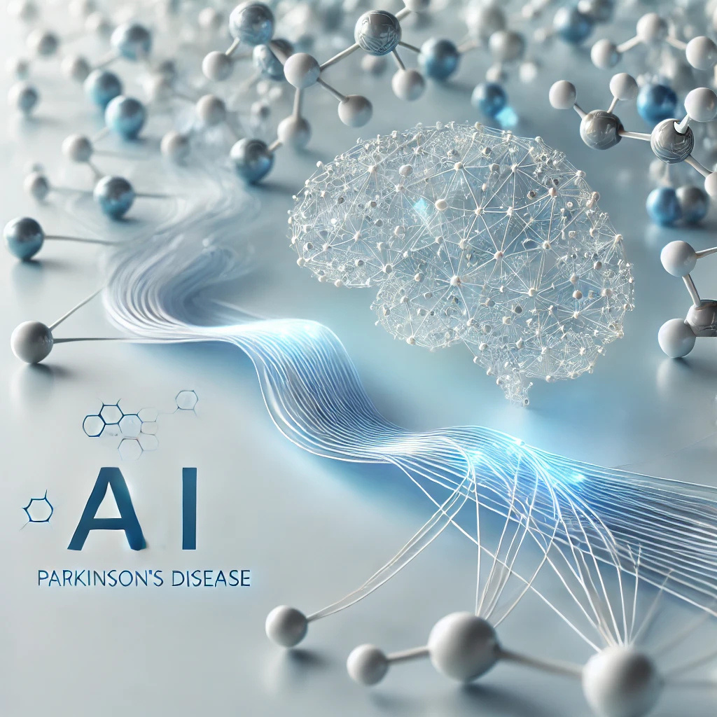




2nd Data Science & AI Summer School 2025
June 28, 2025
+1 (678) 975-5615
www.neliref.org
contact@neliref.org
New Life Research Foundation (NELIREF) Ltd/Gte
Notes:
Good afternoon everyone!
Thank you for being here today.
We are Bio-PrecisionAI we’re passionate about changing the game in drug discovery using AI. Right now, we’re focused on developing small drug molecules for Parkinson’s disease, a condition that impacts over 10 million people worldwide and still doesn’t have a cure.
Our AI platform is designed to accelerate drug discovery, improve treatment outcomes, and address the urgent needs of patients. Now, we’d like to take you through how we’re turning this vision into reality.

Slide 2
Supervised Machine Learning & Deep Learning with Python

Slide 3
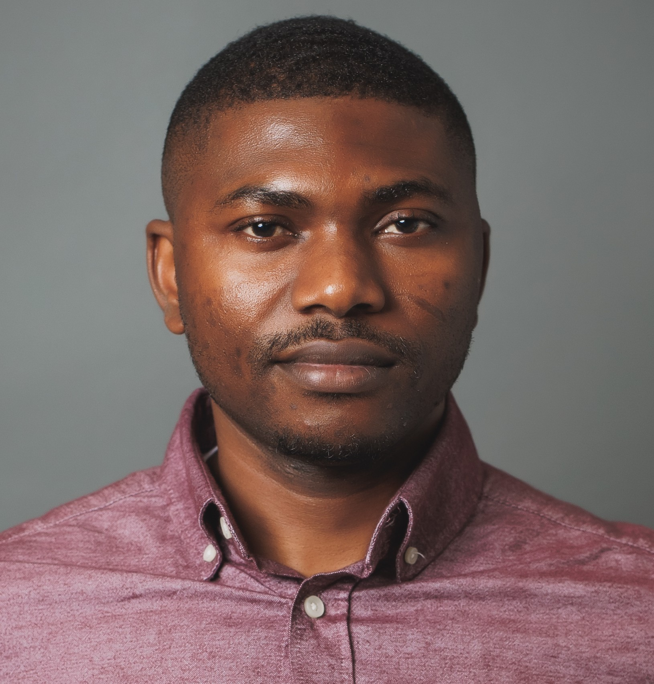
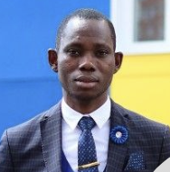
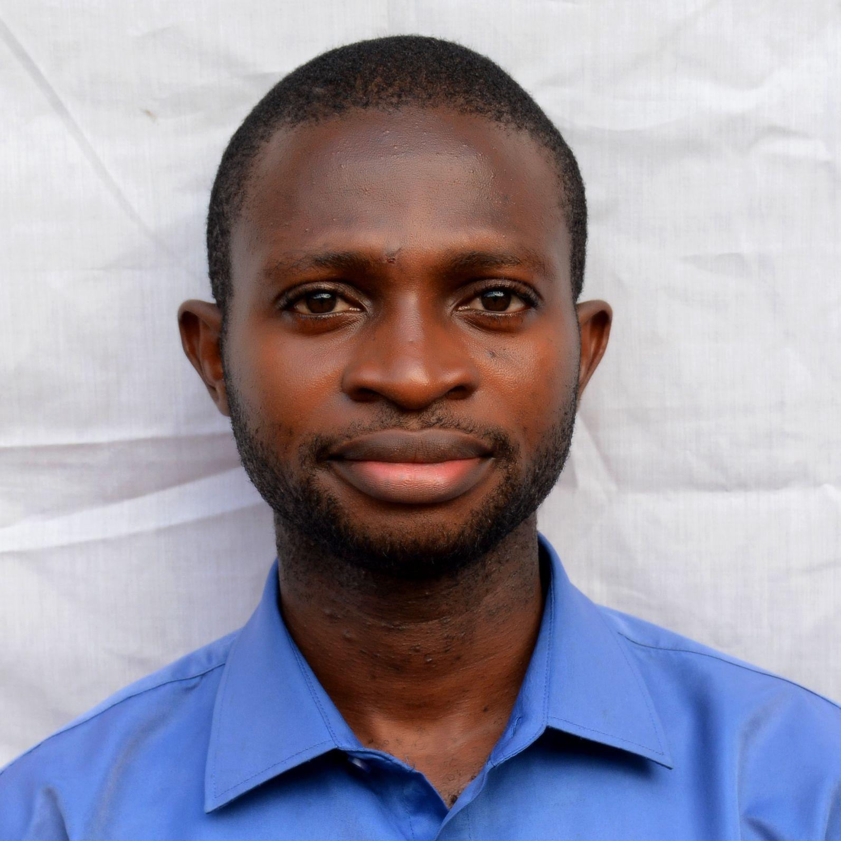
INSTRUCTORS & TEACHING ASSISTANTS (TAs)
Roland Abi
Mfeuter Joseph Tachia
Gabriel Terkuma Saaondo
(Washington DC)
LinkedIn: https://www.linkedin.com/in/roland-abi/
BSc Botany
University of Agriculture Makurdi
M.Sc Plasma Physics Moscow Institute of Physics and Technology;
PhD Student at Innopolis University, Russia

Slide 4

Agenda
• What is supervised learning?
• ML algorithms & use cases
• Deep learning overview
• Implementation in python
• Evaluation & tuning
• Case study
• Q&A

Slide 5

Introduction to Supervised Learning
Supervised learning involves learning from labeled data to predict future outcomes.
Examples: Spam filtering, sentiment analysis.

Slide 6
Supervised vs. Other Learning Types
Supervised: Uses labeled output
Reinforcement: Learning via reward
Supervised learning is foundational and widely applicable.
Unsupervised: No labels

Slide 7
Task Types in Supervised Learning
• Regression: predict continuous values (e.g., Prices)
• Classification: Predict Categories (e.g., Spam Detection)

Slide 8
Classical ML Algorithms
Linear/Logistic Regression
Decision Trees & Random Forests
SVM, k-NN
Each algorithm has specific problem strengths.

Slide 9
Data Preprocessing
Handle missing values
Encode categorical data
Scale features
Split data (train/test)
Preprocessing is essential.

Slide 10
Feature Engineering
• Create interaction terms
• Add polynomial features
• Select important features

Slide 11
Model Evaluation
• Classification Model: Accuracy, Precision, Recall, F1, ROC-AUC
• Regression Model: MAE, MSE, RMSE, R²
Use multiple metrics.

Slide 12
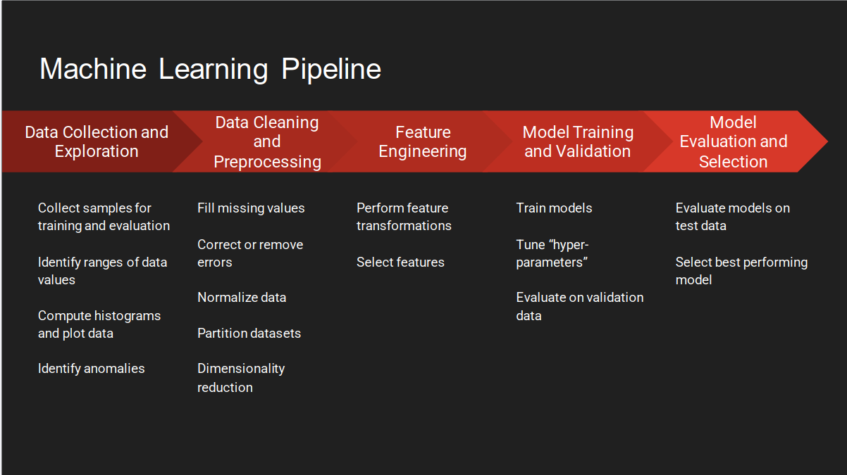

Slide 13
Why Deep Learning?
Deep Learning Handles High-dimensional, Complex Data (Images, Speech, Etc.).
Goes Beyond What Classical ML Can Capture.

Slide 14
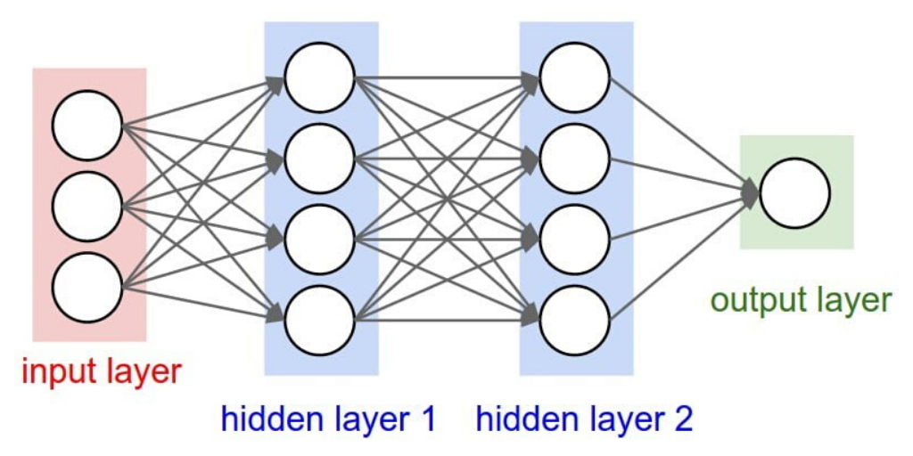
Neural Networks Basics
Neural network components:
Input layer
Hidden layers
Output layer
Activation functions: ReLU,
Sigmoid

Slide 15
DL in Python
Popular libraries: TensorFlow, Keras, PyTorch
Compile()
Fit()
Evaluate()

Slide 16
Overfitting in DL
• Dropout
• Early stopping
• Regularization
Monitor training vs. validation loss.

Slide 17
Model Explainability & Ethics
Tools: SHAP, LIME
Topics: Fairness, bias, accountability
Promote responsible AI.

Slide 18
Case Study: Diabetes Prediction
Load UCI dataset
Clean data (pandas)
Train model (logistic regression)
Evaluate (ROC-AUC)
Show results

Slide 19
Python Tools Recap
Data: Pandas, Numpy
ML: scikit-learn
DL: keras, tensorflow, torch
Visualization: matplotlib, seaborn

Slide 20
Resources
Books: Hands-On ML, Deep Learning with Python
Courses: Coursera, fast.ai
Communities: Kaggle, GitHub

Slide 21
Final Thoughts
ML: Simple, interpretable
DL: Complex, powerful
Build, test, iterate.

Slide 22
Q&A
Questions?
Thank you!

Slide 23


