Slide 1

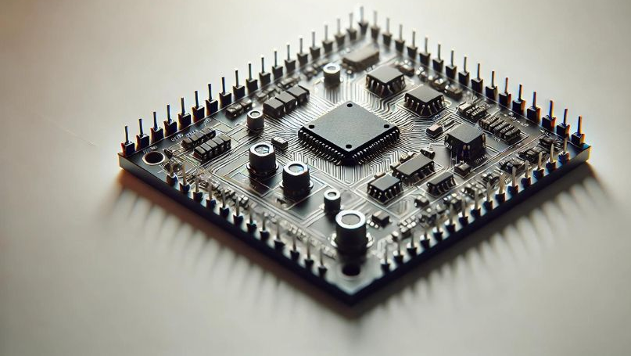
EMBEDDED SYSTEMS
BY DR. PETER NIMBE

Slide 2
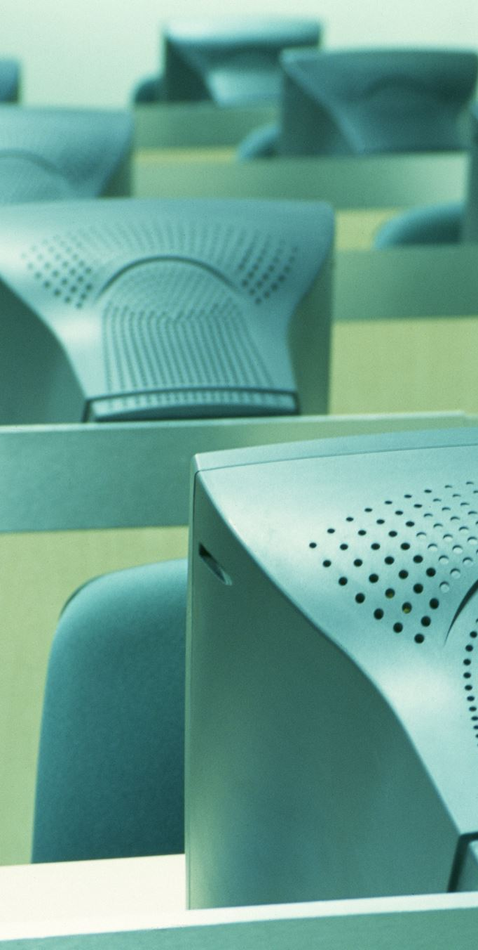
Learning Outcomes
At the end of this lecture, students will be able to:
Define what an embedded system is and understand its purpose. Identify key characteristics of embedded systems.
Trace the historical development and generations of embedded systems.
Differentiate between embedded systems and general-purpose computing systems.
Categorize embedded systems based on functionality and performance.
Recognize various application domains of embedded systems and their impact.

Slide 3
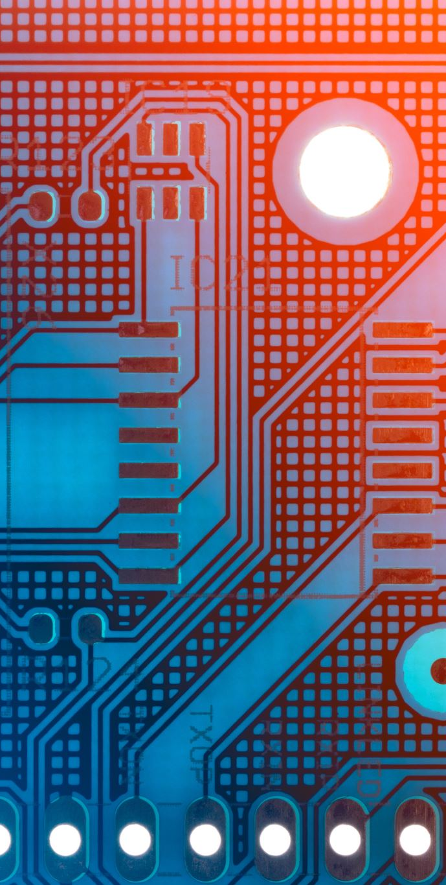
Introduction to Embedded Systems
What is an Embedded System?
An embedded system is a specialized electronic system designed for specific tasks.
Combines hardware and software with real-time operational requirements.
Key Examples:
Mobile phones, automotive control units, and medical devices.

Slide 4

Characteristics of Embedded Systems
High speed and low power consumption
Small size and lightweight
High reliability and adaptability
Application-specific functionality

Slide 5
Simple Examples of Embedded Systems
Digital Watches: Use microcontrollers to manage timekeeping and other features like alarms and stopwatches.
Microwave Ovens: Embedded systems control cooking time, power levels, and display interfaces.
Washing Machines: Automate washing cycles, water levels, and spin speed with embedded microcontrollers.
Fitness Trackers: Monitor heart rate, steps, and sleep patterns using embedded sensors and processors.
Remote Controls: Use embedded systems to transmit signals to control TVs, air conditioners, or other devices.

Slide 6
Simple Examples of Embedded Systems
Smart Thermostats: Regulate home temperature and energy use based on programmed settings or learning algorithms.
Car Anti-lock Braking Systems (ABS): Embedded systems ensure the car’s wheels don’t lock up during braking for safety.
Digital Cameras: Handle image processing, autofocus, and storage.
Traffic Lights: Use embedded systems to control signal timing and manage traffic flow.
Printers: Embedded controllers manage printing tasks, paper feed, and ink usage.
Each of these devices integrates hardware and software designed for a specific function, making them examples of embedded systems.

Slide 7
History of Embedded Systems
1960s: The Birth of Embedded Systems
1970s: Introduction of Microprocessors
1980s: Expansion and Miniaturization
1990s: Embedded Systems in Networking and Multimedia
2000s: Rise of Embedded Systems in Mobile and IoT
2010s and Beyond: Embedded AI and Edge Computing

Slide 8
1960’s: The Birth of Embedded Systems
The first embedded system was created in 1961 with the development of the Apollo Guidance Computer (AGC).
It was used in the Apollo space missions to control spacecraft navigation and guidance.
In 1968, the first real industrial application of an embedded system was in the Volkswagen Beetle, which used a microcontroller for its electronic fuel injection system.

Slide 9
1970’s: Introduction of microprocessors
The introduction of microprocessors revolutionized embedded systems.
In 1971, Intel launched the Intel 4004, the first commercially available microprocessor.
This era saw the rise of embedded systems in consumer electronics, such as calculators and early digital watches.

Slide 10
1980’s: Expansion and Miniaturization
The 1980s saw rapid growth in embedded systems, driven by advancements in semiconductor technology.
Microcontrollers (integrated chips with processors, memory, and I/O capabilities) like the Intel 8051 and Motorola 68HC11 became popular, enabling cost-effective embedded applications in home appliances, medical devices, and automobiles.

Slide 11
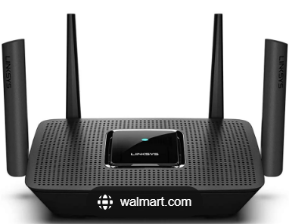
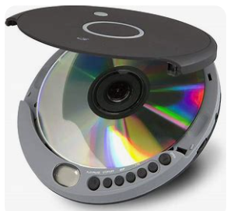
1990’s: Embedded Systems in Networking and Multimedia
Embedded systems began appearing in networking equipment (e.g., routers) and multimedia devices (e.g., CD players).
The rise of the Internet of Things (IoT) concept started gaining traction, hinting at a future of interconnected embedded devices.

Slide 12
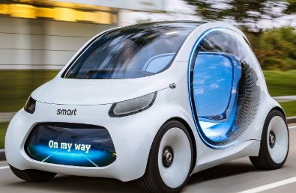
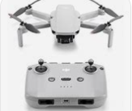
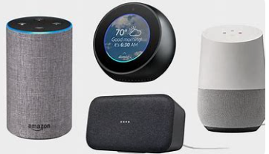
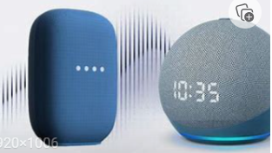
2010: Embedded AI and Edge Computing
Embedded systems advanced to include artificial intelligence (AI) and machine learning capabilities, enabling smarter devices like autonomous vehicles, drones, and smart assistants.
Edge computing emerged, pushing computation closer to devices to reduce latency and enhance real-time processing in applications like industrial automation and healthcare.

Slide 13
Edge Computing
Is a distributed computing paradigm that brings data processing, storage, and computation closer to the source of data generation, such as IoT devices, sensors, or local servers, rather than relying solely on centralized cloud servers.
This approach reduces latency, improves response times, enhances data privacy, and decreases bandwidth usage by processing critical tasks locally, while still allowing less time-sensitive data to be sent to the cloud for further analysis or storage.
Edge computing is essential for applications requiring
real-time decision-making, such as autonomous vehicles, smart manufacturing, and healthcare monitoring systems.

Slide 14
Latency
Latency is the time delay between when a request is made and when the corresponding response or action occurs. It is commonly measured in milliseconds (ms) and is a critical metric in computing, networking, and communication systems. For example:
In networking, latency refers to the time it takes for data to travel from a source (e.g., your computer) to a destination (e.g., a server) and back.
In real-time systems, latency measures how quickly a system can respond to an input or event, such as a button press or sensor activation.
Low latency is crucial for applications like online gaming, video conferencing, autonomous vehicles, and industrial automation, where delays can impact performance or safety.

Slide 15
Embedded Systems vs. General Computing Systems
Feature | Embedded Systems | General Computing Systems
Purpose | Specific | General
Hardware/Software | Specialized | Generic
User Alterability | Fixed (Pre-programmed) | Alterable
Response Requirements | Time-critical | Non-time-critical

Slide 16
Categories of Embedded Systems
Functional Classification:
Stand-alone embedded systems (e.g., MP3 players).
Real-time embedded systems: Hard (e.g., pacemakers) vs. Soft (e.g., microwave ovens).
Networked embedded systems (e.g., home security).
Mobile embedded systems (e.g., smartphones).
Performance-Based Classification:
Small-scale embedded systems
Medium-scale embedded systems
Large-scale embedded systems

Slide 17
Categories of Embedded Systems
Application Domain Classification:
Consumer electronics
Automotive
Industrial automation
Medical devices
Telecommunications
Defense and aerospace
Power and Performance Classification:
Low-power embedded systems
High-performance embedded systems

Slide 18
Based on Functionality

Slide 19
Stand-alone embedded systems
Operate independently without needing external control.
Examples: Digital watches, calculators, and MP3 players

Slide 20
Real-time embedded systems
Perform specific tasks within a defined time frame.
Examples: Anti-lock braking systems (ABS), medical devices, and robotic arms.
Types:
Hard Real-Time Systems: Missing a deadline leads to system failure (e.g., pacemakers).
Soft Real-Time Systems: Missing a deadline degrades performance but doesn't cause total failure (e.g., video streaming).

Slide 21
Networked embedded systems
Connected to a network for communication with other devices.
Examples: Smart home devices, IoT systems, and connected thermostats.

Slide 22
Mobile embedded systems
Designed for portability and energy efficiency.
Examples: Smartphones, fitness trackers, and GPS devices.

Slide 23
Based on Performance

Slide 24
Small-scale embedded systems
Use simple microcontrollers with limited resources.
Low cost, low power consumption.
Examples: Microwave ovens, remote controls.

Slide 25
Medium-scale embedded systems
Use more powerful microprocessors or microcontrollers with external memory and peripherals.
Examples: Home automation systems, industrial robots.

Slide 26
Large-scale embedded systems
Feature high-performance processors and often use real-time operating systems (RTOS).
Require complex software design.
Examples: Telecommunication systems, advanced automotive control systems.

Slide 27
Based on Application Domain
1. Consumer Electronics
Examples: Smart TVs, washing machines, and cameras.
2. Automotive
Examples: Engine control units, parking assistance, and autonomous driving systems.
3. Industrial Automation
Examples: SCADA systems, industrial robots, and assembly line controllers.
4. Medical Devices
Examples: Pacemakers, infusion pumps, and MRI scanners.
5. Telecommunications
Examples: Routers, switches, and base stations.
6. Defense and Aerospace
Examples: Radar systems, missile guidance systems, and drones.

Slide 28
Based on Power and Performance
1. Low-Power Embedded Systems
Designed for battery-powered applications.
Examples: Wearable devices, sensors.
2. High-Performance Embedded Systems
Require significant computational power for complex tasks.
Examples: Gaming consoles, advanced medical imaging systems.

Slide 29
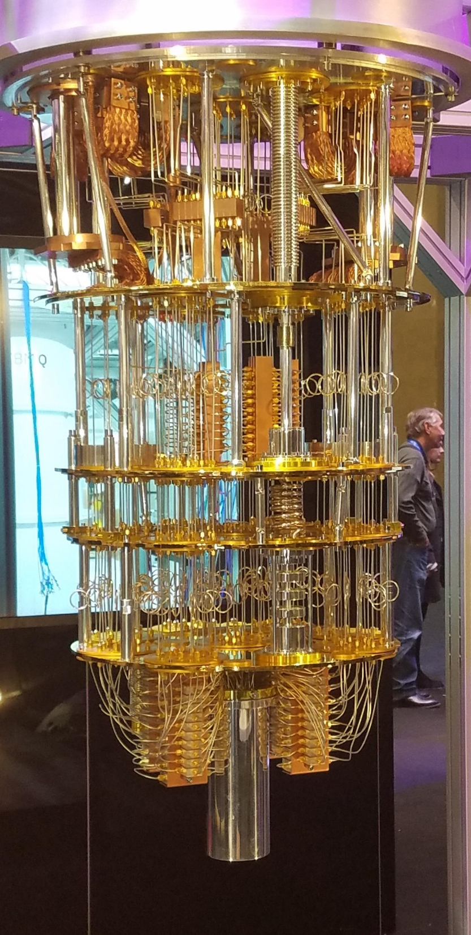
Embedded Systems in Quantum Computers
Embedded systems play a vital role in quantum computers by providing the classical control and interface required to operate the quantum hardware.
While quantum computers represent a fundamentally different computational paradigm, embedded systems are essential for their functionality.

Slide 30
Classical Control Systems
Quantum computers rely on classical embedded systems to control the quantum bits (qubits).
These systems generate precise electrical or optical pulses that manipulate the qubits for operations like initialization, gate execution, and readout.

Slide 31
Cryogenic Environment Management
Many quantum computers (like those using superconducting qubits) operate at near-absolute-zero temperatures.
Embedded systems manage and monitor cryogenic equipment to maintain these extreme conditions.

Slide 32
Data Acquisition and Processing
Embedded systems collect and process the output signals from qubits, converting the quantum states into classical data.
High-speed digital signal processing (DSP) is often integrated into these systems to handle real-time feedback and error correction.

Slide 33
Error Correction and Stabilization
Quantum error correction requires the constant monitoring of qubits to detect and correct errors.
Embedded systems execute algorithms for error detection and stabilization, ensuring reliable quantum computation.

Slide 34
Quantum-Classical Interface
Quantum computers need embedded systems to bridge the gap between the quantum hardware and classical computing systems.
This includes managing the input and output data as well as coordinating the quantum operations with classical algorithms.

Slide 35
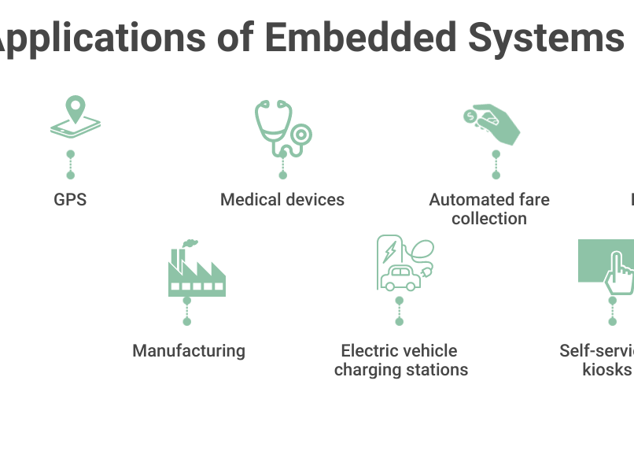
Applications of Embedded Systems
Domains:
Consumer Electronics: Cameras, TVs.
Healthcare: ECG, glucose monitors.
Automotive: ABS, GPS.
Industrial Automation: Assembly line robots.

Slide 36
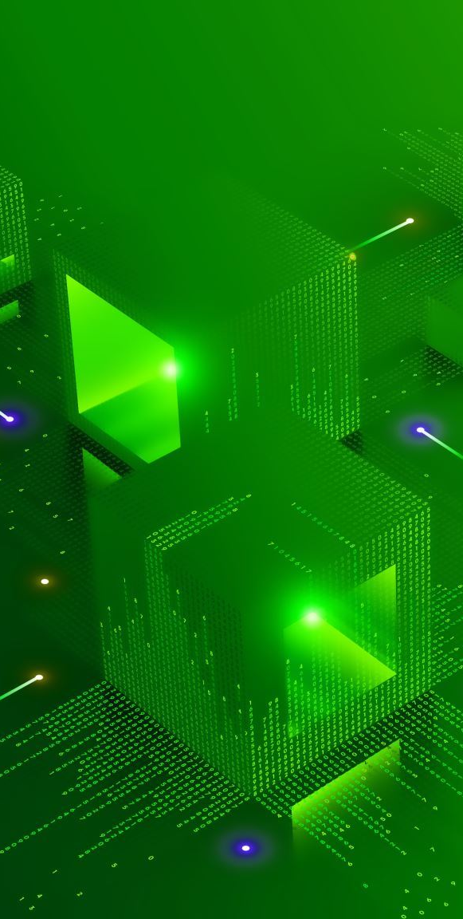
Why Study Embedded Systems?
We study Embedded Systems because;
Embedded systems are integral to modern life.
Growing demand in fields like IoT, automation, and AI.
Real-world impact across industries.

Slide 37
Summary
Key Points:
Embedded systems are specialized, efficient, and application-specific.
They play a vital role in multiple industries.
Understanding their design and applications is crucial for modern engineering.

Slide 38


