Slide 1
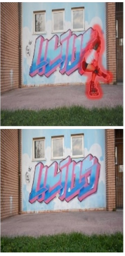
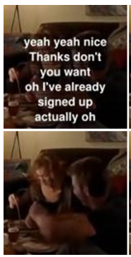
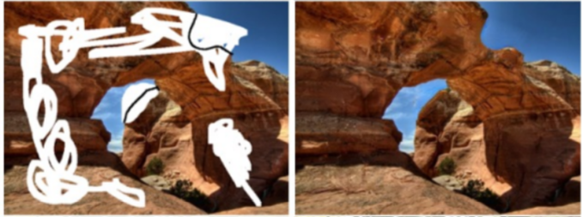
Video Inpainting
To fill in the damaged or missing portions of a video
The main research purpose :
Object Removal / Video Restoration [1-3,5,8,9-12]
With known mask
Blind Video De-captioning [4]
With unknown mask like caption
Free-form Video Inpainting [6,9]
The mask is of arbitrary shape
The difference with the image inpainting
A temporal consistency should be considered
Spatial + Temporal in video inpainting
Object Removal
Blind Video De-captioning
Free-form Video Inpainting

Slide 2
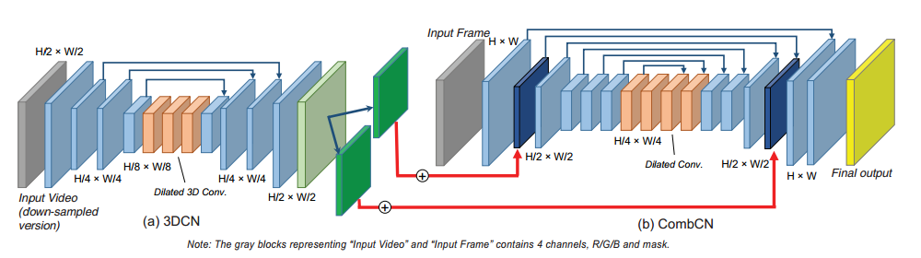
Three typical architectures in references
Baseline [1], also similar to [4]
3D-CNN to learn the temporal information
The outputs of 3D-CNN are added to CombCN (3D-2D combined completion network)

Slide 3
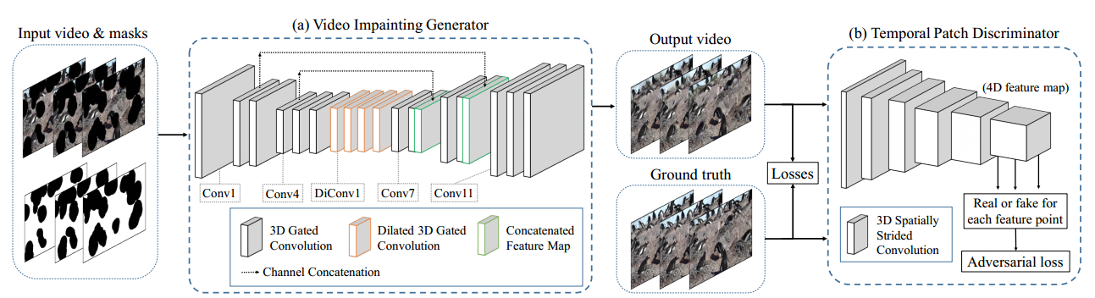
Three typical architectures in references
2. Generator + discriminator [9] also similar to [6]
U-net-like generator network
Discriminator to enhance the temporal consistency and video quality

Slide 4
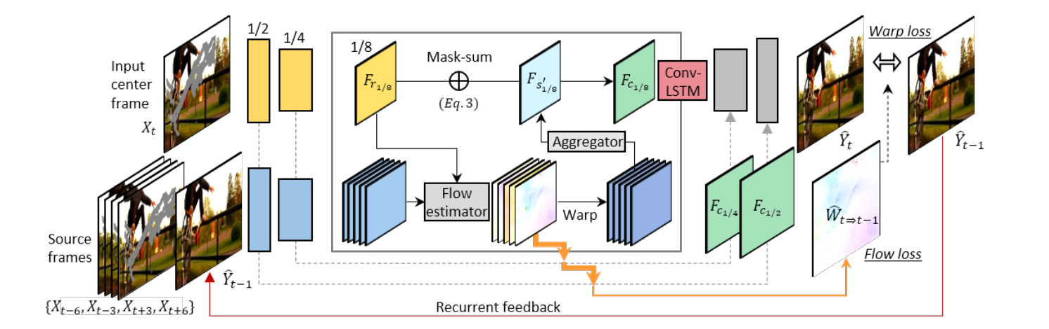
Three typical architectures in references
3. Optical Flow-based [3], also similar to [2, 5, 8, 12]
Learn the flow features in each frame
Align the reference flow features to the source feature domain(current frame) to produce aligned feature map
Recurrence and Memory using ConvLSTM

Slide 5
Three typical architectures in references
4. Others [6, 7, 10, 11]
Other way to find feature map between current frame and reference frames
Optical flow based alignment is not suitable for slow-moving videos [11]
LGTSM (Learnable Gated Temporal Shift Module) [6]
Homography estimator [7]
Asymmetric Attention Block [10]
Shared alignment encoders + alignment regressors [11]

Slide 6
Summary of networks in references
Index | Model | Network
[1] |  | 3DCN + CombCN
[2] | DFC-Net | Three DFC-S and each inputs gradually enlarged as 1/2, 2/3, 1
[3] | VINET | Encoder-Decoder Network + Flow composition + ConvLSTM
[4] | BVDNet | Parallel 3DCN and 2DCN encoder + 2DCN decoder
[5] | VORNet | Warping Network + Inpainting Network(Image inpainting)+refinement network
[6] [6] | LGTSM | U-net like generator and a TSMGAN discriminator
[7] |  | Homography-guided warping + Align-and-Attend Video Inpainter +FlowNet
[8] |  | ImageCN + FlowNet + Flow blending network + ConvLTSM
[9] |  | 3D Gated CNN (U-net) + Temporal PatchGAN (TPatchGAN) discriminator
[10] | OPN | Encoder to parallel produce key and value features + Asymmetric Attention Block
[11] |  | Optical flow based Alignment network + Copy-and-Paste network (context matching module)
[12] | DIP-based | DIP-based generative network to generate inpainted video and flow

Slide 7
Summary of Loss and Dataset
Index | Loss | Dataset
[1] | L1 loss in 3DCN and CombCN separately | FaceForensics, 300VM, Caltech
[2] | L1 loss with hard flow example mining | DAVIS, YouTube-VOS
[3] | Reconstruction loss(L1+ssim), temporal loss(flow+warp) | YouTube-VOS, Other mask | DAVIS
[4] | Reconstruction loss(L1+ssim+gradient), temporal loss | ECCV Challenge datasets
[5] | Reconstruction loss, perceptual loss, PatchGAN + TempoGAN loss | SVOR from YouTube-VOS
[6] | L1 loss, perceptual loss and style loss, TSMGAN loss | FaceForensics, FVI
[7] | Align loss in Homography, Reconstruction loss(hole, valid) + temporal loss(flow, warp)+ imGAN and vidGAN loss in inpainting | Places2 image + irregular mask in Homography and Youtube-VOS in inpainting
[8] | Spatial loss, Short-term temporal loss, Long-term temporal loss | FaceForensics, DAVIS+VIDEVO
[9] | L1 loss(w/o+w mask), perceptual and style loss, T-PatchGAN loss | FaceForensics, FVI
[10] | Reconstruction loss(peel, valid), perceptual and style loss, total variation regularization term | YouTube-VOS++
[11] | Align loss, Reconstruction loss(hole(visible,invisible), no-hole), perceptual and style loss, total variation regularization term | Places + Crawled Youtube videod
[12] | Image generation and flow generation loss, consistency and perceptual loss | DAVIS + 13 videos

Slide 8
Summary of Common tools
Tools | Papers | Function
U-Net | [1, 3, 6*, 8, 9] | Skip-connections
FlowNet | [2, 3, 4, 5, 7, 8] | Flow extraction
PWCNet | [3, 12] | Coarse-to-fine structure
ConvLSTM | [3, 5, 8] | Improve the temporal stability recurrently
VGG | [5, 6, 9, 10, 11, 12] | Compute the perceptual distance
PatchGAN | [5, 9*] | To motivate our model to generate realistic images
No skip connections | [6] | There are many masked areas in the down-sampling layers
[4] uses temporal-pooling skip connections

Slide 9
Conclusion
All of the papers are based on the encoder-decoder network.
The main challenge is to integrate the temporal and spatial information well
Most of the papers are aligning the reference features to the current frame
They use both previous and later frames
Few papers use image inpainting to fill up the invisible hole
Some papers use different GAN discriminator to improve the temporal and spatial consistency

Slide 10
Reference
[1] Wang C, Huang H, Han X, et al. Video inpainting by jointly learning temporal structure and spatial details[C]//Proceedings of the AAAI Conference on Artificial Intelligence. 2019, 33: 5232-5239.
[2] Xu R, Li X, Zhou B, et al. Deep Flow-Guided Video Inpainting[J]. arXiv preprint arXiv:1905.02884, 2019.(CVPR)
[3] Kim D, Woo S, Lee J Y, et al. Deep video inpainting[C]//Proceedings of the IEEE Conference on Computer Vision and Pattern Recognition. 2019: 5792-5801.
[4] Kim D, Woo S, Lee J Y, et al. Deep blind video decaptioning by temporal aggregation and recurrence[C]//Proceedings of the IEEE Conference on Computer Vision and Pattern Recognition. 2019: 4263-4272.
[5] Chang Y L, Yu Liu Z, Hsu W. VORNet: Spatio-temporally Consistent Video Inpainting for Object Removal[C]//Proceedings of the IEEE Conference on Computer Vision and Pattern Recognition Workshops. 2019: 0-0.
[6] Chang Y L, Liu Z Y, Lee K Y, et al. Learnable gated temporal shift module for deep video inpainting[J]. arXiv preprint arXiv:1907.01131, 2019.(BMVC)
[7] Woo S, Kim D, Park K Y, et al. Align-and-Attend Network for Globally and Locally Coherent Video Inpainting[J]. arXiv preprint arXiv:1905.13066, 2019.
[8] Ding Y, Wang C, Huang H, et al. Frame-Recurrent Video Inpainting by Robust Optical Flow Inference[J]. arXiv preprint arXiv:1905.02882, 2019.
[9] Chang Y L, Liu Z Y, Lee K Y, et al. Free-form video inpainting with 3d gated convolution and temporal patchgan[C]//Proceedings of the IEEE International Conference on Computer Vision. 2019: 9066-9075.
[10] Oh S W, Lee S, Lee J Y, et al. Onion-Peel Networks for Deep Video Completion[C]//Proceedings of the IEEE International Conference on Computer Vision. 2019: 4403-4412.
[11] Lee S, Oh S W, Won D Y, et al. Copy-and-Paste Networks for Deep Video Inpainting[C]//Proceedings of the IEEE International Conference on Computer Vision. 2019: 4413-4421.
[12] Zhang H, Mai L, Xu N, et al. An Internal Learning Approach to Video Inpainting[C]//Proceedings of the IEEE International Conference on Computer Vision. 2019: 2720-2729.

