Slide 1
Hangfire

Slide 2
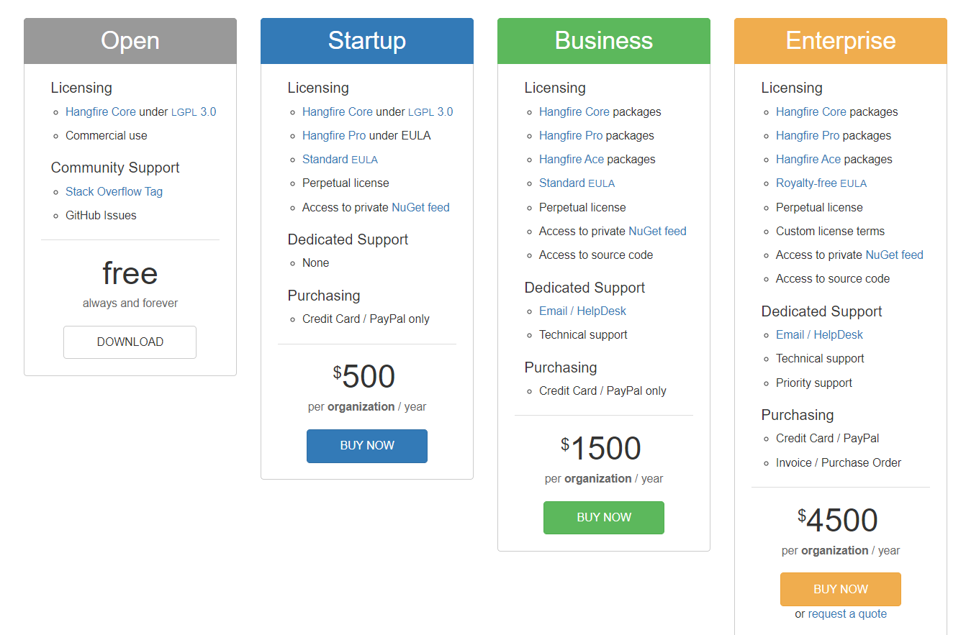
Is it completely Free to use?
It is free with default version, but it has some added functionality such as
Batches
Batch Continuations
We need to purchse it if need technical support from the team.

Slide 3
Introduction
What is Hangfire?
Hangfire is an Open-Source framework that helps you to Create, Process and Mange your background jobs, ie., Operations you don’t want to put in your request processing pipeline.
Examples:
Recurring Jobs
Scheduled Jobs
Fire and Forget job
Sending bulk email
Processing long running jobs
Backups
Image/Video processing

Slide 4
Overview
An easy way to perform background processing in .Net and .Net Core applications.
No Windows Service or Separate process required.
Easy way to perform Fire-And-Forget, Delayed and recurring jobs inside ASP.Net applications.
Provides a unified programming model to handle background tasks in a reliable way.
Run them on share hosting, dedicated hosting or in cloud.

Slide 5
Background Jobs
Fire-And-Forget
These jobs are executed only once and almost immediately after they fired.
Delayed
Delayed jobs are executed only once too, but not immediately – only after the specified time interval
Recurring Jobs
Recurring jobs fired many times on the specified CRON schedule.
Continuations
Continuations are executed when parent job has been finished.

Slide 6
Background Jobs (continue...)
Batches
Batch is a group of background jobs created atomically.
Bach Continuations
Batch Continuation is fired when all background jobs in a parent batch finied.
Background Process
Use them when a background processes run continuously through out the lifetime of an application.

Slide 7
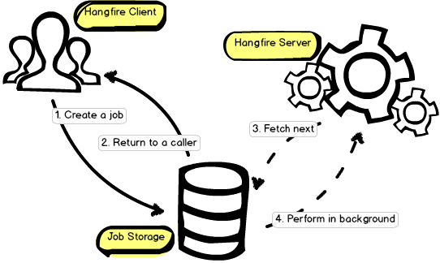
Hangfire Components
Hangfire has three Components
Hangfire Client
Job Storage
Hangfire Server

Slide 8
Advantages
Easy to Setup
No Windows Service, No Windows Scheduler, no Separate applications required
Background jobs are created in a persistent storage
Auto Handling exception with retries
Can use Hangfire on different machines to get more processing power with no configuration
Synchronization is performed automatically
You don’t need to perform manual storage cleanup – hanfire keeps it as clean as possible and removes old records automatically.

Slide 9
Requirements
.Net Framework / .Net Core
Persistent Storage
Sql Server
Redis
Hangfire Nuget Packages
Hanfire.Core
Hangfire.AspNetCore
Hangfire.SqlServer
Configuration in Startup.cs

Slide 10
Securing Hangfire Dashboad
Normally we map our method call to hangfire within authorization boundary, So the only out of the boundary that exposes Hangfire to the end-user is Hangfire dashboard.
We have IDashboardAuthorizationFilter to defined our user permission to access dashboard, here we can use HttpContext to validate the user and allow them to access Dashboard.

Slide 11
Status Tracking
It is difficult to track status of the async / disconnected / separate thread jobs. But hangfire provides filters to track the status of the job in various states.
Available filters
IClientFilter
OnCreated
IServerFilter
OnPerforming - Before starting a process
OnPerformed - After Performing a process
IElectStateFilter
OnStateElection – Current state after state change
IApplyFilter
OnStateApplied – State change from one to another
OnStateUnapplied – State not change

Slide 12
Load Balancing
We register our server in Startup.cs. When we have WebFarm or WebGarden we will be having multiple server running.
Hangfire has in-built Load Balancing feature to handle a job between multiple servers.

Slide 13
Demo

Slide 14
Thank you

