Slide 1
AVL Node Deletion

Slide 2
Demo: https://www.cs.usfca.edu/~galles/visualization/AVLtree.html

Slide 3
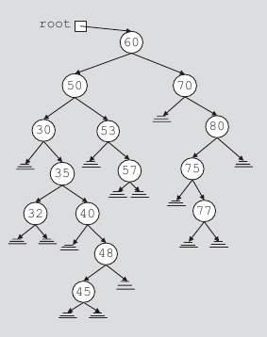
BST Delete: Four Replacement Cases
Case 1: leaf node. (45)
Case 2: has right child, no left child. (40)
Case 3: has left child, no right child. (80)
Case 4: has two children (60)
Data Structures Using C++ 2E

Slide 4
BST Delete: Four Replacement Cases
Case 1: simply delete
Case 2: replaced with the right child
Case 3: replaced with left child
Case 4: replaced with either inorder predecessor or successor. Deletion of such node will fall in one of cases 1/2/3
  Predecessor: rightmost node in the left subtree
  Successor: leftmost node in the right subtree

Slide 5
4 replacement cases in AVL deletion
AVL trees are Binary Search Trees in the first place
Four replacement cases in BST node deletion:
  Case 1: direct deletion
  Cases 2 & 3: replace the node with its lone child.
  Case 4: we can choose either the Inorder Predecessor or Successor as the replacement. Then delete the replacement.
    Inorder predecessor: the max node in the left sub-tree.
AVL: rotations & double rotations are needed to rebalance.

Slide 6
Rotation Cases in AVL Node Deletions
For AVL node insertion, we have 4 rotation cases
  Single Left
  Single Right
  Double (Left + Right)
  Double (Right + Left)
AVL deletion also has 4 (or 6) rotation cases
  Demo: https://www.cs.usfca.edu/~galles/visualization/AVLtree.html

Slide 7
Rotation Cases in AVL Node Deletions
  Case 1:
Single right rotation at b
a
bf = 0
bf = -1
b
bf = 0
bf = -1
b
a
h
T₁
T₃
h
h-1
T₂
T₃
h-1
T₂
h-1
h
T₁

Slide 8
Rotation Cases in AVL Node Deletions
  Case 1.5:
Single right rotation at b
a
bf = +1
bf = -1
b
bf = -1
bf = 0
b
a
h
T₁
T₃
h
T₃
h-1
h
T₂
h
T₁
T₂
h

Slide 9
Rotation Cases in AVL Node Deletions
  Case 2 and 2.5: mirror cases of Case 1 and 1.5

Slide 10
Rotation Cases in AVL Node Deletions
  Case 3:
bf = -1
c
bf = +1
a
A double rotation
Left rotation at a;
Right rotation at c.
b
T₄
h
h-1
T₁
h
T₂
T₃

Slide 11
Rotation Cases in AVL Node Deletions
  Cases 4: a mirror case of Case 3

Slide 12
AVL Node Deletion: Implementation
Similar to AVL insertion, recursion is utilized in deletion implementation.
  A bool parameter, isShorter, is used to tell the parent whether the subtree’s height is reduced.
  Details are on page 652.

Slide 13
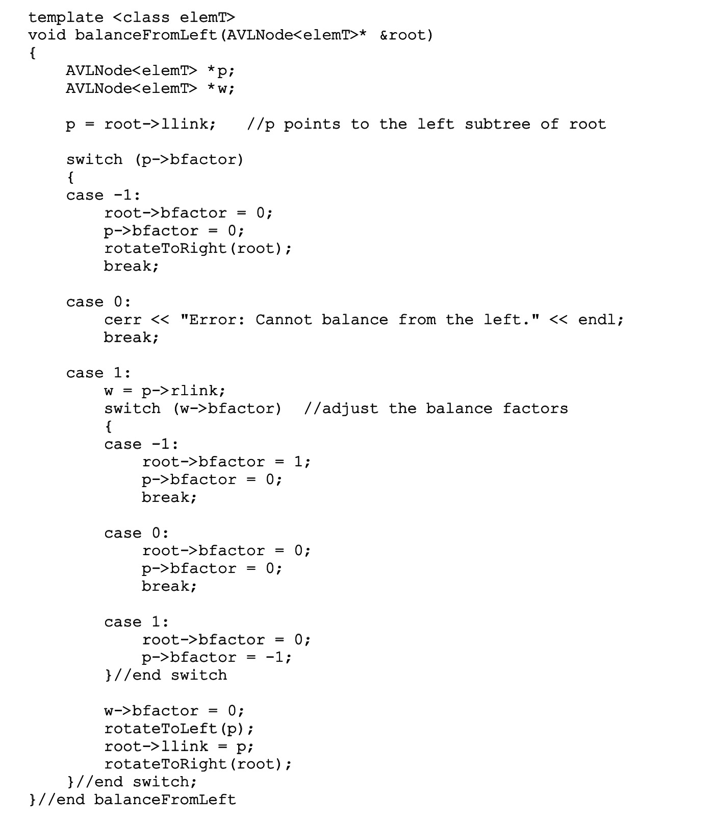
On textbook page 646
This case becomes possible in AVL deletion: case 1.5

Slide 14
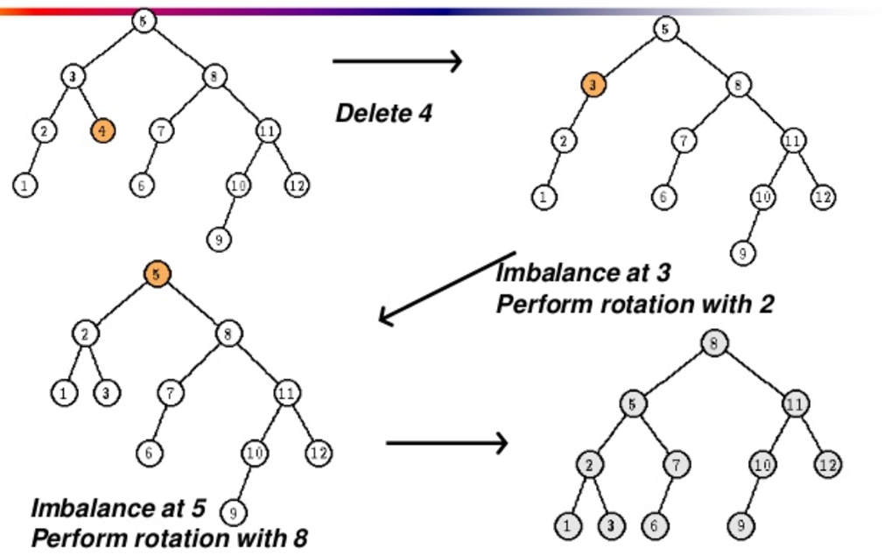
Deletion happened in the right-tree, and it became even shorter
bf = -1
Left high
Similar situation at 5:
bf +1 → +2
https://www.slideshare.net/sandpoonia/lecture11-33728696

Slide 15
AVL Deletion: another difference from Insertion
Imbalance may propagate upward so that many rotations may be needed.
  However, the recursion can take care of the propagation automatically and easily.
    You do not have to specifically handle it.

