Slide 1
Balancing Binary Search Trees
Many algorithms exist for keeping binary search trees balanced
  Adelson-Velskii and Landis (AVL) trees (height-balanced trees)
  Weight-balanced trees
  Red-black trees;
  Splay trees and other self-adjusting trees
  B-trees and other (e.g. 2-4 trees) multi-way search trees
1

Slide 2
Outline
AVL tree: definition & properties
AVL node insertion: procedure on paper
  Cases and updates
AVL node insertion: implementation
AVL node deletion: procedure and implementation
AVL operations: time complexity

Slide 3
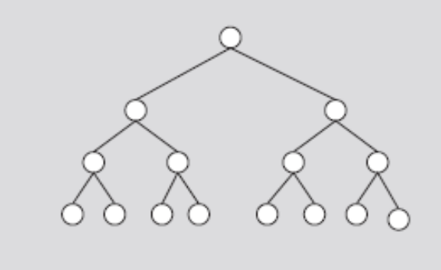
AVL (Height-Balanced) Trees
AVL tree (height-balanced tree)
  Resulting binary search is nearly balanced
Let’s begin with a perfectly balanced binary tree (full binary tree)
FIGURE 11-12 Perfectly balanced binary tree

Slide 4
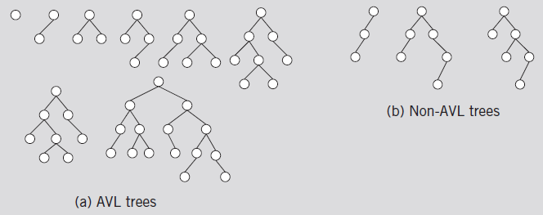
AVL (Height-Balanced) Trees (cont’d.)
An AVL tree (or height-balanced tree) is a binary search tree such that
  The heights of the left & right subtrees of the root differ by at most one
  The left and right subtrees of the root are AVL trees
FIGURE 11-13 AVL and non-AVL trees

Slide 5
AVL Trees: heights of subtrees
Let x be a node in a binary tree. Let x_{l} denote the height of the left subtree of x, and x_{h} denote the height of the right subtree of x.
x
x_{h} = 2
x_{l} = 3

Slide 6
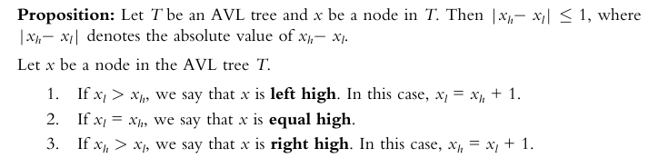
AVL Trees: left / equal / right high
Let x be a node in a binary tree. Let x_{l} denote the height of the left subtree of x, and x_{h} denote the height of the right subtree of x.

Slide 7
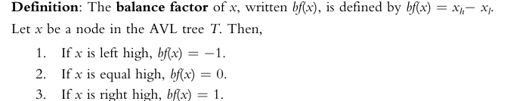
AVL Trees: balance factor (bf)

Slide 8
bf : examples
bf = -1
bf =+1
bf = +1
bf =0
bf =-1
bf =0
bf =0

Slide 9
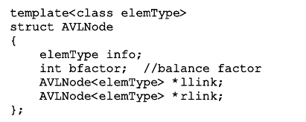
AVL Trees: C++ definition
Definition of a node in the AVL tree

Slide 10
AVL Trees: search / insert / delete
AVL binary search tree search algorithm
  Same as for a binary search tree
  Other operations on AVL trees
    Implemented exactly the same way as binary trees
  Item insertion and deletion operations on AVL trees
    Somewhat different from binary search trees operations

Slide 11
Insertion
AVL is a Binary Search Tree: insertion = search + insert
  If the item is already in tree
    Search ends at a nonempty node; Duplicates are not allowed
  If item is not in AVL tree
    Search ends at an empty link; insert the item there
After inserting a new item in the tree
  Resulting tree might not be an AVL tree anymore
  Solution? Update the tree through rotations

Slide 12
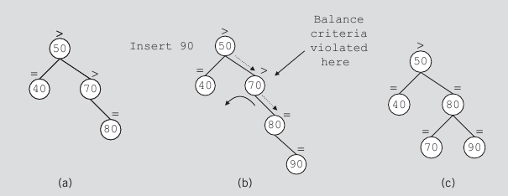
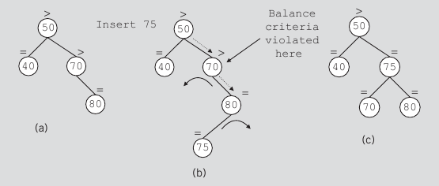
Insertion: violation handling
Inserting 90:
Single left rotation
Inserting 75:
Double rotation
(right followed by left)

Slide 13
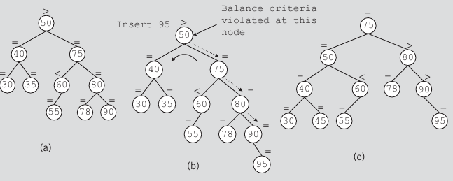
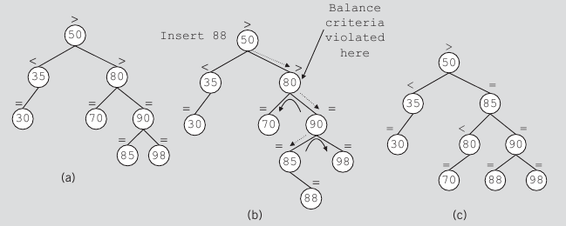
Insertion: two types of rotations
Inserting 95:
Single rotation
Inserting 88:
Double rotation

Slide 14
AVL Tree Rotations
Rotating tree: reconstruction procedure
  Left rotation and right rotation
  Single rotation and double rotation
Totally 4 combinations
  Single left
  Single right
  Left + right (double)
  Right + left (double)

Slide 15
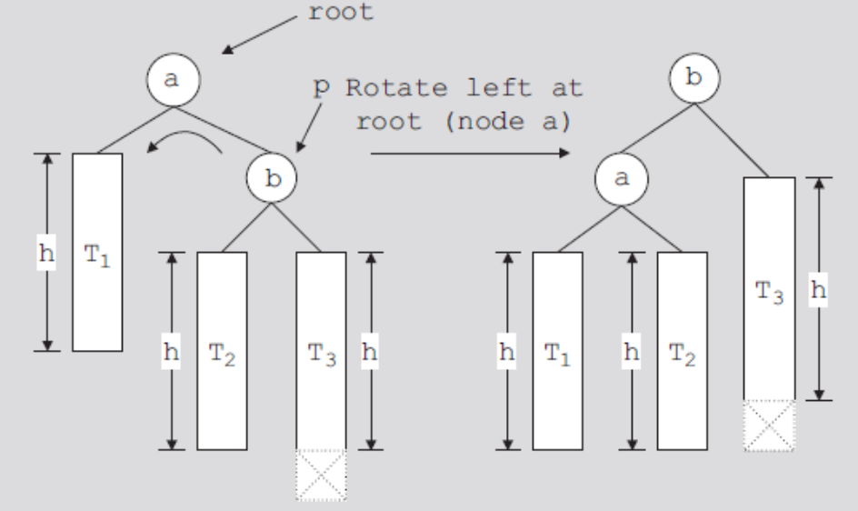
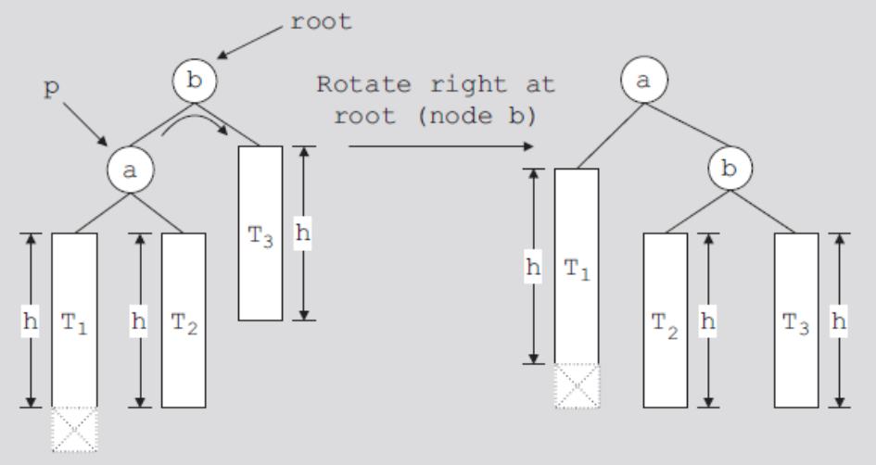
FIGURE 11-19 Single Left rotation at a
The mirror case of the above
FIGURE 11-18 Single Right rotation at b

Slide 16
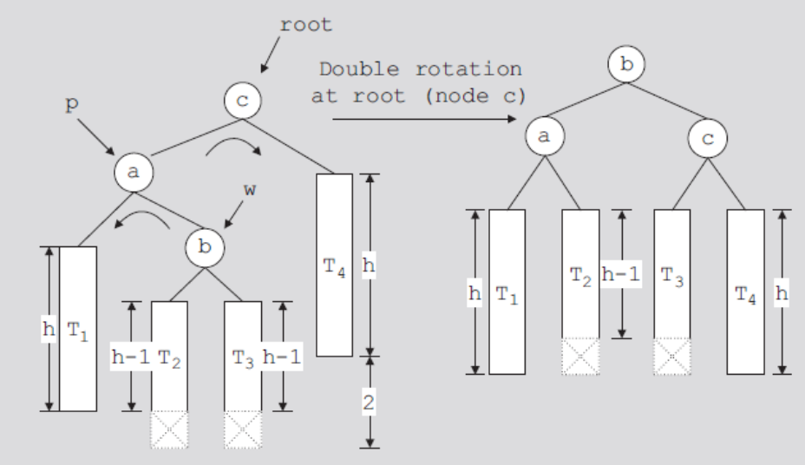
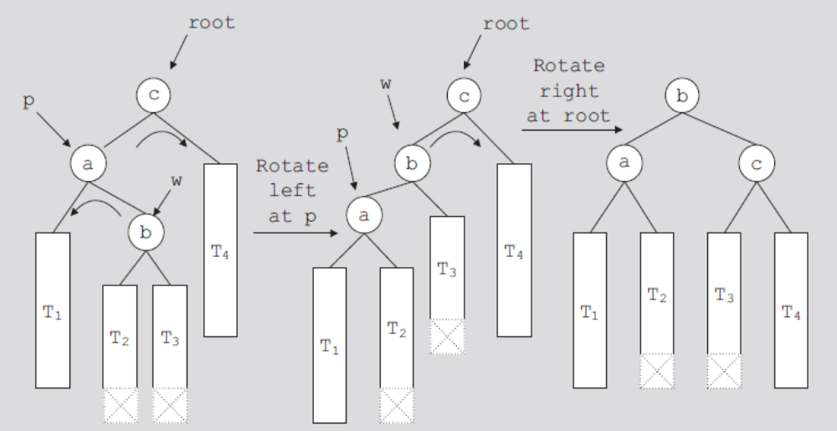
Double rotation:
First rotate left at a
and then right at c
with the
intermediate step

Slide 17
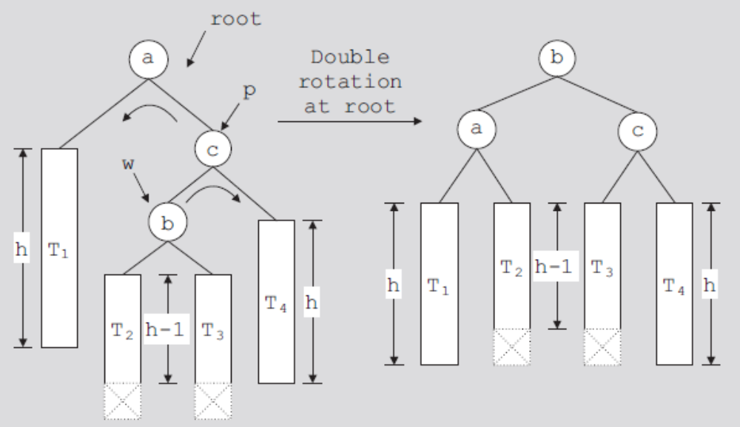
Double rotation (right + left): zoom-in view
Mirror case of the previous slide
FIGURE 11-22 Double rotation: First rotate right at c,
then rotate left at a

Slide 18
AVL Tree Node Insertion: insertIntoAVL
Create a node
Search the tree and find the place for the new node in the tree
Insert new node in the tree
Backtrack the path, which was constructed to find the place for the new node in the tree, to the root node
  If necessary, adjust balance factors of the nodes, or reconstruct the tree at a node on the path

Slide 19
AVL reconstruction: four cases!
When trace back, we will find the first node whose bf is a violation. The signs of last two nodes on the path can be
  Case 1: - -
    single right rotation
  Case 2: + +
    single left rotation
  Case 3: + -
    double rotation (left + right)
  Case 4: - +
    double rotation (right + left)

Slide 20
  root of the subtree; the first node with a violation
  Case 1: - -
  (-1) & (-2)
  Afterwards: ==
  0 & 0
  Action: single right rotation
FIGURE 11-18 Single Right rotation at b
  Case 2: + +
  (+1) & (+2)
  Afterwards: ==
  0 & 0
  Action: single left rotation
FIGURE 11-19 Single Left rotation at a

Slide 21
  root of the subtree; the first node with a violation
  Case 3: + -
  (+1) & (-2)
FIGURE 11-20 Double rotation: First rotate left at a and then right at c
  Double rotation:
  Left + right
FIGURE 11-21 Left rotation at a followed by a right rotation at c

Slide 22
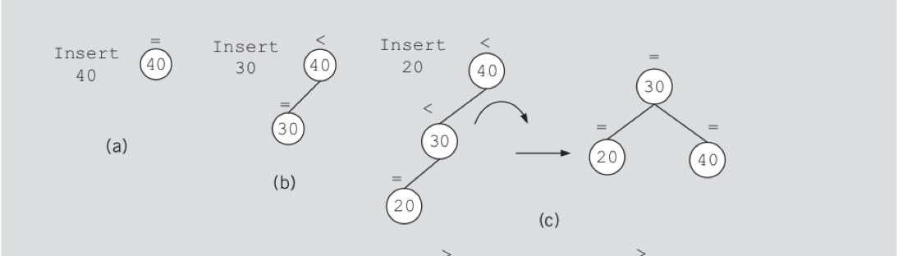
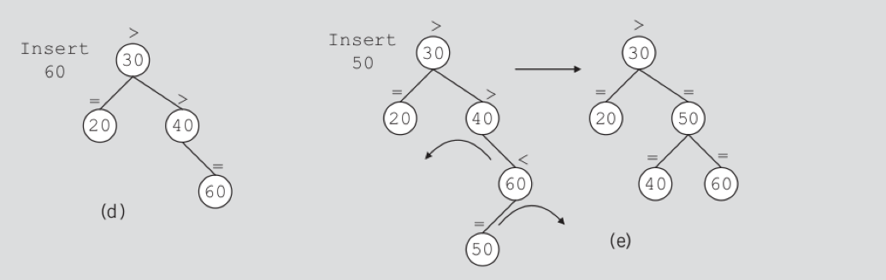
FIGURE 11-23 Item insertion into an initially empty AVL tree

Slide 23
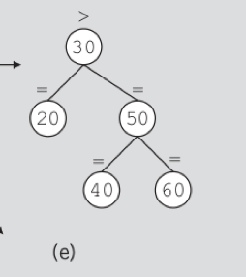
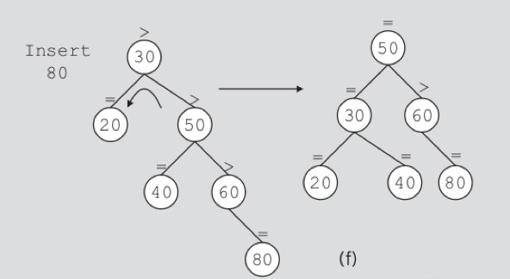

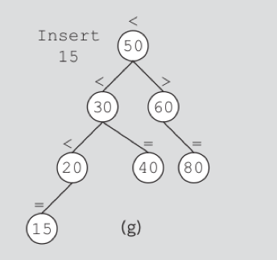
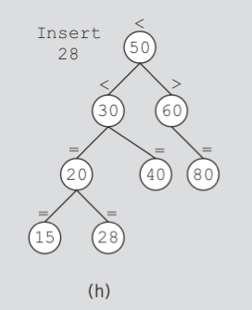
Insert 80
Single left
Insert 28
Insert 15

Slide 24

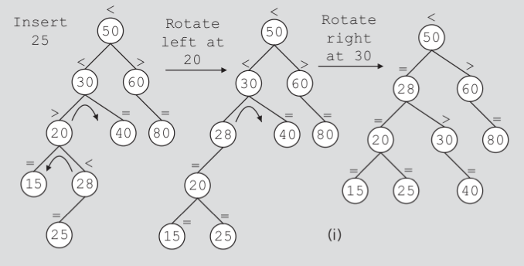
Insert 25
Double: left + right

Slide 25
Demo: https://www.cs.usfca.edu/~galles/visualization/AVLtree.html

Slide 26
AVL Node Insertion: Implementation

Slide 27
Restore AVL
Trace back to find the violation.
  Question: how to implement this?
Update the affected nodes according to one of the four cases
The update need to be done just once; no need to prorogate to upper levels
  Why?

Slide 28
Overall AVL Insertion implementation
insertIntoAVL() on pages 648-649
  rotation functions are available in the textbook.
Node comparison + Insertion & Tree trace back: are implemented using recursion.
A bool parameter, isTaller, is used to tell the parent whether the subtree grew in height or not.

Slide 29
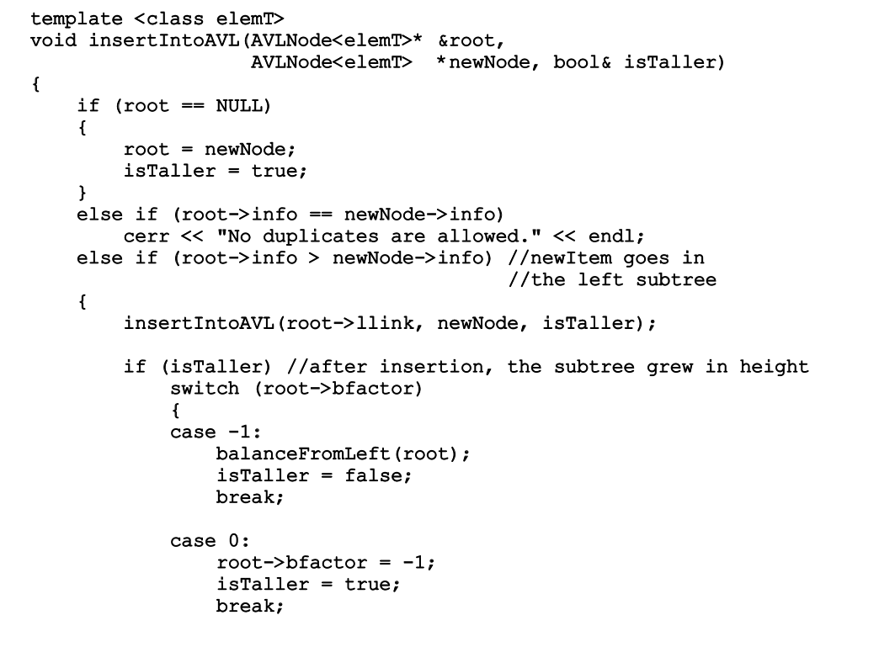
Recursive insertIntoAVL()
Communicate with parent

Slide 30
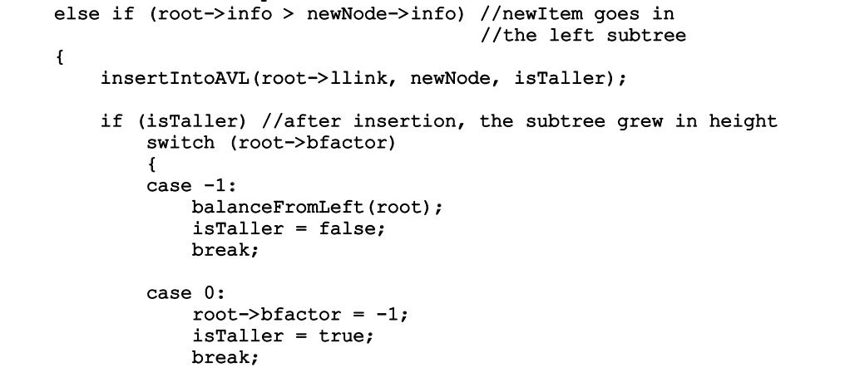
insertIntoAVL(), Cont’d
Smaller, insert to the left-tree; recursive call on llink (left)
bf == 0: left/right tree had the same heights. “isTaller” indicates the left tree just increased its height by 1.
No rotation is needed, but isTaller needs to be sent to upper levels
bf == -1, means left tree was higher at the beginning. “isTaller” from the left tree indicates the left tree just got even higher. bf will become -2, a violation.
Case 1 (--): single right rotation; or
Case 3 (+-): double rotations.

Slide 31
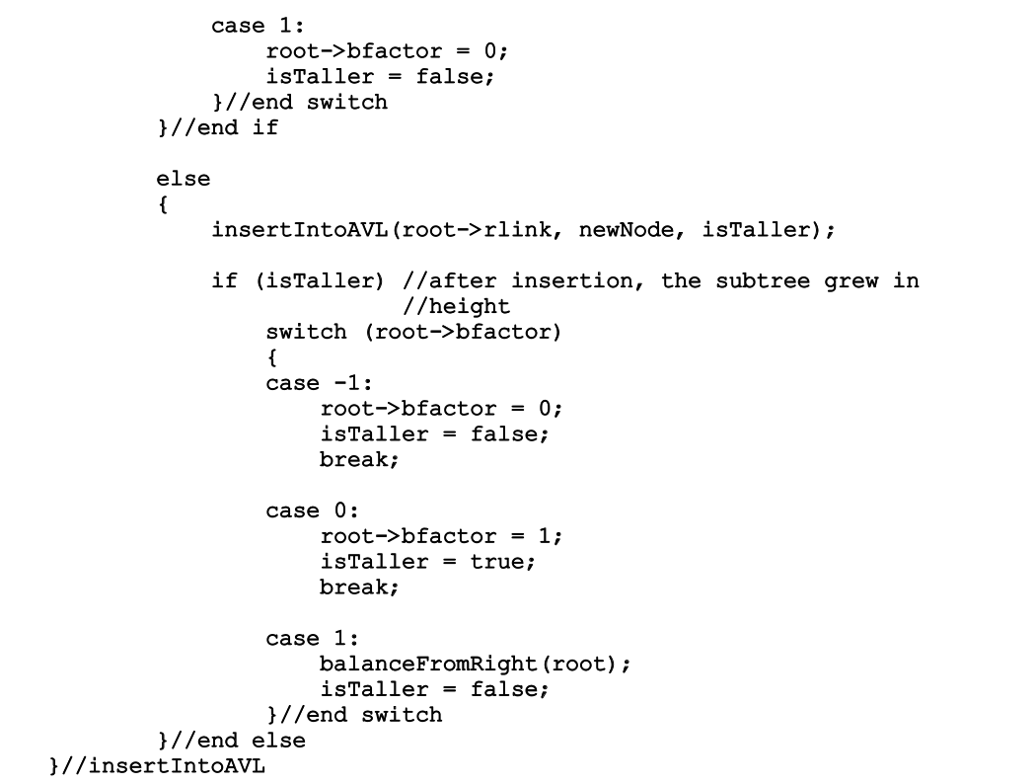
bf == 1: right tree was higher. ”isTaller” indicates the left tree just grew its height.
Now left/right are balanced. isTaller is set to false and not propagated to upper levels.
Bigger, go right; recursive call on rlink (right)
All mirror cases.

Slide 32
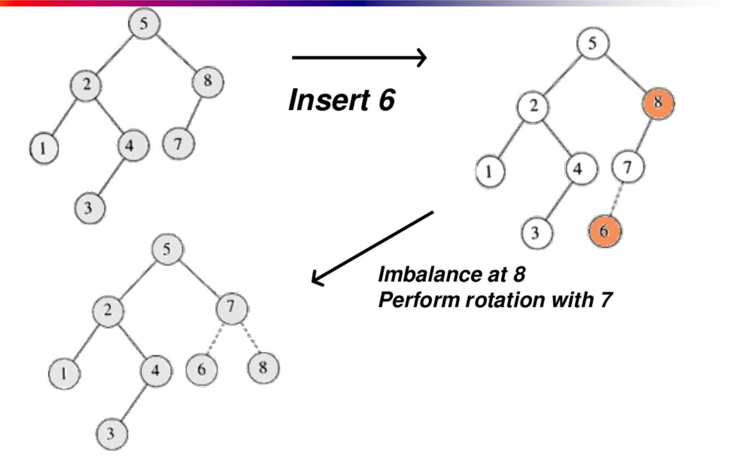
Insertion happened in the left-tree, and it became even taller
bf = -1
Left high
https://www.slideshare.net/sandpoonia/lecture11-33728696

Slide 33
AVL Node Deletion
Now switch to AVL_deletion.ppt under BB

Slide 34
Time complexity of AVL Insertion/Deletion

Slide 35
Heights of AVL trees: Worst-case Analysis
AVL trees are binary search trees in the first place
The whole purpose to develop balanced BSTs, including AVL, is to control the height of the tree
  The height of the tree is corresponding to the worst-case complexities for search, insert, delete.
  We hope the height is O(log n)

Slide 36
Heights of AVL trees
Question:
  given the number of nodes, n, what would be the maximum height, h, for an AVL tree?
  The maximum height is corresponding to the worst-case performance for search, insert and delete.
Or an equivalent question:
  Given the height of an AVL tree, h, what would be the minimum number for n, the number of nodes?

Slide 37
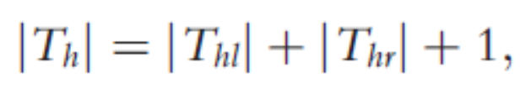
Minimal AVL trees
Consider all possible AVL trees of height h
  Let T_{h} be an AVL tree of height h such that T_{h} has the fewest number of nodes
  Let T_{hl} denote the left subtree of T_{h} and T_{hr} denote the right subtree of T_{h}
  Then:
    where |T_{h}| denotes the number of nodes in T_{h}

Slide 38
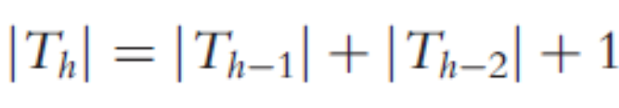
Minimal AVL trees
Suppose:
  T_{hl} is of height h – 1 and T_{hr} is of height h – 2
    T_{hl} is an AVL tree of height h – 1 such that T_{hl} has the fewest number of nodes among all AVL trees of height h – 1
  T_{hr} is an AVL tree of height h – 2 that has the fewest number of nodes among all AVL trees of height h – 2
    T_{hl} is of the form T_{h} -1 and T_{hr} is of the form T_{h} -2
  Hence:

Slide 39
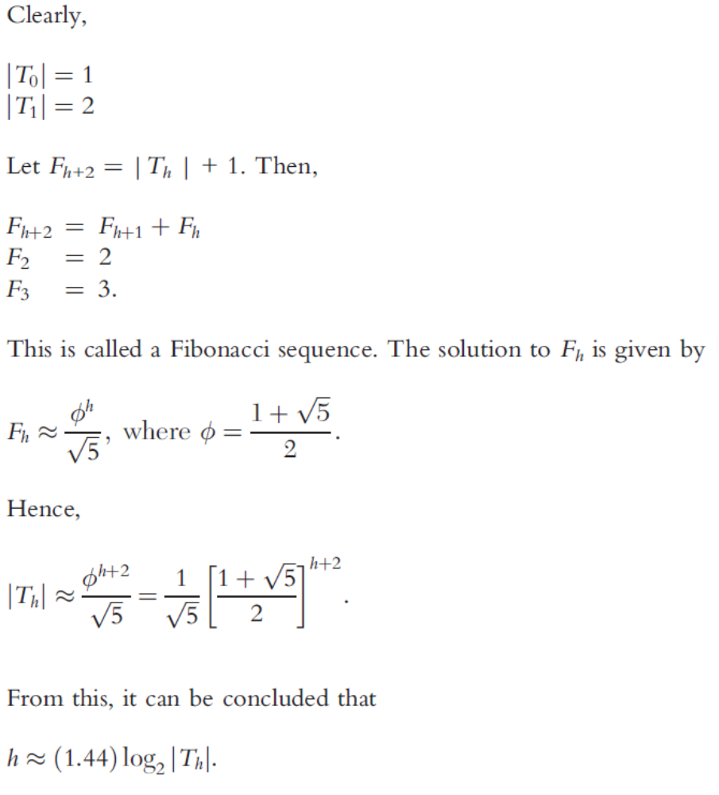
AVL trees:
n vs. h

Slide 40
Summary
This chapter discussed
  Binary trees
  Binary search trees
  Recursive traversal algorithms
  Nonrecursive traversal algorithms
  AVL trees

