Slide 1
Saguache County Water Study Data Visualization
Cammie Newmyer, June 20, 2023

Slide 2
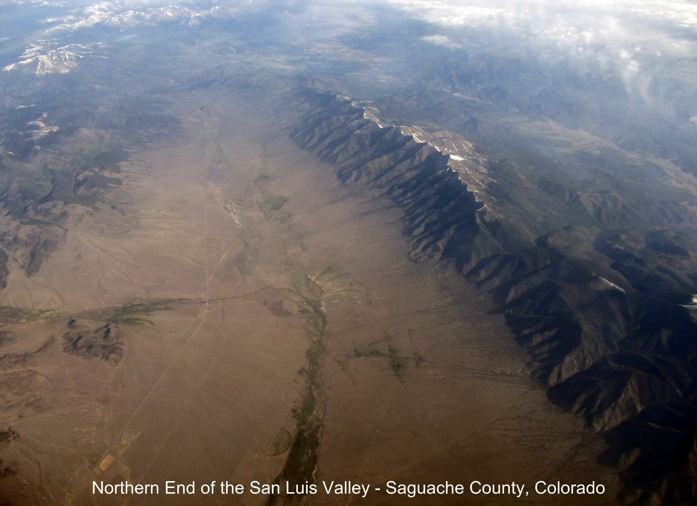
Abstract
This final report presents the successful completion of a project aimed at developing a deep learning model for assessing the likelihood and depth of well penetration through the smectite clay layer in the Rio Grande Basin (Closed Basin) Aquifer, situated in Saguache County, Colorado. The project encompassed the design and implementation of an intuitive interface, comprehensive data collection, dataset construction, deep learning model development, and interface deployment.
The deep learning model, trained using a combination of historical well data and theoretical information on the smectite clay layer, demonstrates a high degree of accuracy in predicting well penetration likelihood and providing depth estimations.
The user-friendly interface integrates real-time predictions and visualization capabilities, empowering stakeholders with valuable insights for informed decision-making in sustainable water management practices. The successful outcome of this project contributes to the responsible utilization of water resources in the Rio Grande Basin, supporting the region's long-term water supply and management goals.

Slide 3
Data Description
The Saguache County Water Study is a data project that combines well completion reports from the Colorado Division of Water Resources well permit site with input from a master water contractor. The data has been carefully prepared, cleaned, and engineered to create a high-quality dataset suitable for training a deep learning model. This study aims to provide valuable insights into water resources in Saguache County, Colorado, and contribute to informed decision-making and sustainable water management
The dataset used in the Saguache County Water Study contains several key features that have been engineered and prepared for analysis and modeling. These features provide important information related to well completion reports and water resources in Saguache County.
Feature Descriptions:
Township_N: This feature represents the township location of the well in Saguache County, providing a geographical reference point.
Range_E: The range feature indicates the range location of the well within Saguache County, helping to narrow down the well's specific area.
Section: This feature denotes the section number where the well is located within the township and range, providing more precise spatial information.
Well_Depth: This feature specifies the depth of the well, indicating how deep the well reaches into the ground to access the water source.
Elevation_Of_Clay_Layer: If reaching the smectite clay layer is likely, then the depth to the aquifer is calculated using the difference between the elevation of the location of the well and the depth at which the smectite clay layer is reached.
Smectite_Clay_Layer: This is the target feature for the model. A value of 1 indicates that the smectite clay layer is likely at this location. A value of 0 indicates it is not likely.
Depth_to_Aquifer: This feature is given by well completion reports identifying blue clay or alternatively when the data is not available expert opinion on the depth of the smectite clay layer in that area.
Elevation: The elevation feature represents the elevation of the surface of the well, which can be crucial in understanding the vertical positioning of the water source.

Slide 4
Research Question
Methodology
How can the development of a deep learning model, utilizing comprehensive data collection and visualization of well sites, township, range, section, and associated geological characteristics, enhance the accuracy of predicting the likelihood of well penetration through the smectite clay layer, and provide depth estimations for wells that are likely to encounter the clay layer?
The methodology for this project involved the design and development of an intuitive interface for data collection and visualization. Historical well data, township range, section, and associated geological characteristics were gathered, along with theoretical information on the smectite clay layer. These datasets were combined, cleaned, and preprocessed to create a comprehensive dataset. A deep learning model was developed and trained using the dataset.
The model's performance was optimized through iterative experimentation and fine-tuning using a validation set. Finally, the trained model was evaluated using a testing set, and the interface was deployed for real-time predictions. This methodology ensured the successful development of a highly accurate deep learning model for assessing well penetration likelihood and providing depth estimations in the Rio Grande Basin aquifer.

Slide 5
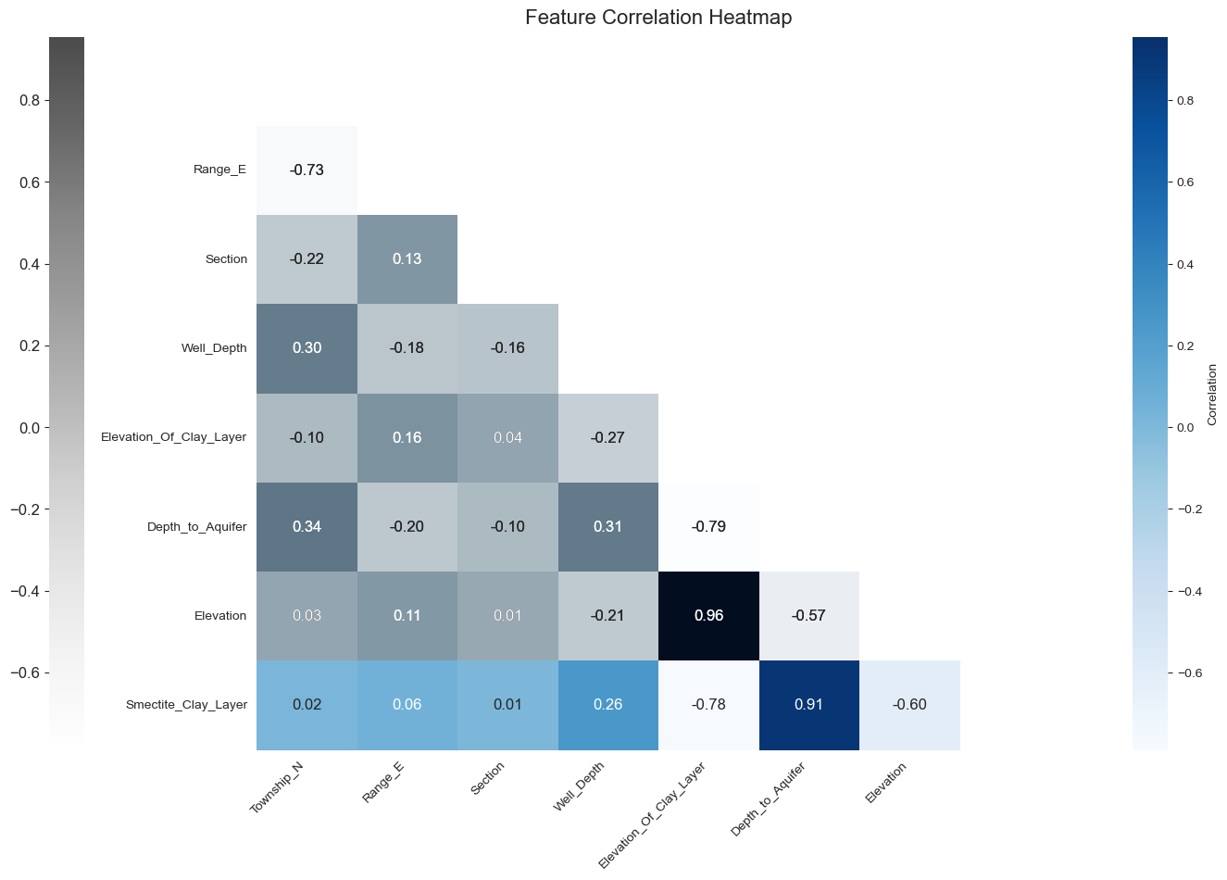
Exploratory Data Analysis
Through exploratory data analysis, several important findings emerged regarding the relationship between the target variable, "Smectite_Clay_Layer," and various features. The feature "Depth_to_Aquifer" displayed a significant positive correlation with the target variable, indicating that as the depth to the aquifer increases, the likelihood of encountering the smectite clay layer also increases.
On the other hand, both "Elevation" and "Elevation_Of_Clay_Layer" exhibited a strong negative correlation with the target variable. This suggests that higher elevations and greater distances from the clay layer are associated with a reduced likelihood of its presence.
Based on these findings, it is expected that these features, namely "Depth_to_Aquifer," "Elevation," and "Elevation_Of_Clay_Layer," will be the most influential predictors in the model. By incorporating these features into the model, it is anticipated that accurate predictions regarding the presence of the smectite clay layer can be made.

Slide 6
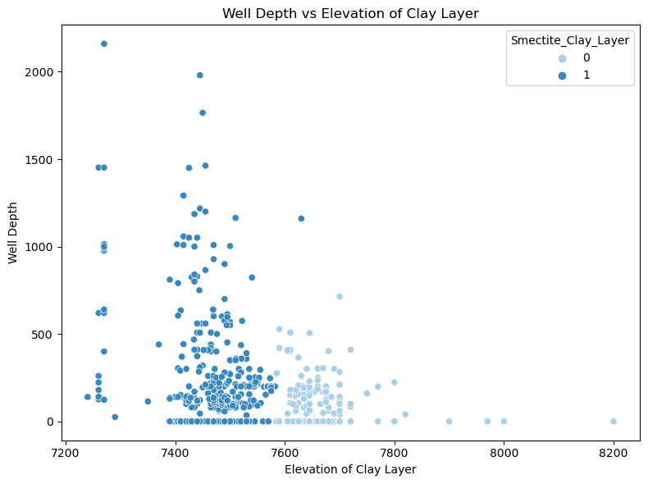
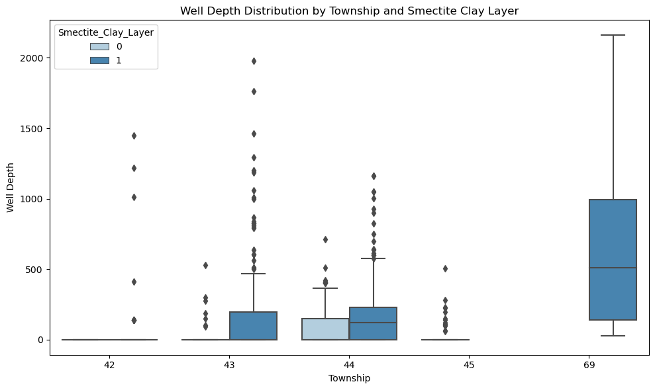
Exploratory Data Analysis
Both of these visualization provide insight regarding the characteristics of well depth with respect to the target variable. In the figure on the left, the Townships {43, 44, 69} correspond with the greatest well depths. In the figure on the right the elevation of the clay layer illustrates that the wells with a likelihood of reaching the clay layer correspond with a lower elevation.

Slide 7
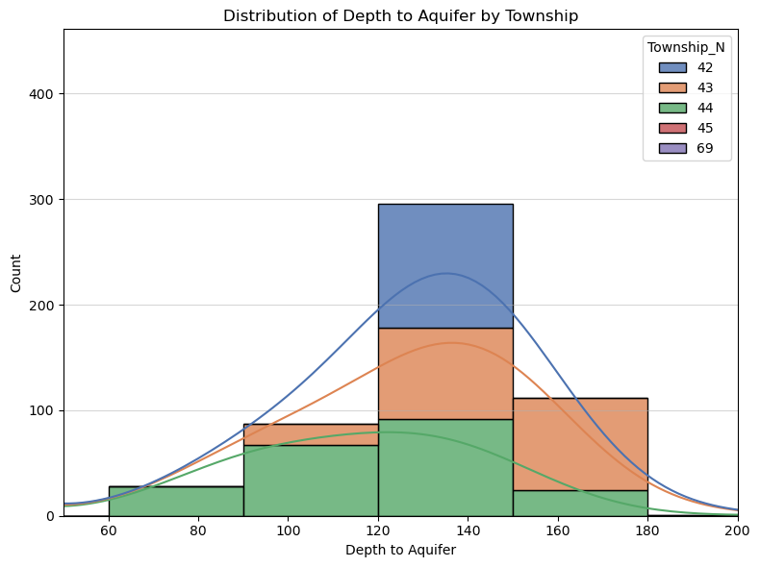
Exploratory Data Analysis
The visualization presented here depicts the distribution of aquifer depth across different Townships. Township 69 (the Baca Grant) exhibits an average depth of 300 ft to the aquifer, while Township 45N lacks any wells that penetrate the smectite clay layer. The visualization specifically considers wells falling within this depth range.
Among the Townships, 42N displays the most significant concentration of wells (300 in total) reaching the confined aquifer. The depth to the aquifer in this case ranges between 120 and 150 feet.

Slide 8
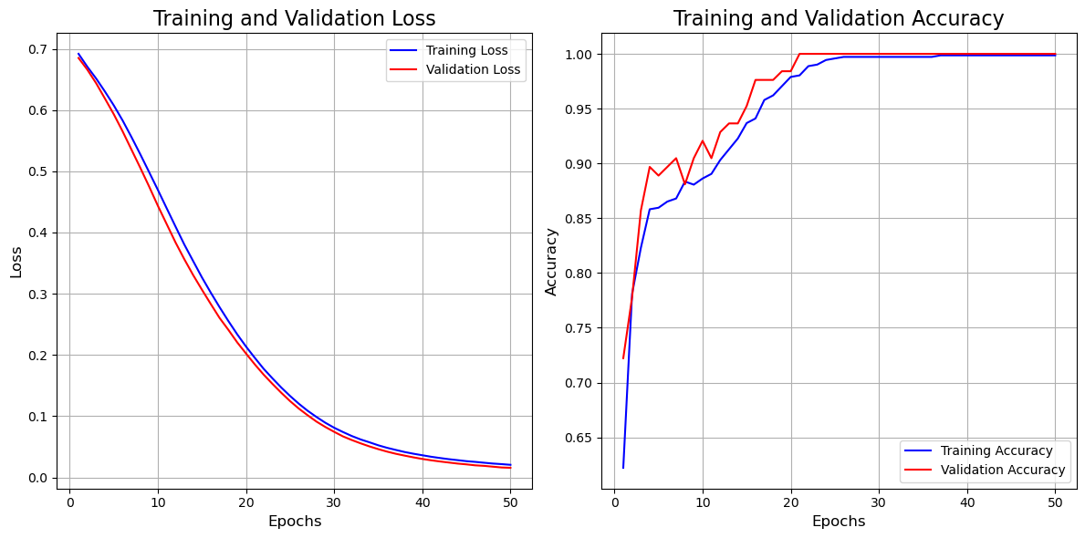
Model Performance Visualization
This visualization illustrates the performance of the training model.
The training and validation loss are closely aligned decreasing from 70% to less than 5% by the end of the full run of 50 epochs.
The accuracy of the model increases from 65% to 100% over 25 epochs. The training accuracy increases steadily while the validation accuracy varies more often.

Slide 9
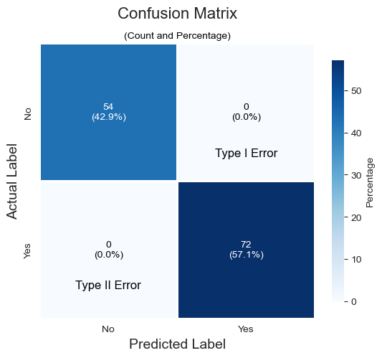
Model Performance Visualization
The confusion matrix is also a model performance visualization. After model tuning, the predictive model has a high accuracy. The confusion matrix illustrates that when the model has been tested on the alternate data, all the predictions that the well would not penetrate the smectite clay layer were predicted correctly and that all the predictions that the well would not penetrate the smectite clay layer were also predicted correctly.

Slide 10
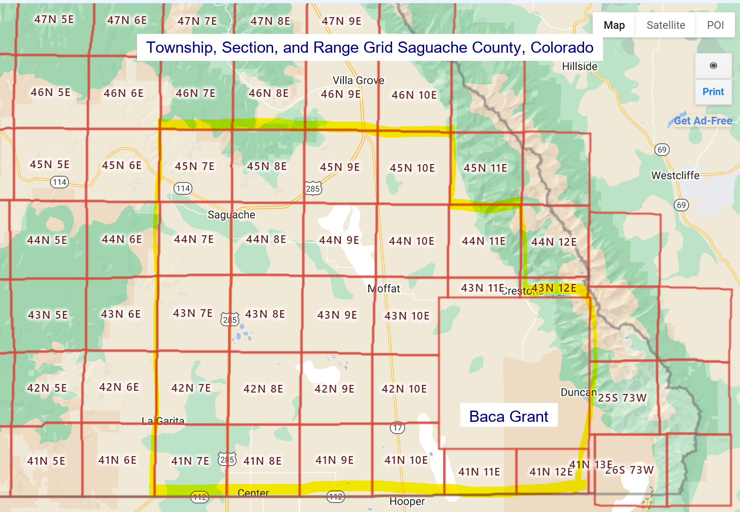
Visualization to Assist the User
This image was annotated in the Saguache_County_Water_Study.ipynb file associated with the project. It has been added to assist the reader with a geographical image of the data. In the next image, the network mapping includes division by Township N, Range E, and Section.
Section corresponds to the 36 squares into which each Range has been further divided. Section is not included in this image nor in the following network map due to the added layer of complexity. However, the feature “Section” is included within the deep learning model and predictive analysis.
Including this image is essential for the interactive portion of the project where the user can input the township, range, and section for predictive purposes.
Original Image Source.

Slide 11
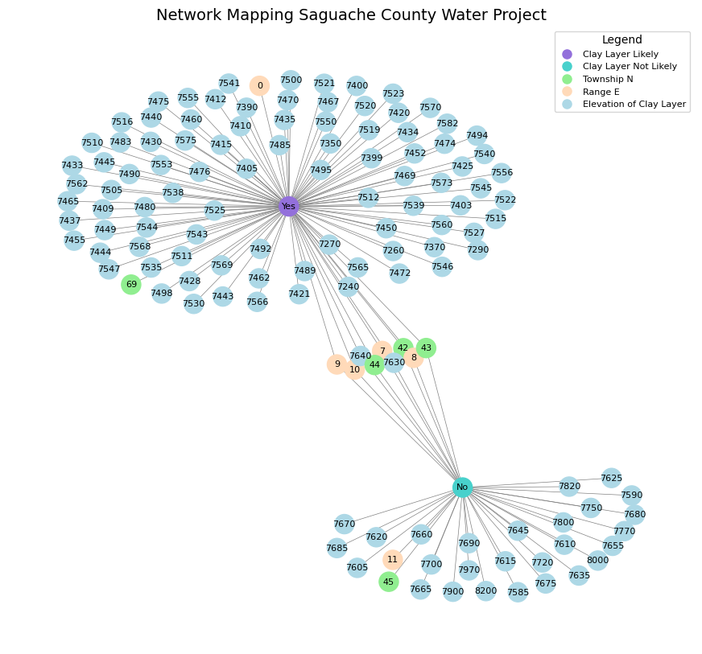
This graph represents a network mapping of the Saguache County Water Project. It visualizes the relationships between different nodes related to the project, including the presence of a smectite clay layer, township numbers, range values, and elevation of the clay layer. Each node is represented by a distinct color, enabling easy identification.
The legend provides a key for interpreting the colors and node types in the graph. The graph highlights the connections between the smectite clay layer and other factors, such as townships, range values, and elevation.
The visualization helps to understand the complex relationships within the water project, providing insights into the geographical distribution and connections between different elements involved in the project.

Slide 12
Conclusion
The Saguache County Water Study successfully developed a deep learning model with a specific architecture to predict the likelihood of well penetration through the smectite clay layer and provide accurate depth estimations. The model utilized a combination of convolutional and dense layers to effectively process comprehensive data on well sites, township range, section, and associated geological characteristics.
Exploratory data analysis and visualization played a crucial role in understanding the dataset and informing the design of the deep learning model. By analyzing the data, patterns and relationships between variables were identified, allowing for informed decisions in model architecture and feature selection.
The final model architecture consisted of a Conv1D layer for 1D convolution, a MaxPooling1D layer for “downsampling,” a Flatten layer for reshaping, and two Dense layers for capturing complex relationships. The output layer used a sigmoid activation function to provide a probability estimation for the presence of the smectite clay layer.
The model was trained using the Adam optimizer, compiled with binary cross-entropy loss, and monitored using early stopping to prevent overfitting. After training, the model was evaluated on a test set, and its performance was assessed using metrics such as test loss and test accuracy. The model demonstrated high accuracy, as evidenced by the Confusion Matrix, where all test data was correctly identified.
To facilitate practical use, the trained model allows users to input Township, Range, and Section values to predict the presence of the clay layer at specific locations. If the model predicts the presence of the clay layer, it also provides the average elevation of the layer at that location as an output.
The developed deep learning model provides an intuitive and user-friendly interface that effectively combines data collection, visualization, and predictive capabilities. It serves as a valuable tool for the Saguache County Water Study, enabling accurate assessments of well penetration likelihood and depth estimations for the smectite clay layer.

