Slide 1
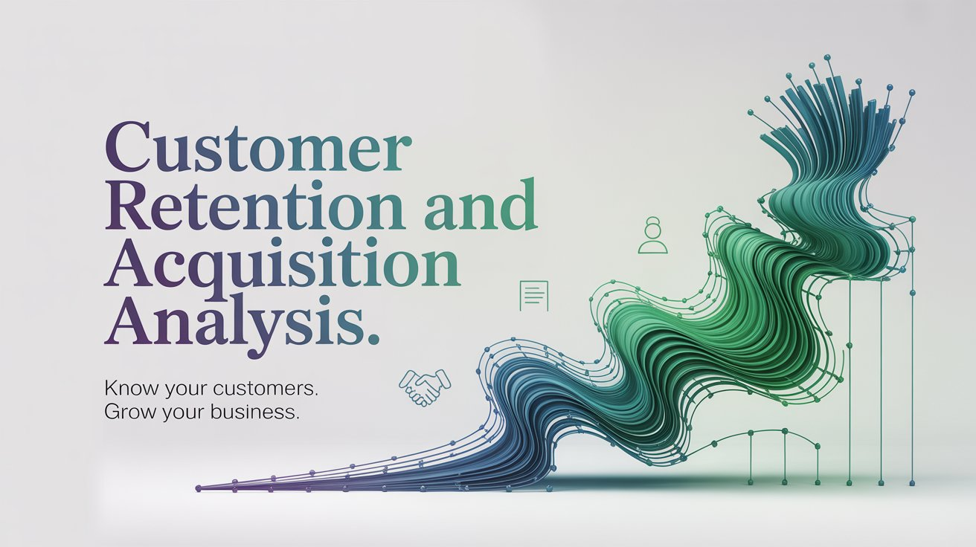

Slide 2
🚀 Project Overview
Goal: Improve customer retention and acquisition through analytics.
Approach: RFM, CLV, segmentation, forecasting, campaign analysis.
Outcome: Strategic insights for better marketing and customer targeting.

Slide 3
✨ Features
RFM Segmentation & Customer Scoring
Customer Lifetime Value (CLV) Calculation
Cohort Analysis & Retention Tracking
Revenue Forecasting with Holt-Winters and SARIMA
Campaign Performance Analysis
Interactive Dashboards (Plotly, Power BI)

Slide 4
🛠 Tools & Technologies
Languages: Python, DAX (Power BI)
Libraries: pandas, numpy, seaborn, sklearn, matplotlib, plotly, statsmodels
ML: KMeans, SARIMA, Holt-Winters
Visualization: Plotly, Power BI, Seaborn, Matplotlib
Platforms: Google Colab, Power BI Desktop, GitHub, Google Drive

Slide 5
📦 Datasets Used
Repeated Orders Dataset (708621 rows × 24 columns)
All Channels Customers Dataset (157661 rows × 26 columns)
Customer Acquisition Dataset (157661 rows × 26 columns)
Original Dataset https://drive.google.com/drive/folders/1IIZ49cPly1_UzSfyLE280nrX2nYQLGi6?usp=drive_link

Slide 6
🧹 Data Preparation
Imported multiple customer & order datasets
Cleaned nulls, fixed types, merged sources
Prepared data for segmentation & modeling
Cleaned Datasets: https://drive.google.com/drive/folders/1EpJNIcN_wH6M6NK2x--D9W3LqrGDFjgY?usp=drive_link

Slide 7
📊 Customer Segmentation using RFM
Calculated Recency, Frequency, and Monetary values
Assigned RFM scores and segmented customers
Segments: Champion, Loyal, At Risk, etc.
Champions show high spend and recent activity.
At-Risk customers need re-engagement strategies.

Slide 8
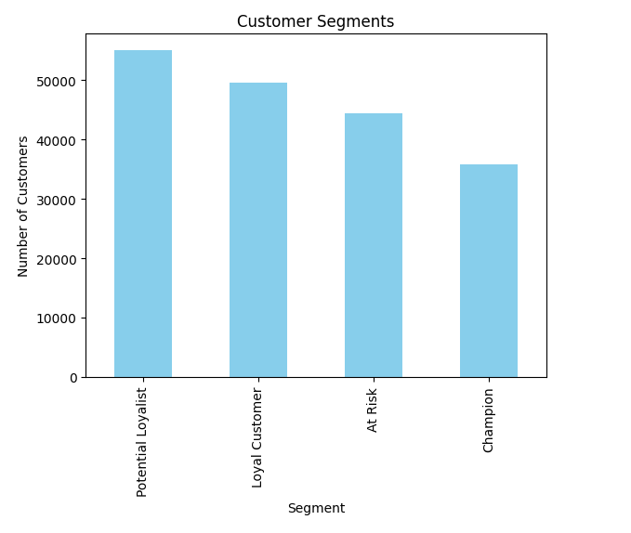
📊 Insights from RFM Segments
Most customers are either At Risk or Potential Loyalists.
Champions have both recent and frequent transactions with high monetary value

Slide 9
💰 Customer Lifetime Value
Computed AOV, Purchase Frequency, and Lifespan (CLV = AOV × Purchase Freq × Lifespan)
CLV Segments: Low, Medium, High
Compared CLV across SME, Retail, 2W, HCV/LCV
Higher CLV customers prioritized for acquisition

Slide 10
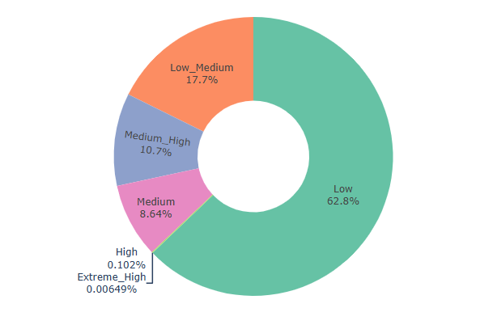
CLV Insights

Slide 11
📢 Campaign Effectiveness
Merged campaign data with customer metrics
Analyzed revenue by campaign and customer segment
Sorted and visualized top-performing campaigns

Slide 12
📈 Revenue Forecasting
Built SARIMA model with Box-Cox transformation
Forecasted 12-week revenue trends
Optimized parameters using BIC
Visualized historical and predicted revenue

Slide 13
⏳ Revenue Forecasting (Holt-Winters)
Used Holt-Winters Exponential Smoothing
Resampled data weekly and trained additive/multiplicative models.
Compared additive vs. multiplicative seasonal models
Forecasted 12 weeks ahead

Slide 14
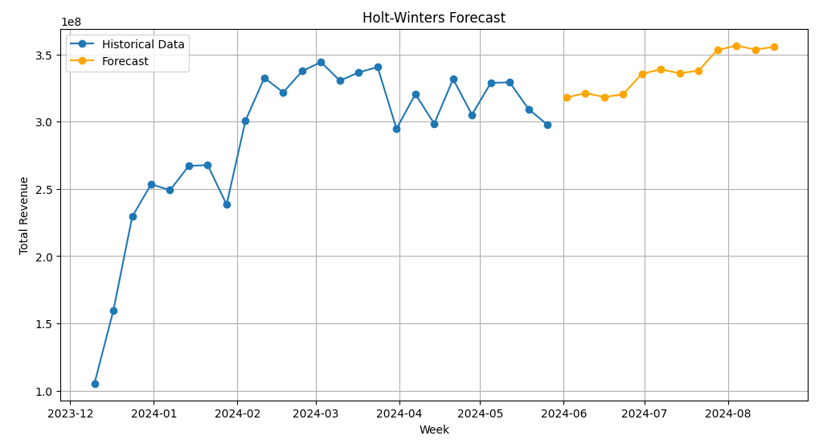
📈 Holt-Winters Forecasting

Slide 15
📆 Cohort & Retention
Grouped customers by first purchase month
Calculated retention and churn rates
Visualized heatmaps and trends over time

Slide 16
📊 Dashboards
Created HTML dashboards using Plotly
CLV Dashboard: Pie, scatter, bar, and box plots
RFM Dashboard: Segment pie, score histograms
Power BI: Acquisition trends and campaign insights

Slide 17
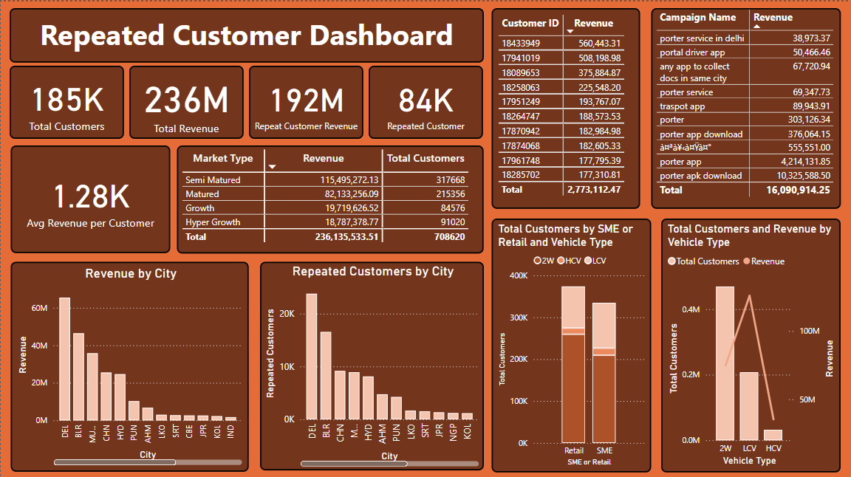
📊 Power BI Dashboard

Slide 18
🚀 Executive Summary
708K+ customer records analyzed from acquisition and repeated orders
81.36% of revenue generated from repeat users
Delhi alone contributed ₹64.5M+ in total revenue
SME 2W customers had the highest Customer Lifetime Value (CLV)
Champions drive the most revenue

Slide 19
📚 Project Resources
All code and files available on GitHub
Interactive dashboards: HTML + PBIX
Cleaned datasets for reuse and exploration
Project Video Link: https://drive.google.com/file/d/11lvBrFhBHsW9s62oEWYlMGGupjkru2vv/view?usp=drive_link
Notion Full Document: https://www.notion.so/Customer-Retention-and-Acquisition-Analysis-193c0db6457880f89778f6c62f862413

Slide 20
👨‍💻 About the Author
🔹 Naveen Dhawan
🎯 Data Analyst | Python & BI Developer
🔗 GitHub: https://github.com/newnaveendhawan
📧 Email: newnaveendhawan@gmail.com
📂 Project Drive Link:
https://drive.google.com/drive/folders/1Z0QtEvMF3rJ211X-YaLqlk1Vj5298c07?usp=drive_link

