Slide 1
Model Driven Network Automation
Jason Belk, Network to Code

Slide 2
Agenda
Introduction
Data Encoding, Data Models, APIs, and Transport
Diving Deeper into RESTCONF
Exploring RESTCONF on IOS-XE with Postman

Slide 3
Introduction
Notes:
Introduction

Slide 4
Why are we here?
Network Operations & Management hasn’t changed for 20 years.
Unless we count the transition from telnet to SSH.
Notes:
Network operations and management hasn’t changed in 20 years
Unless you count SSH!

Slide 5
From CLI to API
The industry is transitioning to an API first model
CLI is for humans
APIs are for machine to machine communication
APIs do not replace CLI
APIs can have a profound impact on operations
APIs facilitate operational efficiency
Notes:
Industry is moving to API first model
- CLI Humans
- APIs
- Machine to machine communications
- Not CLI replacement
- Profound impact on operations by allowing automation
- Operational efficiency by allowing automation

Slide 6
So many new terms…
…in this new world
Linux
Docker
CoreOS
Mesosphere
Python
Go
Ansible
SaltStack
Puppet
Postman
cURL
Model-Driven
Text Editors
YANG
XSD
API-first
IDEs
XML
JSON
YAML
TABS vs. SPACES
NETCONF
RESTCONF
RESTful
gRPC
Notes:
So many new terms…. (Next Slide)

Slide 7

So many new terms…
…in this new world
Linux
Docker
CoreOS
Mesosphere
Python
Go
Ansible
SaltStack
Puppet
Postman
cURL
Model-Driven
Text Editors
YANG
XSD
API-first
IDEs
XML
JSON
YAML
TABS vs. SPACES
NETCONF
RESTCONF
RESTful
gRPC
Notes:
It is hard to put get a grasp on all of them, or even understand them all.

Slide 8
Covering a subset of these today
Keep in mind the skills for the future network engineer are increasing
Linux
Python
Postman
Model-Driven
Text Editors
YANG
XML
JSON
TABS vs. SPACES
NETCONF
RESTCONF
RESTful
Notes:
We cover a subset today

Slide 9
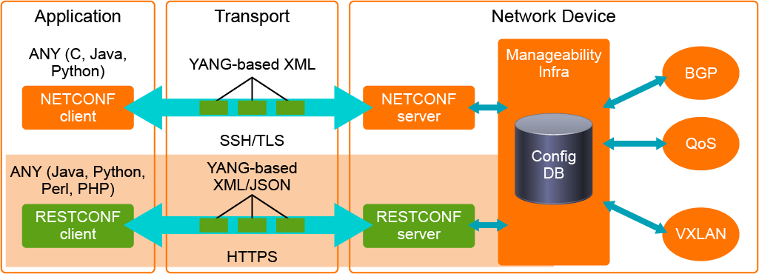
Cisco IOS XE APIs Overview
Accept NETCONF and RESTCONF requests and communicates directly to configuration datastore(s).
Notes:
IOS XE APIs Overview
- Service processes accept NETCONF and RESTCONF request and communicates with the configuration datastores.
- Application – Postman, Python, C, Java, Programs
- Transport – YANG data model defined XML or JSON (RESTCONF only)
- Network Device – Run server process (NETCONF and RESTCONF) which communicate with the devices management database.

Slide 10
Objectives
Understand what data models are and why they’re important
Leave here knowing how to use Postman so you can explore any HTTP-based API
Become familiar with the basics of reading and executing Python scripts using IOS-XE APIs
Know enough to continue your IOS-XE API journey tomorrow
Realize you must understand the basics of programmability sooner than later
Understand you will not be an IOS-XE API expert in 4 hours ☺
Recognize learning takes time
Notes:
Objectives
- Understand data model and why they are important
- Leave here knowing how to use Postman to explore REST APIs
- Basics of reading and executing Python scripts using IOS-EX APIs
- Continued exploration of the technology covered today
- You will become a programmer eventually, if you aren’t already
- Not an expert, more to learn
- Takes time to absorb all around APIs and functionality

Slide 11
Breaking down Network APIs
Data Encoding
Data Models
Transport
Protocols
Notes:
Data Encoding – The formatted structure which data is received and transmitted over the API
Data Models – Defines the structure of the data being encoded
Transport – SSH, HTTP, HTTPS, TLS, HTTP/2
Protocols – NETCONF, REST and RESTCONF

Slide 12
Data Encoding
Who gets confused seeing “{}” or “</tag>” in code or text output?
Notes:
What are all these confusing tags?

Slide 13

Data Encoding
Who gets confused seeing “{}” or “</tag>” in code or text output?
Too bad? They are standard and take a little getting used to…
Notes:
What are all these confusing tags?
To bad! Standard! Need to get use to it!

Slide 14

Data Encoding
There needs to be structure behind what is communicated between systems
cisco#show run interface GigabitEthernet 1
Building configuration...
Current configuration : 146 bytes
!
interface GigabitEthernet1
vrf forwarding MANAGEMENT
ip address 10.0.0.151 255.255.255.0
negotiation auto
no mop enabled
no mop sysid
end
This is formatted text, not structured data
Notes:
Data Encoding
Structure behind the data structure

Slide 15
Data Encoding: JSON & XML
{
"Cisco-IOS-XE-native:GigabitEthernet": {
"name": "1",
"vrf": {
"forwarding": "MANAGEMENT"
},
"ip": {
"address": {
"primary": {
"address": "10.0.0.151",
"mask": "255.255.255.0"
}
}
},
"mop": {
"enabled": false,
"sysid": false
}
}
}
<GigabitEthernet>
<name>1</name>
<vrf>
<forwarding>MANAGEMENT</forwarding>
</vrf>
<ip>
<address>
<primary>
<address>10.0.0.151</address>
<mask>255.255.255.0</mask>
</primary>
</address>
</ip>
<mop>
<enabled>false</enabled>
<sysid>false</sysid>
</mop>
</GigabitEthernet>
JSON
XML
Notes:
Data Encoding: JSON vs XML
- Same hierarchical structure based on YANG data model

Slide 16
Data Encoding: JSON & XML
{
"Cisco-IOS-XE-native:GigabitEthernet": {
"name": "1",
"vrf": {
"forwarding": "MANAGEMENT"
},
"ip": {
"address": {
"primary": {
"address": "10.0.0.51",
"mask": "255.255.255.0"
}
}
},
"mop": {
"enabled": false,
"sysid": false
}
}
}
<GigabitEthernet>
<name>1</name>
<vrf>
<forwarding>MANAGEMENT</forwarding>
</vrf>
<ip>
<address>
<primary>
<address>10.0.0.151</address>
<mask>255.255.255.0</mask>
</primary>
</address>
</ip>
<mop>
<enabled>false</enabled>
<sysid>false</sysid>
</mop>
</GigabitEthernet>
print response['Cisco-IOS-XE-native:GigabitEthernet']['ip']['address']['primary']['address']
10.0.0.151
print response.findall('.//{http://cisco.com/ns/yang/Cisco-IOS-XE-native}address')[1].text
10.0.0.151
JSON
XML
Notes:
Data Encoding: JSON vs XML
- Same hierarchical structure based on YANG data model

Slide 17
Data Encoding
There needs to be structure behind what is communicated between systems
cisco#show run interface GigabitEthernet 1
Building configuration...
Current configuration : 146 bytes
!
interface GigabitEthernet1
vrf forwarding MANAGEMENT
ip address 10.0.0.151 255.255.255.0
negotiation auto
no mop enabled
no mop sysid
end
>>> for line in response.splitlines():
... if 'address' in line:
... print line.split('address')[1].split(' ')[1]
...
10.0.0.151
>>>
Other options exist. All use spacing, loops, or Regular Expressions.
Still very prone to error.
But, automation was/is still possible.
This is formatted text, not structured data
Notes:
Data Encoding
- Structure behind the communication between systems
- Python example of parsing CLI output
- Prone to error
- Doesn’t adapt well to changed to CLI output
- Automation still possible despite these issues, but ultimately not recommended

Slide 18
Data Encoding
Machines can easily parse XML and JSON. You can easily send an object that a machine understands.
Notes:
Data Encoding
- Machines easily parse XML and JSON.

Slide 19
We now know machines communicate using structured data.
What about the proper syntax and constraints of that data?
Notes:
What about proper syntax and constraints on the data?

Slide 20
Data Models
What are Data Models?
Data models describe a constrained set of data
Use well-defined parameters to standardize the representation of data
Notes:
Data Models
What are they?
Describe a constrained set of date
Use defined parameters to standardized the format of the data

Slide 21
Data Models
Examples
How do you describe a VLAN?
VLAN ID
VLAN name
VLAN state
…
Notes:
Data Models - Examples
How do you describe a VLAN?
ID
Name
State
Etc…

Slide 22
Data Models
Examples
How do you describe a VLAN?
VLAN ID – integer between 1 and 4096 ?
VLAN name – string between 1 and N characters ?
VLAN state – enumeration of “down/up” or “shutdown/ no shutdown”
…
This is defining the constraints of the data– the Data Model for a VLAN.
Notes:
Data Models - Examples
How do you describe a VLAN?
ID - int 1 to 4096
Name – str 1 to n chars
State – enumeration (down|up) or (shutdown|no shutdown)
Etc…

Slide 23
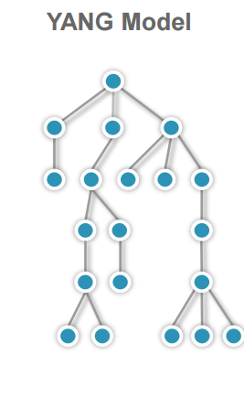
YANG
It is a network-centric data modeling language defined in RFC 6020 specifically built for “network data”
Initially built for NETCONF
Now also used by RESTCONF and can be used by any protocol
Models configuration and operational state data
Provides syntax and semantics
Notes:
YANG
- Network centric data modeling language specifically for ”Network Data”
- Initially for NETCONF
- Models configuration and operational state data
- Provides syntax and semantics

Slide 24
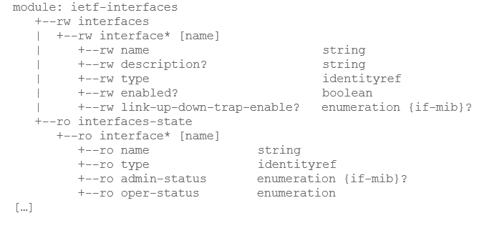
YANG
Sample YANG Module
Notes:
YANG Sample

Slide 25
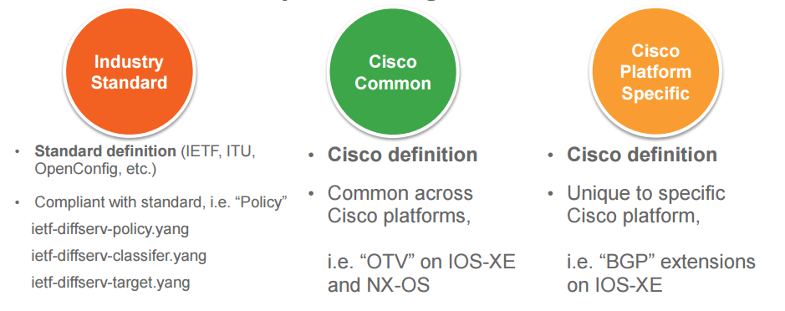
YANG
Open and Native YANG Models
Notes:
YANG Open and Native YANG Models
Industry Standard
Policy definitions
Basic System definitions
Basic interface definitions
Cisco Common
Common definitions across platforms
Examples: OTV on IOS-XE and NX-OS
Cisco Platform Specific
Unique to specfic platforms
Examples: BGP extensions on IOS-XE

Slide 26
Transport
The properly structured and encoded data still needs a way to get from point A to point B:
SSH
HTTP
HTTPS
TLS
HTTP/2
Notes:
Transport
SSH
HTTP
HTTPS
TLS
HTTP/2

Slide 27
APIs
Two most common types of network APIs
NETCONF
Uses XML encoded data
Data that is transported is modeled either using YANG or XSD
NETCONF on IOS-XE uses XML data that adheres to YANG models
NETCONF protocol itself has network centric features (cover some of these later)
Transported over SSH
REST (for network devices)
Uses XML or JSON encoded data
Modeled either using YANG, XSD, JSD, or custom modeling language
RESTCONF on IOS-XE uses XML/JSON data that adheres to YANG models
IOS-XE produces their REST API using data modeled from YANG → RESTCONF
Transported over HTTP/HTTPS
Notes:
NETCONF
- XML data
- YANG Model Defined
- Network centric features
- SSH Transport
RESTCONF
- XML or JSON data
- YANG Model Defined
- REST API is defined from YANG model
- HTTP/HTTPS Transport

Slide 28
Network Programmability Stack
Apps
App1
App2
App3
Bindings
Software Development Kits (SDK) and libraries
YANG development kit (YDK)
Protocols
NETCONF
REST
RESTCONF
gRPC
Encoding
XML
JSON
Transport
SSH
TLS
HTTP(S)
HTTP/2
Models
Data Models
Notes:
NP Stack

Slide 29
Diving Deeper into RESTCONF

Slide 30
Before RESTCONF…
A little background on REST
Notes:
Before RESTCONF some background on REST

Slide 31


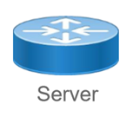
REST
If you understand how to work with a web browser, you understand REST.
Same HTTP Request Methods and Response Codes are used
HTTP GET
HTTP GET
HTML
JSON/XML
Notes:
Understand how a web browser works, you understand REST
Same Request Methods and Response codes (HTTP Standards)

Slide 32
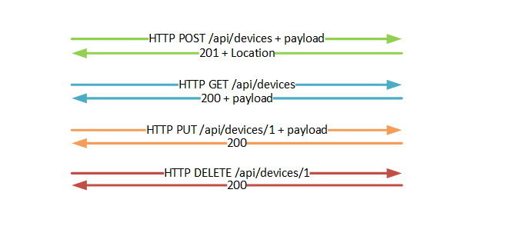
REST
Create, Retrieve, Update and Delete (CRUD)
Create
Retrieve
Update
Delete
Notes:
CRUD
Create
Retrieve
Update
Delete
Request Methods
POST
GET
PUT
DELETE

Slide 33
REST
HTTP Verbs
GET
Retrieve / Read a resource
POST
Creates a new resource
PUT
Update/Replace a resource
DELETE
Removes a resource
PATCH
Update/Modify a resource
Notes:
GET – Read resource
POST – Create a new resource
PUT – Update/Replace resource
PATCH – Update/Modify resource
DELETE – Remove resource

Slide 34
REST
HTTP Verbs in the context of network devices
GET
Retrieve / Read a resource
POST
Creates a new resource
PUT
Update/Replace a resource
DELETE
Removes a resource
PATCH
Update/Modify a resource
show command
create logical interface
replace full interface config with what’s in the body of request
update (append) interface config with what’s in the body of request
remove logical interface
Notes:
Network Device Examples
GET – Show commands
POST – Create logical interface
PUT – Replace full interface config
PATCH – update interface config
DELETE – Remove logical interface

Slide 35
REST
Common HTTP Response Codes
Success (2xx) | Description
200 | Request Succeeded
201 | The request has been fulfilled; new resource created
204 | The server fulfilled request but does not return a body
Client Error (4xx) | Description
400 | Bad Request. Malformed Syntax
401 | Unauthorized
403 | Server understood request, but refuses to fulfill it.
404 | Resource not found given URI
Server Error (5xx) | Description
500 | Internal Server Error
501 | Not implemented
Notes:
Common HTTP response codes
200 – Success
201 – Success resource created
204 – Success no response returned
500 – Internal Server Error
501 - Not Implemented - Wrong URL or structure defined in encoded data
400 – Bad Request – Invalid URL, invalid syntax data encoded, etc
401 – Unauthorized
403 – Forbidden
404 – URI not found

Slide 36
Constructing an API Request
URL
HTTP Verb
GET, POST, PATCH, PUT, DELETE
Body
Used when making a configuration change. We’ll show a JSON Body soon.
Headers
Define the structure of the data being sent and desired to be received.
Are you using JSON or XML?
Authentication
Your privileged level 15 credentials
Notes:
Constructing API requests
- URL
- HTTP Verb (Request Method)
- Body – Encoded data structure
- Headers – Define data structure encoding, XML or JSON
- Authenication

Slide 37
IOS-XE RESTCONF Request 1
Retrieving the GigE1 Configuration
URL - https://clus1/restconf/data/Cisco-IOS-XE-native:native/interface/GigabitEthernet=1
HTTP Verb
GET
Body
N/A
Headers
Accept – application/yang-data+json
Authentication
Your privileged level 15 credentials
Notes:
Get GigE1 configuration RESTCONF request

Slide 38
IOS-XE RESTCONF Response 1
Retrieving the GigE1 Configuration
{
"Cisco-IOS-XE-native:GigabitEthernet": {
"name": "1",
"vrf": {
"forwarding": "MANAGEMENT"
},
"ip": {
"address": {
"primary": {
"address": "10.0.0.151",
"mask": "255.255.255.0"
}
}
},
"mop": {
"enabled": false
},
"Cisco-IOS-XE-ethernet:negotiation": {
"auto": true
}
}
}
Notes:
Returned JSON Encoded data struture

Slide 39
IOS-XE RESTCONF Request 2
Configuring GigE2
URL – https://clus1/restconf/data/Cisco-IOS-XE-native:native/interface/GigabitEthernet=2
HTTP Verb
PATCH
Body
→
Headers
Content-Type – application/yang-data+json
Authentication
Your privileged level 15 credentials
{
"Cisco-IOS-XE-native:GigabitEthernet": {
"ip": {
"address": {
"primary": {
"address": "10.2.0.151",
"mask": "255.255.255.0"
}
}
}
}
}
Notes:
Configure GigE2 interface with RESTCONF
JSON encoded data

Slide 40
So…REST vs. RESTCONF?
Notes:
REST vs RESTCONF

Slide 41
RESTCONF
What is it?
It’s an implementation of a REST API
Model-driven API
Functional sub-set of NETCONF
Exposes YANG models via a REST API (URL)
Uses HTTP(S) as transport
Uses XML or JSON for encoding
Developed to use HTTP tools and programming libraries
RESTCONF
HTTP(S)
NETCONF /YANG
Notes:
RESTCONF
What is it?
Implementation of REST API
Model-driven API
Functional sub-set of NETCONF
Uses HTTP(S)
Data encoded in JSON or XML
Developed to use HTTP tools and programming libs

Slide 42
RESTCONF
Consuming the IOS-XE RESTCONF API
Almost identical to using any other RESTful API
Pay attention to the Accept and Content-Type Headers
Typical RESTful APIs: application/json and application/xml
RESTCONF: application/yang-data+json and application/yang-data+xml (others exist too)
Notes:
Consuming IOS-XE RESTCONF API
- Almost identical to using any RESTful API
- Make sure to understand Accept and Content-Type headers
- Typical
application/json
application/xml
- RESTCONF
application/vnd.yang.data+json
application/vnd.yang.data+xml

Slide 43
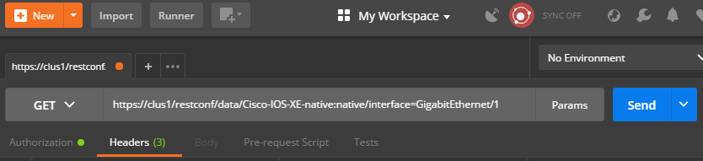
Consuming RESTful APIs
Utilities and Tools
Postman
Chrome Application
requests
Python Module
#!/usr/bin/env python
import requests
import json
from requests.auth import HTTPBasicAuth
requests.packages.urllib3.disable_warnings()
if __name__ == "__main__":
auth = HTTPBasicAuth('cisco', 'cisco')
headers = { 'Accept': 'application/yang-data+json'}
url = 'https://clus1/restconf/data/Cisco-IOS-XE-native:native/interface=GigabitEthernet/1'
response = requests.get(url, verify=False, headers=headers, auth=auth)
print response.text
cURL
Linux Command Line tool
$ curl -H "Accept:application/yang-data+json" –k -u cisco:cisco https://clus1/restconf/data/Cisco-IOS-XE-native:native/interface=GigabitEthernet/1
Notes:
Using RESTful APIs
Postman – Chrome Application or Standalone
Python – Request module
cURL – Linux command line tool

Slide 44
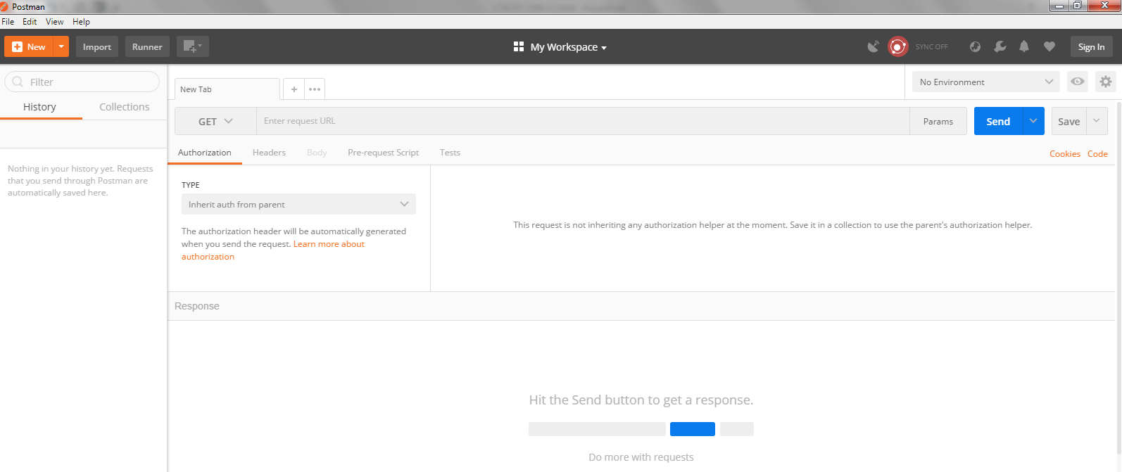
What is Postman?
Notes:
What is Postman?
Useful REST exploration and testing tool.

Slide 45
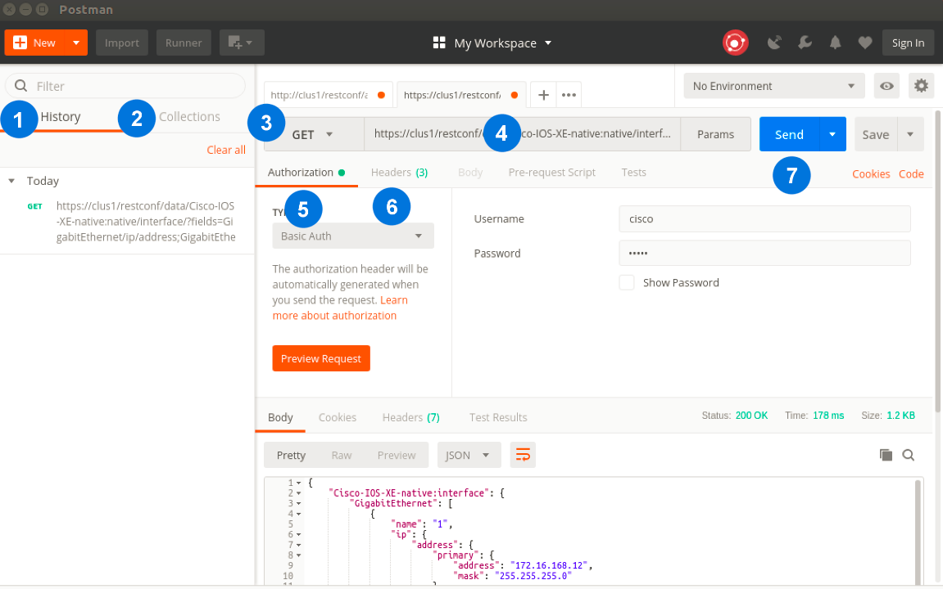
Postman
Exploring HTTP-Based APIs
Notes:
1. History – every API call you make is saved in History. Since Postman is a Chrome application, History is shared between Postman (Chrome) sessions if you’re logged in different PCs.
2. Collections – you can create a collection of items from your History. This makes it possible to build out robust workflows and save them as a collection before you start development / coding.
3. HTTP Verb / Method – drop down for you to select the method required for the API: GET, POST, PATCH, PUT, DELETE, etc.
4. URL – this is where you enter the URL of your API endpoint
5. Authorization – your level 15 credentials will go here for IOS-XE (we’ll be using Basic Auth)
6. Headers – you will configure two headers here, Content-Type and Accept that’ll get sent in the HTTP Header
7. Send button that issues the API call to the device (API endpoint)

