Slide 1
Project:
Plan, Reduce, Repeat
ANH NGUYEN
[20230803]

Slide 2
Scenario 1
Release Day

Slide 3
As-Built Doc Release 1
Stakeholders
Developers
John Doe
Jane Peters
Sam Ross
Ops
Jay Smith
SRE
John Robert
Code Changes
Security fixes
Added new password requirements (Tk-100)
Fixed how SQL queries were handled (Tk-103)
Feature Additions
Added new menu options for users (Tk-102)
Users can now have middle names (Tk-101)
Data and System Changes
Data model changes
Added columns for middle names in user table (TK-101)
Added additional New Menu table (Tk-102)
Users table was split into 2 smaller tables (TK-101)

Slide 4
As-Built Doc Release 1
Design decision highlights
Users table was split into two smaller tables to create more efficient queries and mappings. Keeping it as one big table began to cause slow queries and allowed for a larger number of users. See Design Doc 134 for further discussion.
Test Section
All test suites are passing 100%.
Deployment Notes
The database admins asked for an additional set of scripts to be run for data corrections.

Slide 5
Deployment File
Release 1
ApiVersion: apps/v1
kind: Deployment
metadata:
name: app-deployment
namespace: course4
labels:
app: mainApp
spec:
replicas: 3
selector:
matchLabels:
app: mainApp
template:
metadata:
labels:
app: mainApp
spec:
containers:
- name: mainApp
image: nginx:latest
resources:
requests:
memory: 256mb
cpu: 250m
ports:
- containerPort: 80

Slide 6
As-Built Doc Release 2
Stakeholders
Developers
John Doe
Jane Peters
Sam Ross
Ops
Jay Smith
SRE
John Robert
Code Changes
Security fixes
Fixed a security flaw where attackers could execute a SQL injection attack (Tk-205)
Feature Additions
Rearranged the catalog menu in the UI (Tk-202)
Added a new catalog for exotic plants. (Tk-203)
Added an order processor component to the application (Tk-201)
Data and System Changes
Data model changes
Added new tables in the database to handle the additional catalogs. (TK-203)
Added a new catalog in catalog menu (Tk-202)
Decouple order processing component from UI (Tk-201)

Slide 7
As-Built Doc Release 2
System changes
Increase replicas to 7
Main app: Increase RAM usage by 25%
Add Order processor app with CPU 500m and Memory 1gb
Design decision highlights
Added an additional component to the application, an order processor. The order processor is responsible for batch-processing orders on a schedule. The reasoning behind this was to decouple the UI from order processing, and since order processing can be CPU intensive, this decoupling prevents the app from performing poorly. The Design Doc 5247 goes into more detail about the design specifics.
Test Section
Database load test is passed
Deployment Notes
The release process follows a staged rollout approach
A blue-green deployment strategy was adopted
Automated monitoring tools used to ensure proper functioning

Slide 8
Deployment File
Release 2
Update the file for Release 2 to match the description in the scenario:
ApiVersion: apps/v1
kind: Deployment
metadata:
name: app-deployment
namespace: course4
labels:
app: mainApp
spec:
Replicas: 7
selector:
matchLabels:
app: mainApp
template:
metadata:
labels:
app: mainApp
spec:
containers:
- name: mainApp
image: nginx:latest
resources:
requests:
memory: 320mb
cpu: 250m
ports:
- containerPort: 80
- name: order_processor
image: nginx:latest
resources:
requests:
memory: 1gb
cpu: 500m
ports:
- containerPort: 80

Slide 9
Scenario 2
On-Call Shift

Slide 10
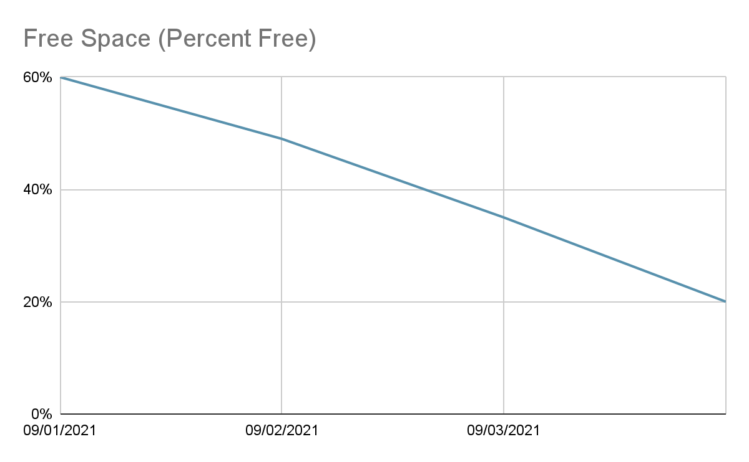
On-Call Shift -- Alert 1
Low Storage Alert
Summary
You receive an alert that the storage is running out on the mount where application logs are being written to. After consulting the SOP, you reach out to the team responsible for the server. They respond that Steve is normally in charge of handling the logs. Every morning he would run the commands listed in the run book, but he has been out sick for a week. The other members of the team forgot that it needed to be done, so the mount filled up.
SOP
Log/Monitoring Details
Low Storage
Depending on the specific alert take the following action:
/home/sre/course4/app.log -- If this mount is low on storage, reach out to Compliance. They will know what logs can be cleared out or will request additional storage.

Slide 11
On-Call Shift -- Alert 2
DNS Troubles
Summary
The networking team recently added a secondary backup DNS server to increase reliability since the one they are using now tends to go down frequently. Your team has several checks in place monitoring the DNS servers to make sure they are up at all times.
SOP
DNS Server Not Answering Requests
If you receive this alert, you should check to see if DNS1 or DNS2 is the current server answering requests. After determining which is the active server, check to see if the server is reachable. If the server is not reachable, immediately initiate the failover procedure to prevent any further network disruptions. If the server is reachable, check the logs to determine what the error is. If the active server cannot be brought back online within 5 mins, initiate the failover procedure. Either way, engage the Networking team to bring the standby server back online.
Failover Procedure
Determine the active server with the dnsTool.
dnsTool -q active_server
If the active server is reachable you can initiate the shutdown process. If this command fails, make sure the dns process is shutdown on the server before continuing
dnsTool -a shutdown -s dns1
Start the failover.
If shutdown was successful: dnsTool -a failover -s dns2
If shutdown was not successful, include the force flag, dnsTool -a failover -s dns -f

Slide 12
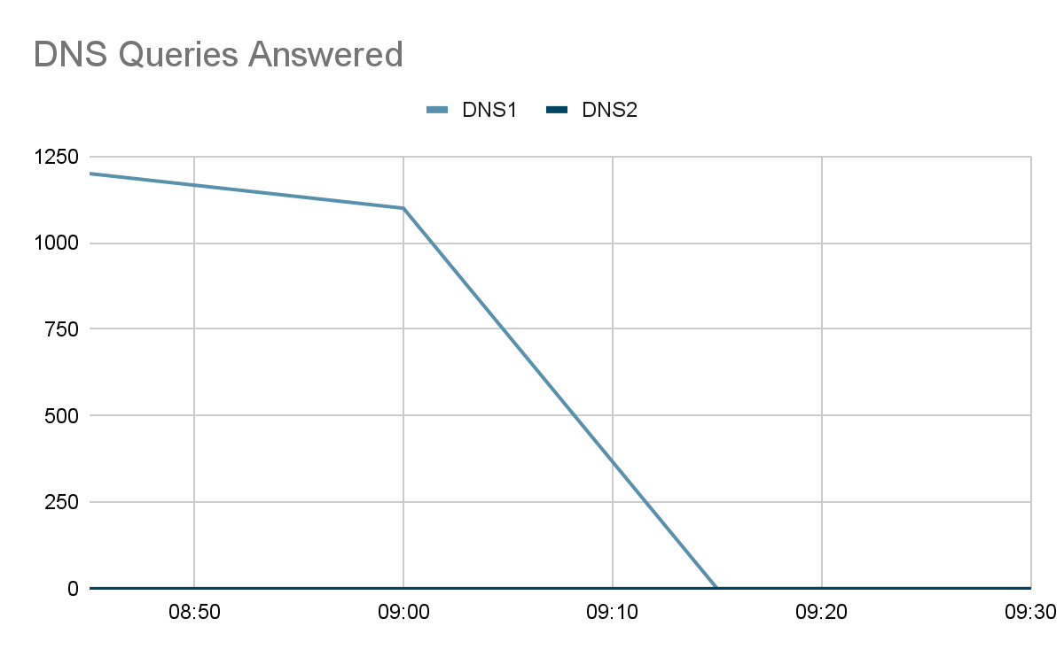
On-Call Shift -- Alert 2
DNS Troubles, cont
Log/Monitoring Details
Networking Server Status Page
Server | Status
DNS1 | UP
DNS2 | UP

Slide 13
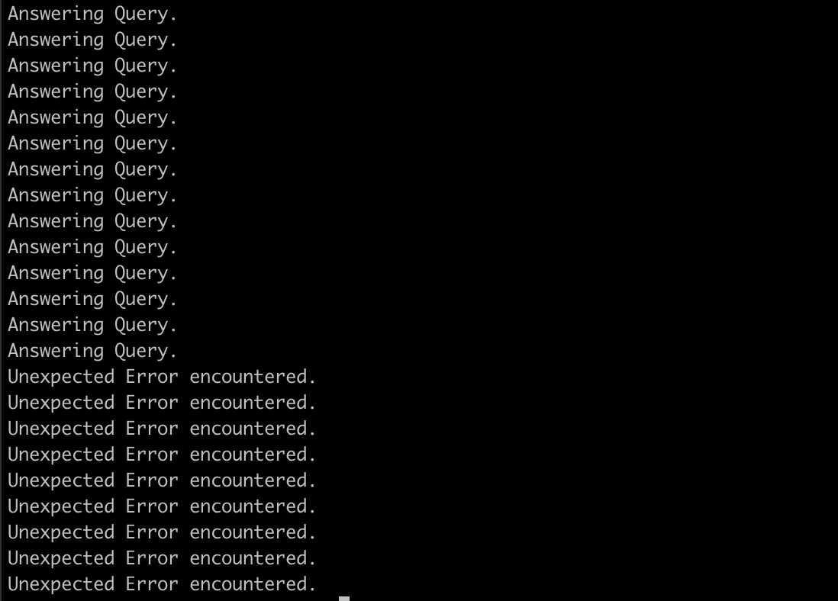
On-Call Shift -- Alert 2
DNS Troubles, cont
Log/Monitoring Details

Slide 14
On-Call Shift -- Alert 3
Application Outage
Summary
You receive the dreaded Application Down alert. Not only do you receive an alert for the application being down, but Customer Support also sent out a page to get all hands on deck for a report of the application being down.
SOP
Log/Monitoring Details
Application Down
If you receive this alert, you need to act immediately. First, verify the application is indeed unreachable. If the application is unreachable, check to make sure the hosts are up and the application processes are running. You must start escalation for this immediately after verification the app is unreachable. Contact the following POCs:
Customer Support -- Susan Vega
Networking -- Bob Sparrow
Ops -- Glen Hammer
Database Admin -- Karen House
Development Team – Gal Tree
Main App Status
Endpoint or Host | Status
exoticplant.plant | UNREACHABLE
planthost1.internal | UP
planthost2.internal | UP
exoticplant.plant.internal | UNREACHABLE

Slide 15
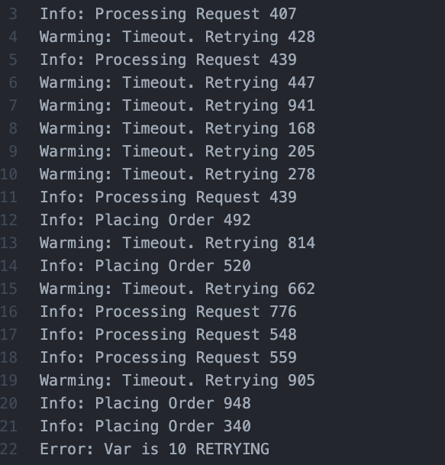
On-Call Shift -- Alert 3
Application Outage, cont
Log/Monitoring, cont.

Slide 16
On-Call Shift -- Alert 3
Application Outage, cont
Log/Monitoring, cont.
09:15 Hey we have reports of an application outage and we can not reach the app either. FROM: svega
09:16 I have an alert for that too. I’m looking at things now, will start a communication channel to coordinate. Checking logs and app servers now. FROM: YOU
09:20 -- !svega !bsparrow !ghammer !khouse !gtree we have an application outage FROM: YOU.
0930 -- Everything looks good from the network FROM: sparrow
0932 -- I can access the DB and it is reporting back normal FROM: khouse
0935 -- Everything here looks normal. FROM: ghammer
0937 -- We are still reviewing logs and seeing if we can reproduce on our end FROM: gtree
0938 -- We should try restarting the app, Maybe that will help FROM: ghammer
0940 -- Maybe that will help. FROM: svega
0943 -- Okay I will try. Bringing down. FROM: YOU
0945 -- App is down. Bring back up. FROM: YOU
0947 -- App is starting. FROM: YOU
0952 -- Main app is back up. FROM: hammer
0955 -- App is still not respond. FROM: svega
0956 -- I’m sending you some new logs !gtree these look off FROM: hammer
1005 -- !sre !ghammer when was the last deploy? What were the details? This looks like a qa build. FROM: gtree
1007 -- I did a deploy with one of the devs to qa to do some testing. Let me check. FROM: ghammer
1010 -- I think there was a mixup when doing the deployment. The wrong scripts was used and that build was deployed to prod. FROM hammer
1011 -- Were there any migrations for that !ghammer FROM: khouse
1012 -- No, just code changes. FROM: hammer
1013 -- Thats good. We should be able to just revert back then. !svega
1015 -- Let me take down the app and redeploy it. FROM: YOU
1017 -- App is down. Bring back up. FROM: YOU
1023 -- App is starting. FROM: YOU
1026 -- Main app is back up. FROM: hammer
1030 -- Everything looks like it is responding now. FROM: svega

Slide 17
On-Call Summary Log
09/04/2021 -- Storage Alert
Troubleshooting
Went to our monitoring stack to check data
I saw disk space is low in the past few days
Checked this path /home/sre/course4/app.log is increase of data
Contact to the team responsible for the server
Resolution
Check with Compliance team to clear logs file or request additional storage
Create cron job for automation clear logs

Slide 18
On-Call Summary Log
09/05/2021 -- DNS Alert
Troubleshooting
Went to our monitoring stack to check data
DNS server DNS1 is active, DNS query answer reduced and stopped
Refer to logs, DNS1 service is error even server status is UP
Standby server DNS2 is UP
Resolution
Initiate the failover procedure to server DNS2, run following command
dnsTool –a shutdown –s dns1 # shutdown dns process then shutdown server
dnsTool –a failover –s dns2 # failover to dns2 (dnsTool –a failover –s dns2 –f # if dns1 shutdown was not successful)

Slide 19
On-Call Summary Log
09/06/2021 -- Application Alert
Troubleshooting
Verify the application is unreachable
Escalate to:
Customer Support: App is response or not
Ops team: make sure hosts status is UP
Database Admin: DB is up and healthy
Networking: there is no issue on connectivity
Development team: reproduction error and deployment review
Resolution
Development team find out that previous deployment was wrong, Dev team re-deploy with correct script. App is back to normal status

Slide 20
Post-Mortem
Application Outage – 09/07/2021
Stakeholders
Customer Support -- Susan Vega
Networking -- Bob Sparrow
Ops -- Glen Hammer
Database Admin -- Karen House
Development Team – Gal Tree
SRE - Me
Incident Timeline
0915: An application outage notice from svega
0920: Me: escalate to teams Network, Ops, Database Admin, Dev team
0930: sparrow found no issue on network
0932: khouse check DB and return normal
0935: ghammer check servers seem normal
0937: gtree checking app logs
0943: Me trying to restart App
0955: App is back up (hammer) but still not response (svega)
0956: hammer gather some new logs
1015: Me re-deploy app by last good version
1025: Main app is back up (hammer)
1030: App is responding (svega)
Impact
App was down for about 45 minutes
Issue prevent/delay customer to place orders, as well as having to pull additional business resources in to process orders manually. This led to a loss of revenue for the business.

Slide 21
Post-Mortem
Application Outage – 09/07/2021 (cont.)
Resolution
Take down the app
Revert deployment code changes (from previous working)
Bring back up, app started and responding
Action Plan
Root Cause: The outage was caused by application is running qa version .
Analysis: The error occurred due to a recent code change, that the wrong scripts was used and that build was deployed to prod instead of qa.
Response: To address the outage, the following actions were taken:
Check last deploy detail with Dev team
Rolled back the code change to revert to the previous working version.
Communicated with users about the issue and provided updates on the progress of the resolution.
Prevention:
Implement stricter code review processes
Enhance the testing strategy to include more comprehensive unit tests, integration tests, and end-to-end tests for critical functionality

Slide 22
Scenario 3
Toil Reduction

Slide 23
Toil Reduction Plan
Toil Items | Why it is considered toil? | Benefits of automating
Manual services status check | Manually checking the status of services can be time-consuming, error-prone, and take away valuable time from more strategic or high-value activities | Implementing automated monitoring and alerting systems, you can significantly reduce the need for manual service checks. This frees up time and resources, allowing you to focus on more valuable tasks and proactive maintenance
Manual clear logs | Manually clearing logs involves identifying and deleting old log files, which can be a repetitive and tedious task | Firstly, it would save time by eliminating the need for manual intervention in clearing logs. Secondly, it would ensure that log files are regularly cleared, preventing excessive disk usage and potential performance issues.

Slide 24
Toil Reduction Plan (cont.)
Toil Items | Why it is considered toil? | Benefits of automating
Manually failover of DNS services | Repetitive, manual, and time-consuming tasks that could be automated | Automated failover mechanisms can detect unresponsive DNS services, trigger failover procedures, and ensure a smooth transition to backup services without human intervention.
Manual deploy code changes | Currently, the process of deploying code changes to different environments is done manually, which is time-consuming and prone to human error. It involves multiple steps such as copying files, configuring settings, and restarting services. | Firstly, it would save time by eliminating the need for manual intervention in each deployment. Secondly, it would reduce the risk of human error, ensuring that the correct code changes are deployed consistently across different environments. Additionally, automation would enable faster and more frequent deployments, allowing for quicker feedback loops and faster time-to-market for new features and bug fixes

Slide 25
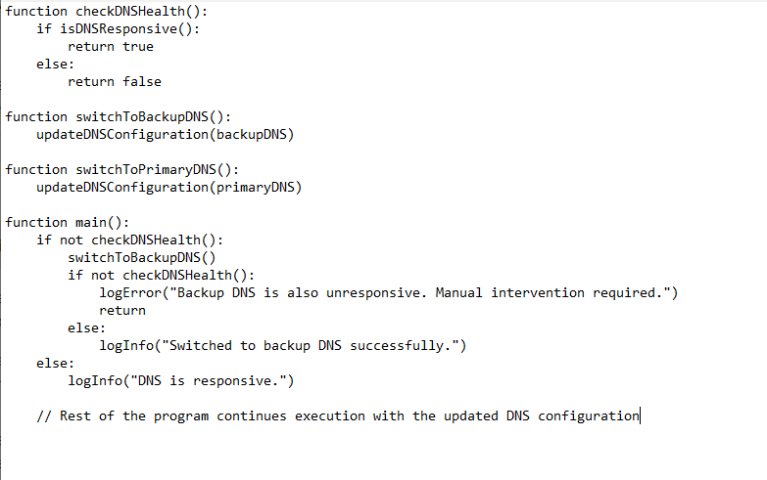
Automation Implementation
DNS service failover automation script pseudocode.

Slide 26
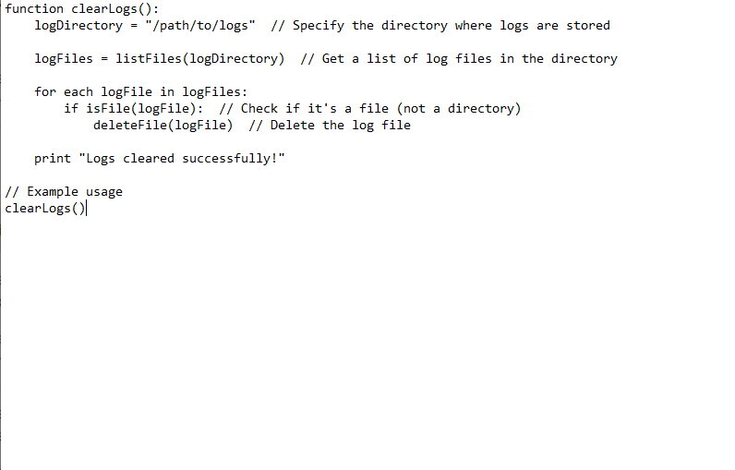
Automation Implementation
Clear logs automation script pseudocode

