Slide 1
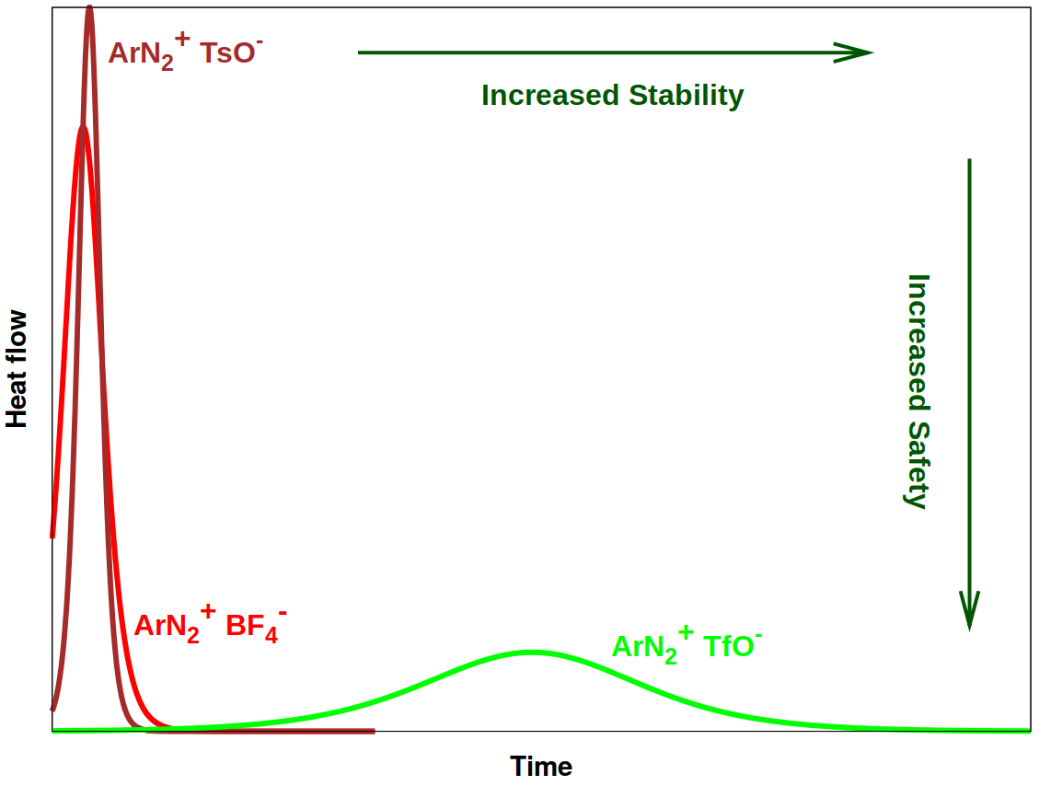

Slide 2
STABILITY
+
-
ArN₂TsO
5 years
+
-
80 years
+
-
ArN₂TfO
ArN₂BF₄
UNSAFE
SAFE
SAFETY

