Slide 1
SPRD Inter-Processor Communication

Slide 2
Agenda
SIPC Overview
SIPC Modules Design
Modem Functions on SIPC

Slide 3
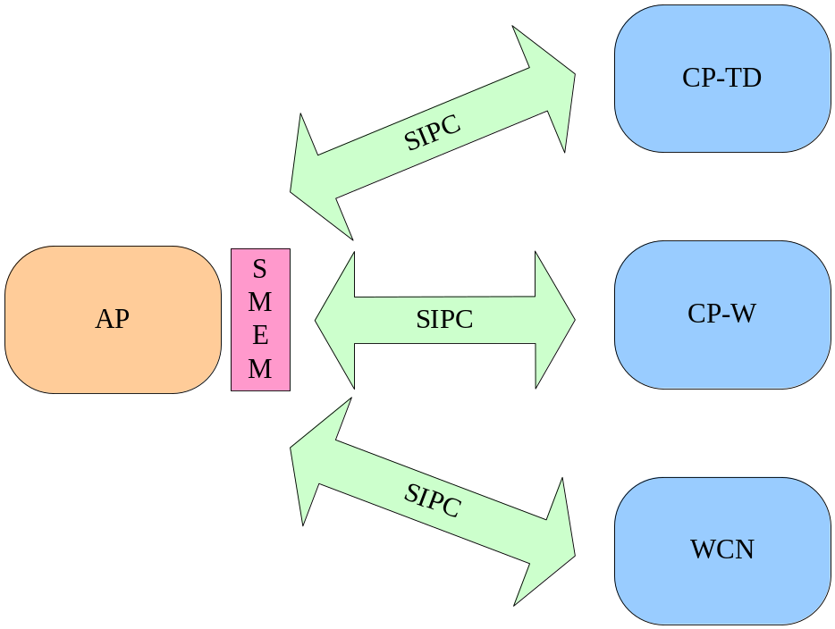
SIPC Overview
AP end can communicate with all other CP ends via SMSG and SMEM.
No IPC between CPs.
Currently, the basic end points contain AP, TD, WCDMA and WCN, and they will expand to LTE in the future.

Slide 4
SIPC Modules Design — Agenda
SIPC Framework
SMSG
SMEM
SBUF
SBLOCK

Slide 5
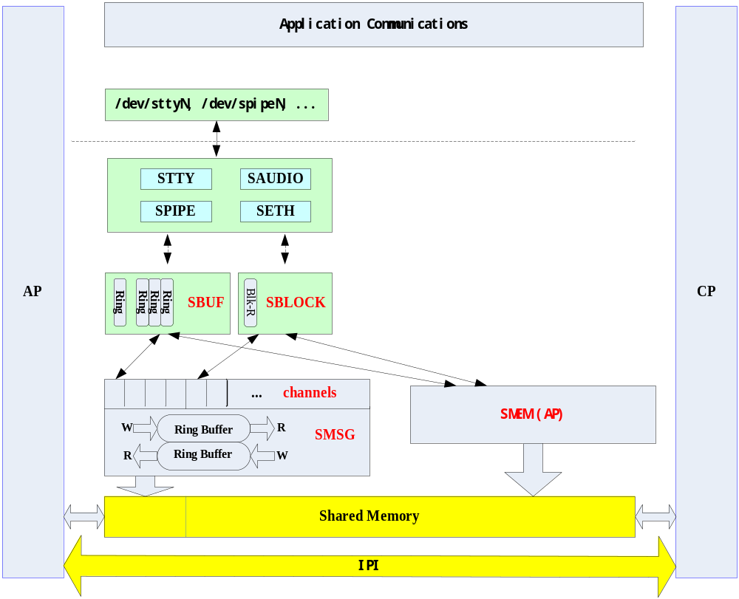

SIPC Modules Design — SIPC Framework

Slide 6
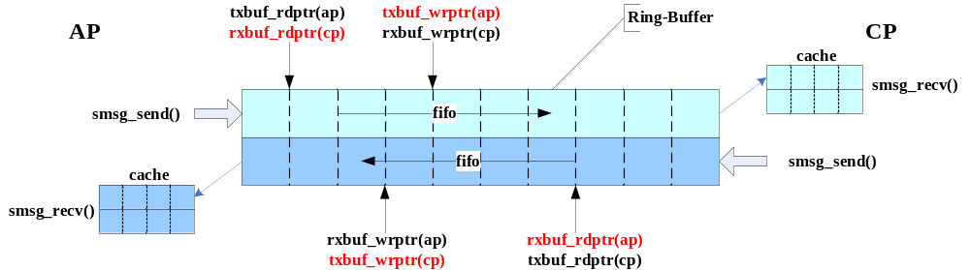
SIPC Modules Design — SMSG
AP/CP communication is implemented based on IPI and shared memory.
The messages are queued and transferred in bi-directional ring-buffer.
SMSG Interfaces
  int smsg_ch_open(uint8_t dst, uint16_t channel, int timeout);
  int smsg_ch_close(uint8_t dst, uint16_t channel, int timeout);
  int smsg_send(struct smsg *msg, int timeout);
  int smsg_recv(struct smsg *msg, int timeout);

Slide 7
SIPC Modules Design — SMEM
SMEM is a module to manage the shared memory, which is basically a memory allocator in AP side.
The interface in AP can call the allocator directly.
The interface in CP is a wrapper of SMSG communication and AP allocator (reserved for SRPC).
SMSM interfaces in AP
  uint32_t smem_alloc(uint32_t order);
  void smem_free(uint32_t addr, uint32_t order);

Slide 8
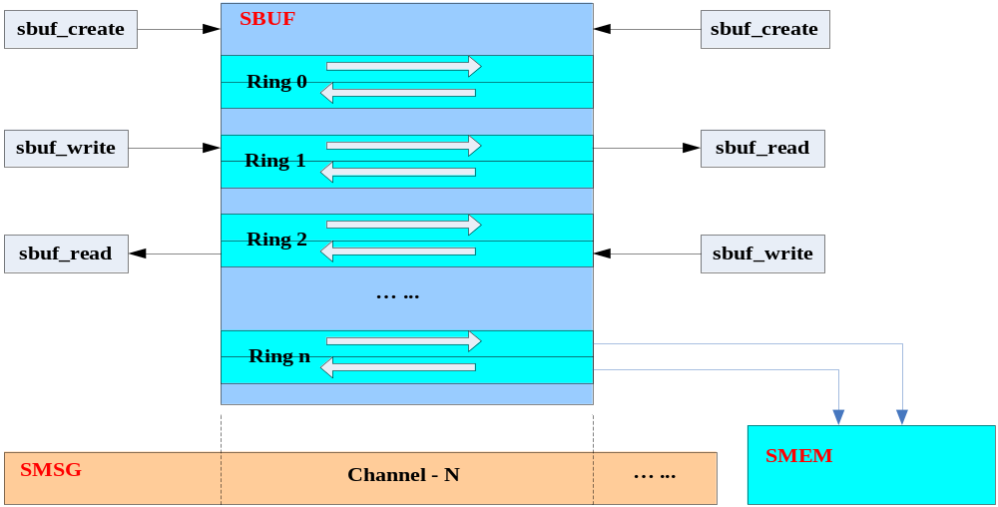
SIPC Modules Design — SBUF
SBUF interfaces
  int sbuf_create(uint8_t dst, uint16_t channel, uint32_t bufnum, uint32_t txbufsize, uint32_t rxbufsize);
  void sbuf_destroy(uint8_t dst, uint16_t channel);
  int sbuf_write(uint8_t dst, uint16_t channel, uint32_t bufid, void *buf, uint32_t len, int timeout);
  int sbuf_read(uint8_t dst, uint16_t channel, uint32_t bufid, void *buf, uint32_t len, int timeout);

Slide 9
SIPC Modules Design — SBLOCK
SBLOCK interfaces
  int sblock_create(uint8_t dst, uint8_t channel, uint32_t txblocknum, uint32_t txblocksize, uint32_t rxblocknum, uint32_t rxblocksize);
  void sblock_destroy(uint8_t dst, uint8_t channel);
  int sblock_register_notifier(uint8_t dst, uint8_t channel, void (*handler)(int event, void *data), void *data);
  int sblock_get(uint8_t dst, uint8_t channel, struct sblock *blk, int timeout);
  int sblock_send(uint8_t dst, uint8_t channel, struct sblock *blk);
  int sblock_receive(uint8_t dst, uint8_t channel, struct sblock *blk, int timeout);
  int sblock_release(uint8_t dst, uint8_t channel, struct sblock *blk);

Slide 10
