Slide 1
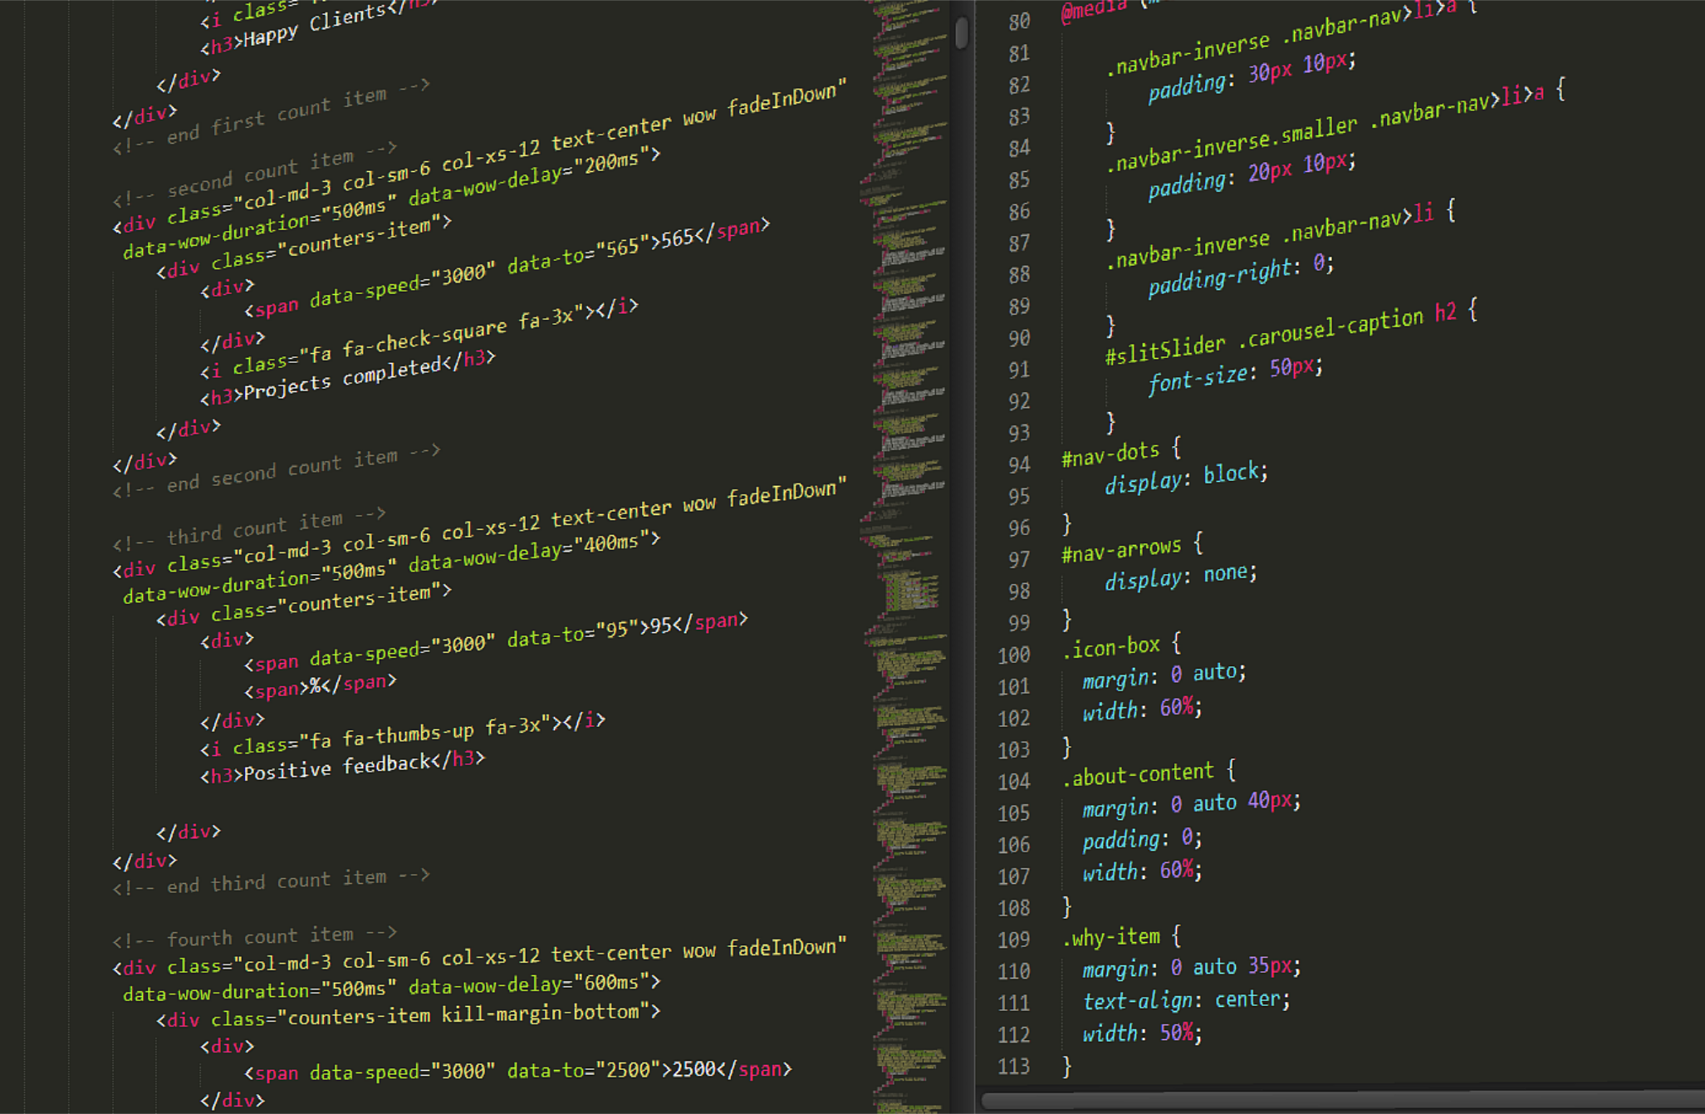
WORKSHOP A
Basics in HTML/CSS

Slide 2
CONTENT
What is web development?
HTML
CSS
Design help
Bootstrap
Help tools
Lunch 12:30

Slide 3
NEW AREA

Slide 4
I talk – you listen and stop me!

Slide 5
CODING
If you don’t have a code/text editor,
Go to sublimetext.com and download it ASAP! ☺

Slide 6
WHAT IS WEB DEVELOPMENT?

Slide 7

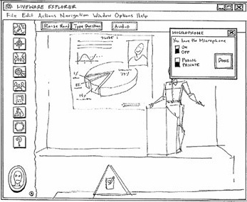
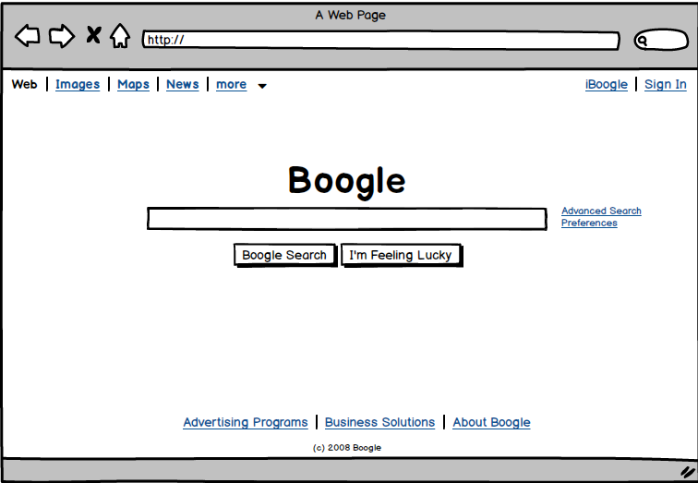
Code
Low-fidelity prototype
Sketch
Paper & pen
High-fidelity prototype
The interaction, size, font, color
Online tool

Slide 8
All the webpages in the world
Static webpages (basic)
Dynamic webpages (more advanced)
Looks the same for everybody
The content changes depending on client, interactive websites
HTML – The content
CSS – Design of the content
HTML
CSS
javaScript
Database
Framework
etc.

Slide 9





SERVER
Request
Response
CLIENT

Slide 10
SERVER
Request
FRONT-END DEVELOPER
Response
HTML, CSS & JavaScript
CLIENT

Slide 11
SERVER
Request
BACK-END DEVELOPER
PHP, Python, Java, Ruby,
MySQL & …
FRONT-END DEVELOPER
Response
HTML, CSS & JavaScript
CLIENT
Front-end + Back-end = Full-Stack Developer

Slide 12
HTML
HyperText Markup Language

Slide 13
HTML the content of the webpage
Text
Images
Links/buttons to other webpages
Menu

Slide 14
<tagname> content </tagname>

Slide 15
HTML the content of the webpage
Text
Images
Links/buttons to other webpages
Menu
<p> <h1> <h2> <h3> …
<img>
<a> <button>
<nav> <div> <ul> <li> <a>

Slide 16
emmelifall.com
Copy the code and paste in your fav. text editor

Slide 17
Get started:
Copy the code from emmelifall.com
and paste in your fav. text editor and save the file as index.html in a new folder.

Slide 18
why save as index.html?

Slide 19
structure of html-file

Slide 20
text, images and links

Slide 21
wait, what about the menu?

Slide 22
CSS
Cascading Style Sheets

Slide 23
CSS design of the content
Size of text and images
Color of text and background
The font of the text
font-size, width, height
color, background-color
font-family

Slide 24
create a new file and
save as style.css

Slide 25
design the text and images

Slide 26
colorpicker

Slide 27
:hover

Slide 28
Design help
this webpage looks like the 90s

Slide 29
We start at 13:40
Have a walk around the office to know what air feels like.

Slide 30
more professional pictures
royalty free pictures, pexels.com

Slide 31
Google Fonts

Slide 32
matching colors together
coolors.co
tinyurl.com/pinkcombo

Slide 33
bookmark
<link rel="icon" type="image/png" href="praline.png">

Slide 34
Bootstrap
a responsive design library/framework

Slide 35
Bootstrap components
https://getbootstrap.com/docs/3.3/components/

Slide 36
a menu

Slide 37
make it clickable

Slide 38
Help tools

Slide 39
W3schools

Slide 40
stackoverflow

Slide 41
Youtube.com

Slide 42
webbstudio.helloworld.se

Slide 43
use chrome and the console
!!!!!

Slide 44
design the menu

Slide 45
Sooo that’s it! ☺
Please give me feedback at:
tinyurl.com/pinkcomment

Slide 46
All the material:
tinyurl.com/pinkworkshop
My email: emmelisg@msn.com

Slide 47
Things to learn more about:
Column system in Boostrap
Class and ID in CSS
Boxmodel in CSS

