Slide 1
SPARTAN
IoT
way towards Smarter INDIA

Slide 2
Is your home SMART ?
The term 'Internet of Things' was coined in 1999 by the computer scientist Kevin Ashton.

Slide 3


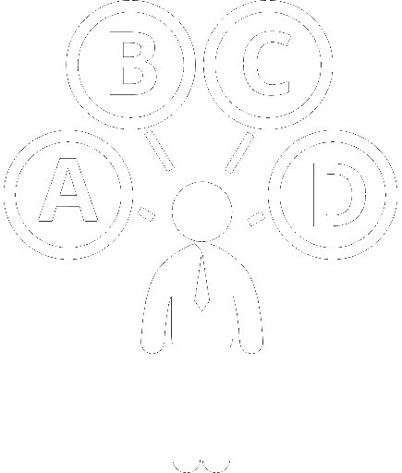
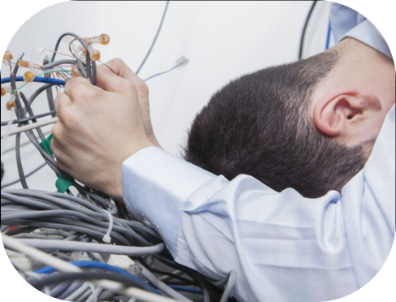

Reasons for NO?
High COST
Low Availability & Options
Lack of skilled electrician
Unaware customers
Complexity of solution

Slide 4

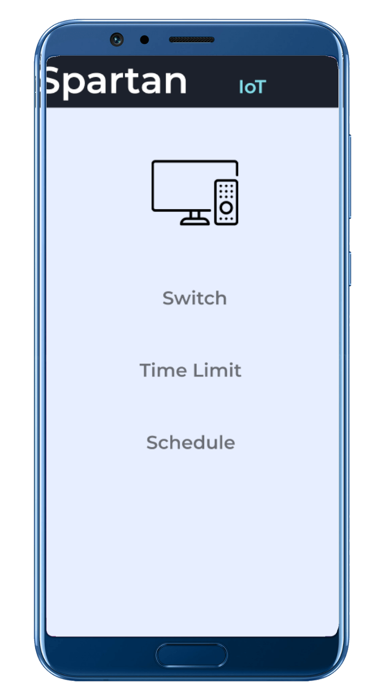
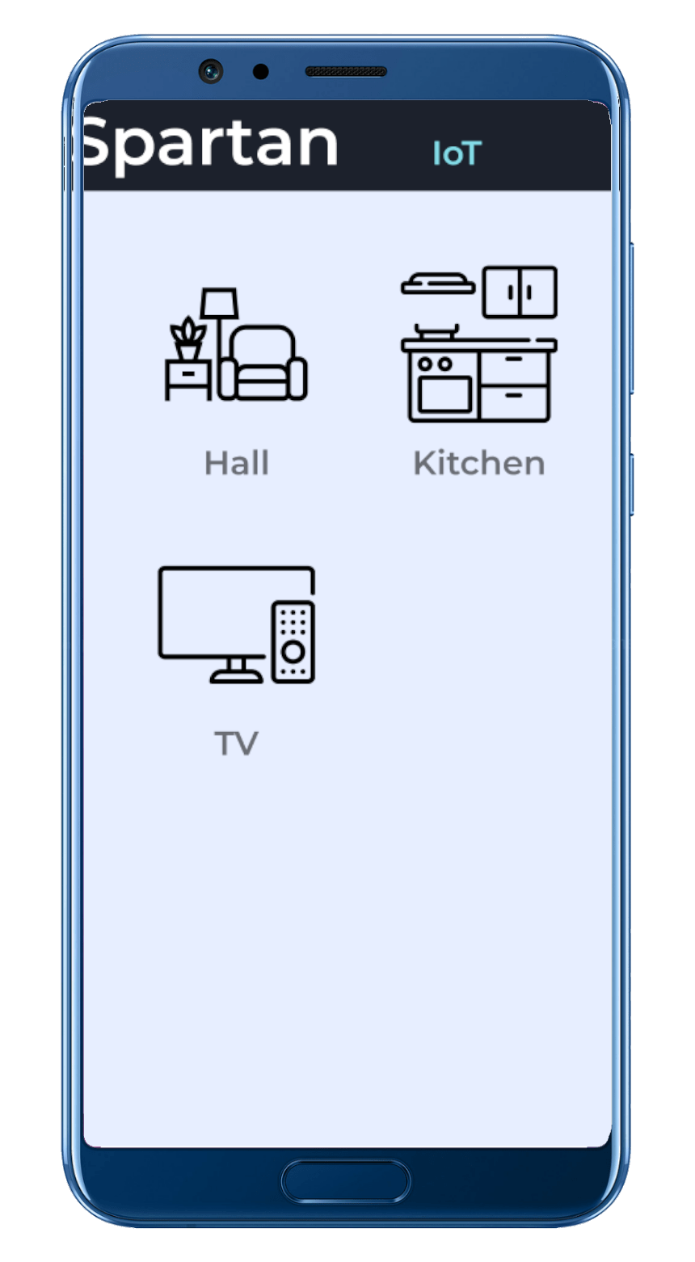
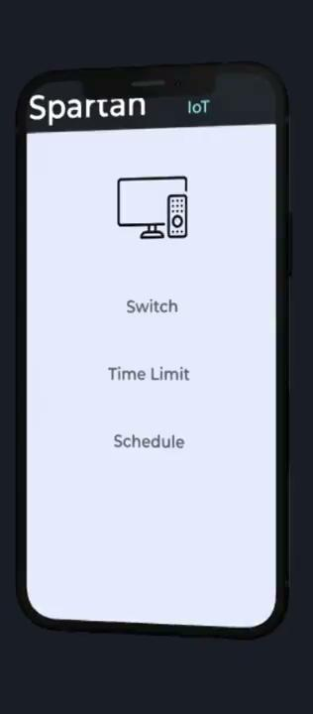
Solution !

Slide 5
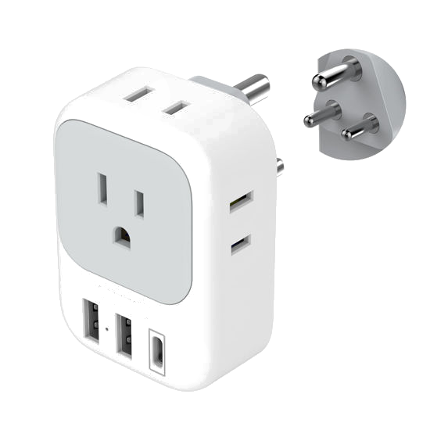
Why Spartan ?
Affordable
Plug & play
Customization
DTC product
Unique tech
Integration capabilities
No need for Technical support
Surge Protection

Slide 6
Weakness
Limited brand recognition
Resource constraints
Dependence on suppliers:
DTC product
Unique tech
Integration capabilities
Security concerns

Slide 7
Opportunities
Growing market demand
Partnerships and collaborations
Sustainable solutions
Subscription-based models

Slide 8
Threats
Competition
Rapid technological advancements
Consumer privacy concerns
high Product Adaptability

Slide 9
Strategy for Expansion
Target Audience:
Tech-savvy homeowners who are interested in integrating smart home solutions into their living spaces but are deterred by the high costs associated with premium products.
Millennials and young families looking for affordable yet reliable smart home automation solutions to enhance convenience and security.
Budget-conscious consumers seeking easy-to-use and customizable smart home devices that fit their lifestyle and needs.
Companies & organizations who desire easy goto solution for automation their campuses.

Slide 10
Strategy for Product
Hero product: Smart plugs
Smart lighting solutions: Affordable LED bulbs, smart light switches, and light strips that can be controlled remotely via a mobile app or voice commands.
Home security devices: Entry-level smart cameras, door/window sensors, and motion detectors designed to enhance home security without a hefty price tag.
Use cases:
Property owners for maintaining remote property.
Parents who want want to limit their kids tech usage.
Millennials for the old parents.
Surge Protector against costly electronic

Slide 11
Strategy for Marketing
Social media marketing
Content Marketing
Email Marketing
Customer Engagement

Slide 12
End goal
By emphasizing affordability, simplicity, and value, the brand aims to disrupt the smart home automation market by making advanced technology accessible to a broader audience. Through strategic marketing efforts and a customer-centric approach, the brand will establish itself as a trusted source for affordable smart home solutions on the e-commerce platform, driving sales and fostering brand loyalty.

