Slide 1
SVG = Scalable Vector Graphics

Slide 2
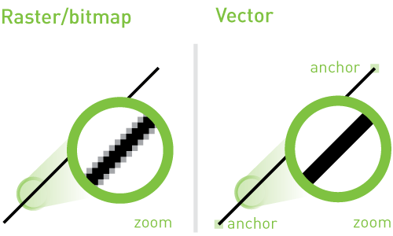
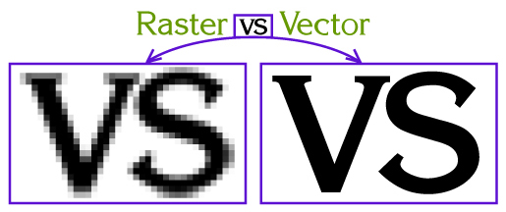
Vector vs. Raster Graphics

Slide 3
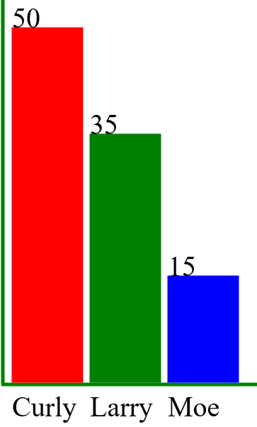

Slide 4
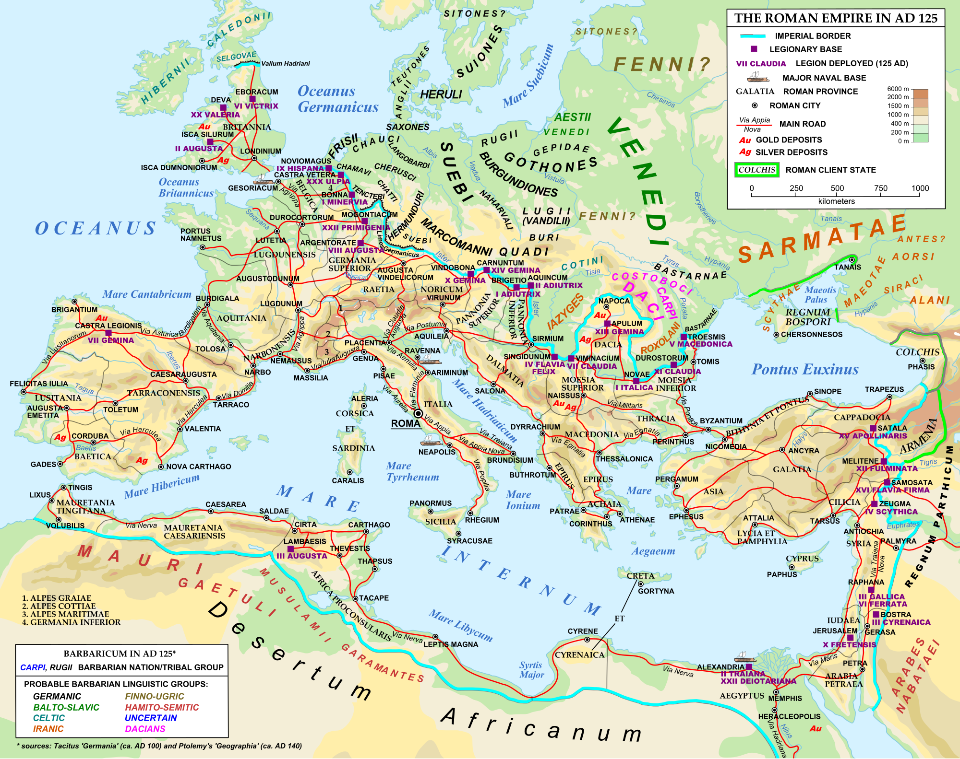

Slide 5
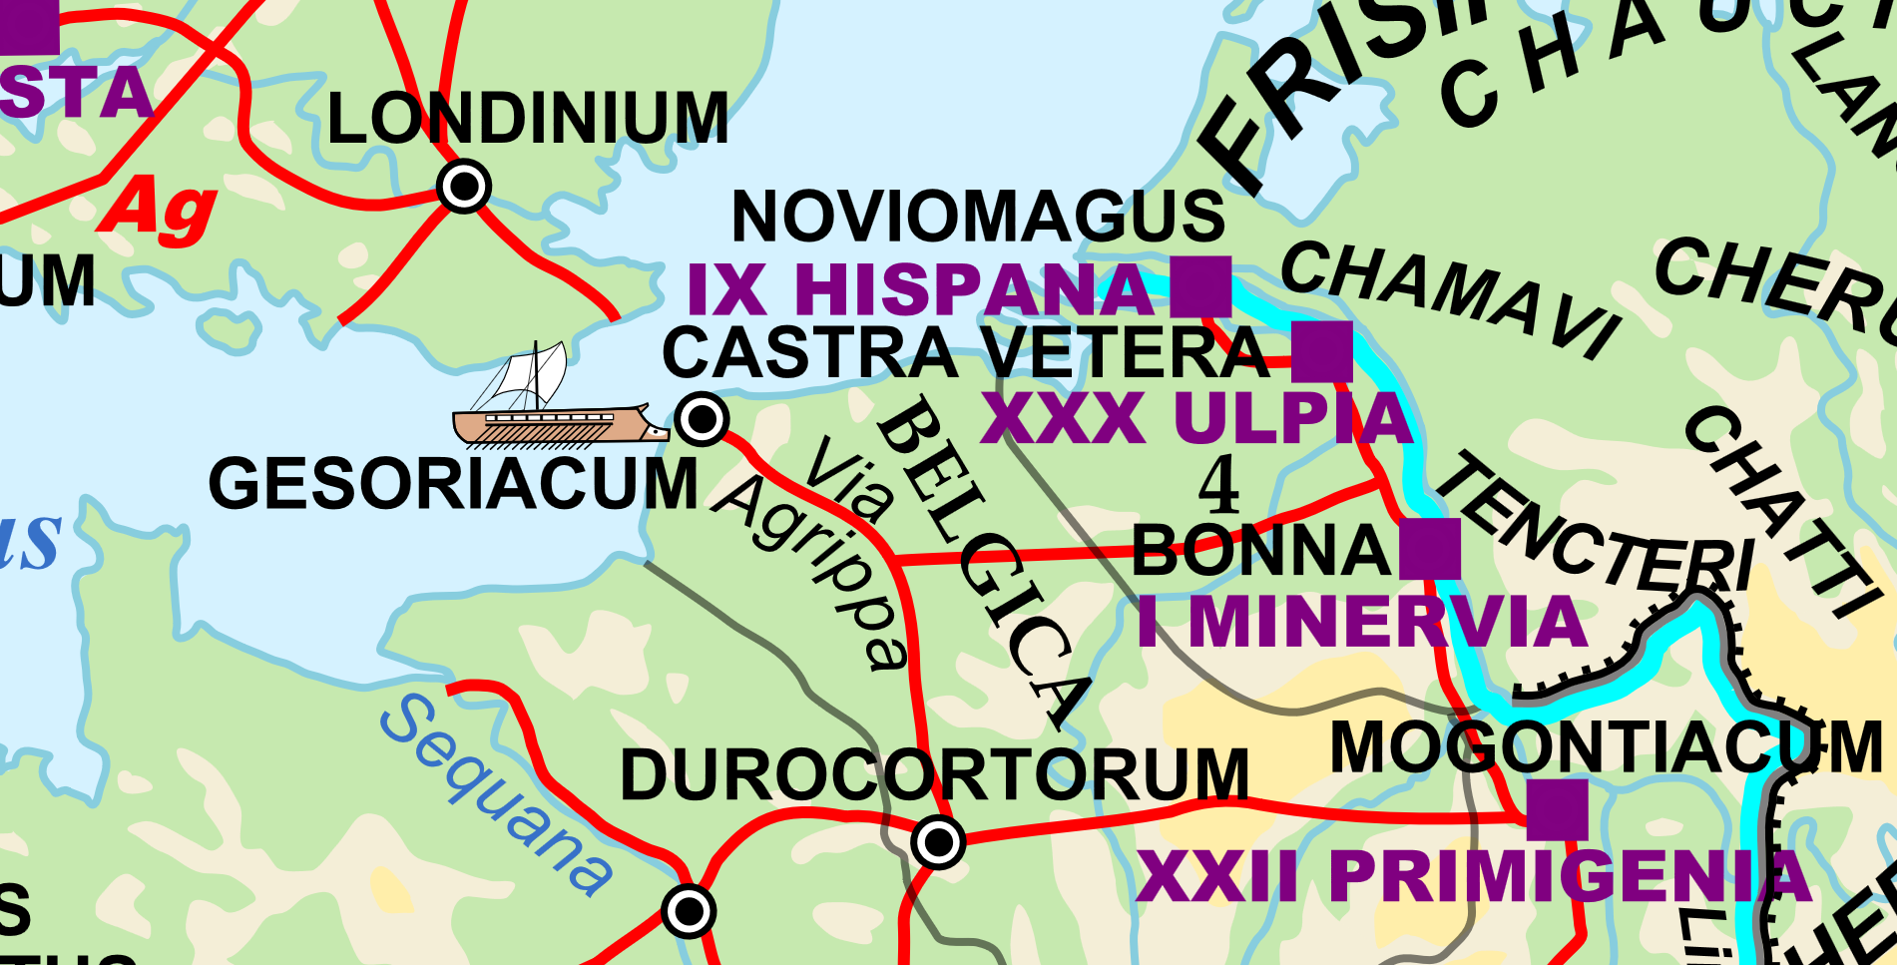

Slide 6
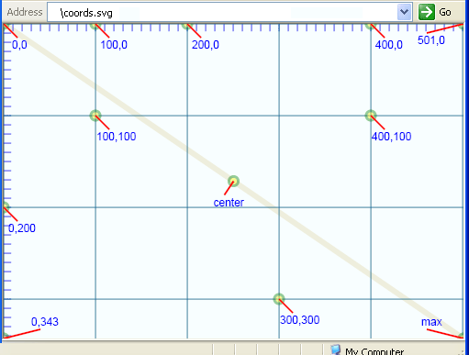
SVG Coordinate System: X/Y-Axis
Y-axis is reversed: increasing values move down the screen

Slide 7
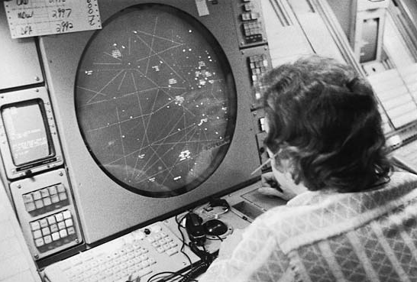
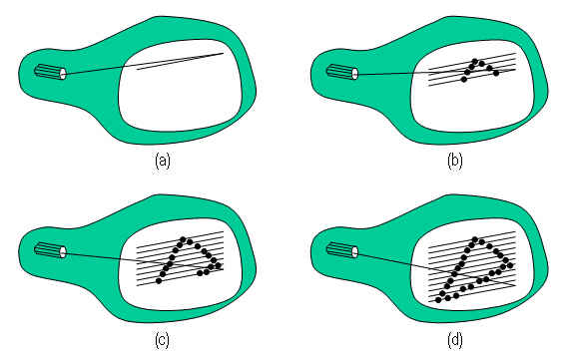
Origin of SVG coord-system in CRT display technology: Cathode-Ray Tubes
Electron-beam scans down the screen, so ‘down’ = positive and increases in value

