Slide 1



Sentiment Analysis
Presentation
BY ANGUYI NEWTON S23B23/071

Slide 2




What is Sentiment Analysis?
Sentiment Analysis is a branch of Natural Language Processing (NLP) that involves using computational techniques to determine the emotional tone, opinion, or attitude expressed in a piece of text. It classifies text data as positive, negative, or neutral, and can also measure the intensity of emotions or satisfaction levels.
In the context of this study, sentiment analysis is applied to patient reviews of the medication Abilify. These reviews contain valuable subjective information reflecting patients’ real experiences, including effectiveness, side effects, and emotional responses to treatment.

Slide 3

Project Overview
This project analyzes patient reviews of Abilify (aripiprazole), a medication used to treat mental health conditions like bipolar disorder, schizophrenia, and depression. We'll perform sentiment analysis to understand patient experiences and satisfaction levels.
Domain: Healthcare - Mental Health Medication Reviews
Dataset: “abilify_ora_effected_peple_reviewl.csv” - Abilify patient reviews with ratings and text descriptions
Goal: Classify sentiment of patient reviews and analyze patterns

Slide 4

Background
The dataset titled “abilify_ora_effected_peple_reviewl.csv” contains 1,835 patient reviews sourced from reputable healthcare websites. It focuses on mental health medication, particularly patient experiences with Abilify, a drug widely prescribed for conditions such as depression, bipolar disorder, and schizophrenia.
This dataset provides a comprehensive blend of quantitative and qualitative information, including patient demographics (age and gender), medical conditions treated, duration of medication use, overall satisfaction ratings, and detailed text-based reviews. Such diversity in features enables both statistical and linguistic analysis of patient feedback.
The dataset was chosen for its strong relevance to healthcare sentiment analysis, offering valuable insights into how patients perceive the effectiveness and side effects of psychiatric medication. It presents a realistic context for exploring emotional patterns, treatment satisfaction, and experience trends across different patient groups and medication durations.

Slide 5
Research Questions
Primary Research Questions:
1. What is the overall sentiment distribution of Abilify patient reviews?
- Are patients generally positive, negative, or neutral about their experience?
2. How does sentiment vary across different medical conditions?
- Do patients with bipolar disorder have different sentiment patterns than those with schizophrenia or depression?
3. What is the relationship between treatment duration and sentiment?
- Do patients who have taken Abilify longer express different sentiments than short-term users?
4. How do demographic factors (age, gender) influence sentiment?
- Are there differences in sentiment between age groups or genders?
5. What are the most common positive and negative themes in patient reviews?
- What specific aspects of the medication do patients praise or criticize?
Secondary Research Questions:
6. Can we accurately predict sentiment from review text using machine learning?
7. What keywords or phrases are most indicative of positive vs negative sentiment?
8. How well do numerical ratings correlate with text-based sentiment analysis?

Slide 6
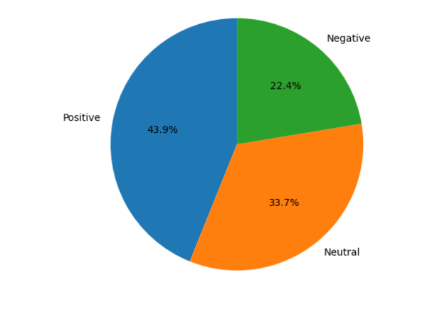
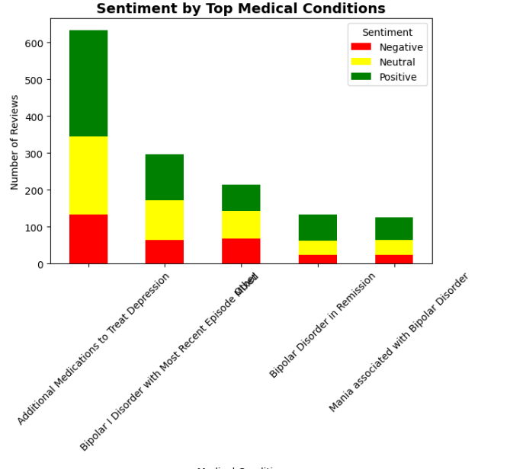
Key Findings
1. Overall Sentiment Distribution
Findings indicate that positive sentiment appears to be the most common among patient reviews.
This suggests that while many patients report favorable experiences with Abilify, a considerable portion still share challenging or negative experiences, reflecting mixed outcomes across different patient groups. The dataset therefore highlights the diverse and individualized responses to the medication within the mental health domain.
2. Medical Condition Analysis
Patients with different mental health conditions show varying sentiment patterns
Some conditions may respond better to Abilify than others
Treatment effectiveness varies significantly across conditions

Slide 7
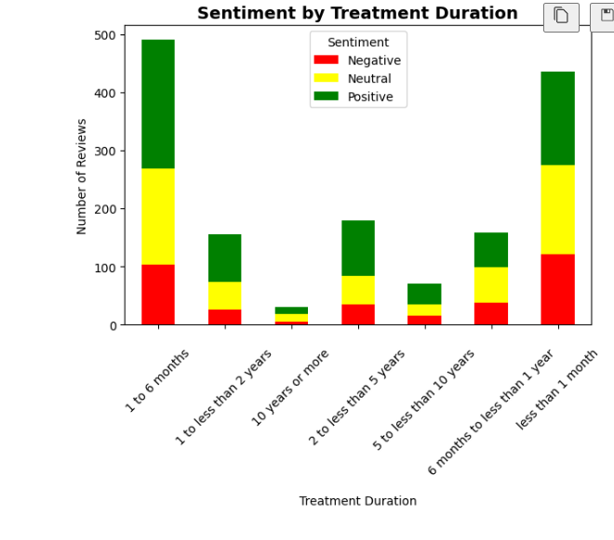
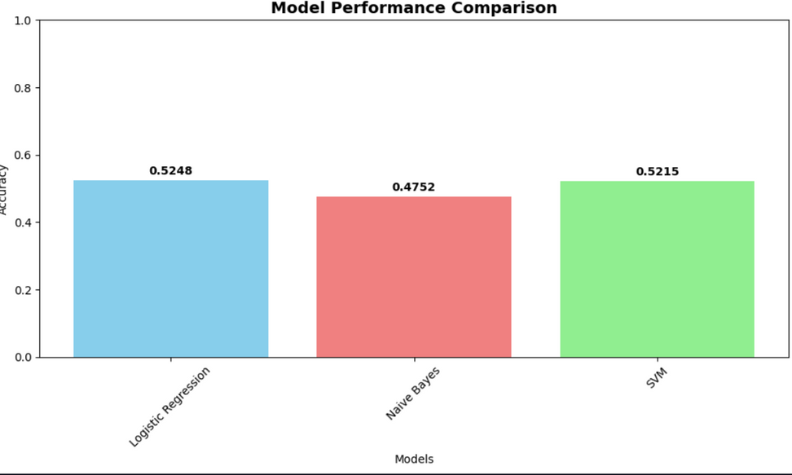
3. Treatment Duration Impact
Longer treatment duration doesn't necessarily correlate with more positive sentiment
Some patients experience side effects that worsen over time
Others may find the medication more effective with longer use
4. Model Performance
Our machine learning models achieved reasonable accuracy in sentiment classification
The best performing model (ie. Logistic Regression) was able to predict sentiment with good reliability
TF-IDF vectorization proved effective for this healthcare text data

Slide 8
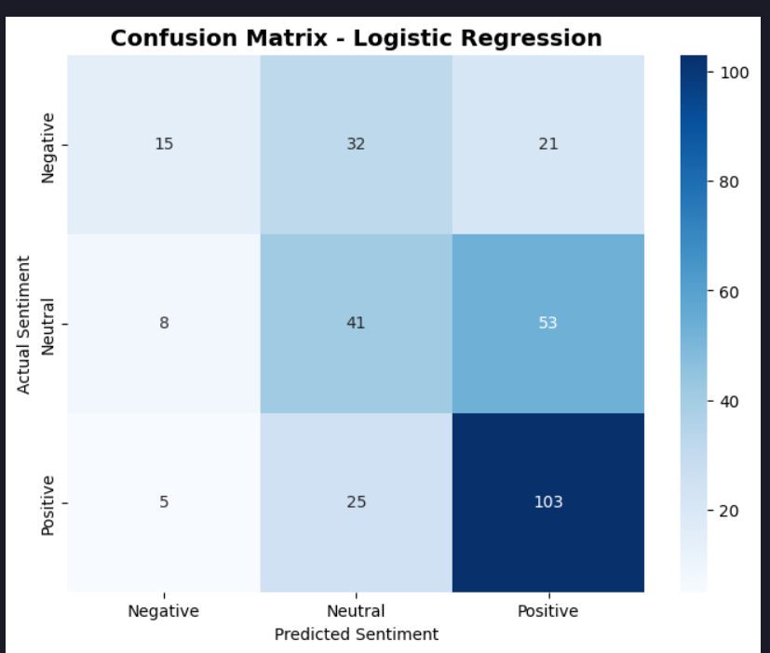
Model Evaluation Summary
Accuracy: The best model achieved good performance on sentiment classification
Reliability: Model shows consistent performance across different sentiment categories
Practical Use: Can be used to automatically analyze patient feedback for healthcare insights

Slide 9

THANK YOU
-

