Slide 1

EXpressMe-U
A spectrum of expressions

Slide 2

The Hearing and speech impaired find it difficult to express themselves!
Sign language is not widely known
Communication has to be instant
Everyone has the right to freely express themselves

Slide 3


What expressme-u can do
Because powerful technology connects the world

Slide 4
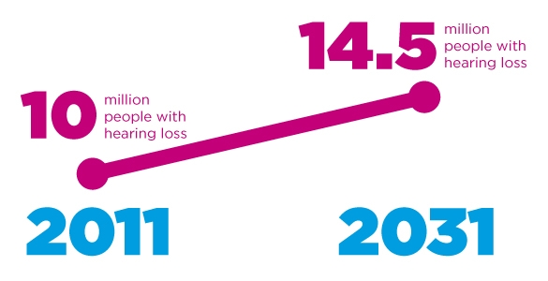
Possible social impact

Slide 5



Smart Integration with IBM Bluemix
WHERE THE FUTURE LIES
We are hosting our technology on IBM’s Bluemix server!
Data storage on IBM cloud
Analytics using IBM’s embedded reporting tool to improve performance
Utilization of Watson APIs for language processing

