Slide 1
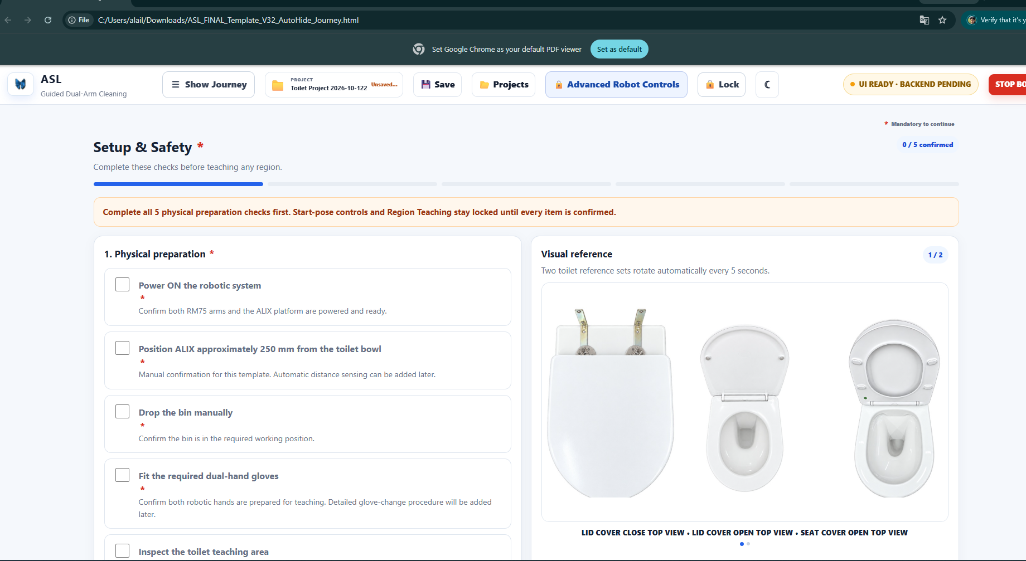
Use the latest template V32 and do this below changes
V32 not have cleat butter fli logo need to replace

Slide 2
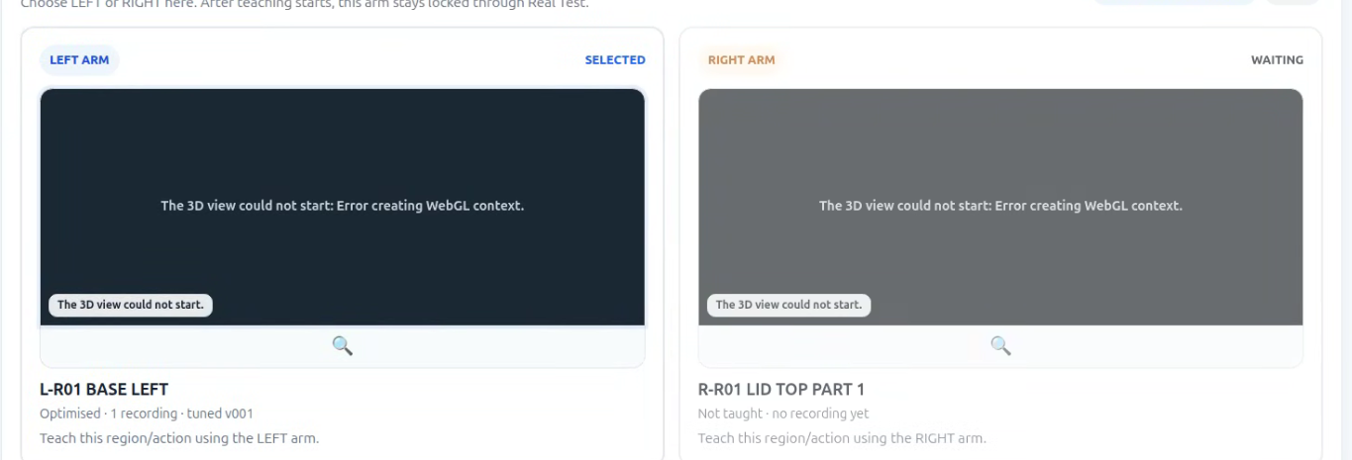
This section it should show region images from ppt, please keep existing images

Slide 3
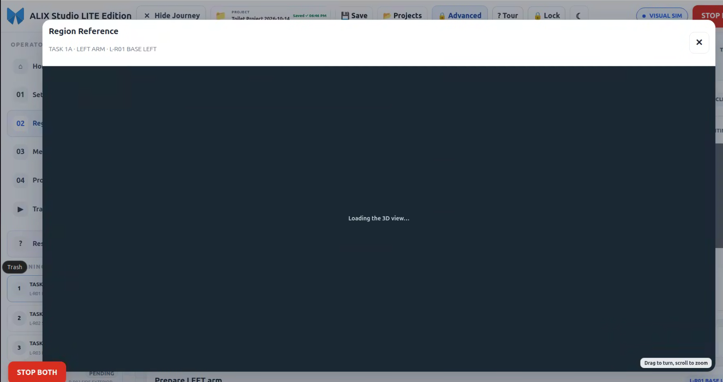
No 3d view just expand the region image

Slide 4
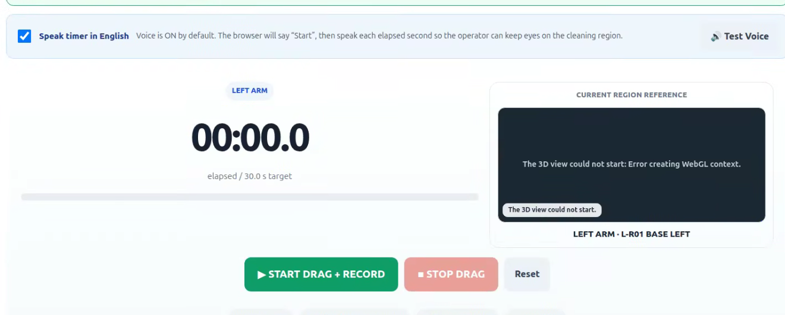
No 3d view just show the selected region image

Slide 5
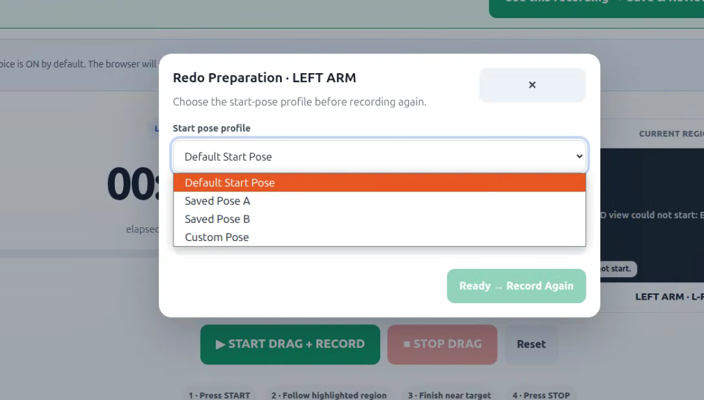
In this dropdown it shows the global points list (from controller) also provide search button)
Control: MOVE J and MOVE L

Slide 6
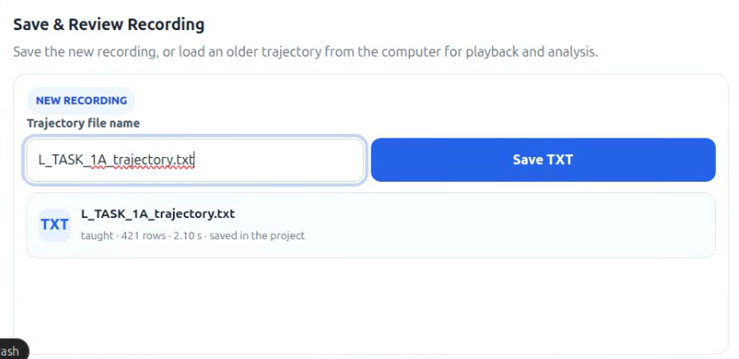
duplicate file name not allowed

Slide 7
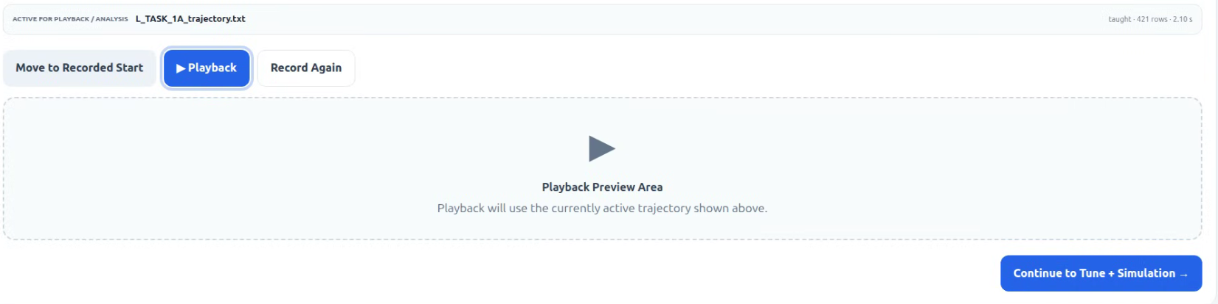
Remove this section

Slide 8
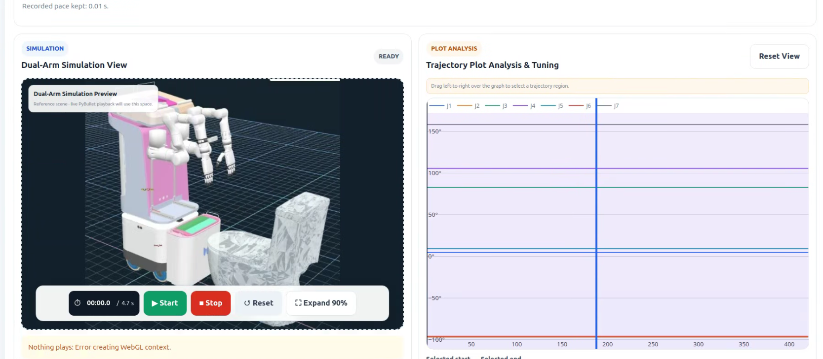
Plot area , need tooltip that shows all joint vales and line number)

Slide 9
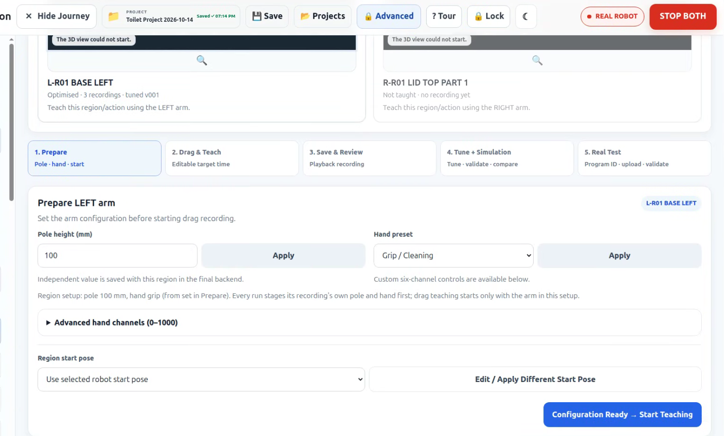
If I forget to

Slide 10
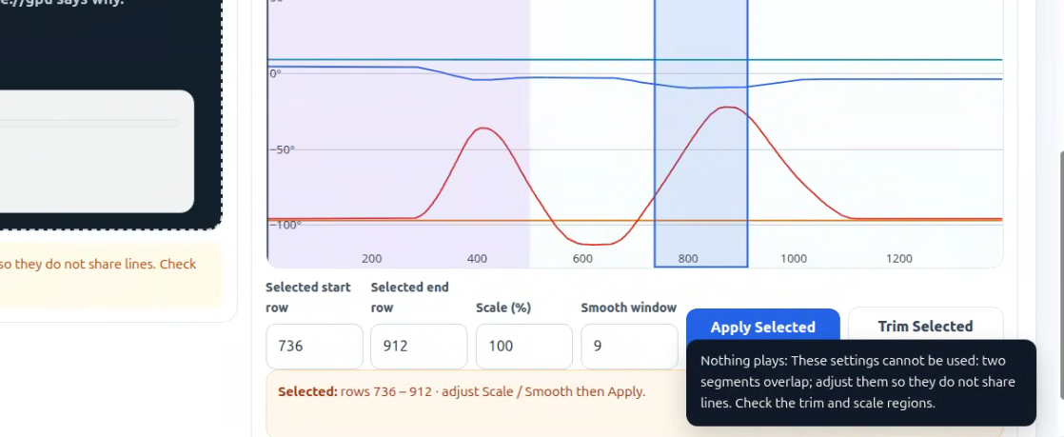
Notification at least need 15 seconds on idle

Slide 11
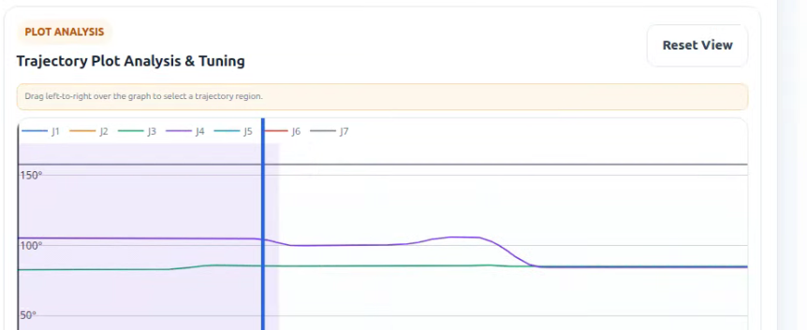
Few buttons needs to add

Slide 12
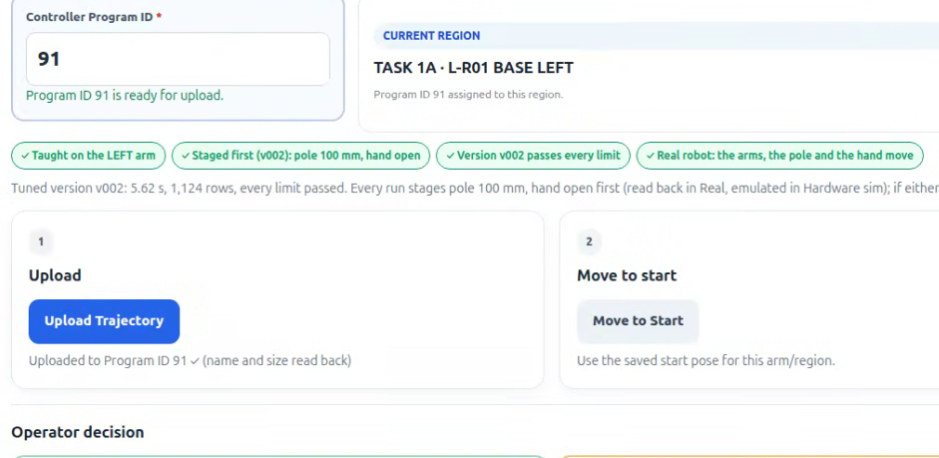
Upload file status like percentage or horizontal bar line

Slide 13
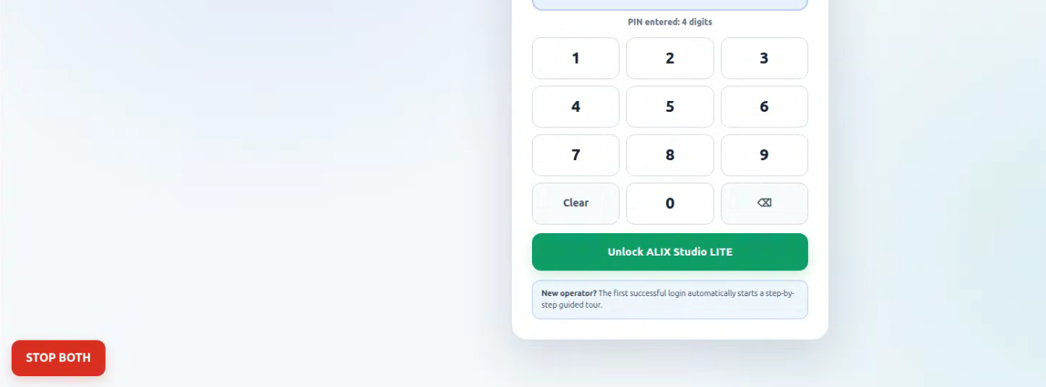
Remove stop both button from login screen

Slide 14
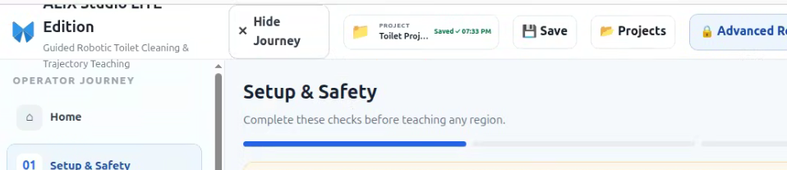
Change Title
ALIX STUDIO LITE to ASL
Realign the text wrap

Slide 15
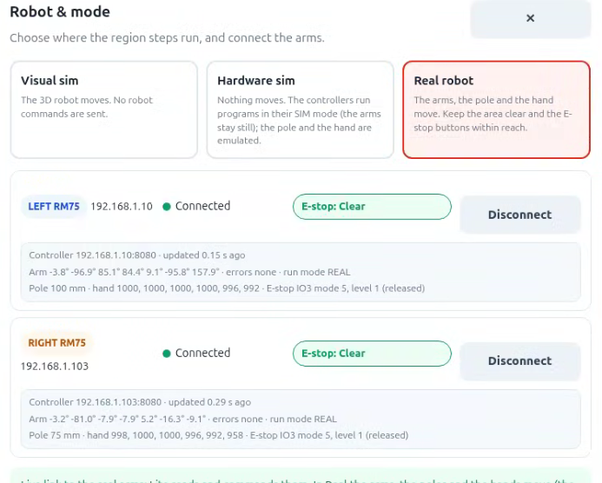
Give common buttons for connect and disconnect all

Slide 16
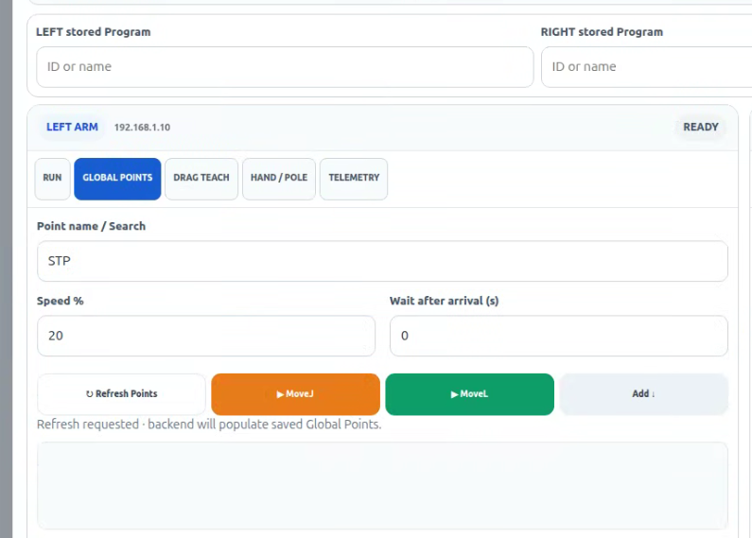
Global points list not visible
and also trajectory (RUN Tab)

