Slide 1
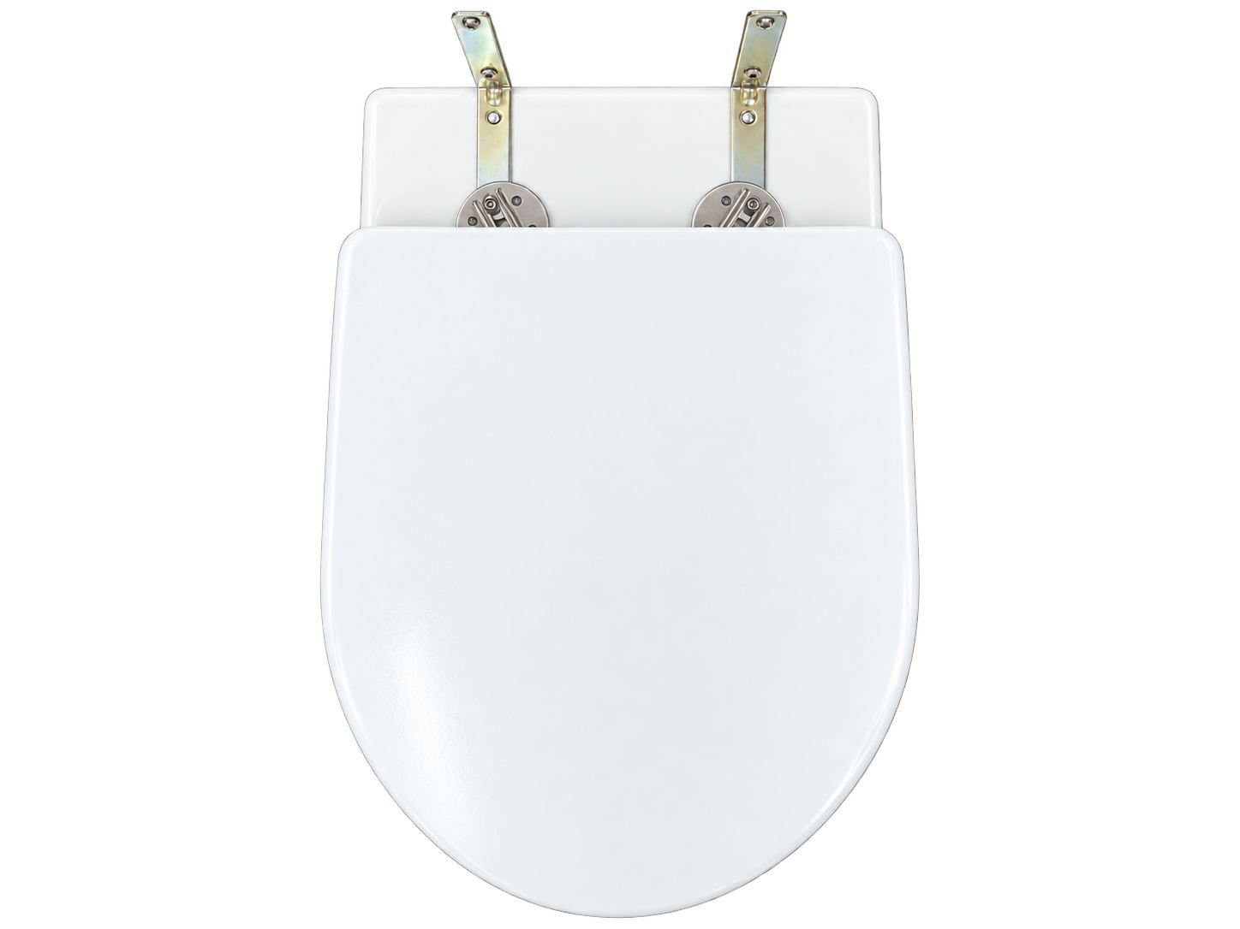
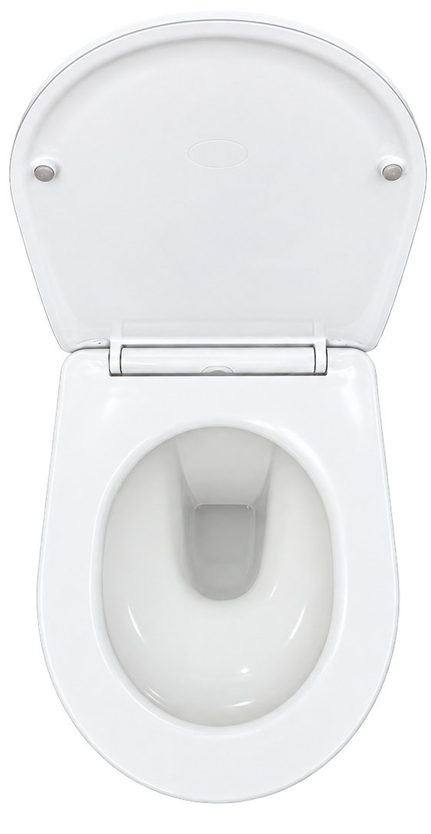
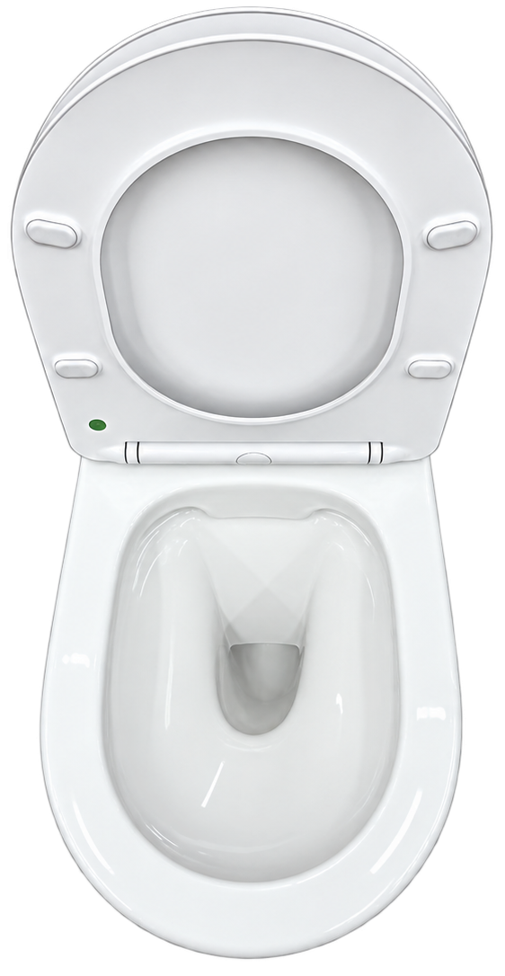
PAGE 02
STATE: LID COVER OPEN TOP VIEW
STATE: SEAT COVER OPEN TOP VIEW
STATE: LID COVER CLOSE TOP VIEW

Slide 2
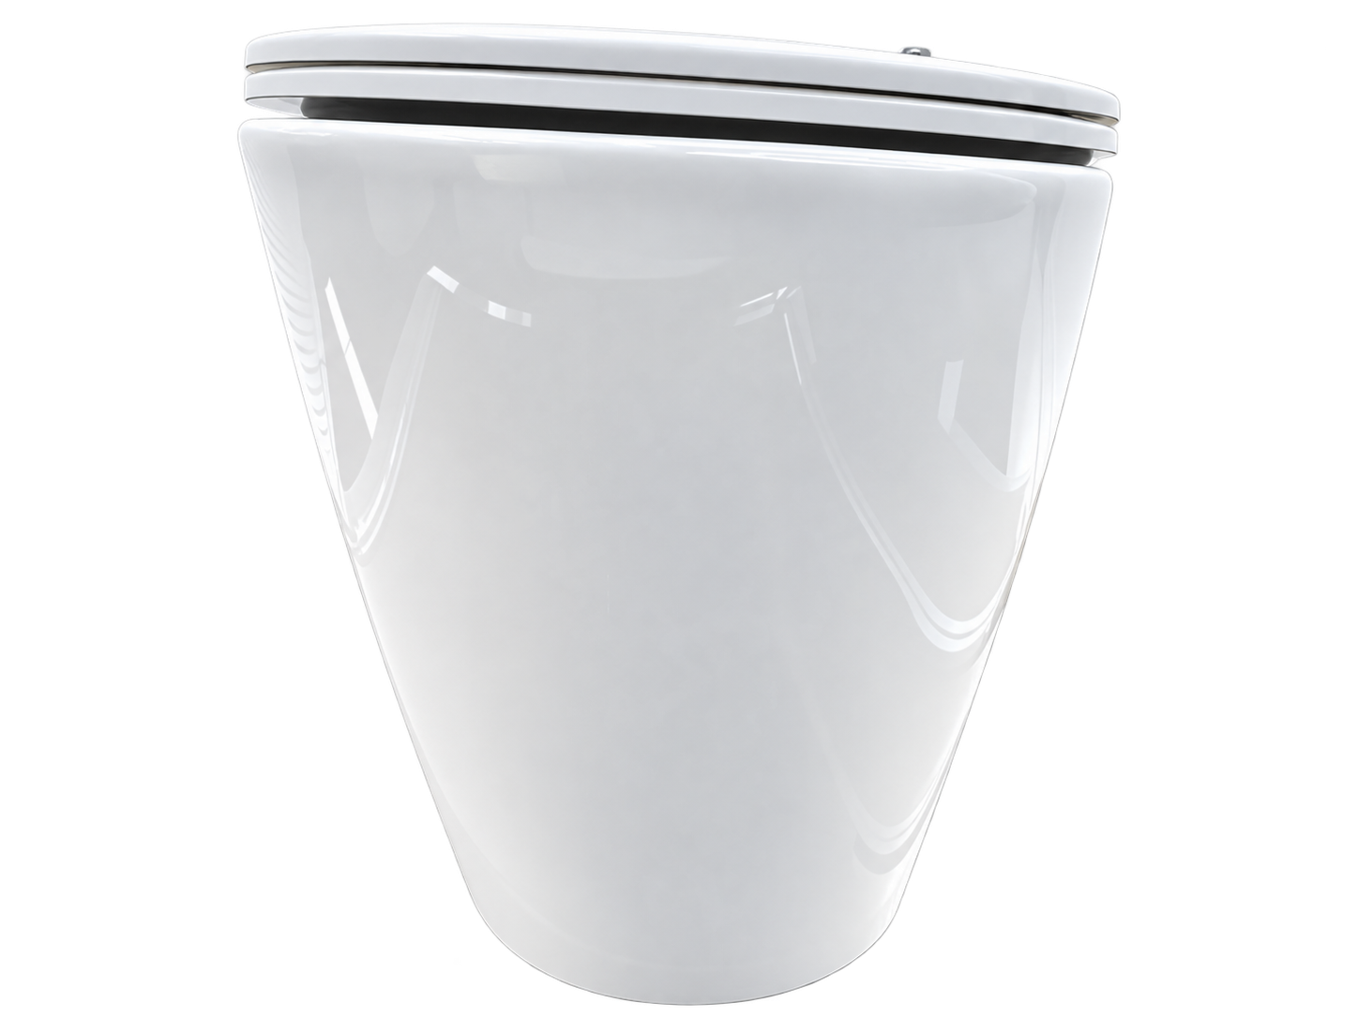
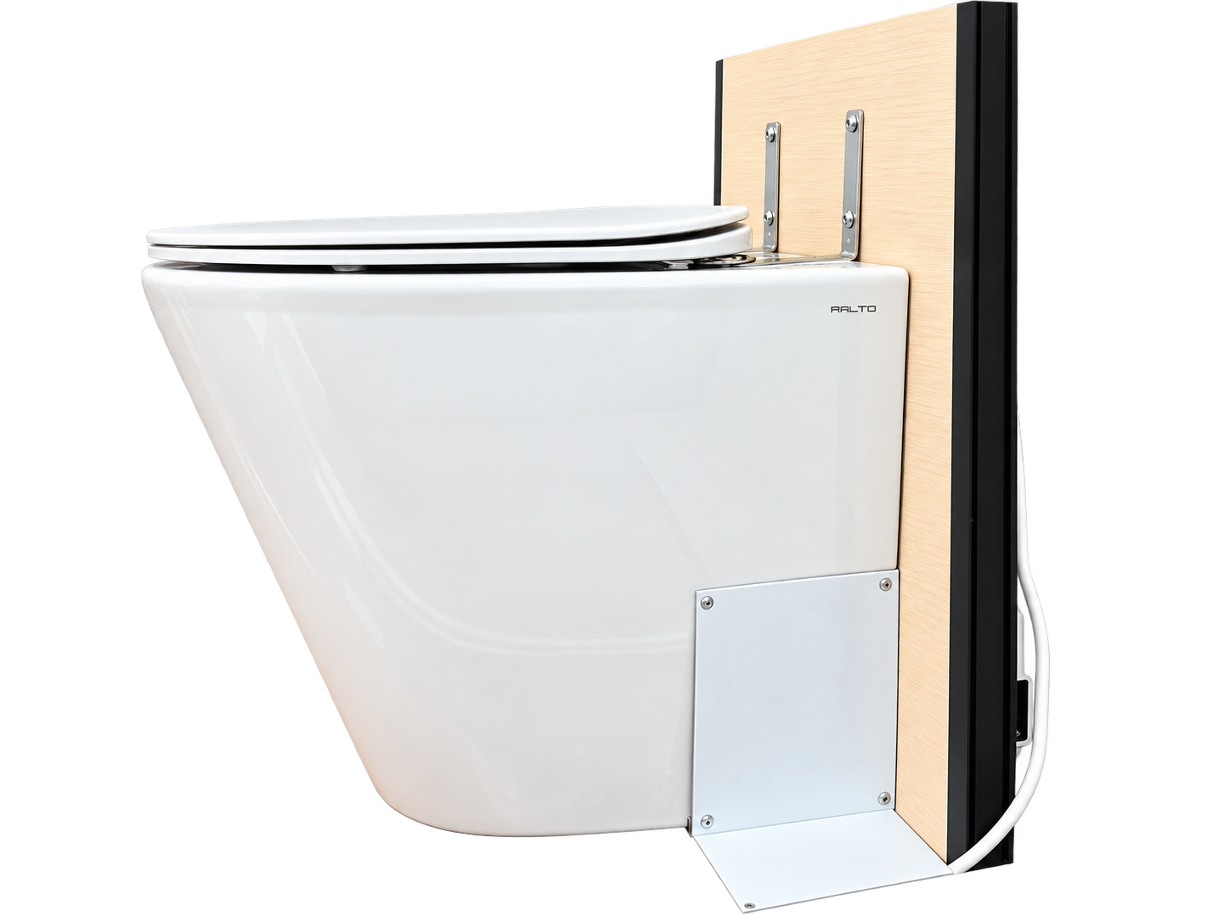
PAGE 03
STATE: BOWL OUTER SIDE VIEW
STATE: BOWL OUTER FRONT VIEW

Slide 3
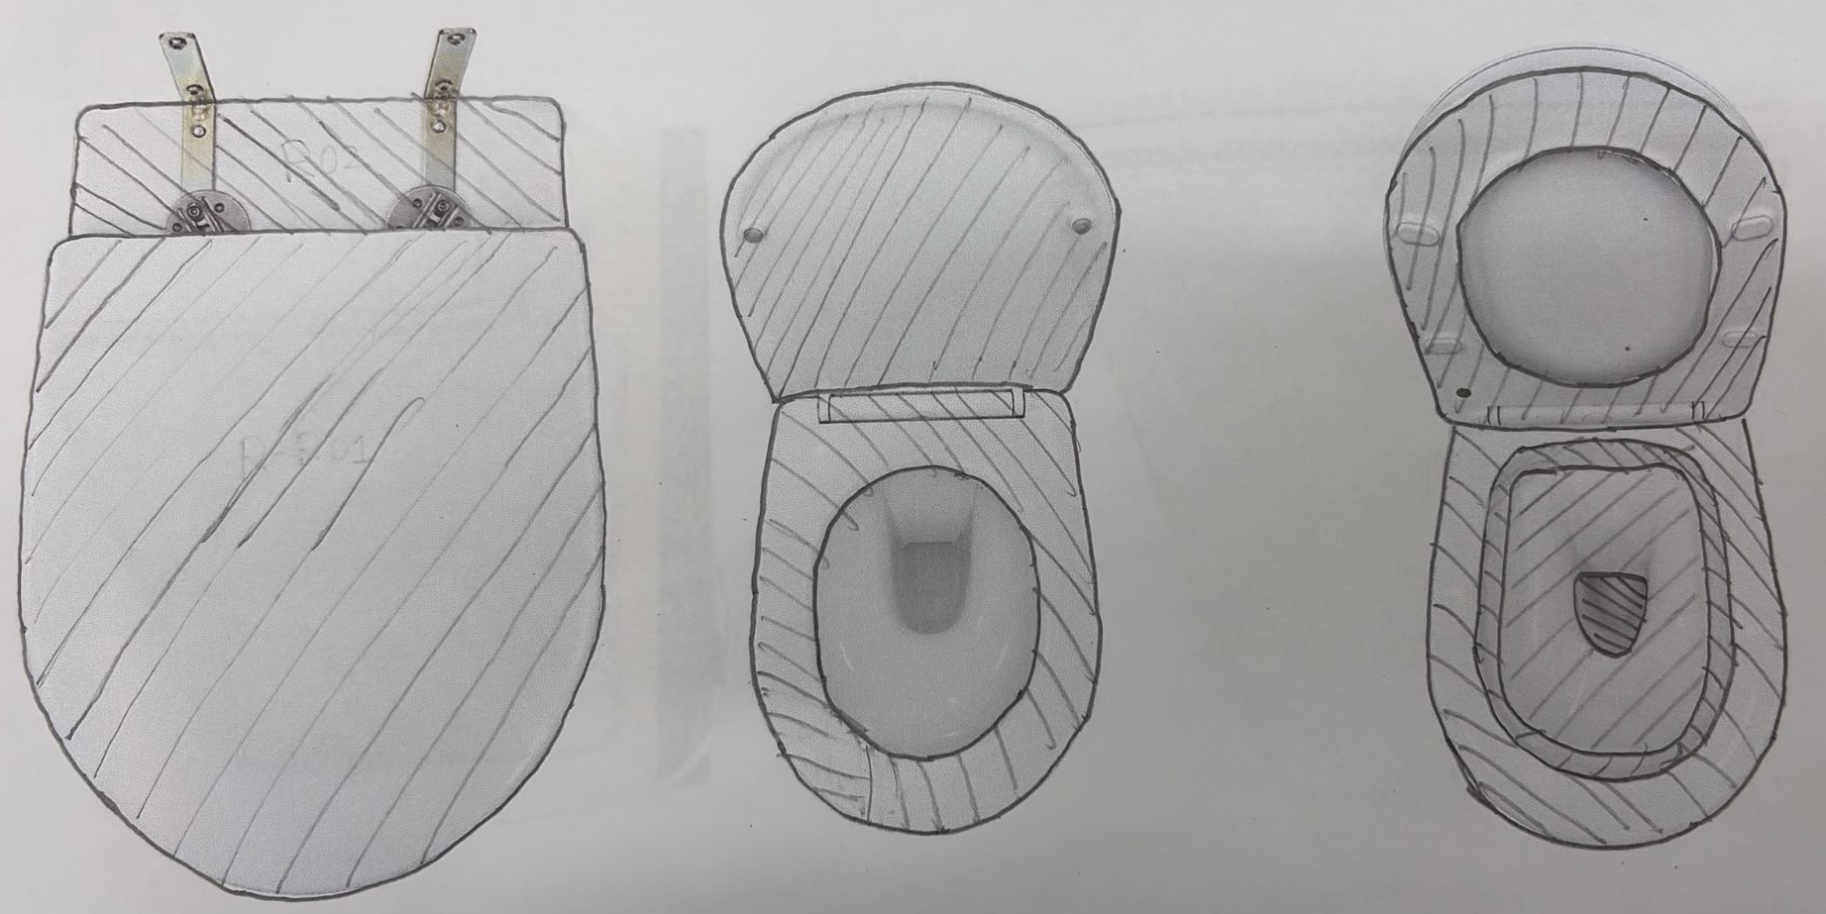









PAGE 04

Slide 4
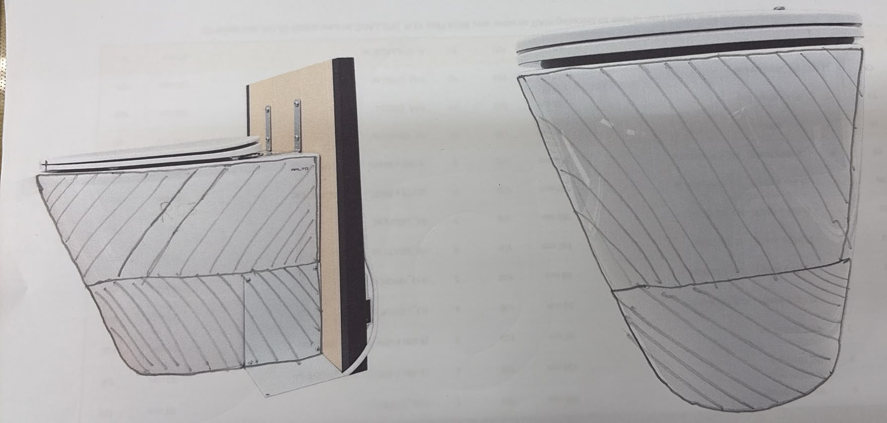



PAGE 05

Slide 5
TASK: 1A
R-R01 LID TOP PART 01
L-R01 BASE LEFT
LEFT ARM
RIGHT ARM

Slide 6
TASK: 2A
L-R02 SIDE EXTERIOR LEFT
R-R01 LID TOP PART 02
LEFT ARM
RIGHT ARM

Slide 7
TASK: 1C
R-R02 RIGHT HINGE
L-R03 PEDESTAL UPPER LEFT
LEFT ARM
RIGHT ARM

Slide 8
TASK: 2
LEFT HINGE
SIDE EXTERIOR RIGHT
LEFT ARM
RIGHT ARM

Slide 9
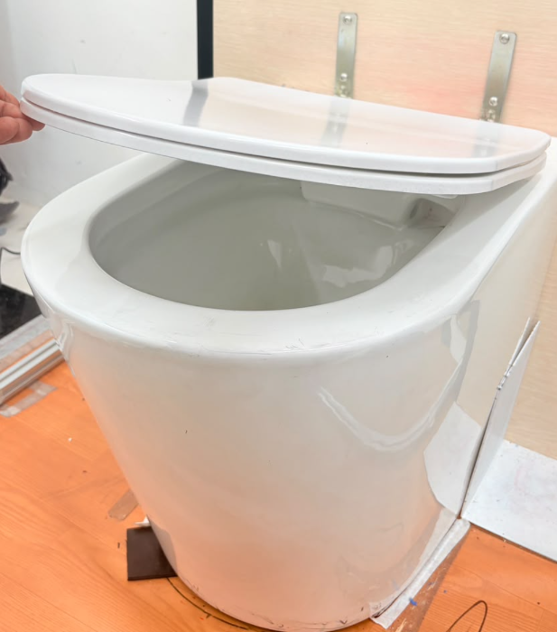
TASK: 3
OPEN LID + SEAT (MASTER)
OPEN LID + SEAT (SUPPORT)
LEFT ARM
RIGHT ARM

Slide 10
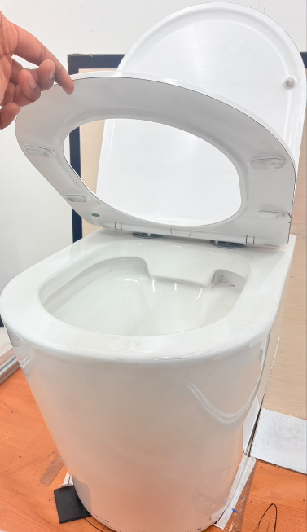
TASK: 4
CLOSE SEAT ONLY (MASTER)
CLOSE SEAT ONLY SUPPORT
LEFT ARM
RIGHT ARM

Slide 11
TASK: 5A
LID UNDERSIDE RIGHT HALF
RIGHT ARM
SEAT TOP PART 1
LEFT ARM

Slide 12

TASK: 5B
PEDESTAL UPPER RIGHT
SEAT TOP PART 2
LEFT ARM
RIGHT ARM

Slide 13
TASK: 6
LID UNDERSIDE LEFT HALF
BASE RIGHT
LEFT ARM
RIGHT ARM

Slide 14
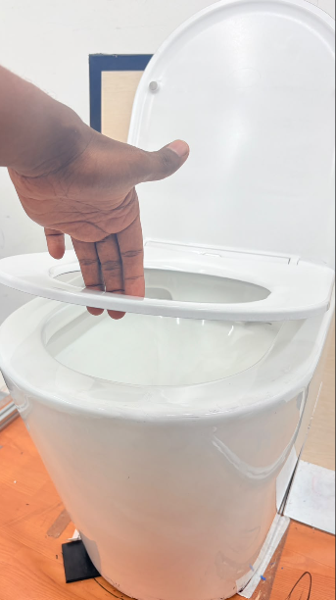
TASK: 7
L-T03 OPEN SEAT (MASTER)
R-T03 OPEN SEAT (SUPPORT)
LEFT ARM
RIGHT ARM

Slide 15
TASK: 8A
SEAT UNDERSIDE RIGHT HALF
RIGHT ARM
RIM TOP PART 1
LEFT ARM

Slide 16
TASK: 8B
RIM TOP PART 2
FLOOR SPILLAGE PART 1
LEFT ARM
RIGHT ARM

Slide 17
TASK: 9
SEAT UNDERSIDE LEFT HALF
FLOOR SPILLAGE PART 2
LEFT ARM
RIGHT ARM

Slide 18
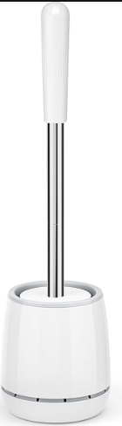
TASK: 10A
FL-R09 INNER RIM PART 1
R-T04 PICK DRAIN BRUSH
LEFT ARM
RIGHT ARM

Slide 19
TASK: 10B
FL-R09 INNER RIM PART 2
R-T04 PICK DRAIN BRUSH
LEFT ARM
RIGHT ARM

Slide 20
TASK: 11A
L-R10 BOWL INSIDE PART 1
HOLD BRUSH OUTSIDE
LEFT ARM
RIGHT ARM

Slide 21
TASK: 11B
L-R10 BOWL INSIDE PART 2
HOLD BRUSH OUTSIDE
LEFT ARM
RIGHT ARM

Slide 22

TASK: 12A
R-T05 CLEAN DRAIN HOLE PART1
L-R11 FLOOR SPILLAGE LEFT PART 1
LEFT ARM
RIGHT ARM

Slide 23
TASK: 12B
R-T05 CLEAN DRAIN HOLE PART 2
L-R11 FLOOR SPILLAGE LEFT PART 2
LEFT ARM
RIGHT ARM

Slide 24
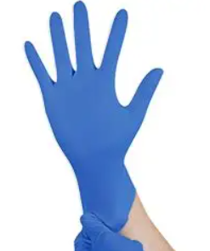
TASK: 13
TASK: 14
DROP GLOVE
R-T06 RETURN DRAIN BRUSH AND DROP GLOVE
L-T04 LEFT GLOVE CHANGE
R-T07 RIGHT GLOVE CHANGE
LEFT ARM
RIGHT ARM

Slide 25
TASK: 15
L-T05 CLOSE SEAT + LID (MASTER)
LEFT ARM
R-T09 CLOSE SEAT + LID (SUPPORT)
RIGHT ARM

