Slide 1
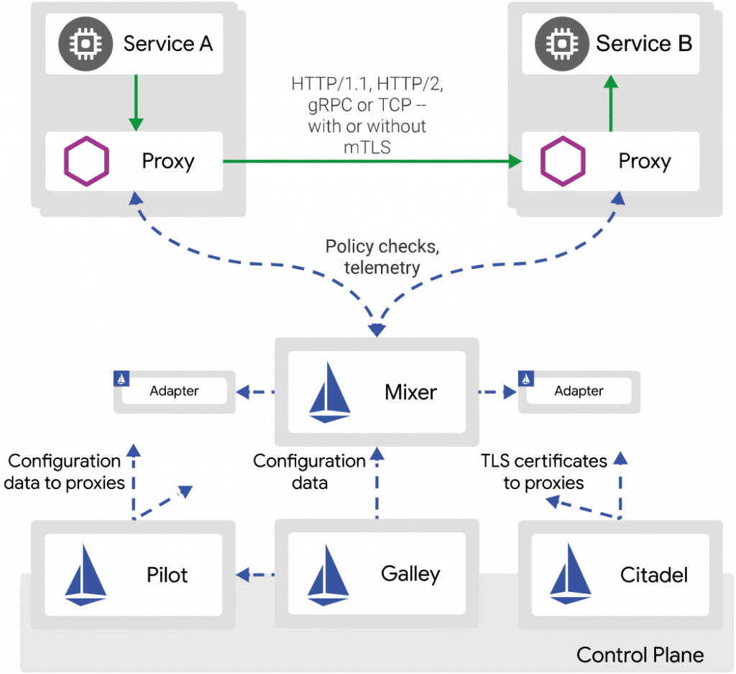
Data Plane
Control Plane
Data Plane
Control Plane

