Slide 1


CLIMATE İMECE
From Climate Action to Implementation with Young People, Educational Institutions and Local Communities
Prof. Dr. Hayal Köksal
Dr. Memet Aslan · Aleyna Çavdar
Azad Kılıçarslan · Ayça Selin Akyol
Bu sunumda yer alan görüş, bilgi ve ifadelerden, sunumun hazırlanmasından ve içeriğinden yalnızca İstanbul Kent Üniversitesi – Prof. Dr. Hayal Köksal sorumlu olup, sunum Yükseköğretim Kurulu’nun (YÖK) görüşlerini yansıtmaz ve Kurula herhangi bir sorumluluk yüklemez.
Istanbul Kent University – Prof. Dr. Hayal Köksal is solely responsible for the views, information and statements expressed in this presentation, as well as for its preparation and content. The presentation does not necessarily reflect the views of the Council of Higher Education of Türkiye (YÖK), nor does it imply any responsibility or liability on its part.

Slide 2
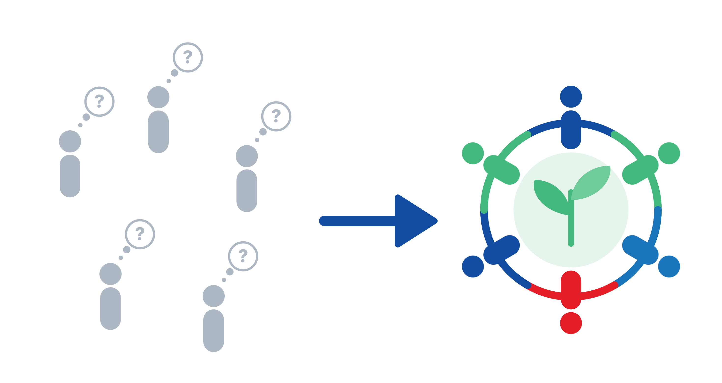
PROBLEM AND AIM
PROBLEM
Awareness alone does not create climate action.
AIM
Make young people active partners in climate solutions.
AWARENESS
ACTION
Bu sunumda yer alan görüş, bilgi ve ifadelerden, sunumun hazırlanmasından ve içeriğinden yalnızca İstanbul Kent Üniversitesi – Prof. Dr. Hayal Köksal sorumlu olup, sunum Yükseköğretim Kurulu’nun (YÖK) görüşlerini yansıtmaz ve Kurula herhangi bir sorumluluk yüklemez.
Istanbul Kent University – Prof. Dr. Hayal Köksal is solely responsible for the views, information and statements expressed in this presentation, as well as for its preparation and content. The presentation does not necessarily reflect the views of the Council of Higher Education of Türkiye (YÖK), nor does it imply any responsibility or liability on its part.

Slide 3
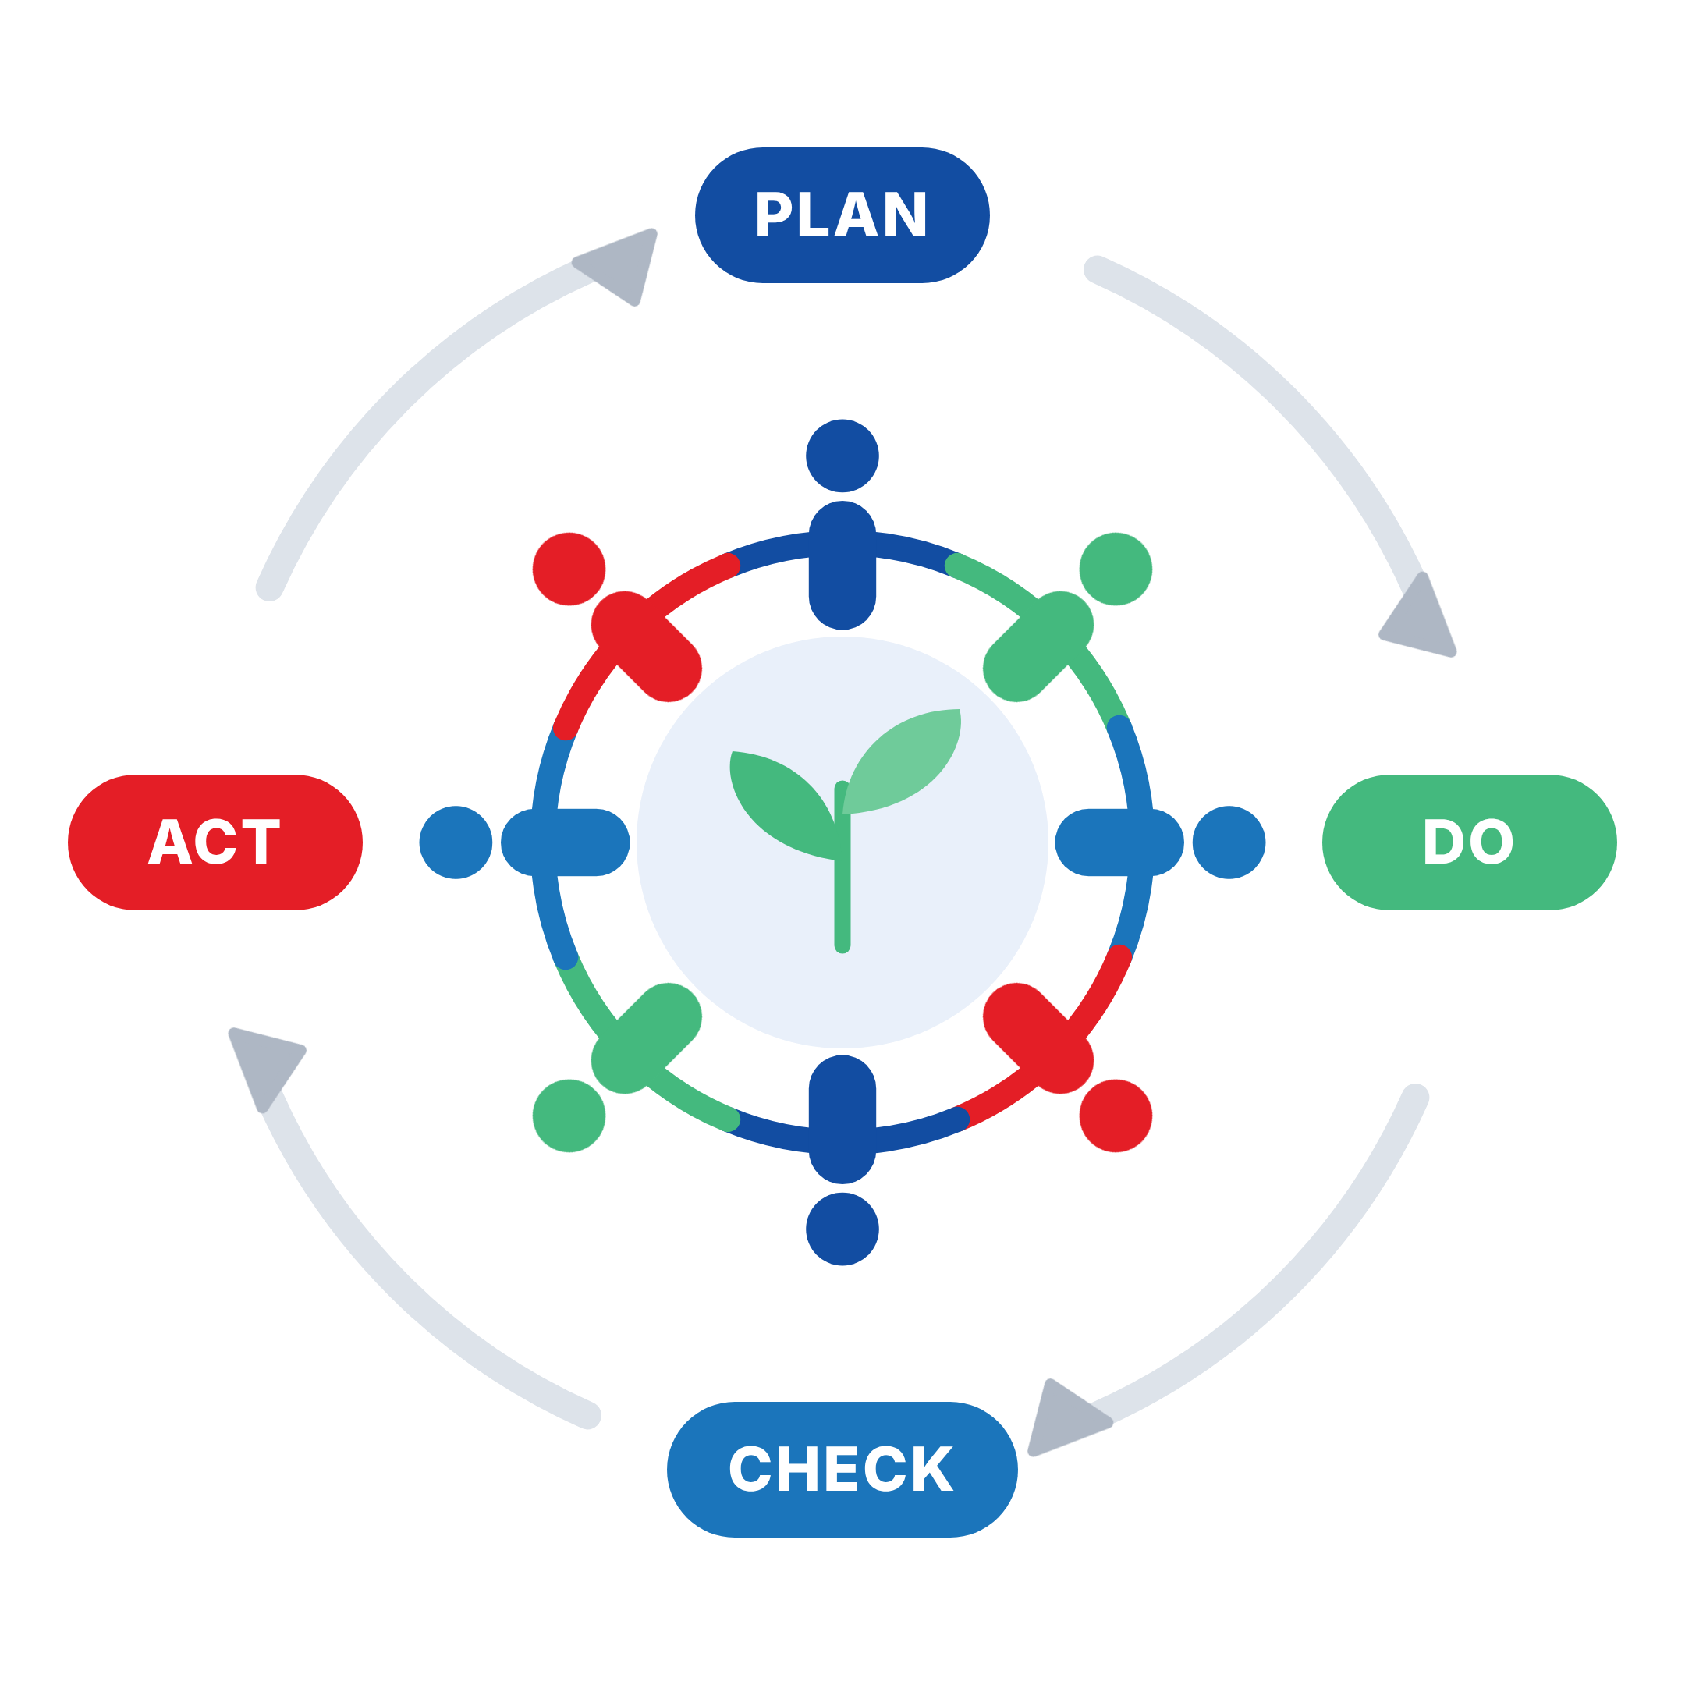


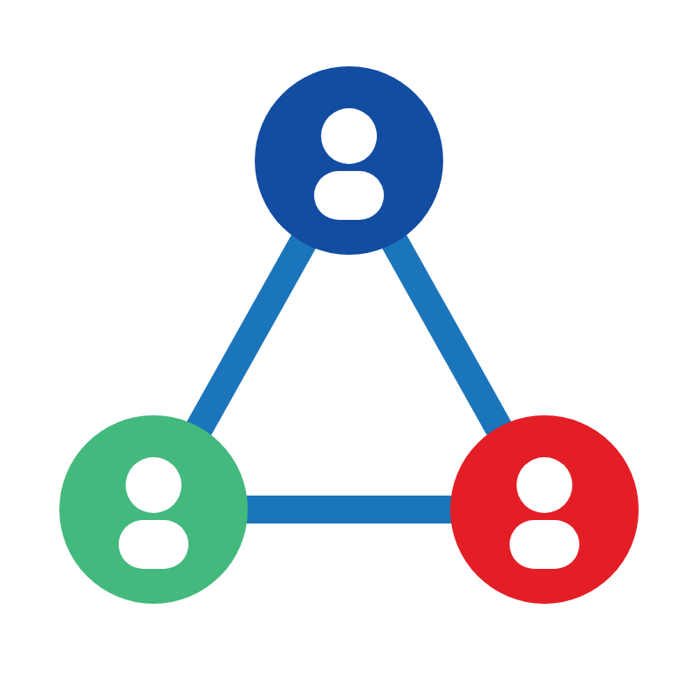
METHOD
İMECE Circles
Small, voluntary learning teams
Shared knowledge
Local experience meets science
Online exchange
Türkiye, Algeria, India
Bu sunumda yer alan görüş, bilgi ve ifadelerden, sunumun hazırlanmasından ve içeriğinden yalnızca İstanbul Kent Üniversitesi – Prof. Dr. Hayal Köksal sorumlu olup, sunum Yükseköğretim Kurulu’nun (YÖK) görüşlerini yansıtmaz ve Kurula herhangi bir sorumluluk yüklemez.
Istanbul Kent University – Prof. Dr. Hayal Köksal is solely responsible for the views, information and statements expressed in this presentation, as well as for its preparation and content. The presentation does not necessarily reflect the views of the Council of Higher Education of Türkiye (YÖK), nor does it imply any responsibility or liability on its part.

Slide 4


EXPECTED OUTPUTS
1
Youth Model
3+
Climate solutions
1
Practical guide
3
Partner countries
Targets of the pilot at Istanbul Kent University
Bu sunumda yer alan görüş, bilgi ve ifadelerden, sunumun hazırlanmasından ve içeriğinden yalnızca İstanbul Kent Üniversitesi – Prof. Dr. Hayal Köksal sorumlu olup, sunum Yükseköğretim Kurulu’nun (YÖK) görüşlerini yansıtmaz ve Kurula herhangi bir sorumluluk yüklemez.
Istanbul Kent University – Prof. Dr. Hayal Köksal is solely responsible for the views, information and statements expressed in this presentation, as well as for its preparation and content. The presentation does not necessarily reflect the views of the Council of Higher Education of Türkiye (YÖK), nor does it imply any responsibility or liability on its part.

Slide 5
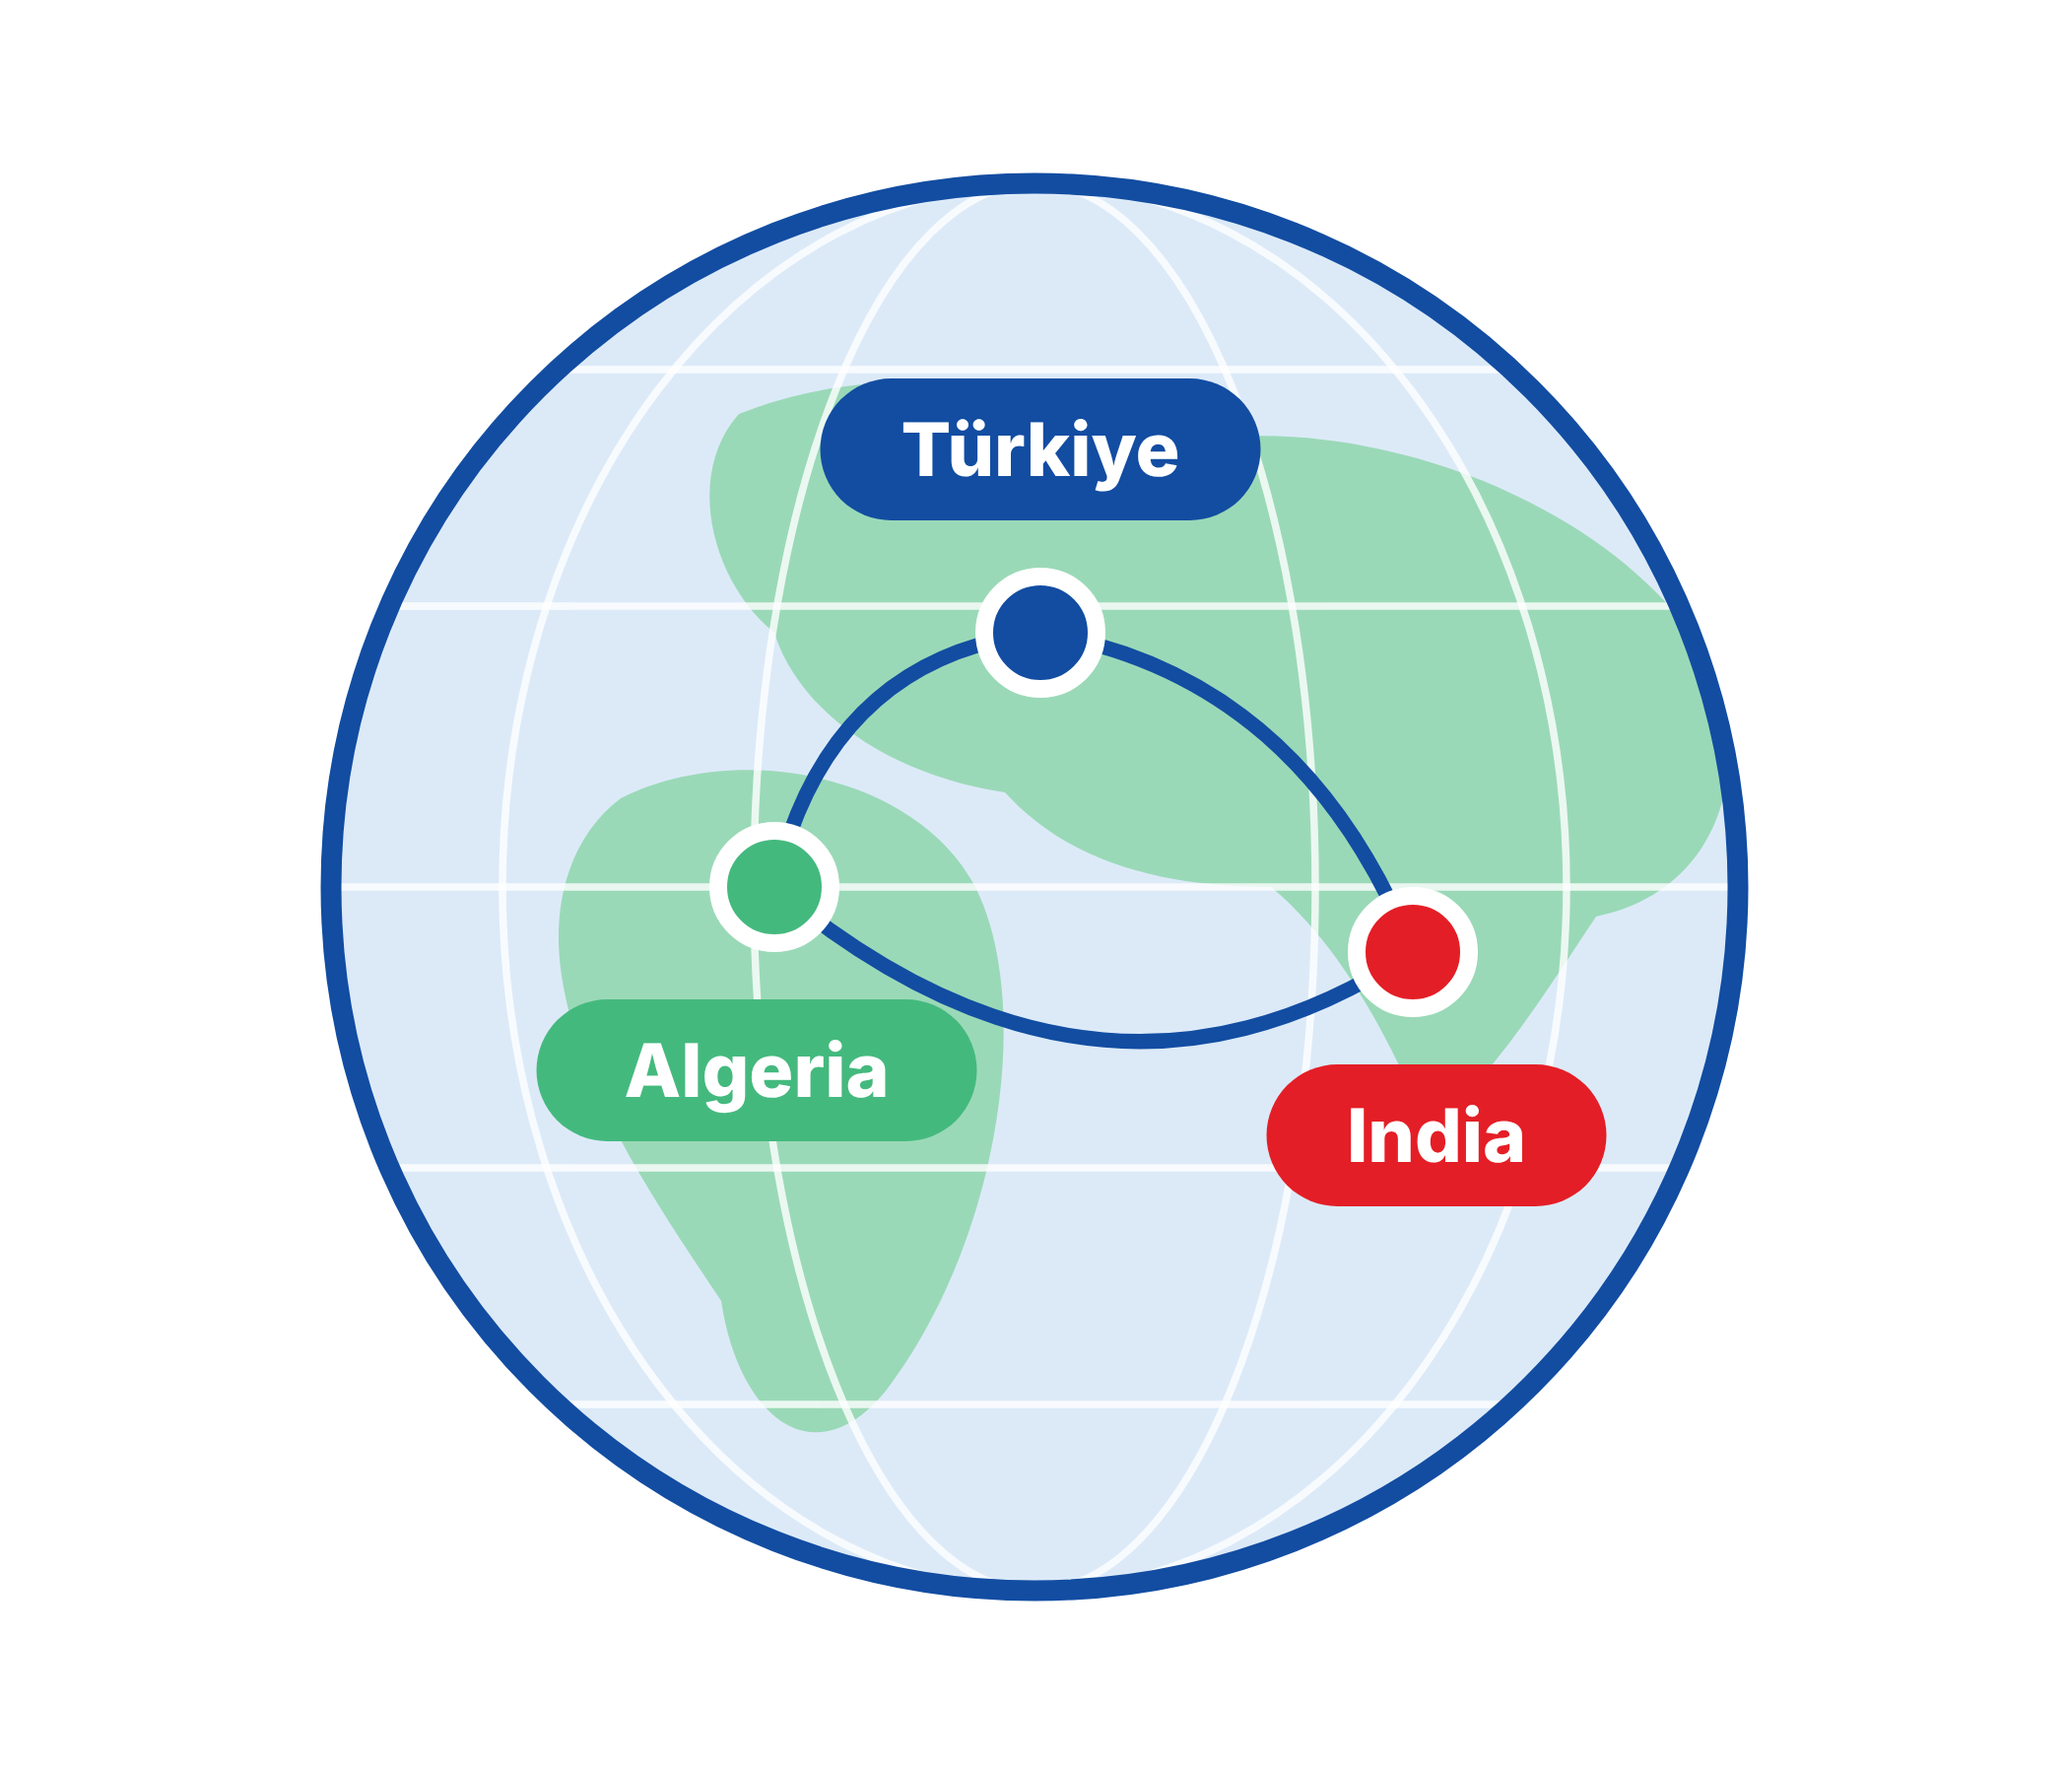

CLIMATE ACTION AND IMPACT
Local action,
global contribution.
Youth become solution partners
Local knowledge meets science
A model others can adopt
Bu sunumda yer alan görüş, bilgi ve ifadelerden, sunumun hazırlanmasından ve içeriğinden yalnızca İstanbul Kent Üniversitesi – Prof. Dr. Hayal Köksal sorumlu olup, sunum Yükseköğretim Kurulu’nun (YÖK) görüşlerini yansıtmaz ve Kurula herhangi bir sorumluluk yüklemez.
Istanbul Kent University – Prof. Dr. Hayal Köksal is solely responsible for the views, information and statements expressed in this presentation, as well as for its preparation and content. The presentation does not necessarily reflect the views of the Council of Higher Education of Türkiye (YÖK), nor does it imply any responsibility or liability on its part.

Slide 6

THANK YOU
Compete with Yourself, Collaborate with Others.
Prof. Dr. Hayal Köksal
Istanbul Kent University, Türkiye
hayal.koksal@kent.edu.tr
Scan to read about İMECE Circles
Bu sunumda yer alan görüş, bilgi ve ifadelerden, sunumun hazırlanmasından ve içeriğinden yalnızca İstanbul Kent Üniversitesi – Prof. Dr. Hayal Köksal sorumlu olup, sunum Yükseköğretim Kurulu’nun (YÖK) görüşlerini yansıtmaz ve Kurula herhangi bir sorumluluk yüklemez.
Istanbul Kent University – Prof. Dr. Hayal Köksal is solely responsible for the views, information and statements expressed in this presentation, as well as for its preparation and content. The presentation does not necessarily reflect the views of the Council of Higher Education of Türkiye (YÖK), nor does it imply any responsibility or liability on its part.

