Slide 1
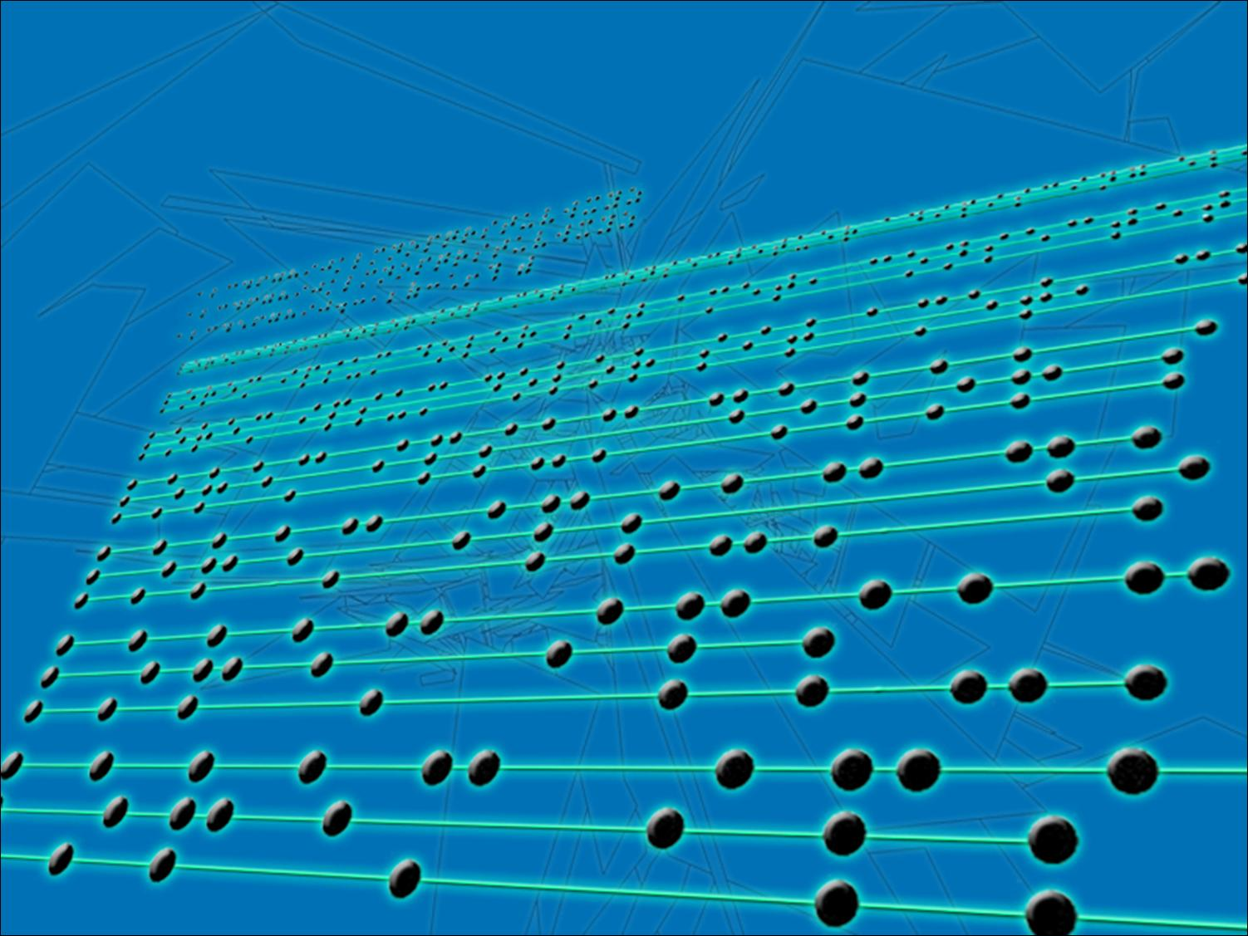
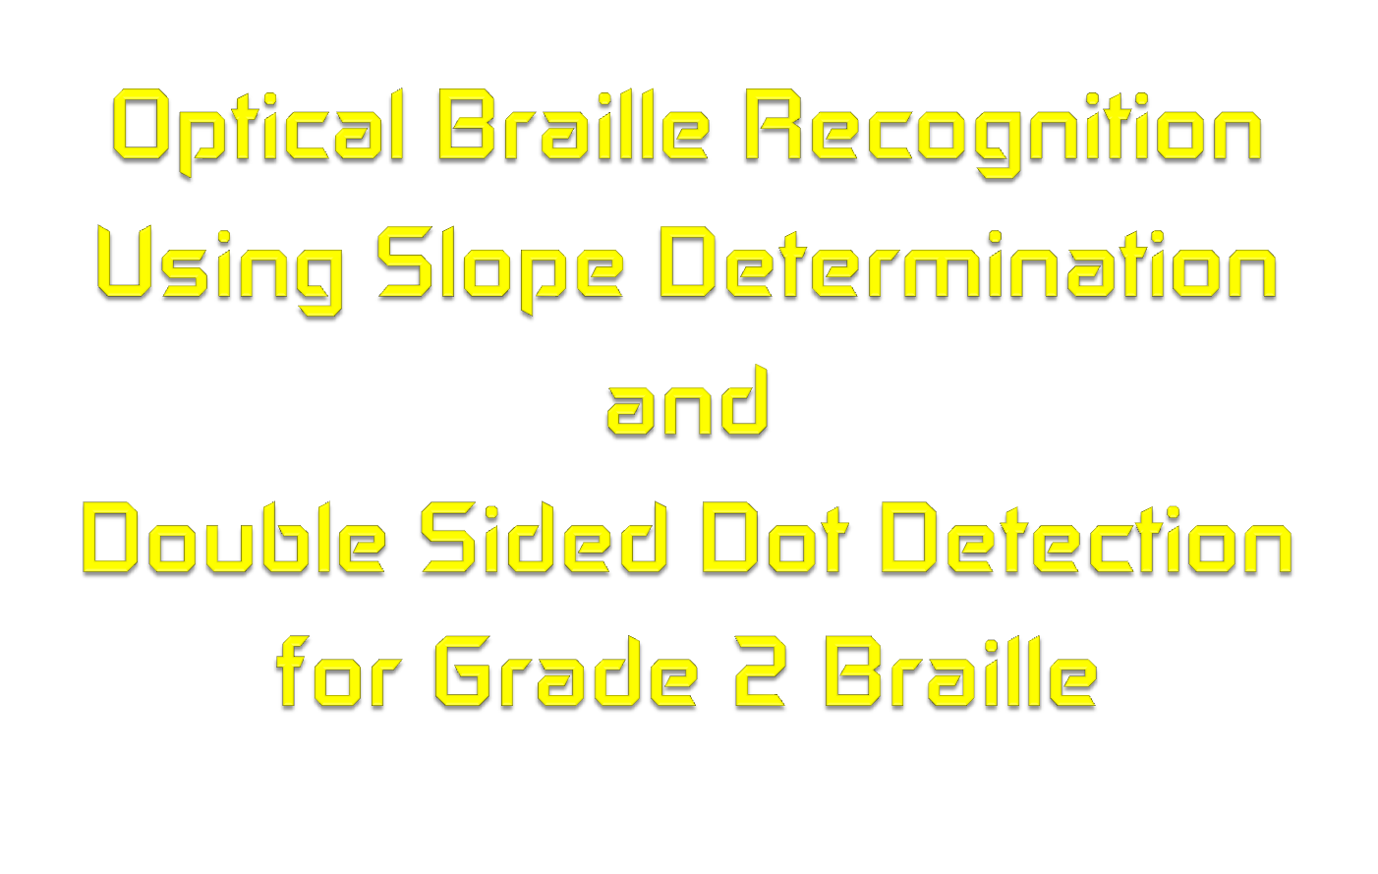

Slide 2

Braille
Method of reading and writing text through touch, rather than sight
Used by visually impaired
composed of six dots arranged in two columns and three rows

Slide 3
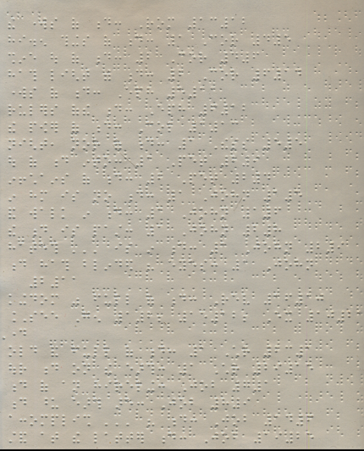
Statement of the Problem
1. How will the system interpret the Braille document if upon scanning, the document/page is already skewed?

Slide 4
Statement of the Problem
2. How will the algorithm for character recognition identify it as a Grade 2 Braille?

Slide 5
Statement of the Problem
3. How will the system differentiate the embossed side from the depressed side since they both produce shadows that is recognized as a character?

Slide 6
Objectives
General
  translate scanned Braille documents into English text
Specific
  to modify the existing image recognition algorithms to recognize Grade 2 Braille
  to create a stand alone application that interprets a double sided and Grade 2 Braille document
  to enhance the previous study

Slide 7
Significance of the Study
Those who work with the visually impaired
Those who want to learn how to read Braille
Braille documents are stored digitally
can reduce the computer memory, compared to grade 1 Braille

Slide 8

Protrusion and Depression

Slide 9
Grade 1 and Grade 2 Braille
myself
Grade 1
m y s e l f
Grade 2
m y f

Slide 10
Scope
  Grade 2 Braille documents
  double sided Braille documents
  6-dot Braille cell
  lowercase Braille characters
  200 dpi resolution

Slide 11
Delimitation
  detect protrusions of the embossed Braille characters.
  only support JPEG image format
  only accepts English alphabetic
  Braille character to English text translation only
  Excellent condition Braille document
  The Braille document to be scanned should not contain foreign objects.
  not have dots that are very close/ joined with each other.
  Can only correct slanted or skewed images at an angle less than or equal to 5.5 degrees.
  cannot process a single character input.
  a standard size of 11 x 11.5 inches can be used as source.

Slide 12
Hypothesis
improving the pattern generation algorithm
additional de-skew detection
to modify the segmentation of the current system to allow the input of double sided Braille

Slide 13
Assumption
Have at least limited experience in using computers
Knowledgeable in cropping or cutting images
Beneficial to have at least minimum experience in working with Braille documents
Knowledge in the use of a scanner

Slide 14
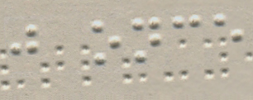
Image input
Pre-cut scanned Braille image

Slide 15
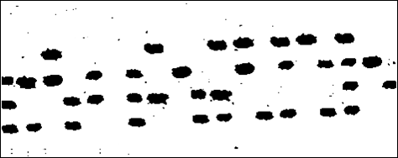
Thresholding

Slide 16

Image Inversion

Slide 17

Noise Reduction

Slide 18
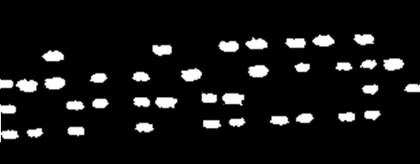
Identifying the centroids
Inverted thresholded image

Slide 19
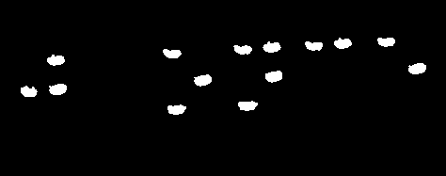
Deskewing
Y2 – Y1
X2 – X1
Slope =

Slide 20
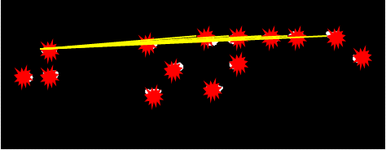
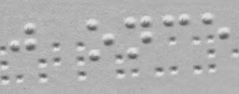
Deskewing
Skew Angle = arctan(Slope)

Slide 21
Grayscale
Gray scaled image

Slide 22
Protrusion VS Depression

Slide 23
Removing Depressions

Slide 24
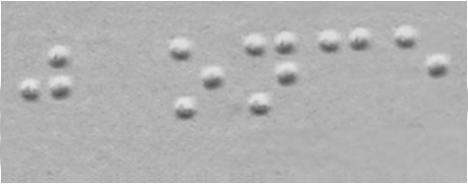
Filling a Region

Slide 25



Character Box Calculation
SPACE
Internal Dot
Inter- Character
Y

Slide 26


Character Isolation and Digital Morphology
1
0
1
0
1
0
1
0
0
1
1
0

Slide 27
Recognition
1 0 1 0 1 0 1 1 1 0 0 0 1 1 0 0 1 0 0 0 1 1 1 0 1 0 1 0 1 0 1 0 1 1 0 0
If Yes
If No
Grade 2 Braille Character Database
Grade 1 Braille Character Database
SPACE
ARRAY
STRING

Slide 28
Feature Extraction
m y f

Slide 29
Program Demonstration

Slide 30
Conclusions
Deletion of Braille dot depressions
Dynamic correction of image skews
Recognition of grade 2 Braille contractions

Slide 31
Recommendations
Using a camera instead of a scanner
Ability to clean or remove foreign objects
Recognition of a whole Braille page/document
Enhance the depression detection algorithm

