Slide 1
Efficient Minimal Perfect Hash Language Models
David Guthrie, Mark Hepple, Wei Liu
University of Sheffield

Slide 2
Large LMs
Brants et al. (2007) showed that MT quality continues to improve even when training corpus size is increased above 1 trillion tokens
Google Web 1T corpus contains 3.8 Billion unique n-grams and is 25GB compressed
LM toolkits can not store this amount of data in memory
Notes:
Estimating the likelihood of a sequence of words is a fundamental part of many natural language processing tasks
probabilities are typically represented using a language model that stores n-grams and their count or probability value

Slide 3
Methods for Reducing the size of LMs
Prune vocabulary
Prune low frequency n-grams
Entropy pruning
Quantizing counts or probabilities
      divide the probability range into Q discrete values. Each n-gram probability is therefore ‘rounded’ to one of the Q values and requires only log2 Q bits to store
Models are still too large to store using LM toolkits
Notes:
Decreases the usefullness of the model and

Slide 4
Trie Data Structure
Most language modeling toolkits including SRILM toolkit, CMU toolkit, and IRSTLM use variations of the trie structure
Compact tree structure where each node stores the unique prefixes of the nodes below it in the tree
Notes:
describe what they are good for

Slide 5
Trie Data Structure
n-1 binary searches to locate an n-gram
O(log₂ N)
Allows enumerations of n-grams starting with different word sequences
Most compact representation uses 7.2 Bytes per n-gram to store a trigram LM using 8 bit quantized counts (with 32 bit word vocabulary)

Slide 6
Random Access Language Models
Work by Talbot and Brants (2008) make use of bloomier filters to map n-grams to their associated probabilities or counts
Store language models without storing the actual n-gram key in the structure and allowing a small probability of returning a false positive
Save significant space but do not allow enumeration over n-grams
Uses in 3.08 Bytes per n-gram to store 8-bit quantized probabilities

Slide 7
Introducing MPHR
We developed two new structures called Single Minimal Perfect Hash Ranking and Tiered Minimal Perfect Hash Ranking
Use significantly less space than all known approaches
allowing full n-gram frequency counts to be stored in up to 36% of the space of Random Access Bloomier Filter
O(1) random access and O(n) construction

Slide 8
Single MPHR Structure
Stage 1: Minimal Perfect Hash Function
Stage 2: Fingerprint Rank Array
Stage 3: Unique Value Array

Slide 9
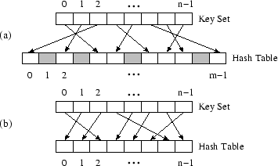
Perfect Hashing
(a) Perfect Hash (b) Minimal Perfect Hash
Notes:
Perfect hash function maps all elements of the key set to an array with no collisions
A minimal perfect hash function can do this with n = m

Slide 10
Storing n-grams
We use a minimal perfect hash function to map every n-gram in the training data to a distinct integer in the range 0 to N − 1, where N is the total number of n-grams to store
Function is perfect, so it is guaranteed to return unique integers for every seen n-gram
We can use these integers a indices to an array and store values at that location
Notes:
The algorithm we use for minimal perfect hash function are in the paper

Slide 11
False Positives
Querying an n-gram from training always returns the correct index into the array
But the hash function will also return integer values in the range 0 to N − 1 for n-grams that have not been seen before (i.e. were not used to build the hash function)!

Slide 12
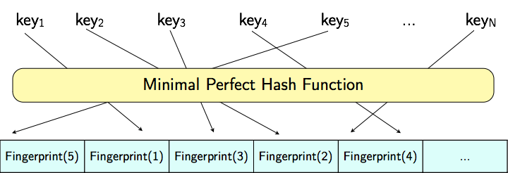
Storing
Fingerprints
Notes:
For every n-gram we compute a random fingerprint and store this in an array at the index given to by the minimal hash function
Only by comparing the fingerprints we can say with high probability whether that n-gram was actually stored in the model.
The amount of bits we keep for the fingerprint determines the false positive rate for n-grams not in the model. Using 12 bit fingerprint gives false positive rate of 0.0002

Slide 13
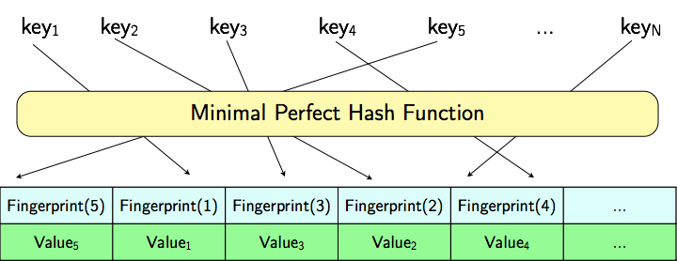
Storing Values
Notes:
Build a minimal perfect hash function for our N keys, that gives us integers in the range 1 to N, use that as index to an array. I said before that we can use different sized finger-prints, but what about the values? 32 bits per int, or 37 bits per int

Slide 14
Values
For every n-gram, we store the ‘rank’ of the frequency count and use a separate array in Stage 3 to store the actual value
motivated by the distribution of n-gram frequency counts in corpora
If there are R distinct ranks then we only need to store ⌈log2 R⌉ bits rather than bits required to store the largest frequency count

Slide 15
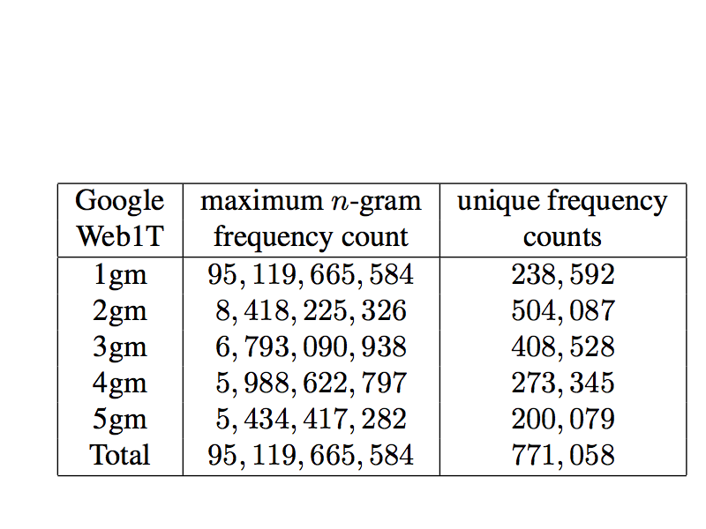
Unique Frequencies
Notes:
Only need 20 bits rather than 37

Slide 16
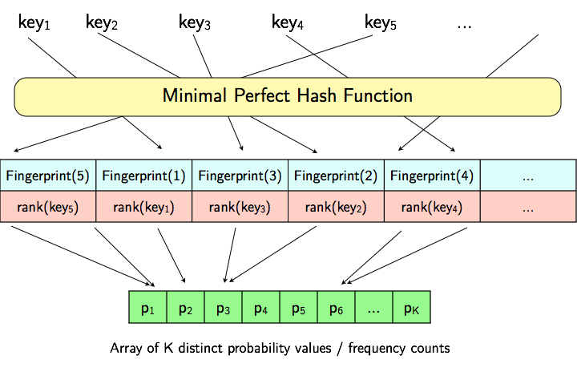
Single MPHR structure
Notes:
Explain how to look up

Slide 17
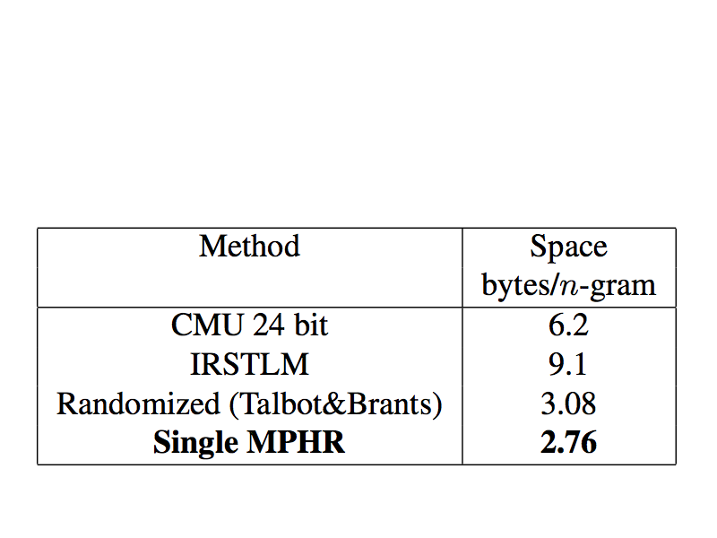
Comparison of Space Usage
Bloomier
Storing 8 bit quantized values and using 12 bit fingerprints

Slide 18
Storing Full Counts
Store full frequency counts for all 3.8 billion ngrams in the Google Web 1T corpus
Bloomier Filter requires: 7.53 bytes/n-gram or 26.63GB
Single MPHR requires: 4.26 bytes/n-gram or 15.05GB
Single MPHR uses 53% of the space required by Bloomier if we apply the same rank array optimization to Bloomier approach MPHR still uses 86% of the space
Notes:
We get more drastic saving if we store full counts because we get to take full advantage of rank storage

Slide 19
Tiered MPHR
In Google Web 1T data the first 256 ranks account for 85% of the n-grams
Use single top level used MPHR to store all fingerprints and some space for rank values and some for redirection to secondary hashes
Secondary MPH functions are computed only for the keys they store and no need to store fingerprints

Slide 20
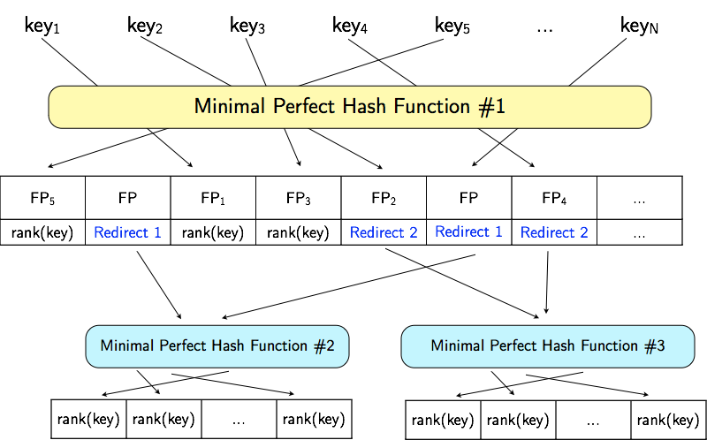
Tiered MPHR

Slide 21
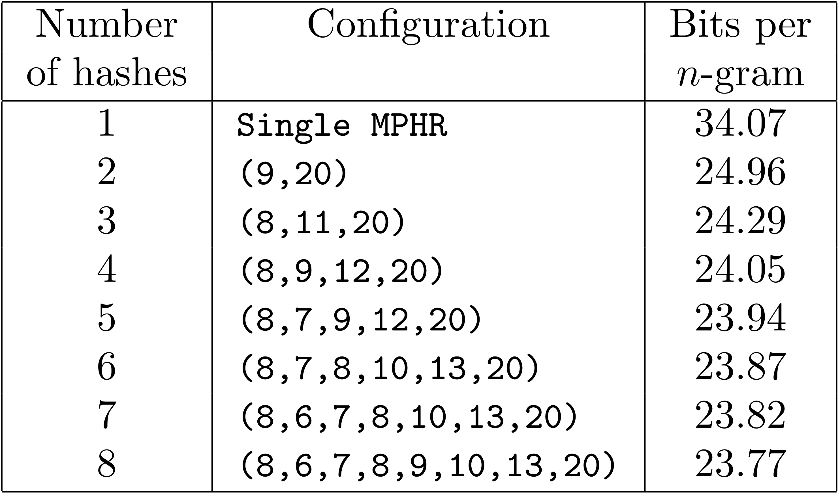
Tiered MPHR for Google 1T Data
Storing full frequency count information
for all 1 to 5 grams with 12 bit fingerprints
Notes:
For 5 hashs we can see that to store all data we use less than 3 bytes per ngram

Slide 22
Summary
We developed an efficient methods of storing large language models
Allows for probability values or counts to be stored and accessed in constant time. Approximately 1000 times faster than using a modern database
Uses significantly less space than all known approaches. Allows for storage of full frequency count information using less than 3 Bytes per n-gram

