Slide 1
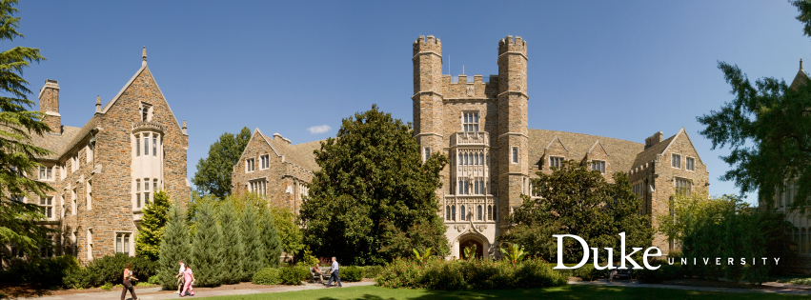
DukeNet: A Mobile Vision Deep Neural Network for DSP
Team: foreverDuke

Slide 2
DukeNet
Goal: Design a deep neural network to fit challenging runtime constraints (i.e. 7ms latency) on Qualcomm Snapdragon 855 with NNAPI
Design detail:
Use MobileNetV3 as inspiration and backbone model.
Remove all ‘fancy’ activations (e.g. Hard swish, ReLU6) which may either be incompatible with hardware or induce significant accuracy drop after quantization.
Replace 5x5 convolutional kernels with their 3x3 counterparts as these kernels are not supported by the NNAPI.
Remove the final FC layer to reduce the number of parameters as they are not necessary.
Scale up the model by 1.4x to fully utilize the 7ms budget.

Slide 3
DukeNet
Current model has around 410 million MACs and 3.96 M parameters.
The submission model is trained within 120 epochs with cosine learning rate schedule (about 4 GPU days on 2 Titan RTX). Similar hyperparameter settings in MobileNetV2 is applied.
At pre-submission, the uint8 model’s performance is accuracy is 72.58% within 6.29 ms.

Slide 4
Contact
Github repo:
https://github.com/newwhitecheng/dukenet

