Slide 1

DukeNet: A Mobile Vision Deep Neural Network for DSP
Team: foreverDuke

Slide 2
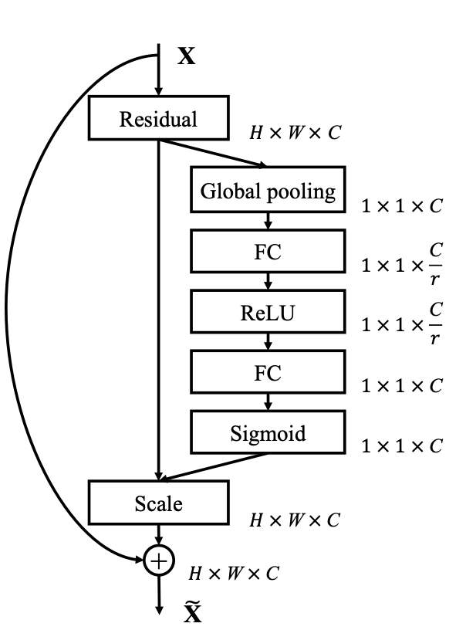
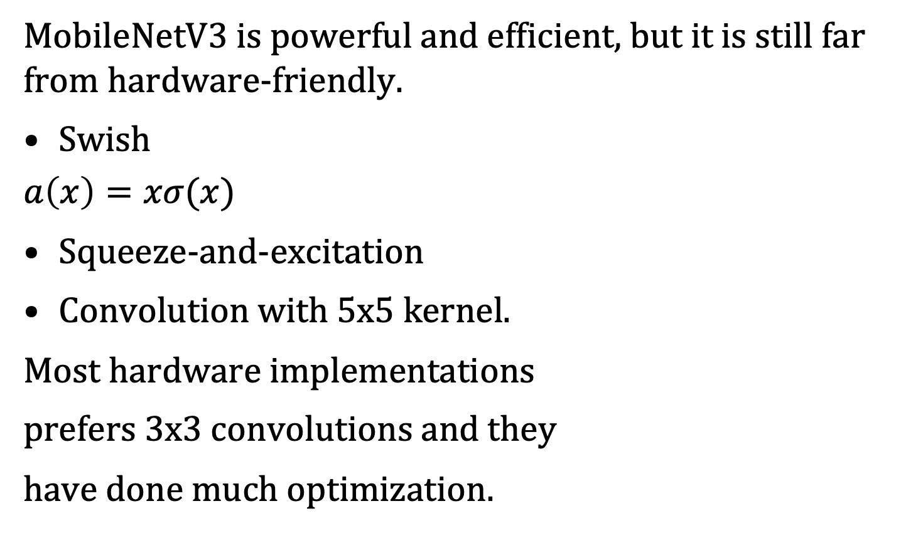
DukeNet: Background
MobileNetV3 is powerful and efficient, but it is still far from hardware-friendly.
Swish
$$a\left(x\right)=xσ(x)$$
Squeeze-and-excitation
Convolution with 5x5 kernel.
Most hardware implementations
prefers 3x3 convolutions and they
have done much optimization.
Source:
Ramachandran, Prajit, Barret Zoph, and Quoc V. Le. "Searching for activation functions." arXiv preprint arXiv:1710.05941 (2017).
Hu, Jie, Li Shen, and Gang Sun. "Squeeze-and-excitation networks." Proceedings of the IEEE conference on computer vision and pattern recognition. 2018.
Notes:
In addition, squeeze and excitation also use sigmoid which would also extremely slow down runtime. SE come with avg pool, which will increase MAC as well. Therefore, we decided to remove SE block.
We also observe that 5x5 convolution is not as well optimized as 3x3 conv on DSP. So we change 5x5 conv with 3x3 conv.

Slide 3
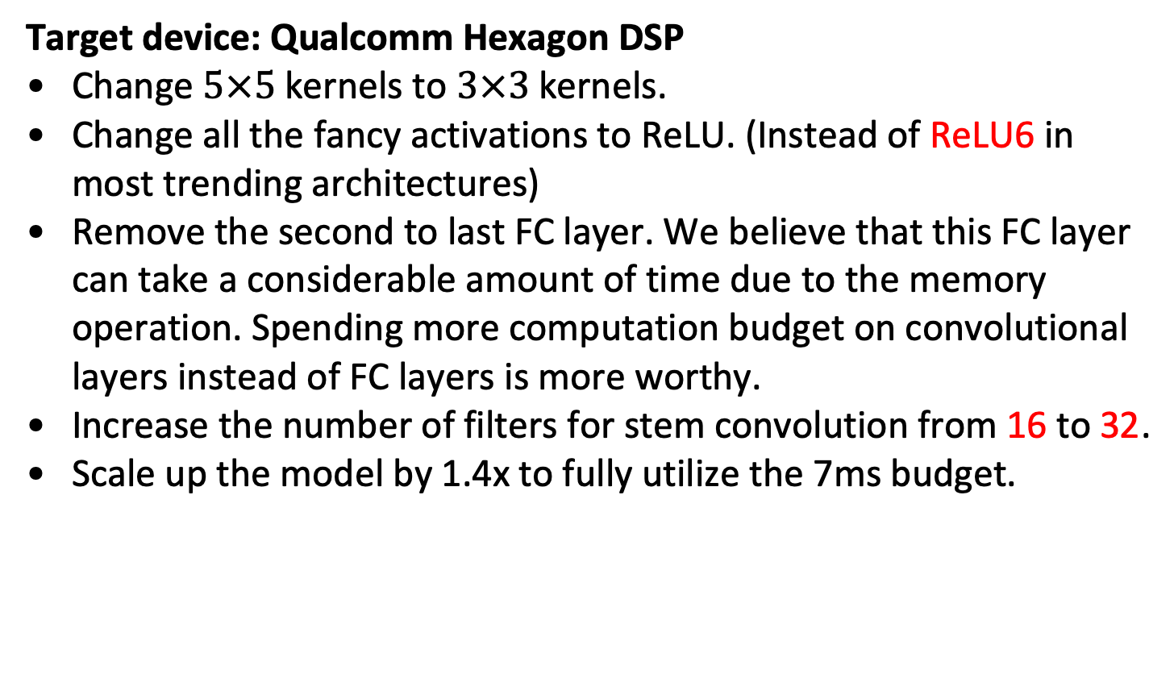
DukeNet: Architecture redesign
Target device: Qualcomm Hexagon DSP
Change $5×5$ kernels to $3×3$ kernels.
Change all the fancy activations to ReLU. (Instead of ReLU6 in most trending architectures)
Remove the second to last FC layer. We believe that this FC layer can take a considerable amount of time due to the memory operation. Spending more computation budget on convolutional layers instead of FC layers is more worthy.
Increase the number of filters for stem convolution from 16 to 32.
Scale up the model by 1.4x to fully utilize the 7ms budget.
Notes:
ReLu6 easilly induce high quantization loss. So we change the network to ReLU only.
Although fully connected layer has less MACs, but it occupy more memory operation.
To have a better trade-off of computation and memory access ratio. We try to use relatively more conv layers in a whole network.

Slide 4
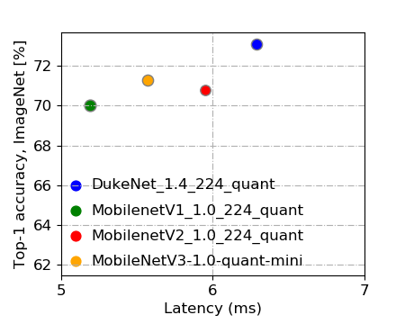
DukeNet
Current model has around 410 million MACs and 3.96 M parameters.
The submission model is trained within 120 epochs with cosine learning rate schedule (about 4 GPU days on 2 Titan RTX). Similar hyperparameter settings in MobileNetV2 is applied.
At pre-submission, the uint8 model’s performance is accuracy is 73.12% within 6.29ms.

Slide 5
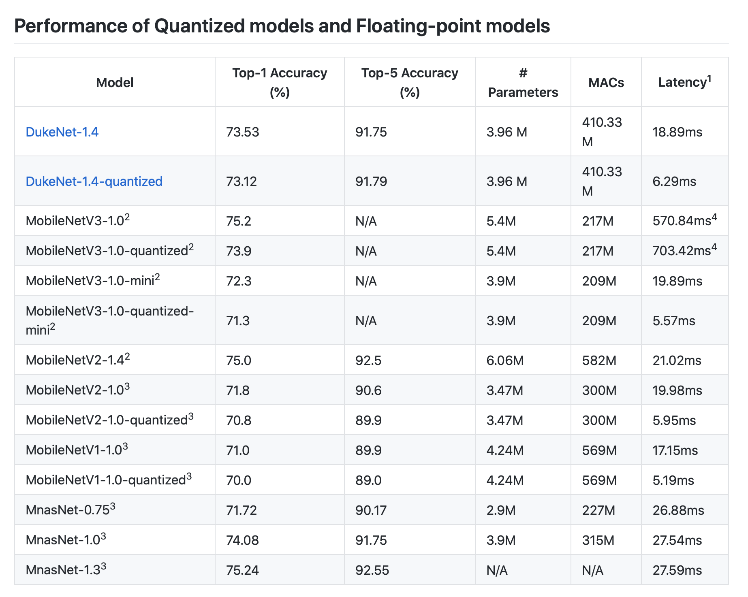
Contact
Github repo:
https://github.com/newwhitecheng/dukenet

