Slide 1
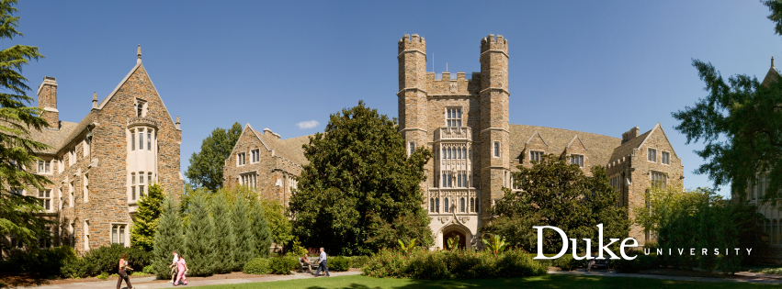
DukeNet - a Mobile Vision Deep Neural Network for DSP
Team: foreverDuke

Slide 2
DukeNet
Goal: Design a deep neural network to fully utilize Qualcomm Snapdragon 855 with NNAPI
Design detail:
Inspired by MobileNetv3 and use it as backbone structure.
Remove all of the ‘fancy’ activations (e.g. Hard swish, ReLU6) which may either incompatible with hardware or induce significant accuracy drop after quantization.
Replace 5x5 depthwise separable convolutions with their 3x3 counterparts as they are not supported by the NNAPI.
Remove the final FC layer to reduce the number of parameters.
Scale up the model by 1.4x to fully utilize the given computation budget.

Slide 3
DukeNet
Current model has around 410.33 million MACs
At pre-submission, the uint8 model’s performance is accuracy is 72.8% with 6.29 latency

Slide 4
Contact
Github repo:
https://github.com/newwhitecheng/dukenet

