Slide 1

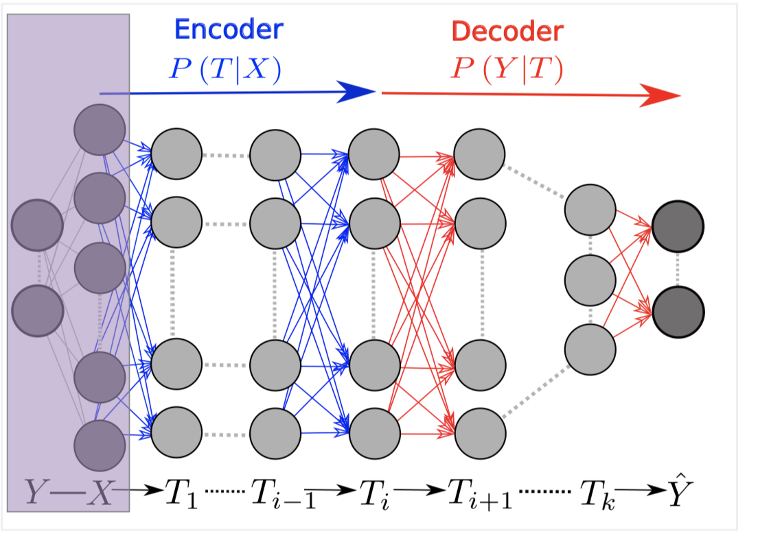
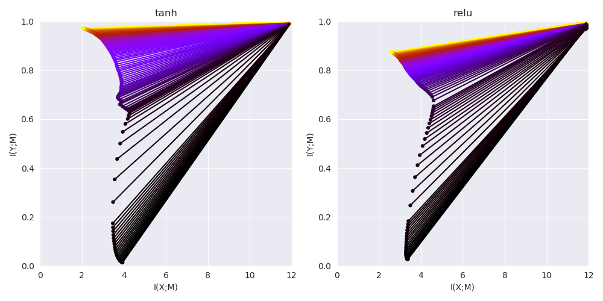
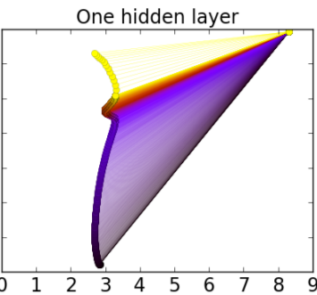
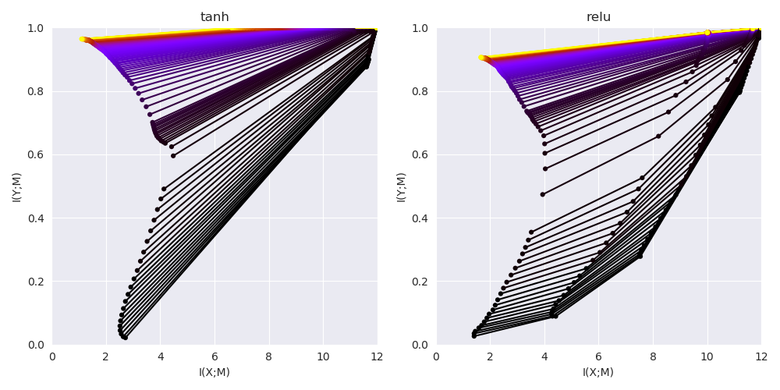
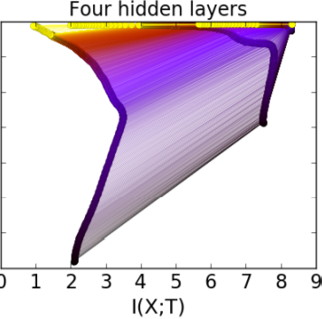
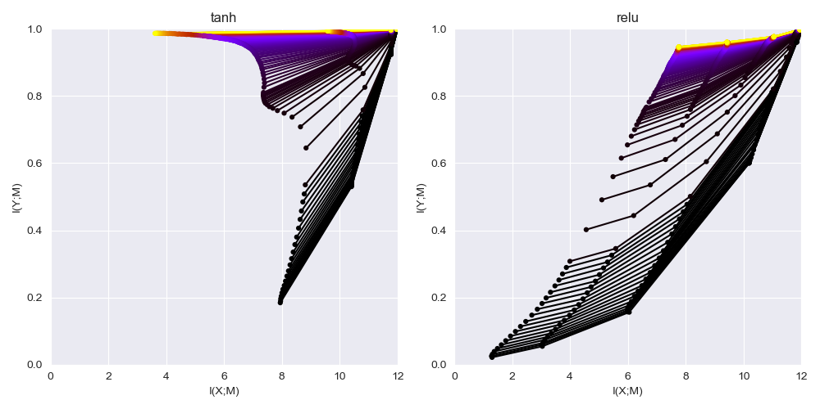
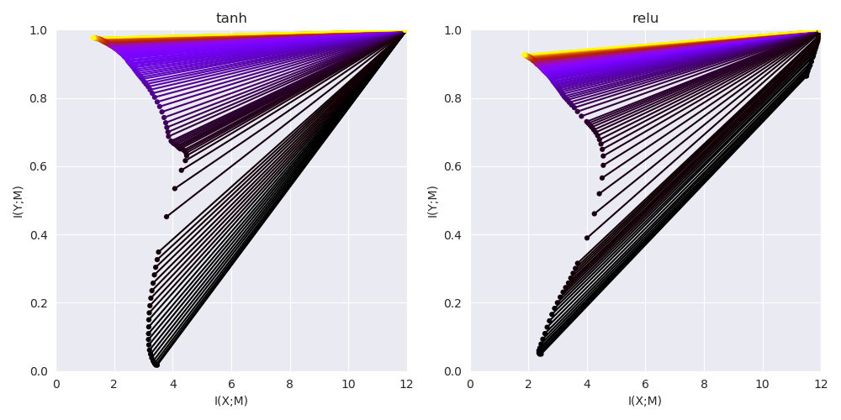
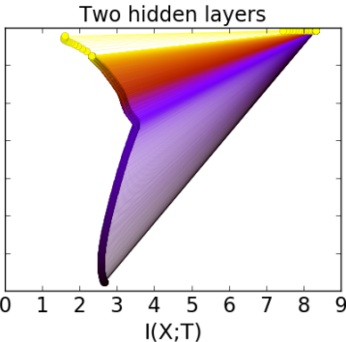
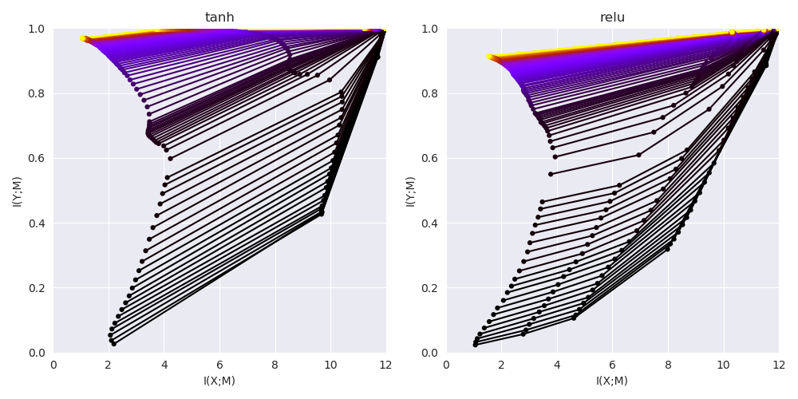
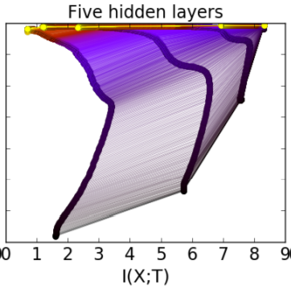
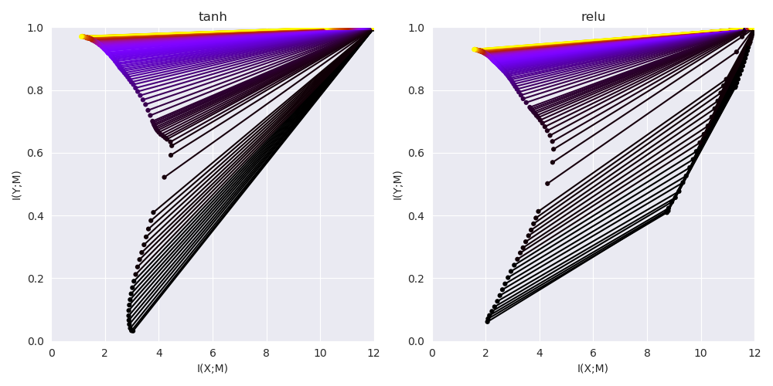
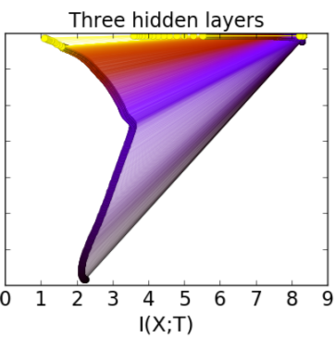
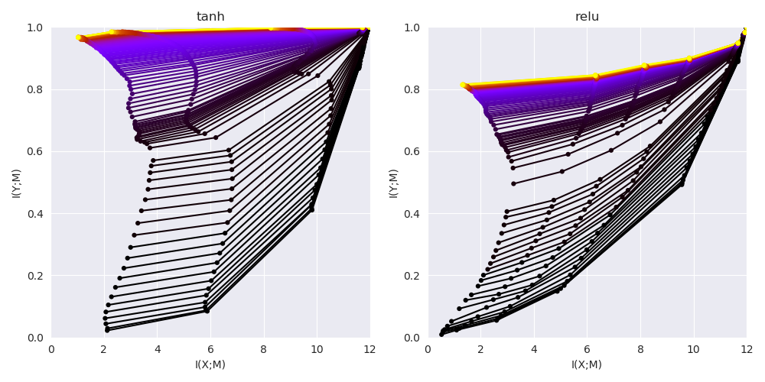
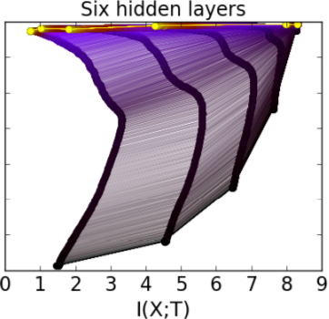
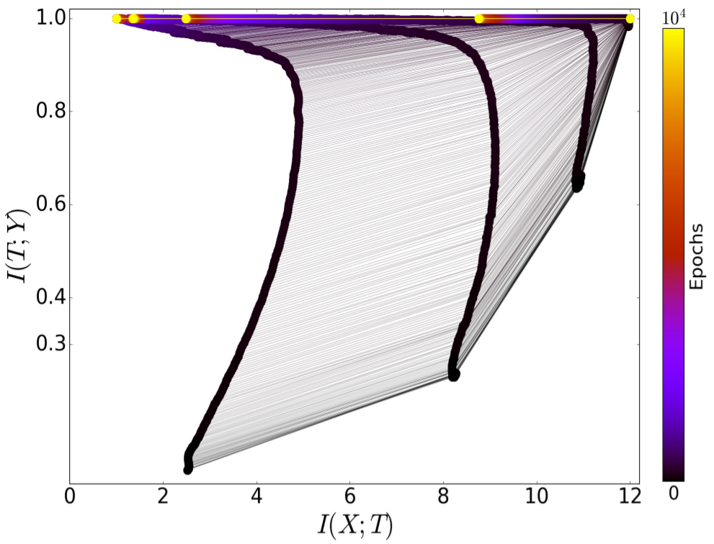
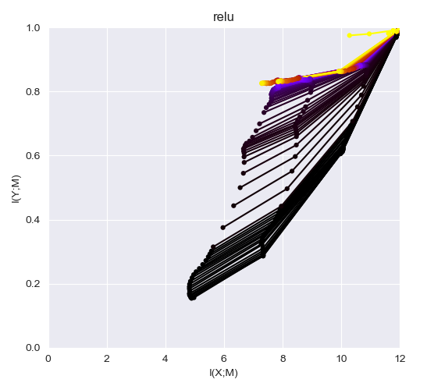
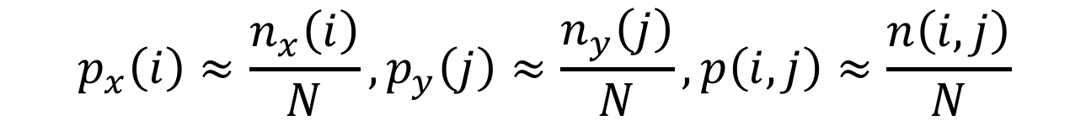
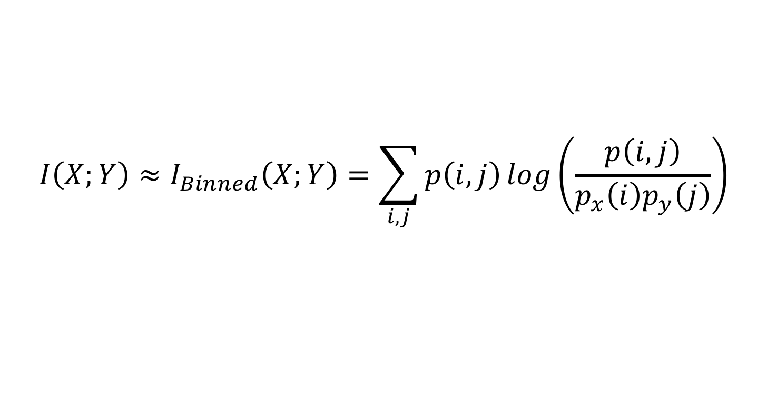
Opening the Black Box of Deep Learning with Information Theory: Review and Rethink
Dave Cheng, Yiran Chen, Hai (Helen) Li Department of Electrical and Computer Engineering, Duke University
Introduction
Motivation
Experiment Setting
Can we understand the blackbox of deep neural network?
Ravid Shwartz-Ziv et al [1] combines the information bottleneck theory and deep learning, and gives the information-theoretic explanation to the training process of Neural Network.
Tishiby’ Claims:
The training of SGD can be divided into fitting phase and compression phase.
The compression phase takes most of the training epochs, and decide the generalization capability of the NN.
The benefit of the Hidden Layers is computational, as they dramatically reduce the stochastic relaxation times.
The calculation of MI:
Our Questions:
Can all the results be reproduced?
Will the conclusion stand with different activation functions?
Setting:
same structure, 10-7-5-4-3 MLP
same dataset sampled from a sphere symmetry distribution.
Apart from tanh, add ReLU and Threshold ReLU as the activation functions.
Estimating entropy with binned method of 30 bin levels, 60 bin levels and 20 bin levels.
Test number of hidden layers from 6 to 1, with both tanh and ReLU
$$I\left(X;Y\right)≈I_{Binned}\left(X;Y\right)=\sum_{i,j}{p\left(i, j\right)\log\left(\frac{p\left(i,j\right)}{p_{x}\left(i\right)p_{y}\left(j\right)}\right)}$$
$$p_{x}\left(i\right)≈\frac{n_{x}\left(i\right)}{N}, p_{y}\left(j\right)≈\frac{n_{y}\left(j\right)}{N}, p\left(i, j\right)≈\frac{n\left(i, j\right)}{N}$$
Fig 1: The DNN layers form a Markov chain of successive internal representations of the input layer X
$$Accurate when N→∞ (Bin Size →0)$$
Number Of Layers
Bin Size
Bin Size 0.05 (40 bins)
The patterns are similar, but when using ReLU, the last layer will always move towards the Information Bottleneck Curve.
Bin Size 0.1 (20 bins)
Bin Size do not affect the result.
Activation Functions
On Going Work
Tishiby’s Original result
Tanh
ReLU
Threshold ReLU with thres. 0.1
Test the effect of L1 sparsity on larger network.
Analyze the relation between te trace on IP and the gradient of the weights.
Our result of Tanh shows four phases rather than Two
No compression phase observed with ReLU or threshold ReLU
Notes:
https://cdn0.tnwcdn.com/wp-content/blogs.dir/1/files/2018/01/Blockchain-Funds.png https://1.bp.blogspot.com/-K65Ed68KGXk/WOa9jaRWC6I/AAAAAAAABsM/gglycD_anuQSp-i67fxER1FOlVTulvV2gCLcB/s1600/FederatedLearning_FinalFiles_Flow%2BChart1.png

