Slide 1
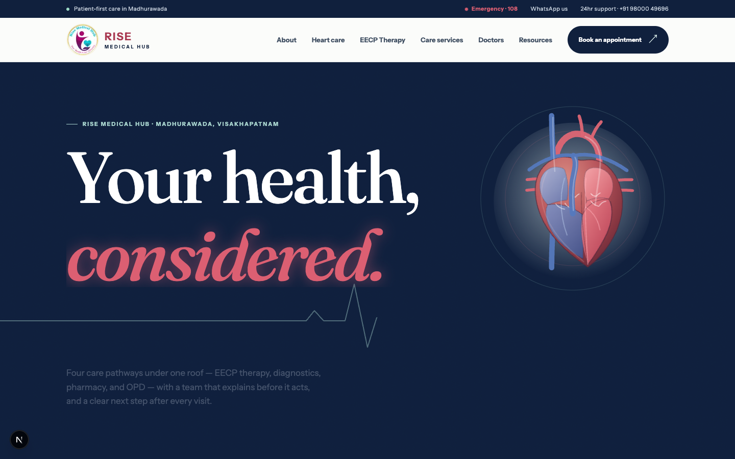
RISE MEDICAL HUB
Rise needs a digital front door—not another brochure.
Why the redesigned website matters for patient trust, clinical credibility, discoverability, and enquiry conversion.
DECISION DECK · 18 JULY 2026
RISE MEDICAL HUB · WEBSITE DECISION
Redesigned staging site
01

Slide 2
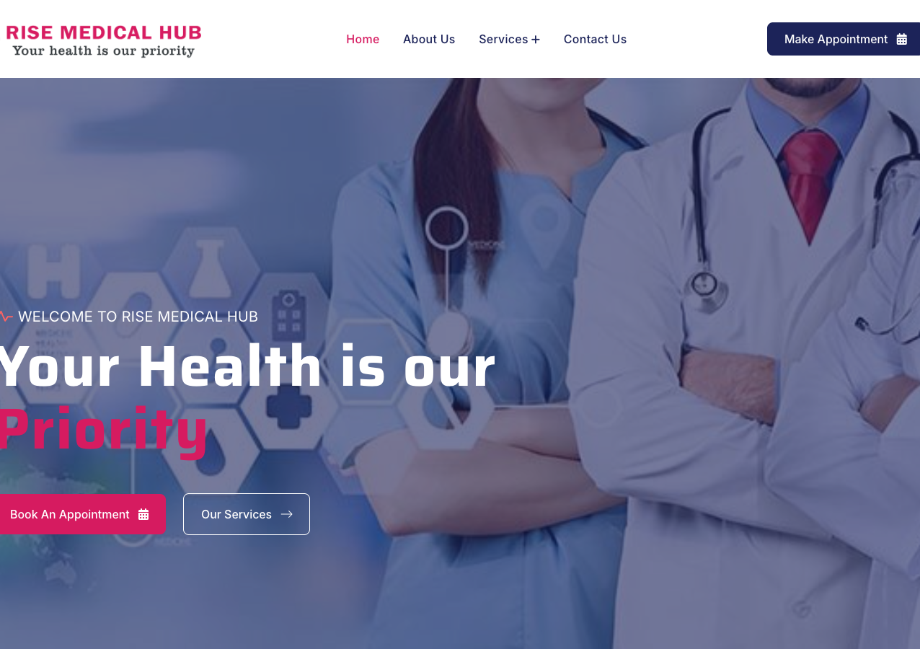
CURRENT STATE
The current site is visible—but not distinctive.
A generic promise
“Your Health is our Priority” could belong to almost any clinic. It does not explain Rise’s connected care, specialists, or heart-care focus.
Trust arrives too late
Doctors, evidence, suitability, and patient expectations are missing from the first decision journey.
The result
The website lists services, but does not yet build a reason to choose Rise.
RISE MEDICAL HUB · WEBSITE DECISION
Source: risemedicalhub.com · inspected 18 Jul 2026
02

Slide 3
MEASURED LIVE-SITE EVIDENCE
Friction appears before trust can form.
These are not aesthetic preferences. They are structural signals affecting comprehension, accessibility, and discoverability.
2
13
0
duplicate H1 headings
dead-end # links
canonical tags or schema
The same hero promise is rendered twice on the live homepage.
Clicks lead nowhere and weaken navigation and accessibility.
Search engines receive little help understanding the clinic or page hierarchy.
RISE MEDICAL HUB · WEBSITE DECISION
Source: live homepage DOM audit · 18 Jul 2026
03

Slide 4
THE REDESIGNED JOURNEY
The redesigned journey answers the right questions.
OLD SEQUENCE
Generic hero → appointment form → repeated services → generic about
01
02
03
Understand
Trust
Act
A clear local promise, four care pathways, and plain-language explanations answer: “Can Rise help me?”
Doctors, qualifications, evidence, suitability, limitations, and expectations answer: “Can I believe this?”
Phone, WhatsApp, directions, urgent guidance, and a transparent booking handoff answer: “What do I do next?”
The patient moves from uncertainty to a clear next step—without being rushed into a form.
RISE MEDICAL HUB · WEBSITE DECISION
Source: redesigned staging site
04

Slide 5
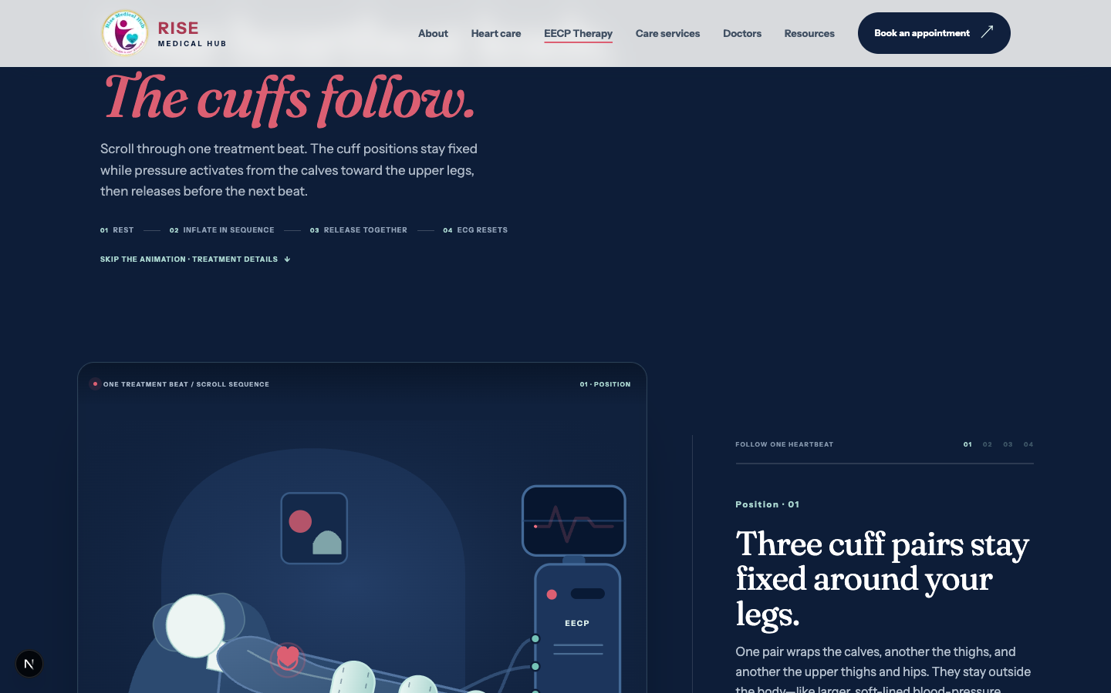
SIGNATURE CARE
EECP becomes a care pathway—not a claim.
CURRENT SITE
“Safe” · “improves heart function” · “no downtime”
Benefits are presented without enough context about selection, contraindications, limits, or evidence.
REDESIGNED EXPERIENCE
Selected patient · monitored session · benefits and limits · other options · evidence
The animation explains cuff timing while the copy protects clinical credibility and directs urgent symptoms away from booking.
RISE MEDICAL HUB · WEBSITE DECISION
Source: current EECP page + redesigned EECP staging page
05

Slide 6
TRUST ARCHITECTURE
Trust is built before the appointment.
The redesign gives patients four independent reasons to believe the clinic will be clear, credible, and reachable.
01
People
02
Evidence
A 16-specialist directory makes qualifications, departments, and the right first consultation visible.
Heart and EECP content links patients to guidelines, trials, warning signs, and clear limitations.
03
Place
04
Process
Madhurawada, Visakhapatnam, phone, directions, and emergency access are present throughout the journey.
The booking form states exactly what happens: WhatsApp opens, the patient reviews, and nothing is sent until they press send.
RISE MEDICAL HUB · WEBSITE DECISION
Source: redesigned homepage, doctors, resources and appointment pages
06

Slide 7
SEARCH VISIBILITY
The redesign is SEO-ready. The migration is not.
The new architecture gives search engines clearer subjects and local relevance. Without redirects and canonicals, existing value can still be lost at launch.
CURRENT
REDESIGNED
Generic descriptions No canonical tags No structured data Misspelled EECP URL Broken capitalised Services link
Distinct page titles and descriptions MedicalClinic + medical/FAQ schema Clean service and resource URLs Local Madhurawada relevance Expanded sitemap
P0 MIGRATION CONTROL
Add a canonical to every indexable page and 301 every legacy .html URL—including /eecp-theraphy.html—to its new destination.
RISE MEDICAL HUB · WEBSITE DECISION
Source: live + staging metadata, robots and sitemap audit
07

Slide 8
CONTROLLED LAUNCH
Launch responsibly with three safeguards.
01
02
03
Verify facts
Protect equity
Measure demand
Sign off doctor names, qualifications, languages, schedules, service claims, phone/WhatsApp, parking, reporting times, and 24-hour support.
Ship redirects, canonical URLs, one preferred domain, legal pages, structured-data validation, and Search Console submission.
Track form starts, WhatsApp continuation, phone taps, directions, failed handoffs, and the service that generated each enquiry.
CONTENT SIGN-OFF
REDIRECTS + CANONICALS
LAUNCH + TRACKING
RISE MEDICAL HUB · WEBSITE DECISION
Source: website audit
08

Slide 9
THE DECISION
Approve the redesigned site—with a controlled launch gate.
The strategic work is done. The remaining work is factual sign-off, migration protection, legal readiness, and measurement.
1 Verify 2 Redirect 3 Measure
RISE MEDICAL HUB · WEBSITE DECISION
09

