Slide 1
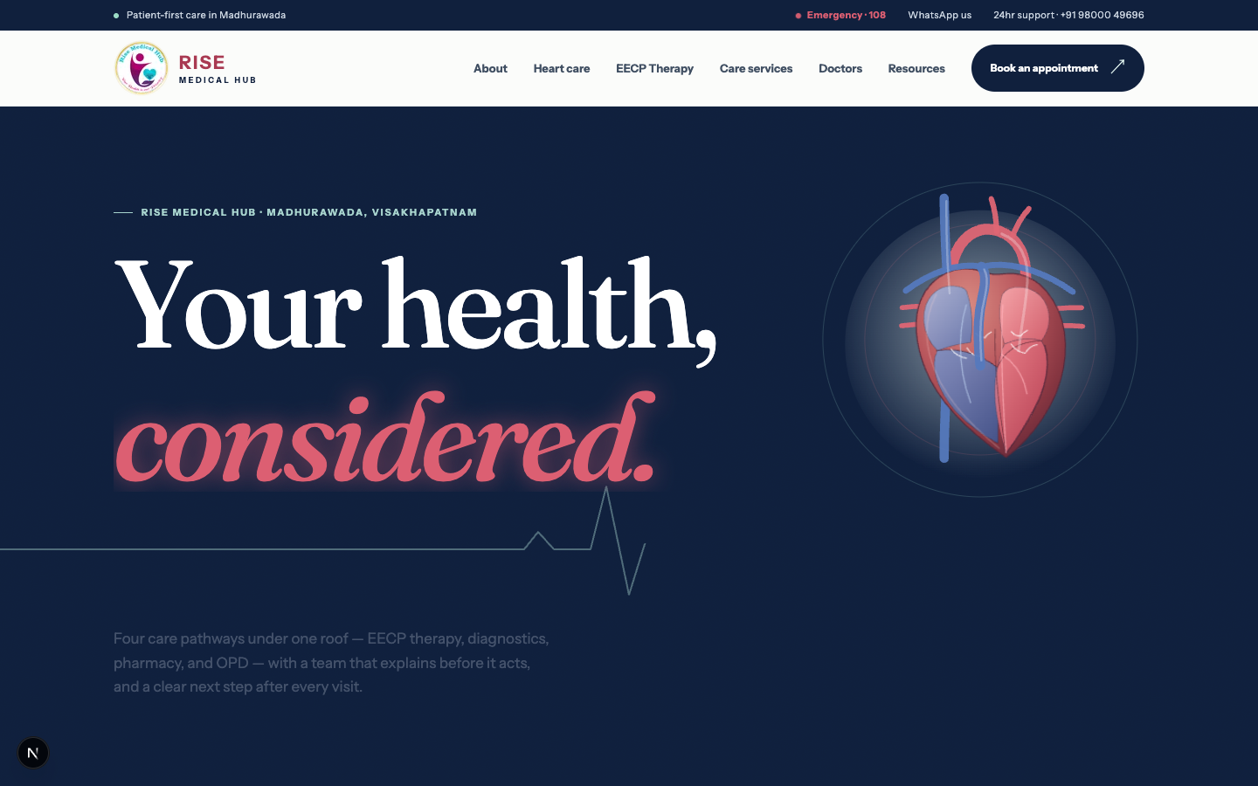
RISE MEDICAL HUB
Rise deserves a website as credible as its care.
A clearer, more trusted digital front door for patients, clinicians, and growth.
DECISION DECK · 18 JULY 2026
RISE MEDICAL HUB · WEBSITE DECISION
Redesigned staging site
01

Slide 2
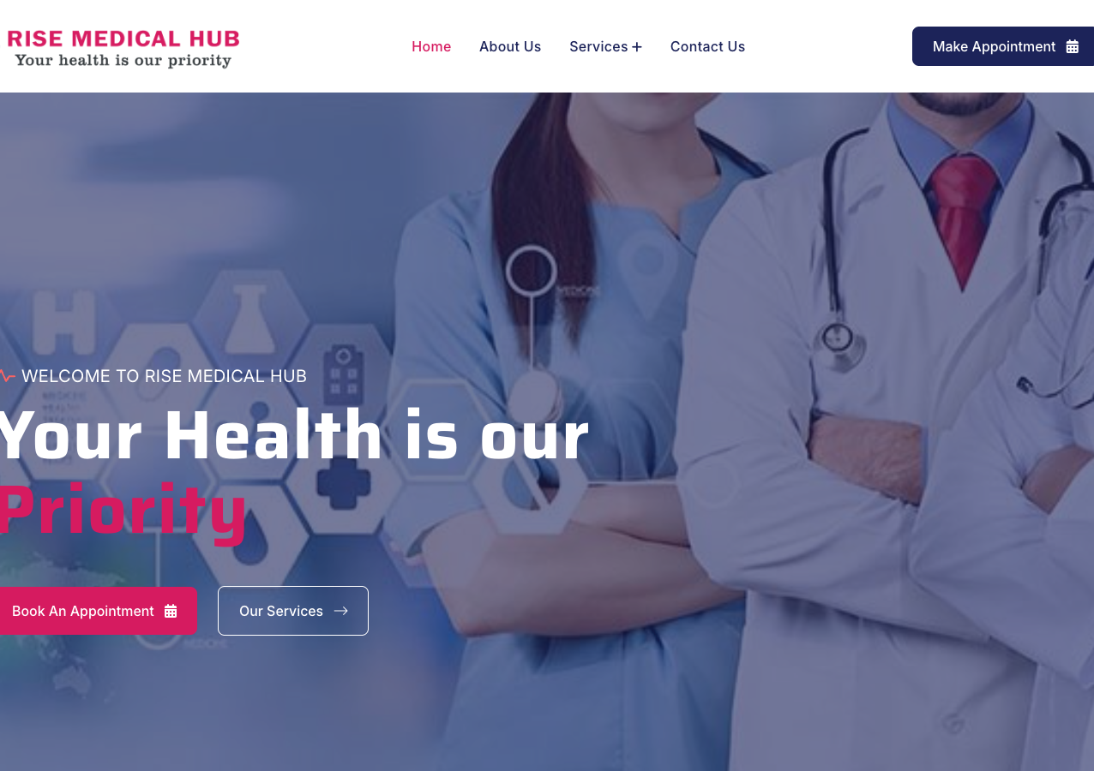
CURRENT STATE
The current website makes Rise look generic.
A generic promise
“Your Health is our Priority” could belong to almost any clinic. It does not explain Rise’s connected care, specialists, or heart-care focus.
Trust arrives too late
Doctors, evidence, suitability, and patient expectations are missing from the first decision journey.
The result
The website lists services, but does not yet build a reason to choose Rise.
RISE MEDICAL HUB · WEBSITE DECISION
Source: risemedicalhub.com · inspected 18 Jul 2026
02

Slide 3
THE REDESIGNED JOURNEY
The redesigned site turns uncertainty into action.
OLD SEQUENCE
Generic hero → appointment form → repeated services → generic about
01
02
03
Understand
Trust
Act
A clear local promise, four care pathways, and plain-language explanations answer: “Can Rise help me?”
Doctors, qualifications, evidence, suitability, limitations, and expectations answer: “Can I believe this?”
Phone, WhatsApp, directions, urgent guidance, and a transparent booking handoff answer: “What do I do next?”
The patient moves from uncertainty to a clear next step—without being rushed into a form.
RISE MEDICAL HUB · WEBSITE DECISION
Source: redesigned staging site
03

Slide 4
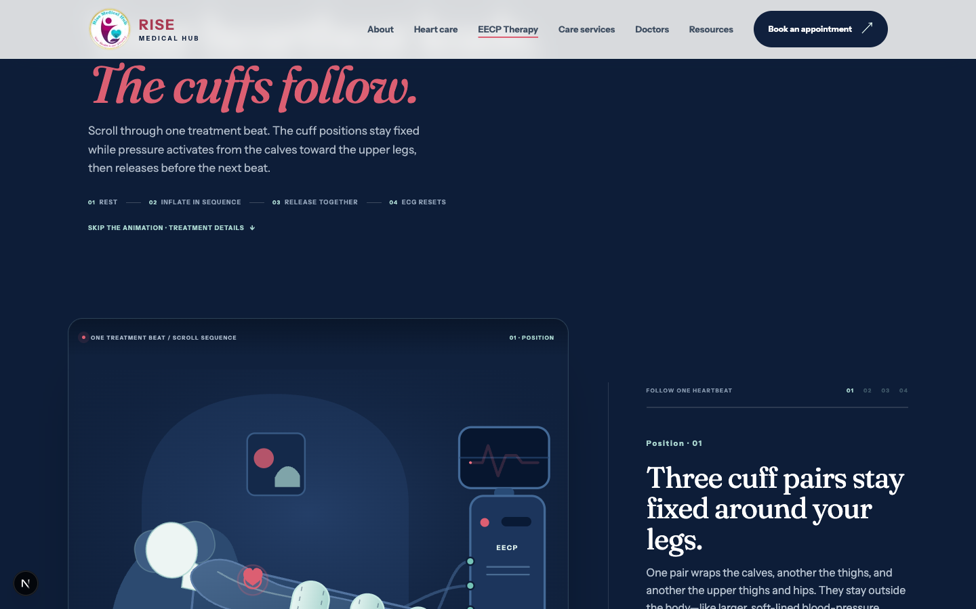
SIGNATURE CARE
EECP proves the difference.
CURRENT SITE
“Safe” · “improves heart function” · “no downtime”
Benefits are presented without enough context about selection, contraindications, limits, or evidence.
REDESIGNED EXPERIENCE
Selected patient · monitored session · benefits and limits · other options · evidence
The animation explains cuff timing while the copy protects clinical credibility and directs urgent symptoms away from booking.
RISE MEDICAL HUB · WEBSITE DECISION
Source: current EECP page + redesigned EECP staging page
04

Slide 5
THE DECISION
Approve the redesigned website—and launch with confidence.
Launch after three checks: verified facts, protected search equity, and measurable enquiries.
1 Verify 2 Redirect 3 Measure
RISE MEDICAL HUB · WEBSITE DECISION
05

