Slide 1
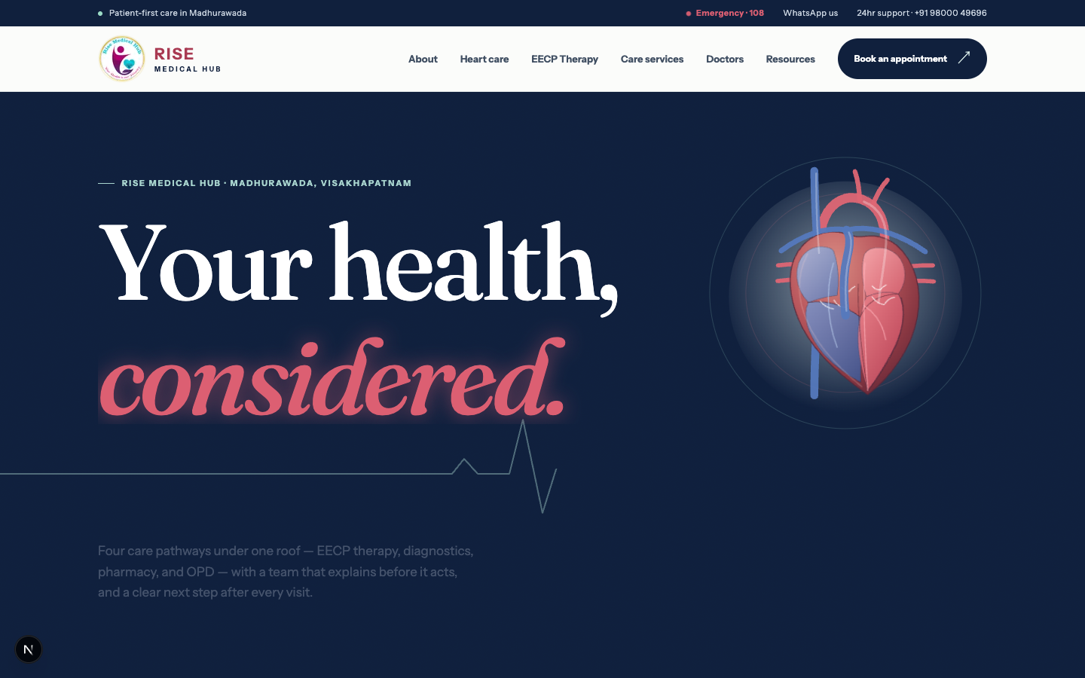
RISE MEDICAL HUB
Rise needs more than a prettier website. It needs a growth engine.
The current site hides Rise’s strongest services from search and patients. The redesign turns them into discoverable, credible pathways.
DECISION DECK · 18 JULY 2026
RISE MEDICAL HUB · WEBSITE DECISION
Live-site + redesigned build audit
01

Slide 2
WHAT THE OLD SITE ACTUALLY HAS
The old website does not own Rise’s strongest care.
It has pages, but not the depth or structure needed to win high-intent searches or establish clinical trust.
10
0
270
URLs in its sitemap
Heart or Doctors pages
words on the EECP page
The architecture stops at generic service pages and booking.
No page explains heart care or introduces the specialist roster.
Thin copy at a misspelled URL: /eecp-theraphy.html.
RISE MEDICAL HUB · WEBSITE DECISION
Source: live sitemap + page audit · 18 Jul 2026
02

Slide 3
SEARCH VISIBILITY
The SEO problem is structural—not cosmetic.
The old site gives search engines generic, duplicated signals. The new architecture creates specific subjects, evidence, and local relevance.
CURRENT
REDESIGNED
Same description on 10/10 pages No canonical tags or schema / and /index.html duplicate Diagnostic title says EECP Therapy 98 dead-end # links
23 clean sitemap URLs Unique titles for major pathways MedicalClinic + medical/FAQ schema Heart, EECP and Doctors depth Local NAP + evidence resources
LAUNCH REQUIREMENT
Finish canonicals, 301 every legacy .html URL, and submit the new sitemap to Search Console.
RISE MEDICAL HUB · WEBSITE DECISION
Source: live metadata, sitemap and DOM audit · 18 Jul 2026
03

Slide 4
WHAT THE REDESIGN CREATES
The new site turns expertise into searchable assets.
Four pages now do the explanation and trust-building that the old site leaves to the front desk.
01
Heart Care
02
EECP
1,924 words on warning signs, tests and treatments, with MedicalWebPage + FAQ schema.
1,607 words on suitability, benefits, limits and alternatives, backed by 10 evidence sources.
03
Doctors
04
Local discovery
16 specialists across 11 departments, with qualifications, focus and a direct booking path.
Madhurawada NAP, directions, clean URLs, sitemap and MedicalClinic schema.
RISE MEDICAL HUB · WEBSITE DECISION
Source: redesigned local build audit · 18 Jul 2026
04

Slide 5
THE REDESIGNED JOURNEY
The new website sells trust before the appointment.
OLD SEQUENCE
Generic promise → service list → appointment form
01
02
03
Find
Trust
Act
Dedicated Heart, EECP, Doctors and service pages match what patients actually search.
Qualifications, evidence, suitability and limits answer: “Why should I choose Rise?”
Phone, WhatsApp, directions and booking turn confidence into a measurable enquiry.
The website does the explanation and trust-building before the front desk receives the enquiry.
RISE MEDICAL HUB · WEBSITE DECISION
Source: redesigned page architecture
05

Slide 6
THE DECISION
Approve the redesigned website—and the SEO launch that makes it pay.
Publish the content, protect every legacy URL, complete doctor and local schema, and measure calls, WhatsApp, directions, and bookings.
1 Publish 2 Protect 3 Grow
RISE MEDICAL HUB · WEBSITE DECISION
06

